Slide 1

The Tower Bridge of London
An Engineering Marvel

Slide 2


Table of Contents
01
The Tower Bridge of London
02
Engineering That Made It Possible
03
Fields of Engineering & Technology Involved
04
Technologies and Materials
05
Future of Tower Bridge – What’s Next?

Slide 3

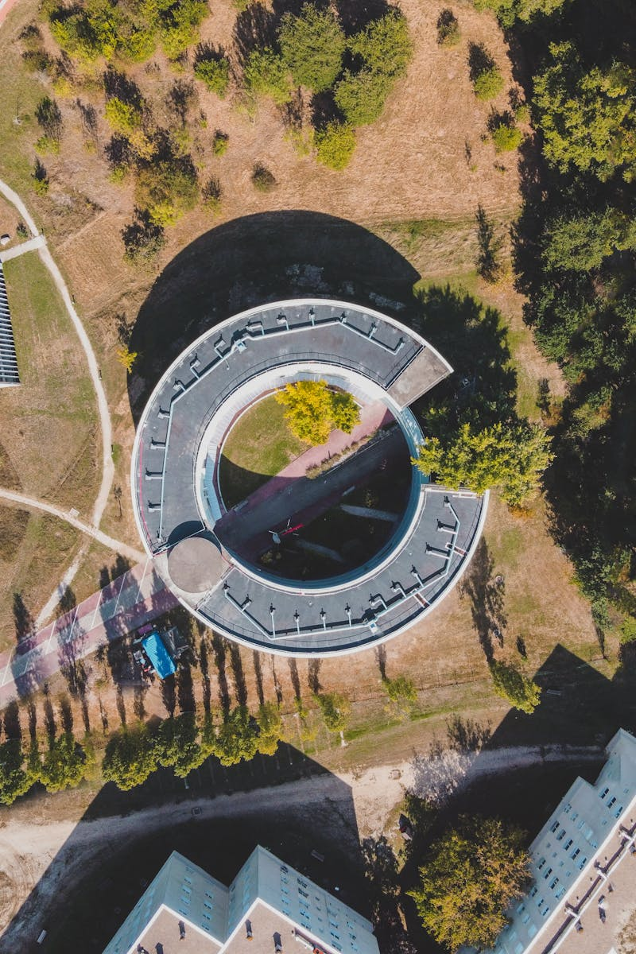
The Tower Bridge of London
01
Overview of the Tower Bridge of London.
02
Situated in London, spanning the River Thames.
03
A symbol of London's rich history and engineering prowess.
04
Wide view of Tower Bridge (Unsplash/Pixabay).
Photo by Pexels

Slide 4
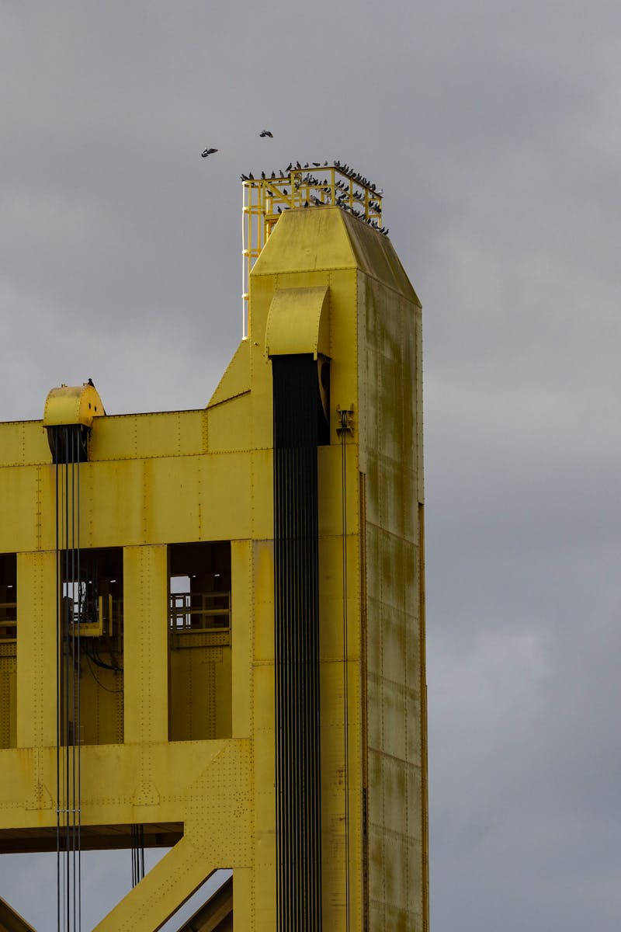
Engineering That Made It Possible
01
Built in 1894, designed by Sir Horace Jones & engineer Sir John Wolfe Barry.
02
Lifts like a seesaw using counterweights.
03
Originally powered by steam engines, now uses hydraulics + electric motors.
04
Steel + stone = strength & durability.
Photo by Pexels

Slide 5
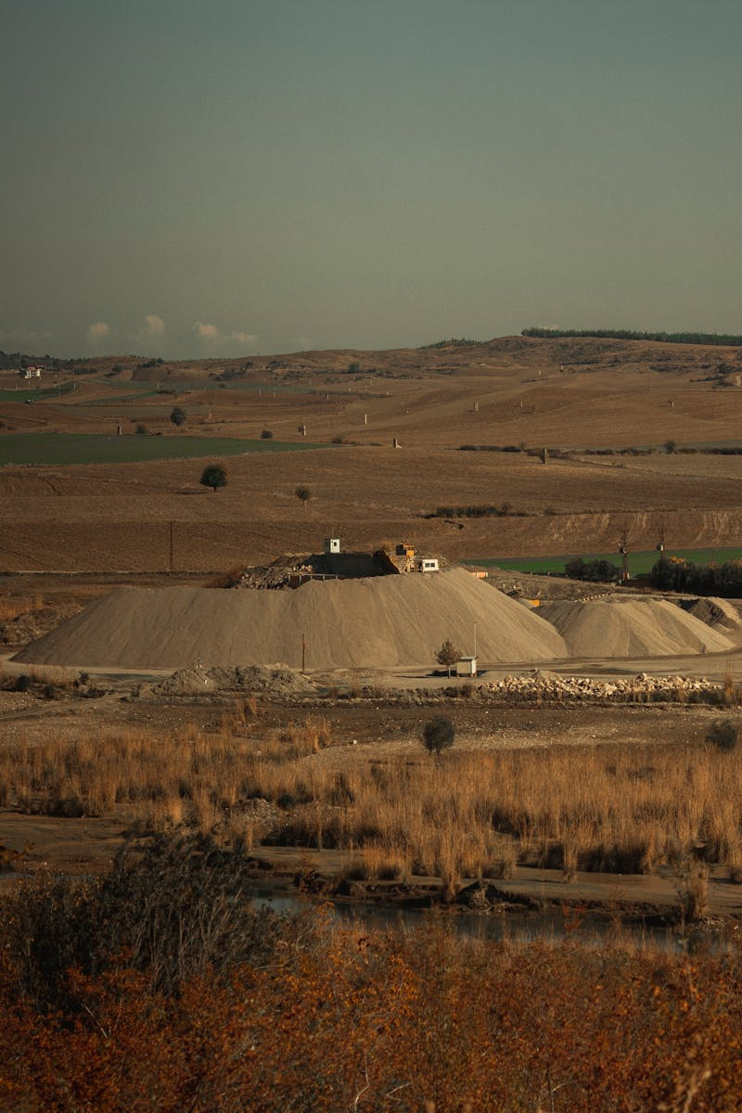
Fields of Engineering & Technology Involved
01
Foundations, roads, towers.
02
Gears, lifting system.
03
Motors, control panels.
04
Oil-powered lifting system.
Photo by Pexels

Slide 6

Technologies and Materials
01
Strong steel + durable stone.
02
Hydraulics, sensors, computer controls.
03
Integration of modern technologies.
04
Collage (gears, hydraulics, control room, bridge opening).
Photo by Pexels

Slide 7
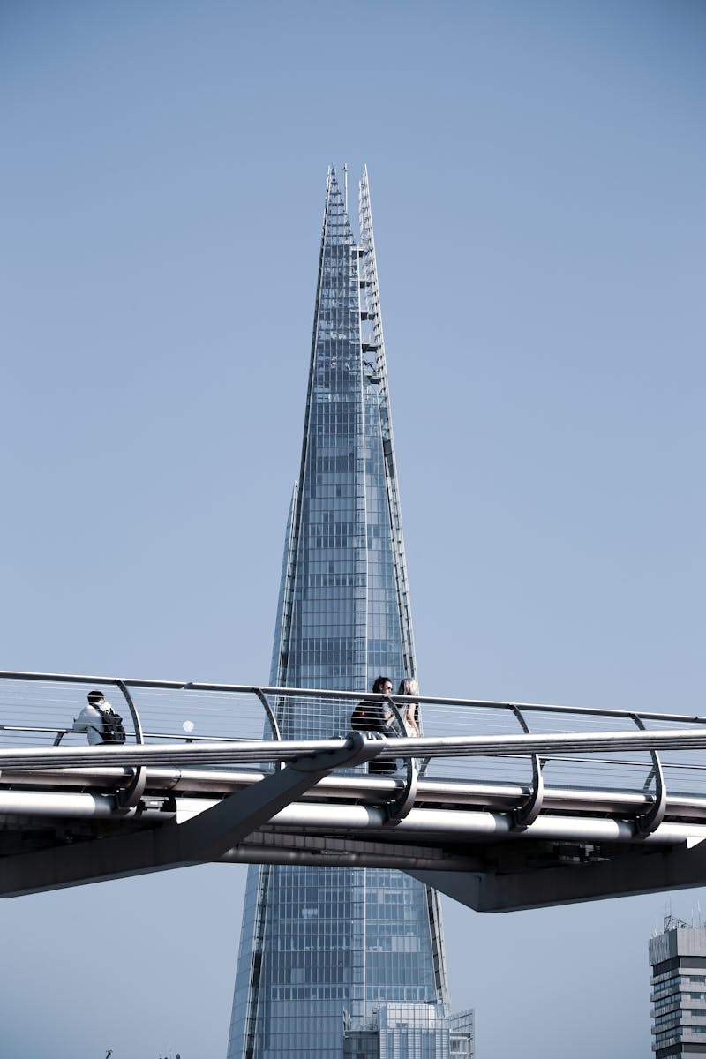
Future of Tower Bridge – What’s Next?
01
Real-time health monitoring.
02
Renewable energy source.
03
Predictive maintenance.
04
Protect River Thames.
Photo by Pexels

