Slide 1
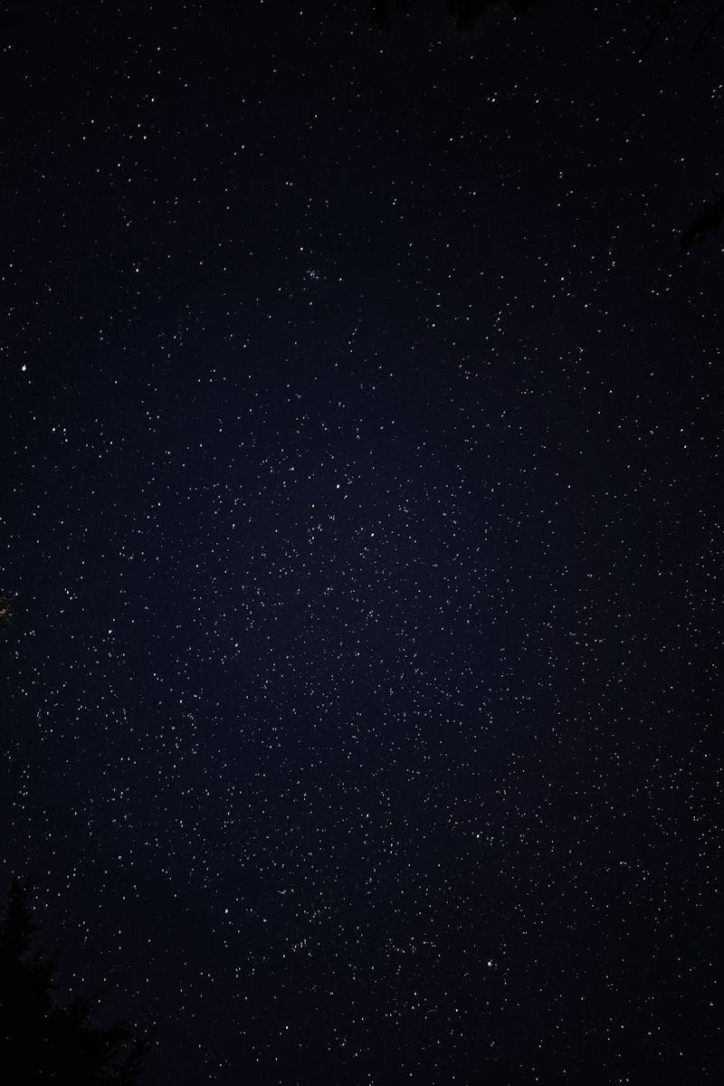
The Under 25 App – Where Students Earn
Helping students cover daily expenses, grow, and connect.
Photo by Pexels

Slide 2
01
Title Slide
Table of Contents
02
The Problem
03
The Solution – The Under 25 App
04
Student Success Stories
05
Why Join Under 25?

Slide 3

1
Title Slide
Welcome to Under 25
The Under 25 App – Where Students Earn. Include Amber_U25 and Under 25 logo in footer.
Helping students cover daily expenses, grow, and connect with a youthful, motivating tone.
Student-friendly, modern design with cosmic backgrounds and futuristic feel for engagement.
Display username Amber_U25 and Under 25 logo in the footer for branding.

Slide 4
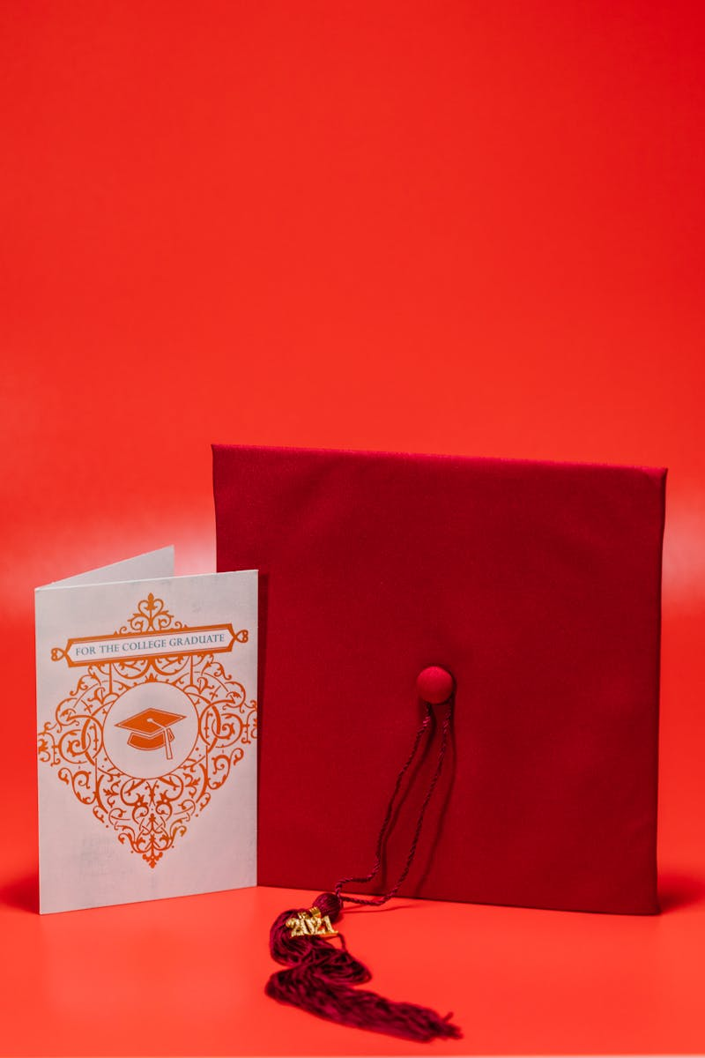
2
The Problem
Challenges Faced by Students
Difficulty managing daily expenses while studying.
Limited earning opportunities during academic life.
Lack of affordable resources and guidance for students.
Illustrate with a stressed student in a cosmic background, keeping the tone clear and professional.

Slide 5
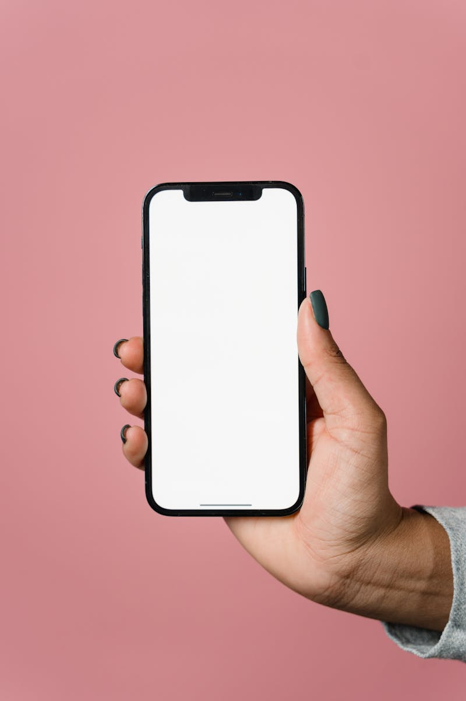
3
The Solution – The Under 25 App
Key Features for Growth
Earn money through micro-jobs and XP race activities.
Build a network of like-minded students for community support.
Learn from curated resources and events to foster growth.
Show mockup screenshot of the app (e.g., Total Money Earned, Opportunities) with space visuals and include Amber_U25 and Under 25 logo in footer.

Slide 6
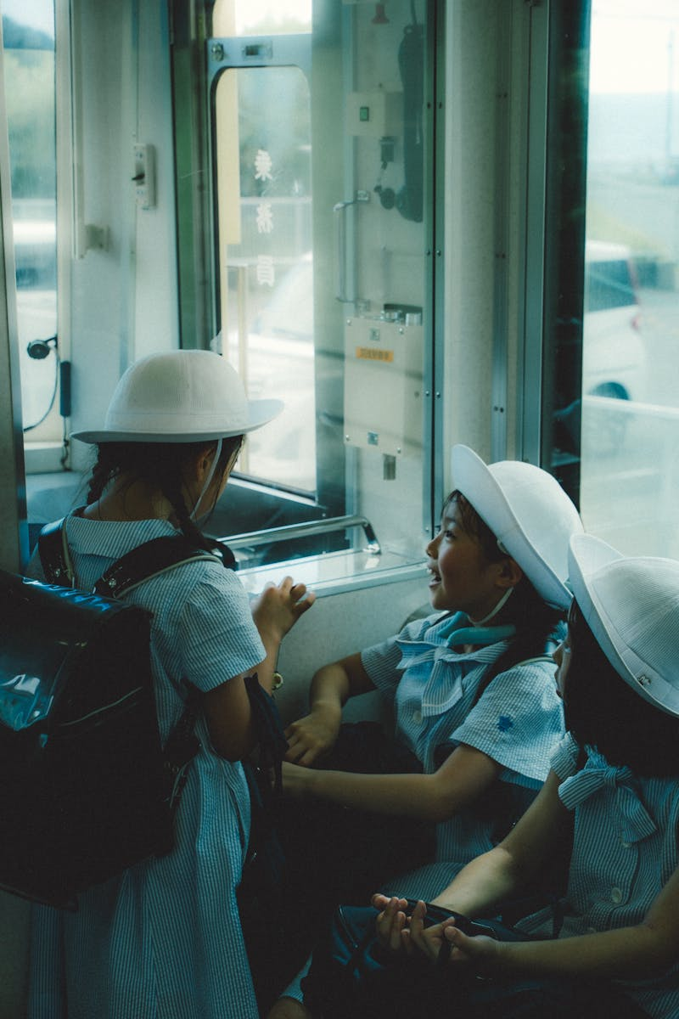
4
Student Success Stories
Real Achievements
e/ruddy00 earned 2400/- through the app. Add titled screenshot (ss) for visual impact.
e/mirzzzz earned 400/-. Include student-friendly space visuals with testimonials.
e/manthaaaaan earned 4000/-. Feature happy students as astronauts in the visuals.
These stories highlight earning potential; include Amber_U25 and Under 25 logo in footer for motivation.

Slide 7
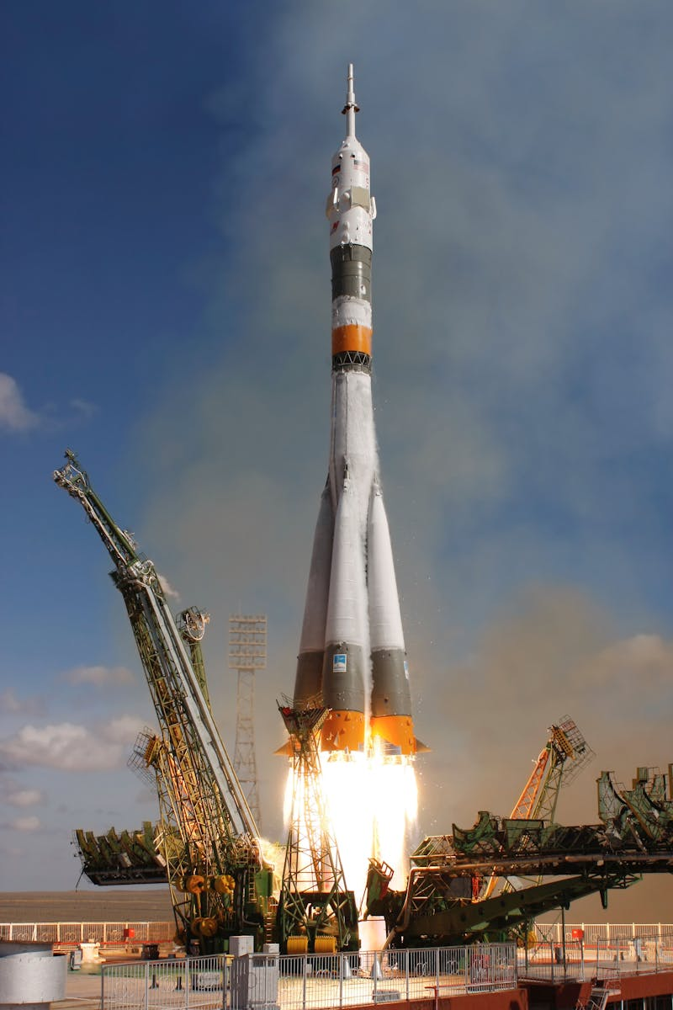
5
Why Join Under 25?
Benefits and Action
Start earning while studying to cover daily expenses.
Unlock internships, gigs, and scholarships for career growth.
Build your network early with like-minded peers.
Be part of a youth-driven space community. Call to Action: 'Download Now' in bold, glowing text, with Amber_U25 and Under 25 logo in footer.

