Slide 1
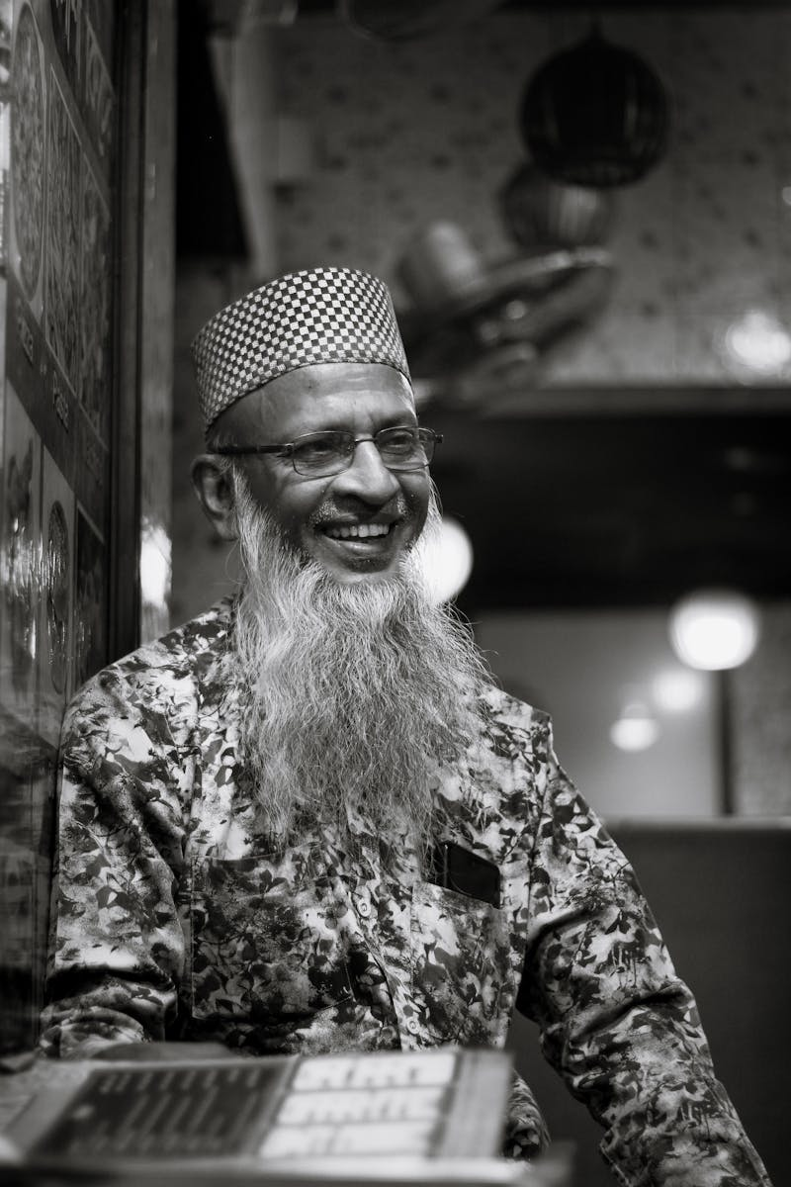
Three Keys to a Happy Life Unlocking Your Inner Happiness
Photo by Pexels

Slide 2
01
Introduction: The Pursuit of Happiness
Table of Contents
02
Key #1: Cultivating Meaningful Relationships
03
Key #2: Practicing Gratitude and Mindfulness
04
Key #3: Finding Purpose and Meaning
05
Conclusion: Embracing the Journey

Slide 3

1
Introduction: The Pursuit of Happiness
What truly makes us happy?
Happiness isn't a destination, it's a journey. It's about cultivating inner peace and contentment. Material possessions, status, and external validation are often mistaken for true happiness. Like any skill, happiness can be learned, practiced, and improved upon. Exploring the three essential keys to unlock a lasting state of well-being.

Slide 4

2
Key #1: Cultivating Meaningful Relationships
The Power of Human Connection
Humans are social creatures, and strong relationships are vital for our emotional well-being. Focus on quality over quantity. Nurture relationships based on trust, respect, and empathy. Truly listen to understand, not just to respond. Show genuine interest in others. Let the people you care about know how much they mean to you. Small acts of kindness go a long way.

Slide 5

3
Key #2: Practicing Gratitude and Mindfulness
Appreciating the Present Moment
Focusing on what you have, rather than what you lack, shifts your perspective and increases happiness. Regularly writing down things you're grateful for can significantly boost your mood. Paying attention to the present moment without judgment reduces stress and anxiety. Simple breathing techniques can help you center yourself and find peace in the present moment.

Slide 6

4
Key #3: Finding Purpose and Meaning
Living a Life of Significance
Identifying what's truly important to you provides a compass for making meaningful life choices. Pursuing goals that align with your values gives you a sense of purpose and direction. Volunteering, helping others, or working towards a cause you believe in can bring immense fulfillment. Being true to yourself and living in accordance with your values is essential for a happy and meaningful life.

Slide 7

5
Conclusion: Embracing the Journey
A lifelong pursuit of happiness
It's not a one-time achievement, but a journey of self-discovery and growth. Don't strive for perfection. Accept yourself with all your flaws and imperfections. Treat yourself with the same kindness and understanding that you would offer to a friend. Begin incorporating these three keys into your life today and unlock your potential for lasting happiness.

