Slide 1

Tiffin Center Success
Starting Small, Thinking Big
Photo by Pexels

Slide 2
01
The Tiffin Dream
Table of Contents
02
Capital Breakdown
03
Menu Strategy
04
Customer Focus
05
Growth Path

Slide 3

1
The Tiffin Dream
Your Journey Begins Here
Starting your tiffin center business with just 1 lakh capital makes entrepreneurship accessible to everyone.
Tiffin services are always in demand as people seek convenient, affordable, and hygienic meal options.
With proper planning, your tiffin center can generate profits within the first few months of operation.
Begin small and expand gradually as your customer base grows and your reputation builds.

Slide 4

2
Capital Breakdown
Making Every Rupee Count
Allocate 30% of your capital for basic kitchen equipment, utensils, and cooking essentials.
Spend 25% on initial stock of ingredients, spices, and packaging materials for your first month.
Use 20% for local advertising, flyers, and word-of-mouth campaigns to attract your first customers.
Keep 25% aside for rent, utilities, and unexpected costs to ensure smooth business operations.

Slide 5

3
Menu Strategy
Food That Sells
Focus on regional dishes that people love and are willing to pay for regularly.
Create meals that are both delicious and nutritious to attract health-conscious customers.
Set competitive prices that ensure good margins while remaining affordable for your target market.
Offer rotating specials to keep customers interested and coming back for variety.

Slide 6
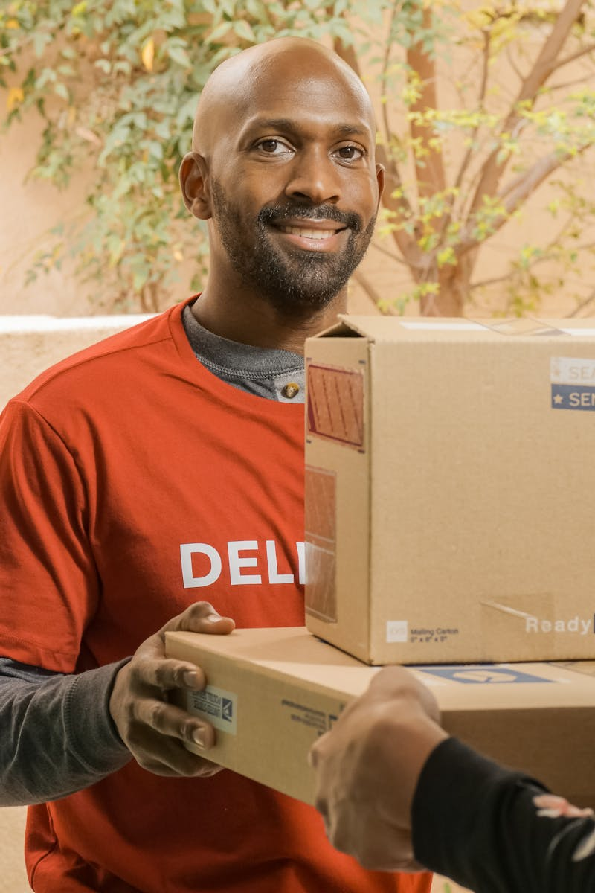
4
Customer Focus
Building Loyalty
Maintain consistent food quality and hygiene standards to earn customer trust and repeat business.
Ensure punctual delivery every time to build reliability and customer satisfaction.
Remember regular customers' preferences and dietary needs to create lasting relationships.
Actively seek and implement customer suggestions to continuously improve your service.

Slide 7

5
Growth Path
From Small to Big
Gradually increase your customer base and delivery areas as your business stabilizes.
Develop a recognizable brand identity that sets your tiffin center apart from competitors.
Add new meal plans, catering services, or specialty dishes to increase revenue streams.
Create employment opportunities and become a trusted name in your local food business ecosystem.

