Slide 1

Time Mastery: Unlock Your Potential
+
+
+
Strategies for College Success: Effective Time Management Techniques
+
+
+

Slide 2



Table of Contents
01
The Time Crunch: Why Time Management Matters
02
Assess & Analyze: Know Where Your Time Goes
03
Strategies for Success: Mastering Your Schedule
04
Tools & Tech: Time Management Allies
05
Thank You

Slide 3


The Time Crunch: Why Time Management Matters
Effective time management minimizes stress levels. Knowing you're on track reduces anxiety and promotes a sense of control.
Allocating dedicated study time leads to better understanding and retention, resulting in higher grades and academic success.
Contrary to popular belief, managing time effectively creates more free time for hobbies, socializing, and relaxation.
Time management is a crucial skill valued by employers. Mastering it now prepares you for future professional success.
Photo by Google

Slide 4
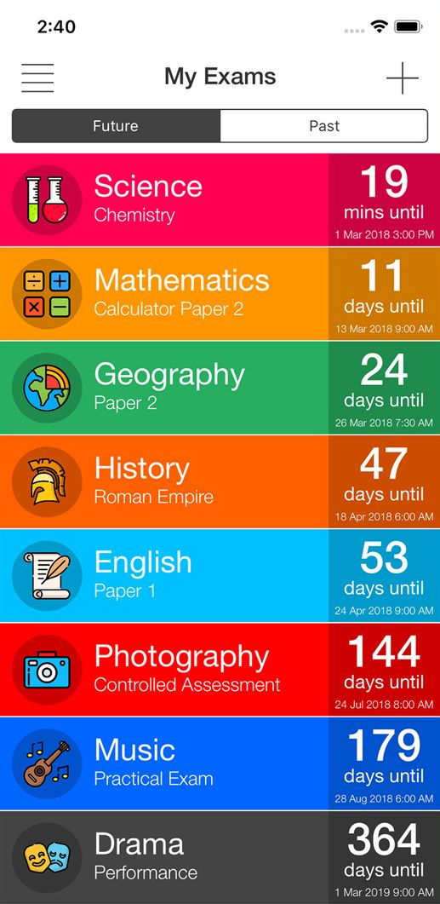
Assess & Analyze: Know Where Your Time Goes
Track your activities for a week. Use a journal or app to record how you spend each hour of the day for a realistic view.
Analyze your audit to pinpoint activities that consume time without adding value. Social media and excessive gaming are common culprits.
Determine which tasks are most important. Use methods like the Eisenhower Matrix (urgent/important) to categorize and prioritize.
Set Specific, Measurable, Achievable, Relevant, and Time-bound goals. This provides direction and keeps you focused on what matters.
Photo by Google

Slide 5
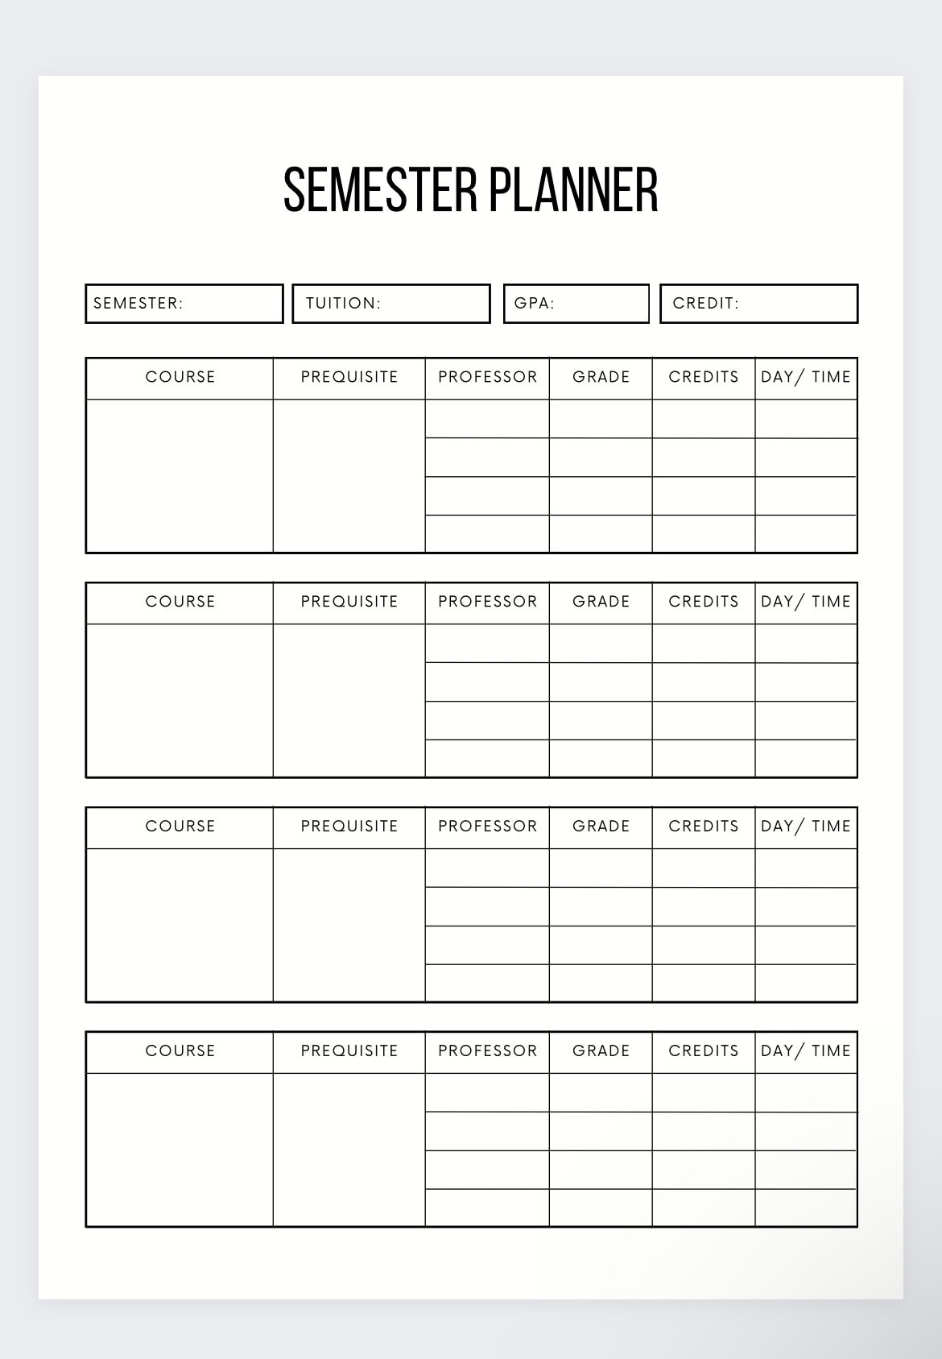
Strategies for Success: Mastering Your Schedule
Allocate specific blocks of time for specific tasks. Treat these blocks like appointments you can't miss for increased productivity.
Work in focused 25-minute intervals, followed by a 5-minute break. This prevents burnout and enhances concentration during study sessions.
Create a dedicated workspace free from interruptions. Turn off notifications, silence your phone, and inform others of your focused time.
If possible, delegate tasks to others or seek assistance when overwhelmed. Collaboration can free up your time and reduce your workload.
Photo by Google

Slide 6
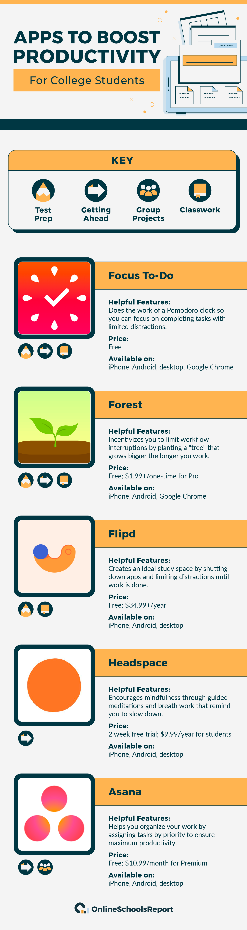
Tools & Tech: Time Management Allies
Google Calendar, Outlook Calendar, or similar apps help schedule appointments, set reminders, and visualize your upcoming commitments easily.
Trello, Asana, or Todoist help organize tasks, set deadlines, and track progress. These tools centralize and streamline workflow.
Freedom, Forest, or Cold Turkey block distracting websites and apps during study sessions, promoting focus and concentration to improve workflow.
Evernote, OneNote, or Google Keep help capture ideas, organize notes, and access information quickly, enhancing study efficiency and comprehension.
Photo by Google

Slide 7

Thank You
Thank you for taking the time to learn about time management. We hope you find these strategies helpful in your college journey.
We're happy to answer any questions you may have about time management techniques or any of the strategies discussed today.
Check your student portal for more resources on time management, study skills, and academic success strategies from college staff.
Mastering time management is an investment in your future. With dedication and practice, you can achieve your goals and unlock your potential.
Photo by Google

