Slide 1
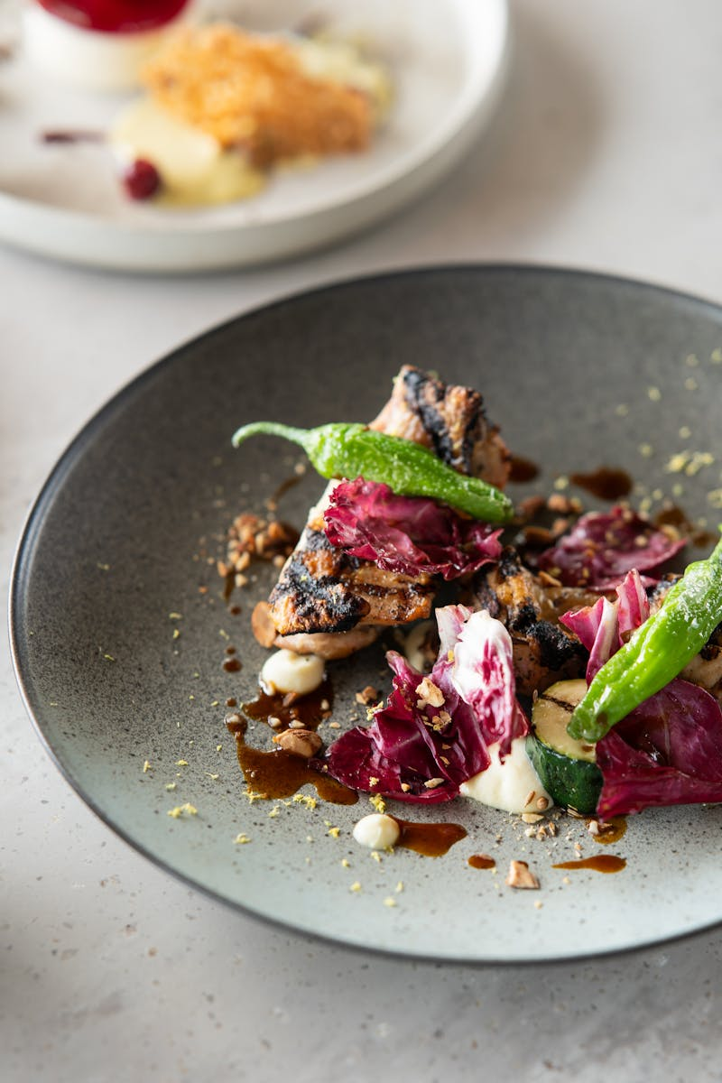
Top 10 Michelin Star Restaurants Worldwide Exploring Pricing, Popular Menu Items, and Services
Photo by Pexels

Slide 2
01
Osteria Francescana
Table of Contents
02
Eleven Madison Park
03
Central
04
Mirazur
05
Noma
06
Asador Etxebarri
07
Maido
08
Arpège
09
Steirereck
10
Odette

Slide 3
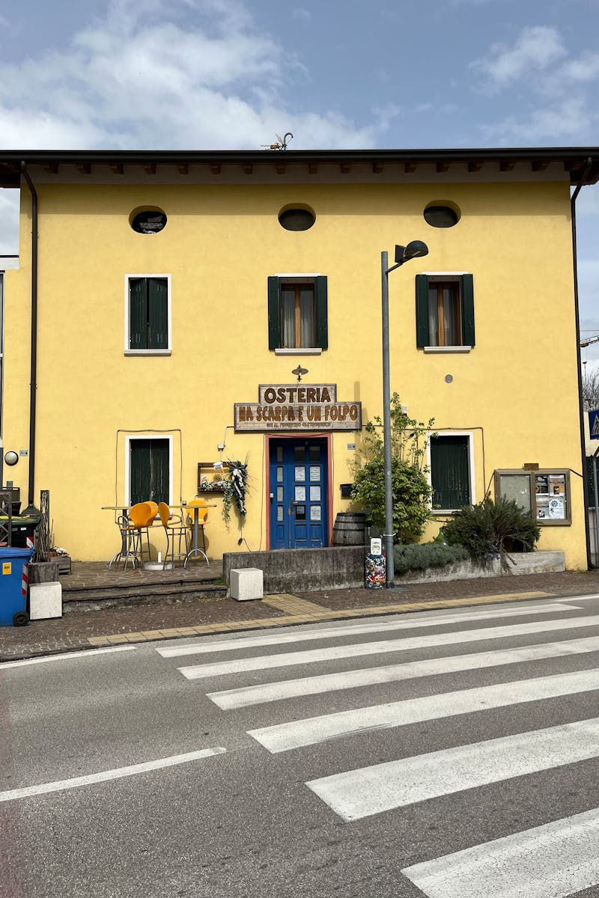
1
Osteria Francescana
Innovative Italian Cuisine in Modena, Italy
Osteria Francescana, led by chef Massimo Bottura, is a three-Michelin-star restaurant in Modena, Italy, known for its creative and modern take on Italian dishes, blending tradition with avant-garde techniques. The tasting menu starts at approximately €250-€350 per person, with optional wine pairings adding €150-€200; additional costs for beverages and service charges may apply. Popular items include the 'Oops! I Dropped the Lemon Tart' dessert at €45, and the 'Five Ages of Parmigiano Reggiano' at €60; these innovative dishes are among the best-sellers due to their unique flavors. Offers personalized dining experiences, expert wine pairings, and a focus on sustainable sourcing, with attentive staff providing detailed explanations of each course for an immersive culinary journey.

Slide 4
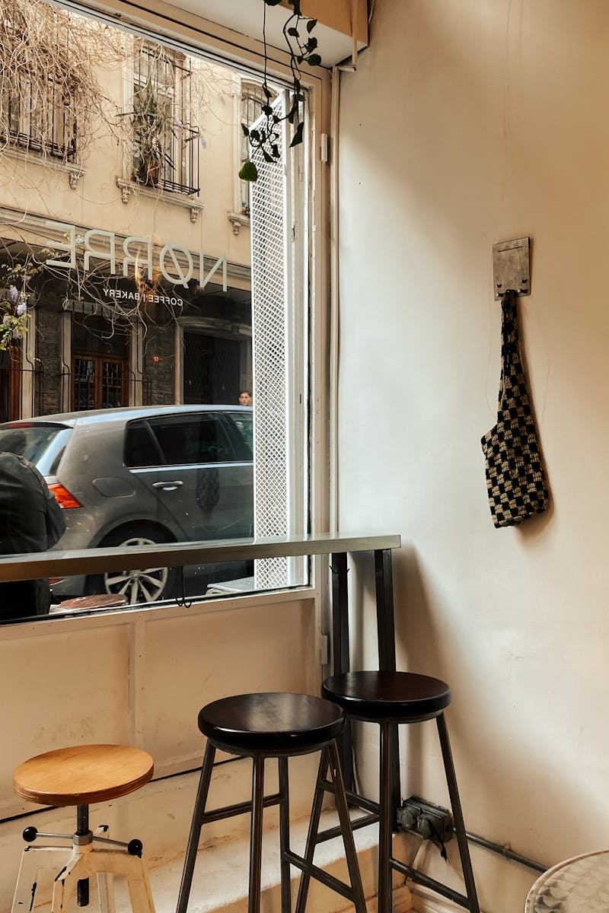
2
Eleven Madison Park
Seasonal American Cuisine in New York, USA
Eleven Madison Park, a three-Michelin-star restaurant in New York City, USA, emphasizes farm-to-table ingredients and redefines modern American dining under chef Daniel Humm. The seasonal tasting menu is priced at around $350-€450 per person, with wine pairings ranging from $200-€300; taxes and gratuity are additional. Best-sellers include the honey lavender duck at $120 and the apple pie dessert at $45; these dishes highlight the restaurant's innovative twists on classics. Provides customized dietary accommodations, interactive table-side presentations, and a sommelier-led wine service, ensuring a luxurious and memorable fine-dining experience.

Slide 5
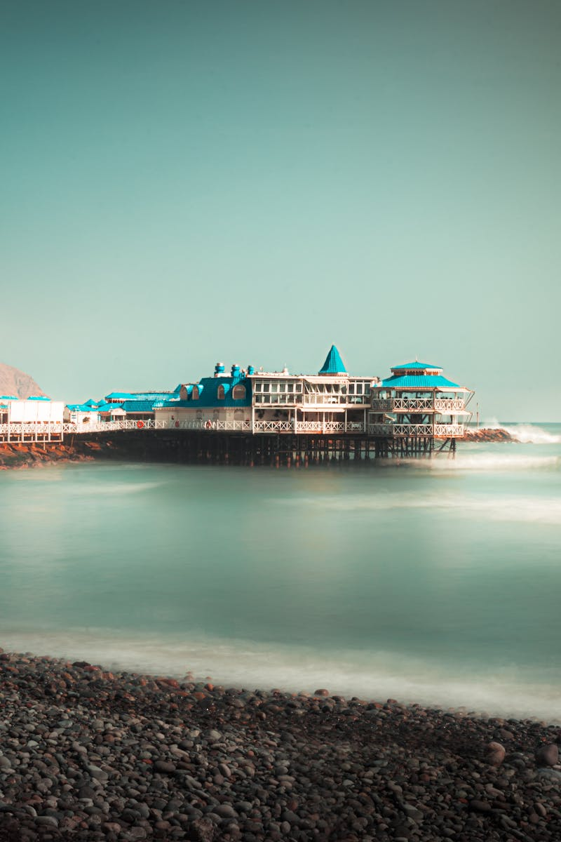
3
Central
Peruvian Cuisine in Lima, Peru
Central, headed by chef Virgilio Martínez, is a two-Michelin-star restaurant in Lima, Peru, celebrated for its focus on native Peruvian ingredients and biodiversity from the Andes. Tasting menus start at $150-€200 per person, with beverage pairings around $100-€150; additional fees for reservations and extras may apply. Top items are the quinoa-based dishes at $40 and the Amazon-inspired ceviche at $35; these reflect the restaurant's emphasis on regional flavors. Features educational storytelling about ingredients, personalized menu adaptations, and a dedicated team for seamless service in a contemporary setting.

Slide 6
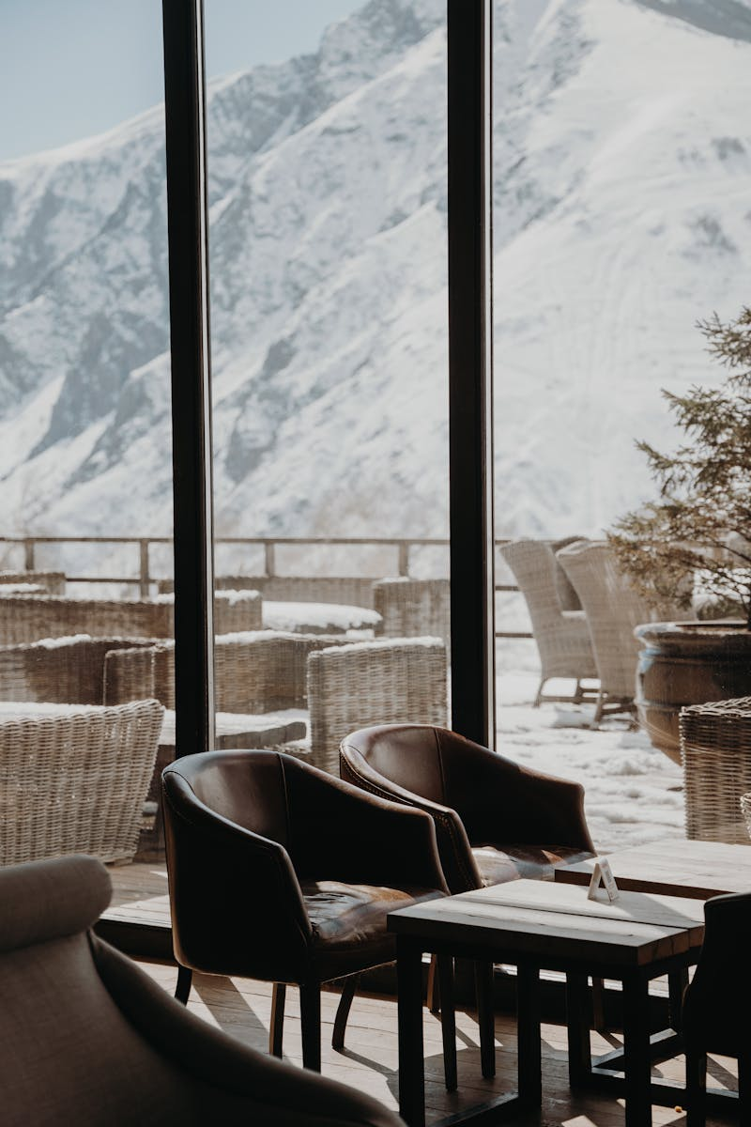
4
Mirazur
Mediterranean Cuisine in Menton, France
Mirazur, a three-Michelin-star restaurant in Menton, France, led by chef Mauro Colagreco, draws inspiration from the sea and mountains for its garden-fresh, sustainable dishes. The menu costs approximately €250-€350 per person, including wine options at €150-€250; service charges are typically included. Favorites include the citrus-infused seafood at €50 and the vegetable garden plate at €40; these showcase the restaurant's seasonal approach. Offers garden tours, bespoke wine selections, and attentive staff to guide guests through the multi-course experience, emphasizing relaxation and exclusivity.

Slide 7

5
Noma
New Nordic Cuisine in Copenhagen, Denmark
Noma, founded by chef René Redzepi in Copenhagen, Denmark, is a two-Michelin-star pioneer of New Nordic cuisine, focusing on foraged and local ingredients. Tasting menus range from €300-€450 per person, with drinks pairings at €200-€300; advance booking fees may add to the cost. Popular dishes are the fermented vegetables at €45 and the seafood platters at €60; these are highlights of the ever-changing menu. Provides immersive foraging experiences, tailored dietary options, and expert guidance on Nordic flavors for an educational and intimate dining atmosphere.

Slide 8
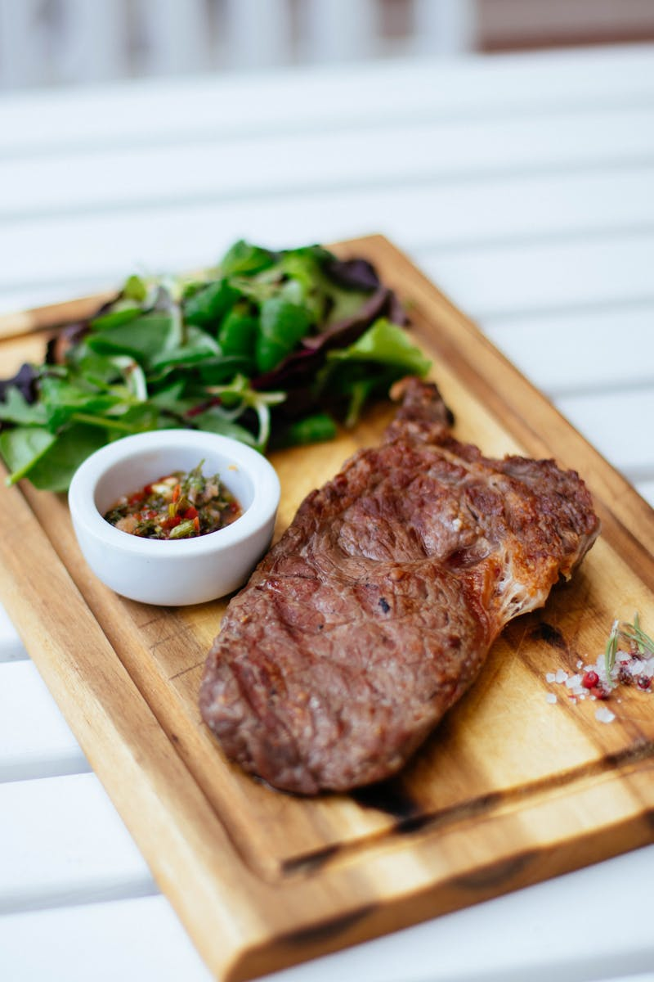
6
Asador Etxebarri
Basque Grill Cuisine in Axpe, Spain
Asador Etxebarri, a one-Michelin-star restaurant in Axpe, Spain, specializes in wood-fired grilling under chef Victor Arguinzoniz, using traditional Basque techniques. Menus start at €150-€250 per person, with wine selections from €100-€150; grilling demonstrations may incur extra costs. Best-sellers include the grilled beef at €55 and the smoked fish at €40; these embody the restaurant's fire-cooked simplicity. Offers live cooking views, personalized fire techniques, and a warm, rustic service style to enhance the authentic Basque experience.

Slide 9

7
Maido
Nikkei Cuisine in Lima, Peru
Maido, a two-Michelin-star restaurant in Lima, Peru, by chef Mitsuharu Tsumura, fuses Japanese and Peruvian flavors in its Nikkei cuisine. Tasting menus are priced at €200-€300 per person, with pairings around €100-€150; reservations often include service fees. Top items are the sushi rolls at €35 and the ceviche fusion at €30; these are customer favorites for their innovative taste. Includes cultural fusion explanations, customized omakase options, and attentive staff for a blend of Peruvian and Japanese hospitality.

Slide 10
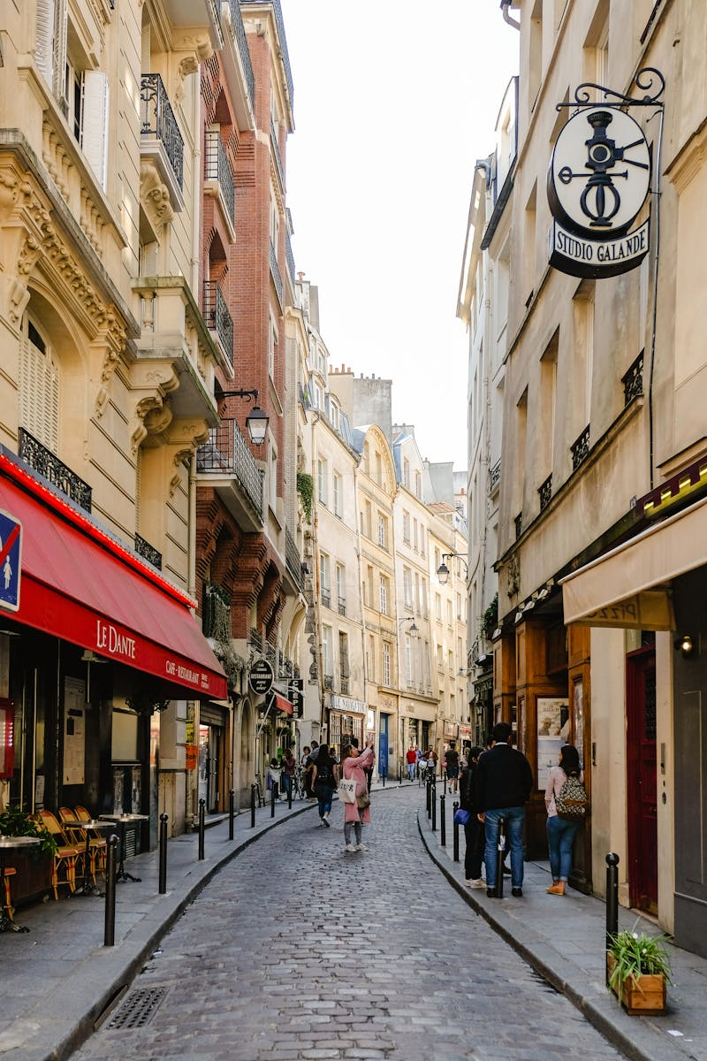
8
Arpège
Vegetable-Centric Cuisine in Paris, France
Arpège, a three-Michelin-star restaurant in Paris, France, led by chef Alain Passard, is renowned for its emphasis on seasonal vegetables and elegant French cooking. Menus range from €250-€400 per person, with wine options at €150-€250; additional charges for special requests. Popular dishes include the roasted vegetables at €50 and the signature soufflé at €45; these highlight the restaurant's vegetable focus. Provides detailed course narratives, personalized vegetarian adaptations, and a sophisticated ambiance with expert service.

Slide 11
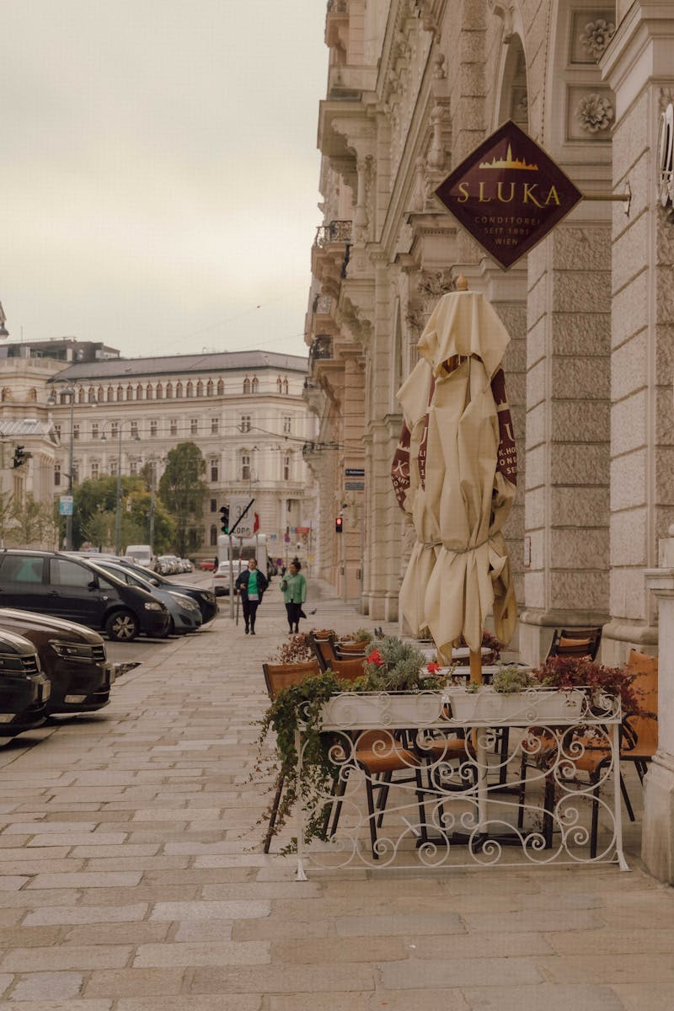
9
Steirereck
Austrian Cuisine in Vienna, Austria
Steirereck, a two-Michelin-star restaurant in Vienna, Austria, offers modern Austrian dishes with a focus on local and organic ingredients. Tasting menus start at €200-€300 per person, with beverages from €100-€200; service is generally inclusive. Best-sellers are the wild game dishes at €55 and the herbal infusions at €35; these represent the restaurant's regional heritage. Features farm-sourced explanations, wine cellar tours, and a team dedicated to creating a welcoming, high-end dining environment.

Slide 12
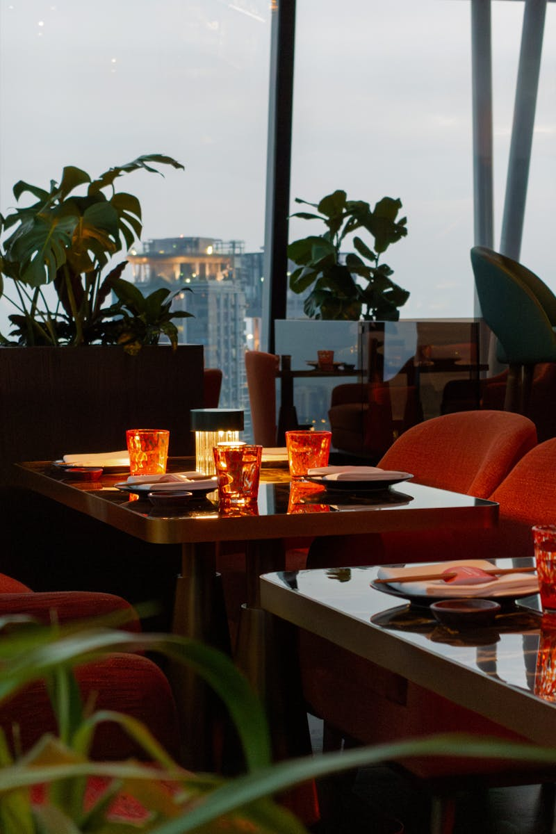
10
Odette
Asian-Inspired Cuisine in Singapore
Odette, a three-Michelin-star restaurant in Singapore by chef Julien Royer, blends French techniques with Asian influences for contemporary fine dining. Menus are priced at €250-€350 per person, with pairings around €150-€250; taxes and tips are extra. Popular items include the truffle-infused rice at €50 and the seafood tartare at €40; these are staples of the inventive menu. Offers tailored cultural experiences, sommelier consultations, and impeccable service in a minimalist setting for an elegant affair.

