Slide 1

Toronto: A City of Sports, Landmarks, and Industry Exploring the Heart of Ontario
Photo by Pexels

Slide 2
01
Toronto: A Sports City
Table of Contents
02
Iconic Landmarks of Toronto
03
Toronto: A Hub of Industry

Slide 3
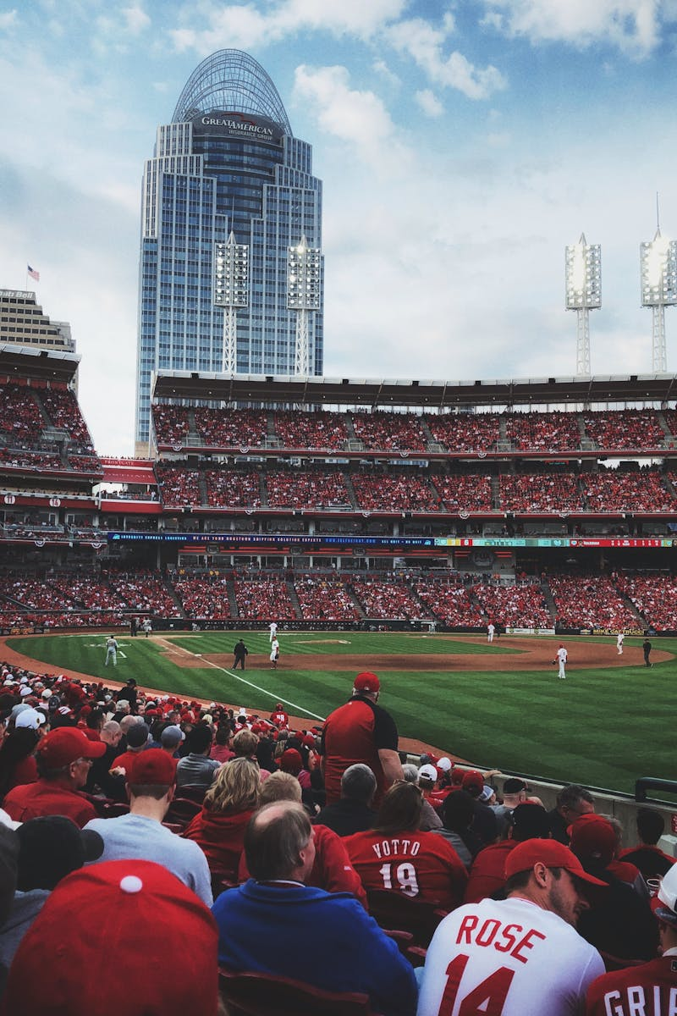
1
Toronto: A Sports City
Home to Passionate Fans and World-Class Teams
The Toronto Maple Leafs, a storied NHL franchise, boast a rich history and passionate fanbase. The Toronto Raptors, NBA champions, have ignited basketball fever across the city. The Toronto Blue Jays, a beloved MLB team, bring the excitement of baseball to the city. Toronto FC, a Major League Soccer team, reflects the city's diverse and growing soccer culture.

Slide 4
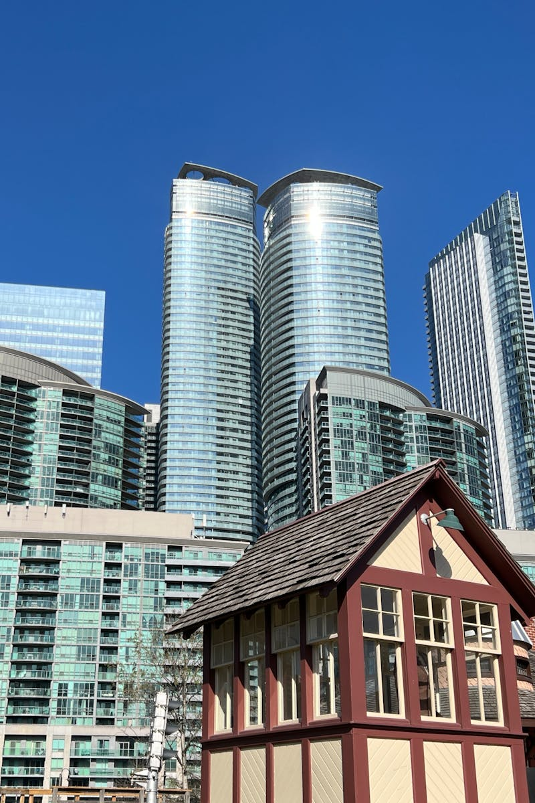
2
Iconic Landmarks of Toronto
Defining the Cityscape
The CN Tower, a towering landmark, offers breathtaking panoramic views of the city. Casa Loma, a magnificent castle, showcases architectural grandeur and historical significance. The ROM, a world-renowned museum, houses diverse collections of art, culture, and natural history. St. Lawrence Market, a bustling marketplace, offers a wide array of fresh produce, artisanal goods, and culinary delights.

Slide 5
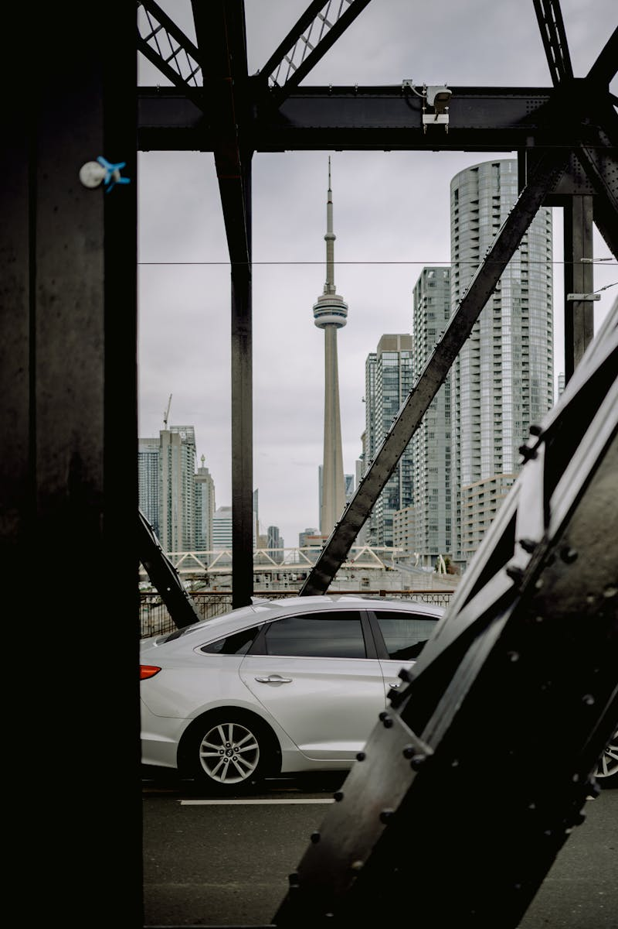
3
Toronto: A Hub of Industry
Driving Economic Growth
Toronto's financial sector is one of the largest in the world, centered around Bay Street. The city is a growing hub for technology companies, attracting talent and investment. Toronto has a strong manufacturing base, particularly in automotive and aerospace industries. Toronto is a major center for film and television production, often referred to as 'Hollywood North'.

