Slide 1

Understanding Economic Systems: Shaping Our World
A comprehensive guide to Capitalism, Socialism, and Mixed Economies.
Photo by Pexels

Slide 2
01
Babu Banarasi Das University
Table of Contents
02
Decoding the Economic System
03
The Trinity of Economies
04
Capitalism Unveiled
05
Socialism Explained
06
The Best of Both Worlds?
07
Quick Quiz!
08
Wrapping Up
09
Thank You!

Slide 3

1
Babu Banarasi Das University
Economic Systems and Their Types
Medhavi Mishra, Anshika Dubey, Aastha Shahi, Khizra Bano present an insightful look into economic systems, exploring their structures and impacts.
Economic system and it's types.
Welcome to a Journey Through the World of Economic Systems. Let's understand how societies organize their resources!
Embark on this educational adventure to demystify the complexities of economies and their effects on our lives.

Slide 4

2
Decoding the Economic System
What is it, and why does it matter?
An economic system is how a society organizes the production, distribution, and consumption of goods and services.
Features include resource allocation methods, property rights, and the degree of government intervention, shaping economic outcomes.
Economic systems influence everything from job availability and income levels to the prices of everyday goods and services.
For instance, a market-oriented system may foster innovation, while a centrally planned system could prioritize equality.

Slide 5

3
The Trinity of Economies
Capitalist, Socialist, and Mixed Systems.
Emphasizes private ownership and free markets.
Features social ownership and control.
Combines elements of both capitalism and socialism.
Each system dictates how resources are allocated and managed, affecting economic activities differently.

Slide 6
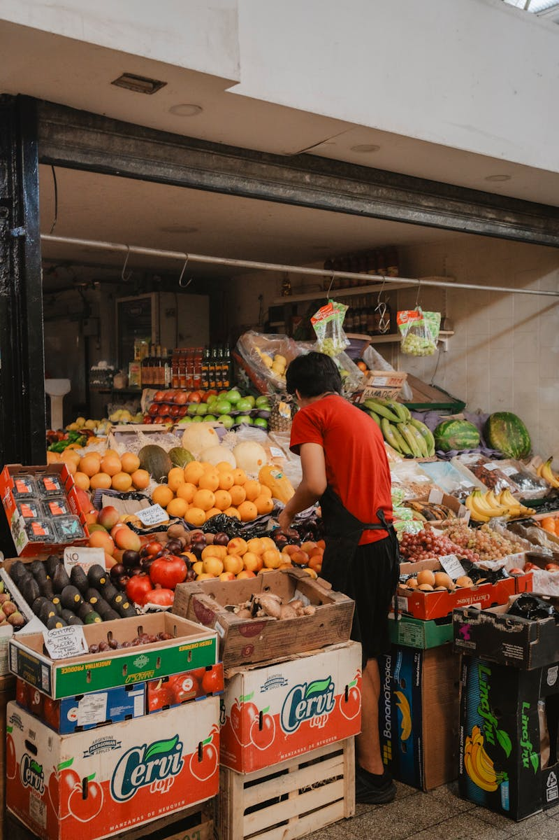
4
Capitalism Unveiled
The power of the free market.
An economic system where private individuals or businesses own capital goods. Production is based on supply and demand.
Private property, free markets, and competition drive innovation and efficiency.
Pros: Efficiency, innovation. Cons: Inequality, market failures.
The USA is a prime example, with its entrepreneurial spirit and vast array of privately-owned businesses.

Slide 7

5
Socialism Explained
Equality and Collective Ownership.
An economic system where the community collectively owns and controls the means of production and distribution.
Emphasis on social equality, welfare programs, and reduced income disparities.
Pros: Reduced inequality, social safety nets. Cons: Potential inefficiency, slower innovation.
Scandinavian countries like Sweden exemplify a democratic socialist approach with strong social support systems.

Slide 8

6
The Best of Both Worlds?
Understanding Mixed Economies.
Combines aspects of both capitalism and socialism, allowing for private enterprise alongside government regulation and intervention.
Includes private sector freedom, government regulations, and social safety nets.
Pros: Balance between efficiency and equity. Cons: Bureaucracy, potential for conflicting policies.
Germany exemplifies a mixed economy, balancing a market-driven economy with strong social welfare programs and regulations.

Slide 9

7
Quick Quiz!
Test Your Knowledge.
1. System emphasizing private ownership? 2. Goal of socialism? 3. Economy combining aspects of both? 4. What drives Capitalism?
5. Country with social welfare programs? 6. Negative side of capitalism? 7. What balances Equity and efficency?
Take a moment to reflect on the key concepts we've covered.
(Capitalism, equality, mixed, market, Sweden, inequality, mixed)

Slide 10

8
Wrapping Up
The Big Picture.
Economic systems shape societies through resource distribution and wealth creation.
Understanding systems helps us navigate the global economic landscape and make informed decisions.
Each system presents unique challenges and opportunities.
Encourage students to continue exploring global economies and their impacts.

Slide 11

9
Thank You!
For your Participation
We appreciate your active participation and attentiveness throughout this presentation.
Special thanks to Babu Banarasi Das University for providing this platform to educate and inform.
We encourage everyone to explore further and deepen their understanding of economic systems.
Thank you once again for your time and attention. We hope you found this presentation insightful.

