Slide 1

Unlocking Growth: Navigating India's Digital Marketing Landscape
+
+
+
A Data-Driven Approach to Success with RiseAlive
+
+
+

Slide 2



Table of Contents
01
The Digital Revolution: Marketing Transformed
02
The Pillars of Digital Marketing Strategy
03
Data-Driven Digital Marketing: The Edge You Need
04
RiseAlive: Your Partner in Digital Success
05
RiseAlive's Expertise: Services That Deliver
06
Amplifying Your Brand: The RiseAlive Advantage
07
SEO: Mastering Search Engine Rankings
08
Social Media Marketing: Engaging Your Audience
09
PPC: Driving Immediate Results

Slide 3
Table of Contents
10
Thank You

Slide 4


The Digital Revolution: Marketing Transformed
Digital marketing employs online channels like websites, apps, and social media to promote products and services effectively.
It enables a focused approach, tailoring strategies based on consumer behavior for enhanced engagement and conversion rates.
Digital platforms provide the space to increase visibility, generate leads, boost sales, and foster lasting customer relationships.
Digital marketing has become an integral part of business strategies, assisting brands in achieving visibility and growth.

Slide 5
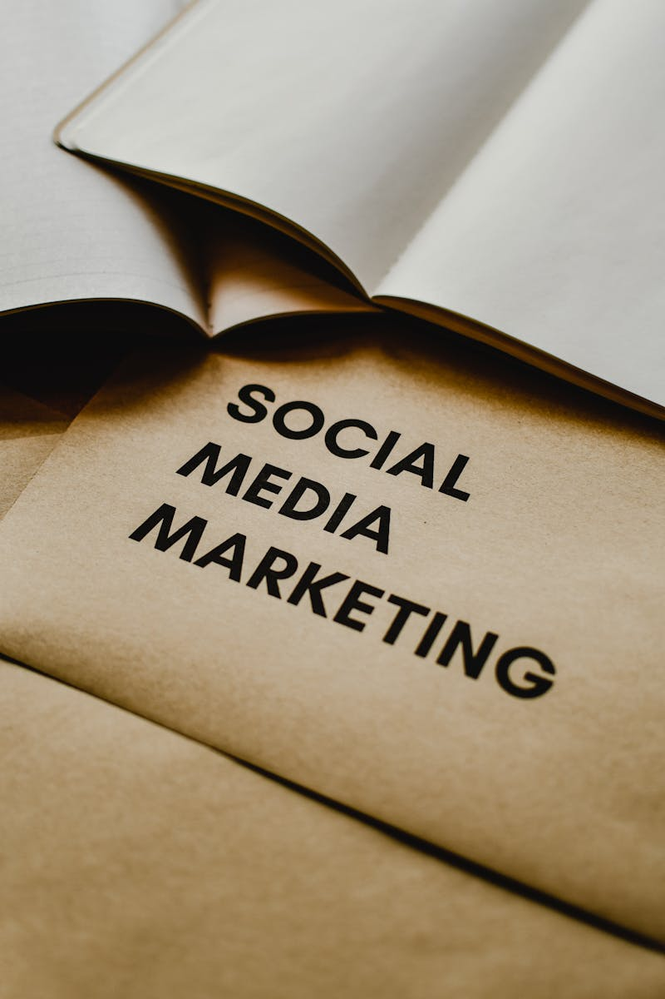
The Pillars of Digital Marketing Strategy
SEO improves website visibility in search engine results, increasing organic traffic and reaching a wider audience.
Engage audiences, build brand awareness, and drive traffic through strategic social media campaigns and content.
Create valuable content, like blogs, articles, and webpages, to attract and engage your target demographic effectively.
Drive immediate results with targeted ad campaigns on platforms like Google Ads, reaching potential customers actively searching.

Slide 6

Data-Driven Digital Marketing: The Edge You Need
Businesses must embrace a data-driven approach in digital marketing to achieve substantial revenue generation and growth.
Specializing in performance marketing ensures targeted strategies and measurable results, boosting client revenue effectively.
Data-driven methodologies offer a competitive advantage, surpassing traditional approaches and driving impactful outcomes.
Focusing on data insights enhances ROI, delivering efficient campaigns and achieving client revenue objectives.

Slide 7

RiseAlive: Your Partner in Digital Success
RiseAlive has over 20 marketing specialists leveraging SEO, Google Ads, SMO, PPC, and more to boost client ROI.
The company adopts a data-driven method in its digital marketing services, ensuring informed decisions and strategies.
RiseAlive improves ROI and helps clients meet revenue goals using performance marketing and lead management systems.
Partnering with RiseAlive enables businesses to generate substantial revenue, meeting and exceeding client expectations.

Slide 8

RiseAlive's Expertise: Services That Deliver
RiseAlive improves online visibility and ranking through strategic SEO practices, attracting targeted traffic.
Elevate your brand on social media with RiseAlive's expert SMO services, boosting engagement and brand awareness.
Drive instant results with RiseAlive's targeted PPC campaigns, optimizing your ROI and reaching the right audience.
Engage audiences with compelling content, leveraging RiseAlive's expert content writing to resonate with your target market.

Slide 9

Amplifying Your Brand: The RiseAlive Advantage
RiseAlive accelerates brand growth through a suite of proven digital marketing services like SEO, SMO, and PPC, and more.
The company's digital marketing specialists have over 10 years of experience in the field, offering invaluable expertise.
Our specialists are passionate about business growth, ensuring maximum exposure on Google's SERPs and beyond, effectively.
RiseAlive provides strategically driven services that amplify brands and drive consumer engagement effectively and efficiently.

Slide 10
SEO: Mastering Search Engine Rankings
Increase your online presence by implementing the best strategies that make people connect with your business easily.
Increase your website's credibility and authority to improve its search engine ranking by attracting more organic traffic.
Increase organic traffic and engagement by using high-quality and relevant content that meets search engine standards.
Enhance user experience and search engine crawlability through technical optimizations for improved site performance.

Slide 11

Social Media Marketing: Engaging Your Audience
Foster loyal relationships and create brand advocates through active community engagement strategies to grow online.
Expand your reach and drive targeted traffic with strategic social media advertising campaigns for optimal results.
Boost visibility and engagement by creating shareable content that enhances brand awareness across multiple social channels.
Refine social media campaigns and maximize ROI by analyzing performance metrics to ensure an increase in efficiency.

Slide 12

PPC: Driving Immediate Results
Identify high-impact keywords that drive valuable traffic and align with your target audience to maximize campaign effectiveness.
Create compelling ad copy that speaks directly to your target audience, improving click-through rates and overall campaign performance.
Ensure that your campaign is aligned with your audience, which maximizes conversions and improve overall campaign efficiency and effectiveness.
Monitor and refine your PPC campaigns with performance tracking, and see which key metrics provide greater ROI and drive better results.

Slide 13

Thank You
We are grateful for your time and consideration. Thank you for attending this presentation.
Feel free to reach out with any questions or to discuss how RiseAlive can elevate your digital marketing strategy.
We look forward to the opportunity to collaborate and drive success together in the digital landscape of India.
Choose RiseAlive as your trusted partner to navigate the digital world and achieve your business objectives effectively.

