Slide 1

Unlocking Potential: The Power of Focus
Achieving Goals Through Concentrated Effort
Photo by Google

Slide 2
01
The Focus Advantage
Table of Contents
02
Eliminating Distractions
03
Setting Clear Goals
04
Mindfulness Practices
05
The Pomodoro Technique
06
The Power of Single-Tasking
07
Fueling Focus: Nutrition & Hydration
08
Prioritizing Sleep
09
Focus as a Habit
10
Thank You

Slide 3

1
The Focus Advantage
Why concentration is your superpower.
Focus allows us to identify and address the most critical tasks, ensuring resources are directed where they matter most for maximum impact.
By eliminating distractions, we can achieve a state of deep work, leading to higher quality output and increased efficiency in our endeavors.
Focused attention enhances our ability to absorb and retain information, leading to quicker learning and a deeper understanding of complex concepts.
Concentrated effort propels us towards our goals with greater speed and accuracy, minimizing wasted time and maximizing overall progress.
Photo by Google

Slide 4

2
Eliminating Distractions
Strategies for minimizing interruptions.
Become aware of your distractions. Acknowledge them without judgment and gently redirect your focus back to the task at hand.
Schedule periods of time away from screens and devices to reduce digital stimuli and create space for focused thought and reflection.
Design your workspace to minimize visual and auditory distractions. Utilize noise-canceling headphones or create a designated quiet zone.
Allocate specific blocks of time for focused work, and protect those periods from interruptions by setting boundaries and communicating your needs.
Photo by Google

Slide 5
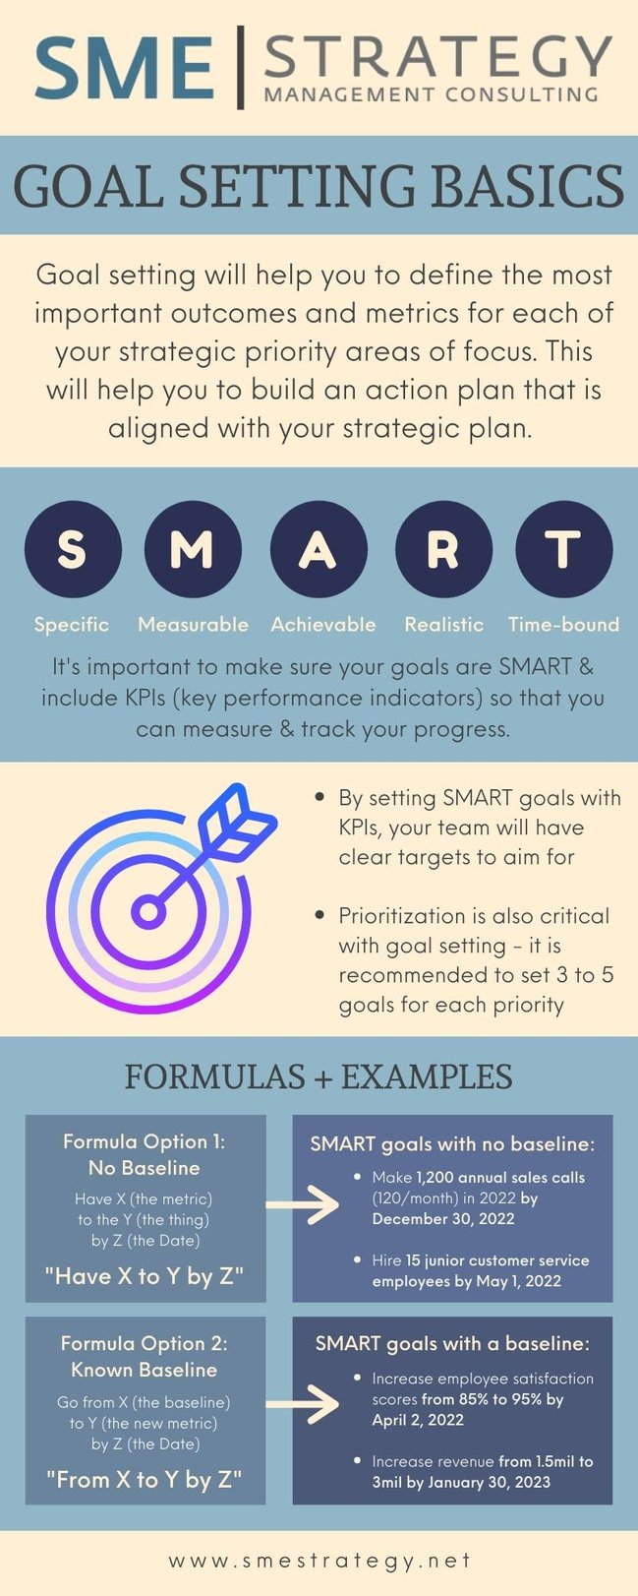
3
Setting Clear Goals
Defining targets for focused action.
Employ the SMART framework (Specific, Measurable, Achievable, Relevant, Time-bound) to ensure your goals are well-defined and attainable.
Divide large, complex goals into smaller, more manageable steps. This makes the overall objective feel less daunting and easier to approach.
Create a mental image of yourself achieving your goals. This can enhance motivation and reinforce your commitment to focused action.
Periodically review your goals to ensure they remain aligned with your overall objectives and adjust your approach as needed to stay on track.
Photo by Google

Slide 6
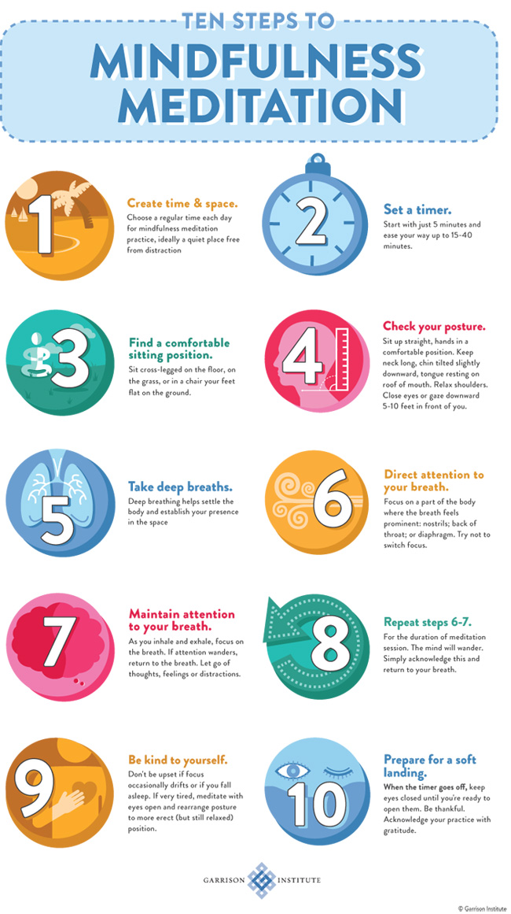
4
Mindfulness Practices
Cultivating presence for enhanced focus.
Regular meditation enhances focus by training your mind to stay present and reduces mental clutter, allowing you to approach tasks with clarity.
Simple breathing techniques can help calm your nervous system and improve concentration by increasing oxygen flow to the brain.
Practicing body scan meditations can increase your awareness of physical sensations, promoting relaxation and reducing restlessness, improving focus.
Cultivate the habit of bringing your attention back to the present moment whenever your mind wanders, grounding you in the task at hand.
Photo by Google

Slide 7
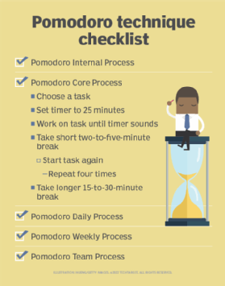
5
The Pomodoro Technique
Structured focus for increased productivity.
Work in focused 25-minute intervals, followed by a short 5-minute break to recharge your mental energy and maintain concentration.
Use your breaks wisely: stand up, stretch, hydrate, or engage in a light activity that helps you relax and refresh your mind before the next interval.
After every four pomodoros, take a longer 20-30 minute break to allow for deeper relaxation and prevent burnout from prolonged focus.
Keep track of the number of pomodoros completed each day to monitor your productivity and identify patterns that influence your ability to focus.
Photo by Google

Slide 8
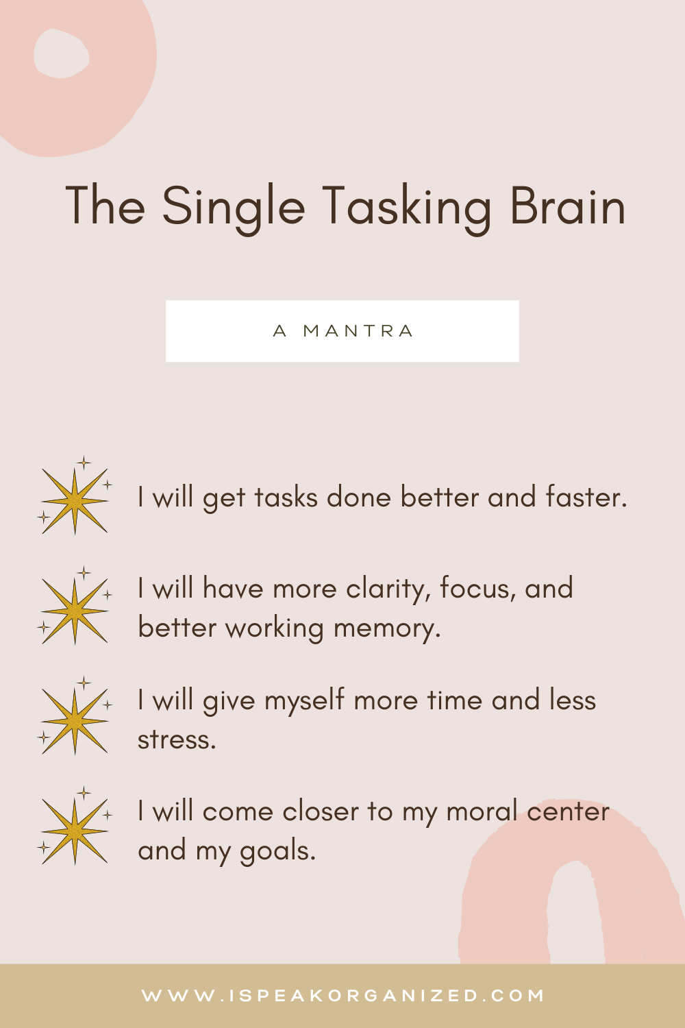
6
The Power of Single-Tasking
Why doing one thing at a time is more effective.
Resist the urge to juggle multiple tasks simultaneously. Multitasking reduces efficiency and increases the likelihood of errors, hindering overall progress.
Concentrate your attention on a single task until it is completed. This allows you to fully immerse yourself in the work, leading to higher quality output.
Single-tasking reduces mental clutter and overwhelm, lowering stress levels and improving your overall sense of well-being and productivity.
By giving each task your undivided attention, you can foster a deeper sense of engagement and satisfaction in your work, enhancing job satisfaction.
Photo by Google

Slide 9
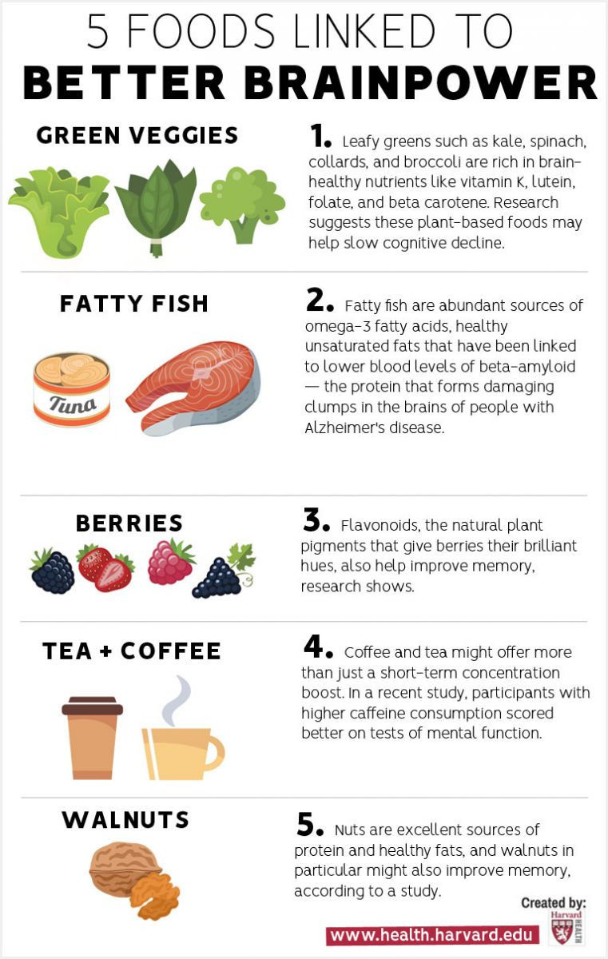
7
Fueling Focus: Nutrition & Hydration
The link between diet and concentration.
Stay adequately hydrated throughout the day. Dehydration can lead to fatigue and reduced cognitive function, impairing your ability to focus effectively.
Consume a balanced diet rich in fruits, vegetables, whole grains, and lean protein. This provides the nutrients your brain needs to function optimally.
Limit your intake of sugary foods and drinks, which can lead to energy spikes followed by crashes, disrupting your concentration and productivity.
Incorporate brain-boosting foods like fatty fish, nuts, seeds, and berries into your diet to support cognitive function and enhance your ability to focus.
Photo by Google

Slide 10
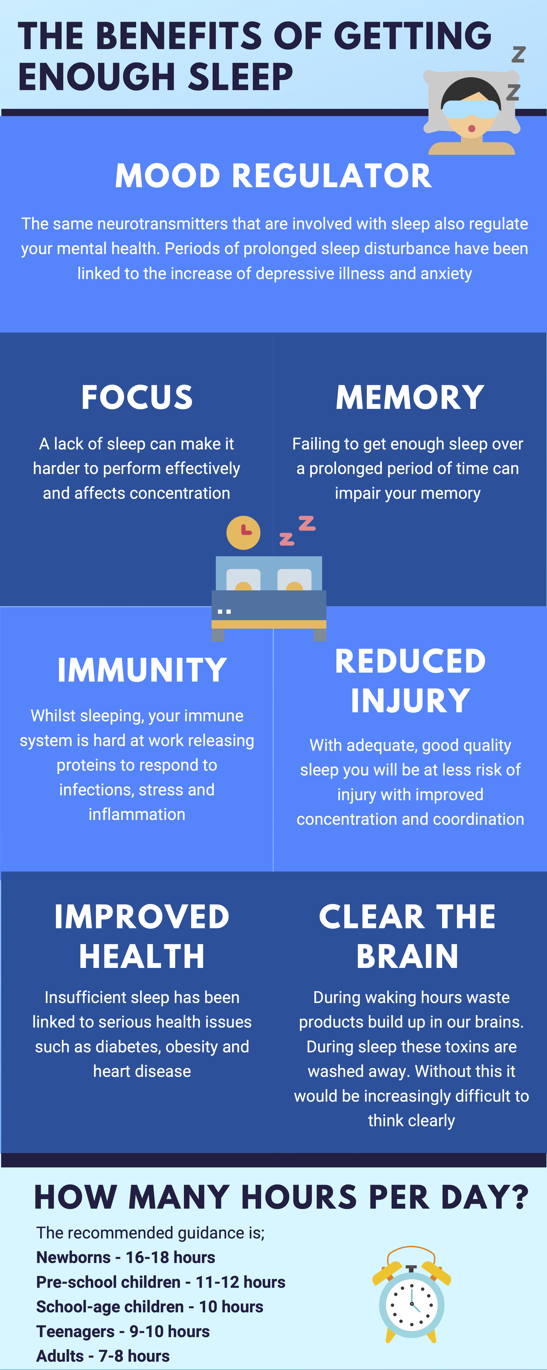
8
Prioritizing Sleep
The importance of rest for cognitive function.
Prioritize getting adequate sleep each night to allow your brain to rest and rejuvenate. Sleep deprivation impairs cognitive function and reduces focus.
Establish a consistent sleep schedule to regulate your body's natural sleep-wake cycle and improve the quality of your sleep for focus enhancements.
Create a conducive sleep environment by ensuring your bedroom is dark, quiet, and cool. This promotes restful sleep and enhances cognitive function.
Develop a relaxing pre-sleep routine to signal to your brain that it's time to wind down. Avoid screens and caffeine before bed to improve sleep quality.
Photo by Google

Slide 11

9
Focus as a Habit
Building long-term concentration skills.
Begin by implementing small, incremental changes to your daily routine to gradually build your ability to focus and maintain concentration over time.
Practice focused activities regularly to reinforce neural pathways in your brain and make concentration a natural habit over time; be consistent daily.
Monitor your progress over time and celebrate your achievements to stay motivated and reinforce your commitment to building focus as a long-term habit.
Be patient with yourself and practice self-compassion when you experience setbacks. Building focus is a process that requires time, effort, and perseverance.
Photo by Google

Slide 12

10
Thank You
Grateful for your attention.
Thank you for taking the time to listen and engage with this presentation on the power of focus.
May the insights shared here help you unlock your full potential through concentrated effort and mindful awareness.
We hope you continue to cultivate your ability to focus and achieve your goals with greater ease and effectiveness.
Your attention and participation are greatly appreciated. We wish you success in all your future endeavors and focus efforts.
Photo by Google

