Slide 1
Unlocking Wellness: Ancient Herbs for Modern Health
Harnessing the Power of Traditional Herbal Remedies for a Healthier You
Photo by Google

Slide 2
01
A Timeless Tradition
Table of Contents
02
The Power of Plants
03
Immunity Boosters
04
Stress Relief Naturally
05
Digestion Support
06
Cognitive Enhancement
07
Anti-Inflammatory Allies
08
Safe & Responsible Use
09
Incorporating Herbs
10
Thank You

Slide 3
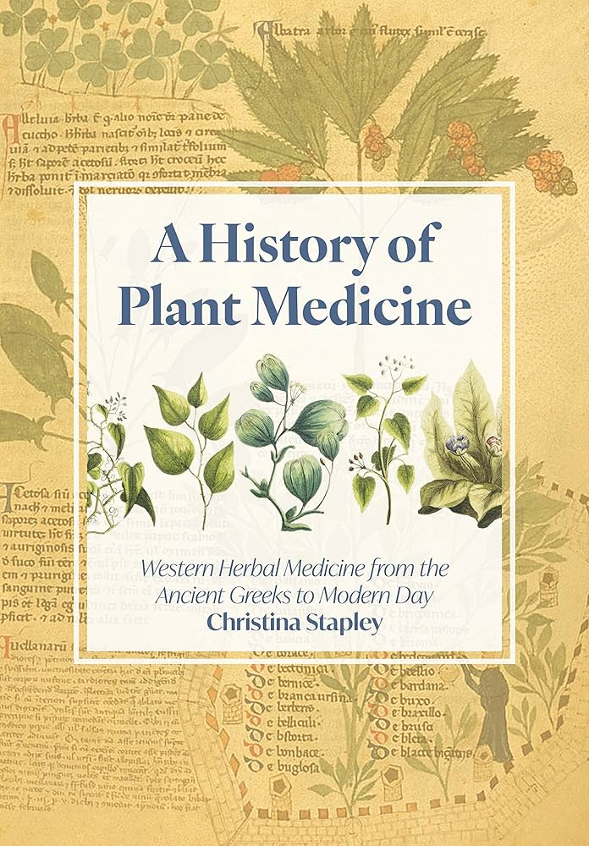
1
A Timeless Tradition
Discovering the Rich History of Herbal Medicine
Herbal medicine boasts a history spanning millennia. Civilizations across the globe have relied on plants for healing and wellness.
From Ayurveda to Traditional Chinese Medicine, herbs play vital roles in holistic health systems passed down through generations.
While rooted in tradition, modern research is continually exploring the efficacy and safety of various herbal remedies.
Many pharmaceuticals are derived from, or inspired by, compounds found in plants, highlighting herbs' continuing importance.
Photo by Google

Slide 4
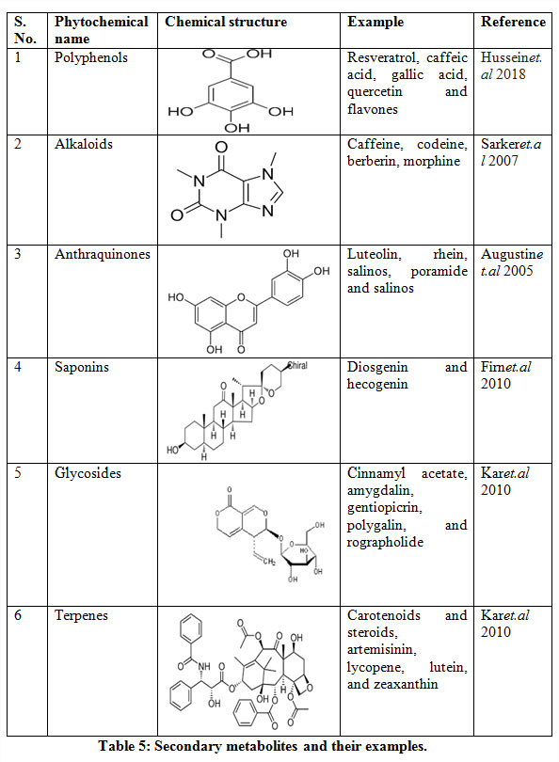
2
The Power of Plants
Understanding the Active Compounds in Herbs
Herbs contain phytochemicals, naturally occurring compounds that can exert therapeutic effects on the body.
The effects of herbs are often due to the synergistic action of multiple compounds, not just one isolated component.
Different parts of the plant (roots, leaves, flowers) contain varying concentrations and types of beneficial compounds.
How our bodies absorb and utilize these compounds influences the effectiveness of herbal remedies.
Photo by Google

Slide 5
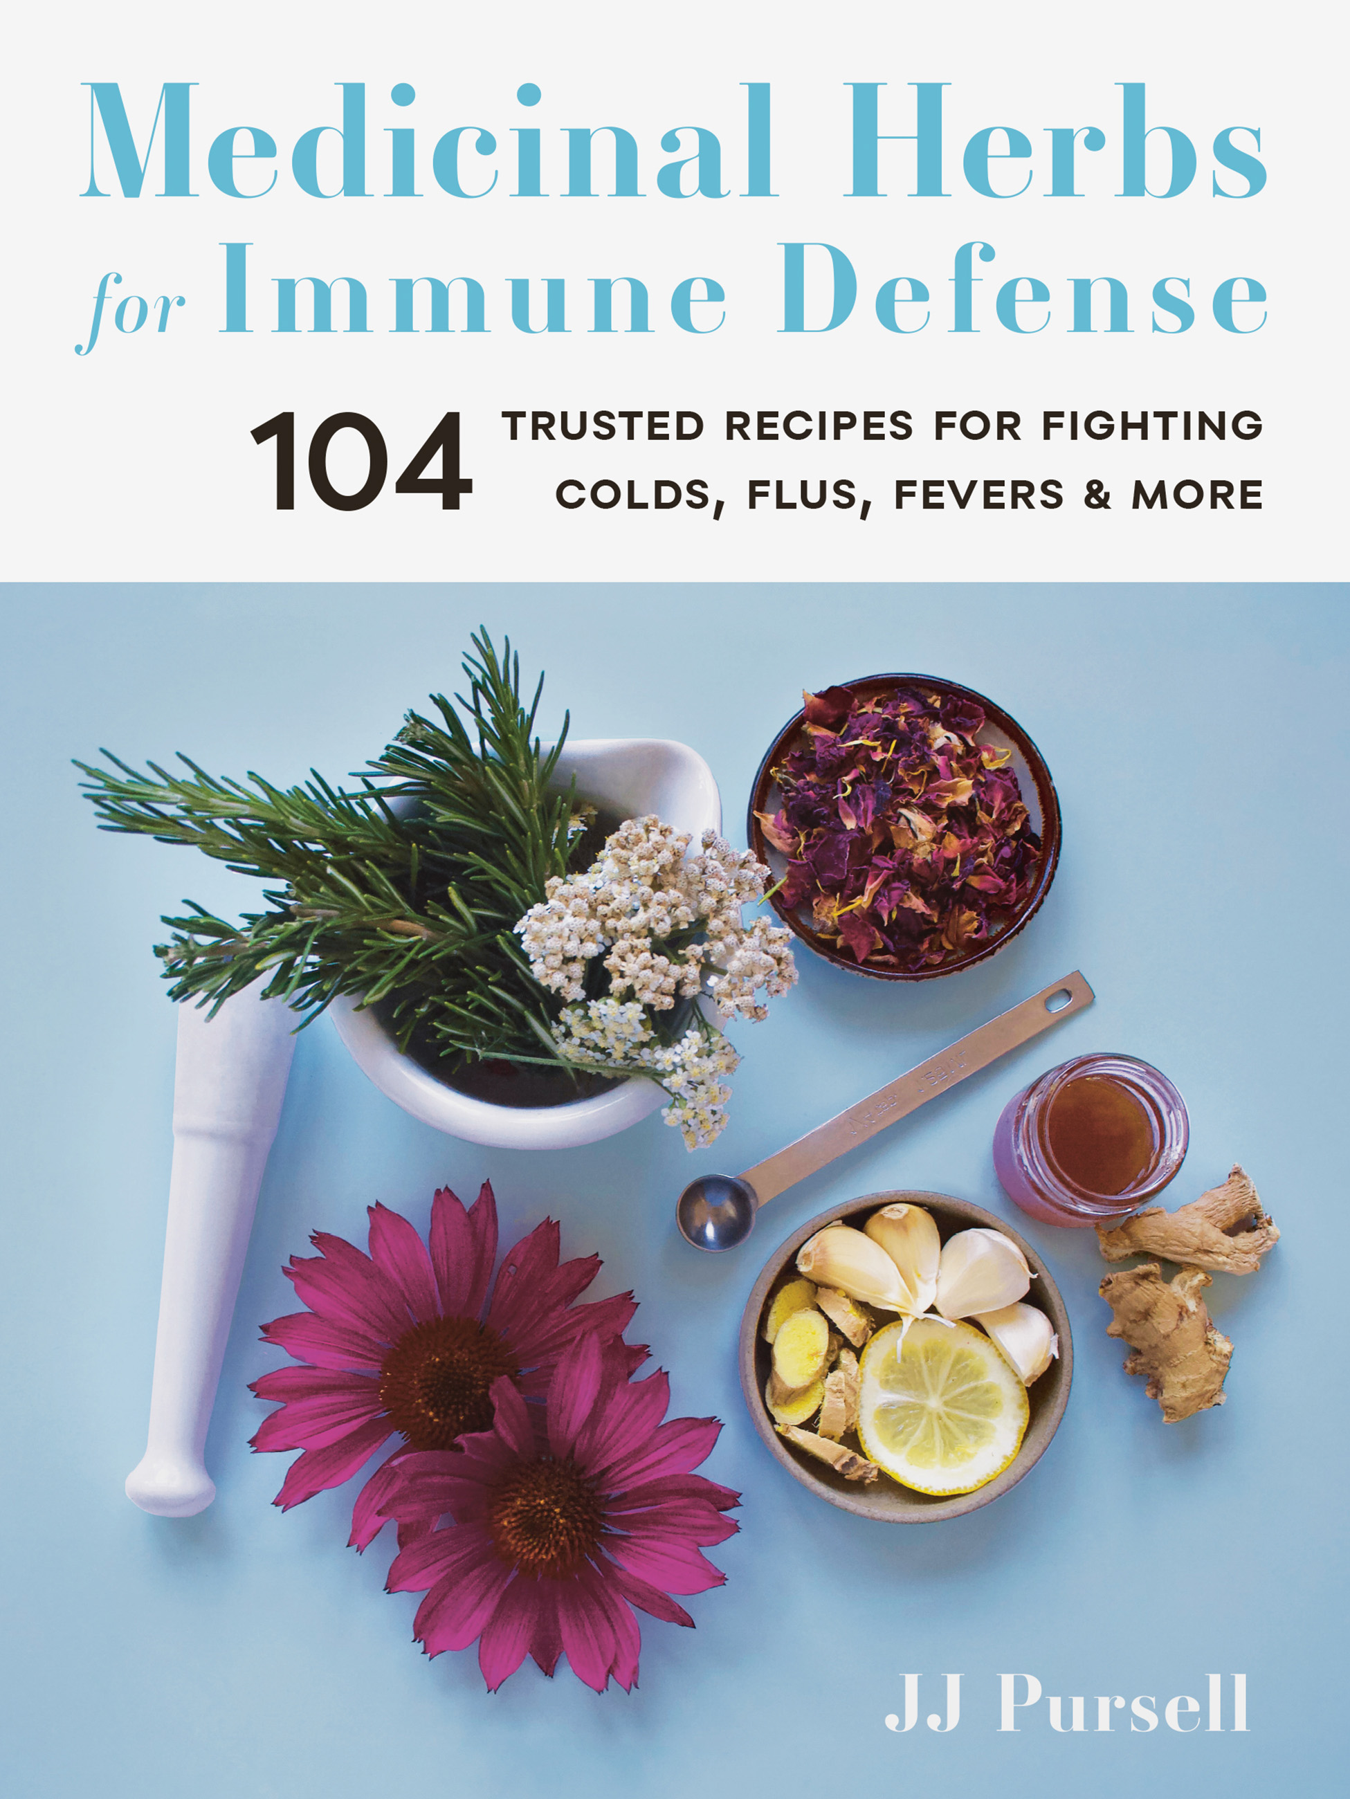
3
Immunity Boosters
Herbs to Strengthen Your Body's Defenses
Known for its immune-stimulating properties, echinacea may help shorten the duration and severity of colds.
Rich in antioxidants, elderberry can combat viral infections and support respiratory health.
Used in Traditional Chinese Medicine, astragalus is believed to enhance immune function and increase energy levels.
With potent anti-inflammatory and antioxidant properties, ginger can alleviate cold symptoms and boost immunity.
Photo by Google

Slide 6
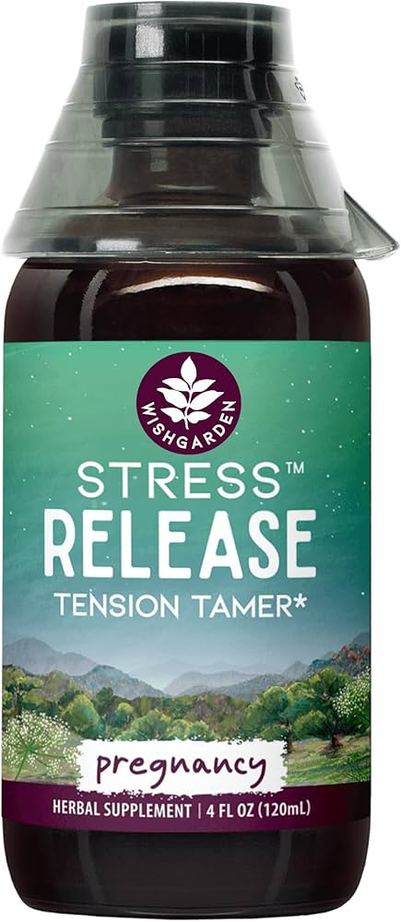
4
Stress Relief Naturally
Calming Herbs for a Balanced Mind
Renowned for its calming and relaxing properties, lavender can reduce anxiety and promote restful sleep.
This gentle herb soothes the nervous system, easing stress and promoting relaxation before bedtime.
An adaptogen, ashwagandha helps the body cope with stress, reduces cortisol levels, and improves overall well-being.
Effective in reducing anxiety and insomnia, passionflower provides a natural calming effect without drowsiness.
Photo by Google

Slide 7
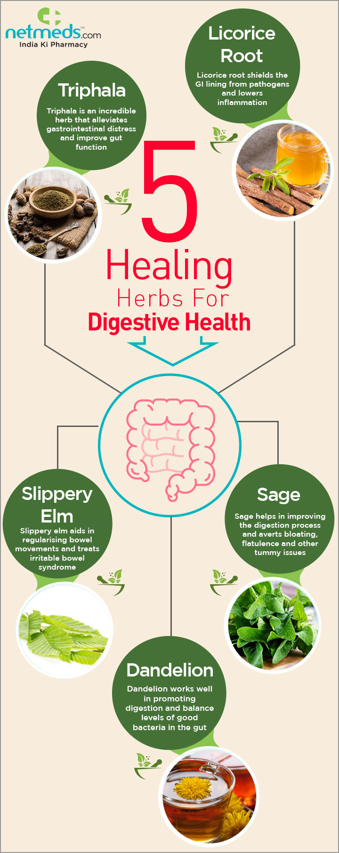
5
Digestion Support
Herbs for a Happy and Healthy Gut
Known for its ability to relieve indigestion, bloating, and gas, peppermint soothes the digestive tract.
Besides its immune benefits, ginger can also ease nausea, improve digestion, and reduce inflammation in the gut.
Chewing fennel seeds or drinking fennel tea can alleviate bloating, gas, and other digestive discomforts.
Dandelion can stimulate bile production, aiding digestion and promoting liver health.
Photo by Google

Slide 8
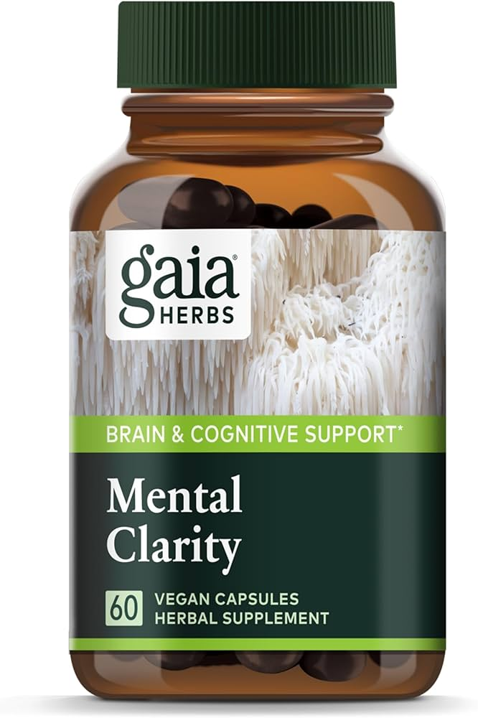
6
Cognitive Enhancement
Herbs to Sharpen Your Mind and Memory
Known to enhance cognitive function by improving blood flow to the brain, ginkgo biloba may boost memory and focus.
Used in Ayurveda, bacopa monnieri can enhance memory, reduce anxiety, and improve cognitive performance.
The scent of rosemary is believed to improve memory and concentration. It also contains antioxidants that protect brain cells.
Used traditionally to improve mental clarity and reduce anxiety, gotu kola supports cognitive function and overall brain health.
Photo by Google

Slide 9
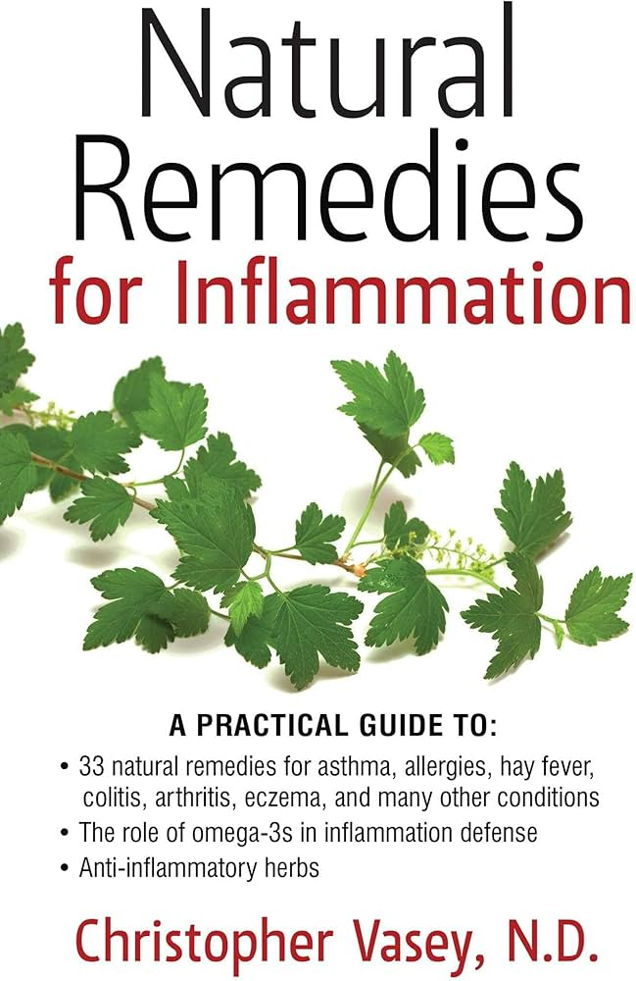
7
Anti-Inflammatory Allies
Herbs to Reduce Inflammation and Promote Healing
Curcumin, the active compound in turmeric, possesses potent anti-inflammatory and antioxidant properties.
Ginger's anti-inflammatory properties can alleviate pain and swelling associated with arthritis and other inflammatory conditions.
Also known as Indian frankincense, boswellia reduces inflammation and pain, particularly in joints.
Containing salicin, a natural aspirin-like compound, willow bark can alleviate pain and reduce inflammation.
Photo by Google

Slide 10
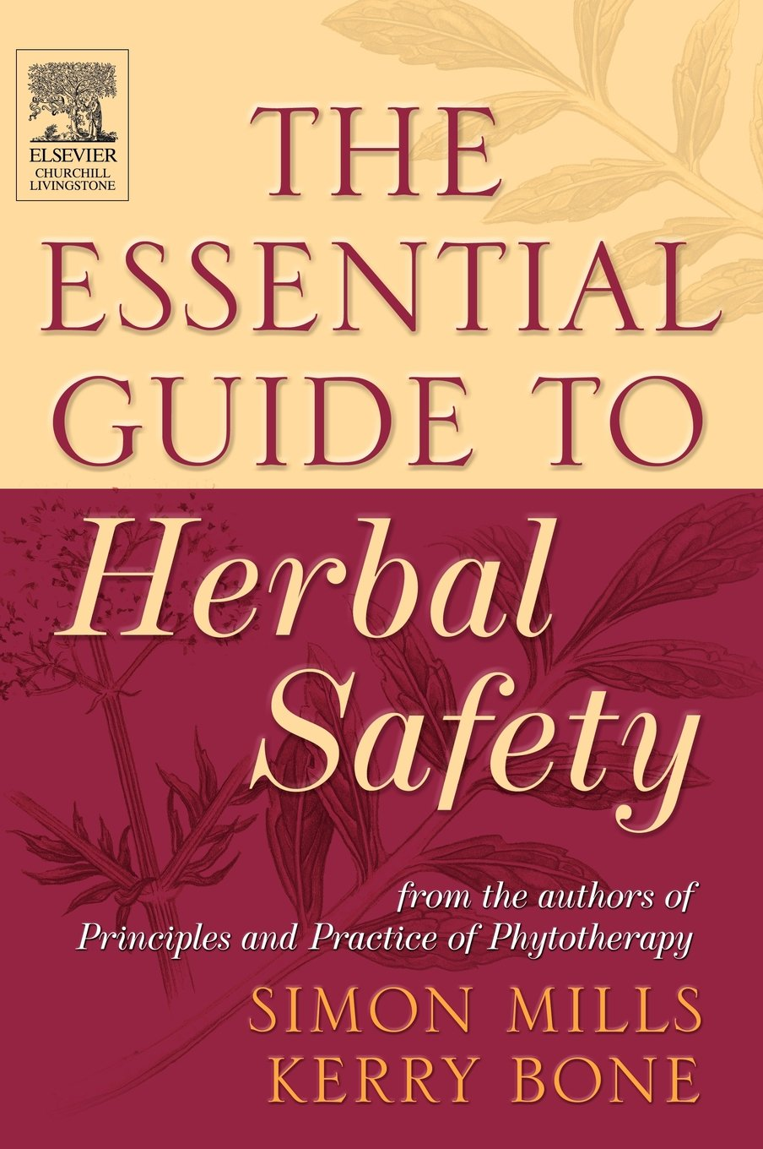
8
Safe & Responsible Use
Important Considerations Before Using Herbs
Always consult a qualified healthcare professional or herbalist before starting any new herbal regimen, especially if you have existing conditions.
Be aware that herbs can interact with prescription medications. Discuss potential interactions with your doctor.
Follow recommended dosages carefully. More is not always better, and excessive amounts can cause adverse effects.
Choose high-quality herbs from reputable sources to ensure purity, potency, and safety.
Photo by Google

Slide 11

9
Incorporating Herbs
Easy Ways to Integrate Herbal Remedies into Your Daily Life
Enjoy a cup of herbal tea as a calming and therapeutic beverage. Experiment with different blends to find your favorites.
Add fresh or dried herbs to your meals for flavor and health benefits. Incorporate herbs like basil, oregano, and thyme.
Consider herbal supplements or extracts for a more concentrated dose of beneficial compounds. Choose reputable brands.
Use essential oils derived from herbs in diffusers or topical applications for aromatherapy benefits like stress relief and relaxation.
Photo by Google

Slide 12

10
Thank You
Thank You
Thank you for your time and attention. We hope this presentation has provided valuable insights into the world of herbal medicine.
We encourage you to continue exploring the fascinating world of herbs and their potential to enhance your health and well-being.
Remember, this information is for educational purposes only and does not constitute medical advice.
Stay informed, stay curious, and continue your journey toward natural wellness. Have a wonderful day!
Photo by Google

