Slide 1

Unlocking the Energy Universe
Journey into Heat, Work, and the Laws of Thermodynamics
Photo by Google

Slide 2
01
The Essence of Energy Transfer
Table of Contents
02
Pioneers Shaping Discovery
03
Thermal Equilibrium Basics
04
Conserving Energy Power
05
Heat's Natural Flow
06
Maximizing Energy Use
07
Zeroing in on Cold
08
Thermodynamics in Action
09
Time's Unstoppable Flow
10
Thank You for Joining

Slide 3
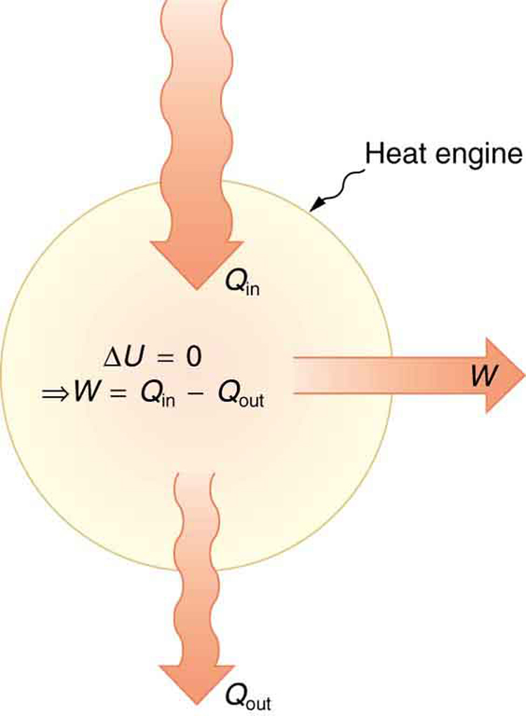
1
The Essence of Energy Transfer
Exploring Thermodynamics Basics
Thermodynamics studies the links between heat, work, temperature, and energy, focusing on how energy moves from one form or place to another as a key principle of nature.
Heat represents a form of energy that equals a specific amount of mechanical work, showing how everyday processes involve converting energy in practical ways.
This science deals with energy transfers and transformations, providing a foundation for understanding how systems operate in the physical world around us.
Early observations like those from Count Rumford highlighted that heat generation ties directly to work, forming the basis for modern thermodynamic principles.
Photo by Google

Slide 4
2
Pioneers Shaping Discovery
The Stories Behind Thermodynamics
Count Rumford observed that boring cannon barrels produced endless heat proportional to the work involved, proving heat's link to energy and challenging old ideas.
Sadi Carnot introduced heat-engine cycles and reversibility, exploring limits on work from high-temperature heat, which advanced engine efficiency concepts.
Rudolf Clausius developed the first and second laws from earlier ideas, establishing core rules that govern energy changes in systems and their surroundings.
These pioneers connected heat and work, laying the groundwork for thermodynamics to apply across engines, nature, and beyond in everyday applications.
Photo by Google

Slide 5
3
Thermal Equilibrium Basics
The Zeroth Law in Focus
When two systems each reach thermal equilibrium with a third, they balance with each other, allowing tools like thermometers to measure consistent temperatures accurately.
This law makes temperature scales meaningful by ensuring systems in equilibrium share the same temperature, simplifying how we track heat in various settings.
It enables the use of a third system to verify equilibrium, which is essential for experiments and real-world applications in energy studies.
The zeroth law establishes a foundation for understanding how heat flows and systems stabilize, guiding further exploration of energy behaviors.
Photo by Google

Slide 6
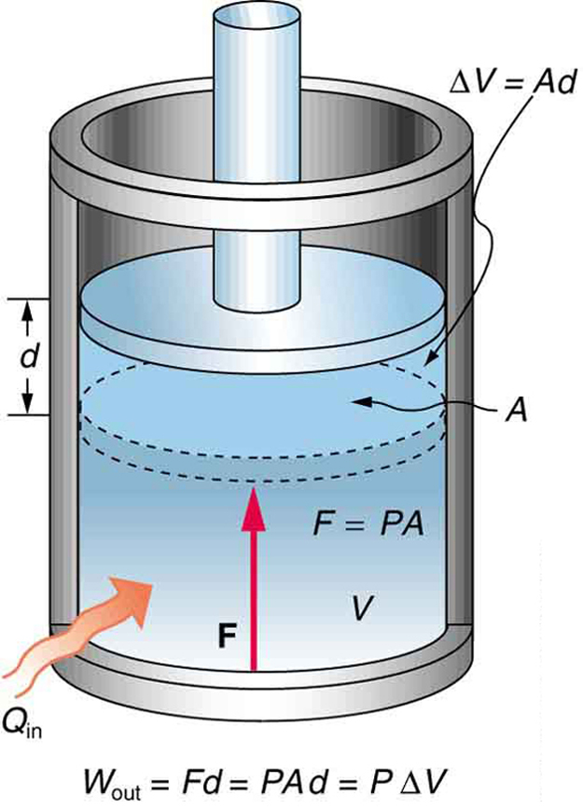
4
Conserving Energy Power
The First Law Explained
The change in a system's internal energy equals heat added minus work done, showing that energy shifts forms but never disappears in closed systems.
Energy cannot be made or destroyed, only transformed, which underscores the law's role in explaining processes like heating and mechanical actions.
Heat from surroundings and work by the system directly affect internal energy, illustrating how exchanges maintain overall energy totals.
This law applies to all systems, from simple machines to complex biological processes, emphasizing the conservation principle in daily life.
Photo by Google

Slide 7
5
Heat's Natural Flow
Second Law Fundamentals
Heat moves naturally from hotter to colder regions and cannot fully convert to work at a given temperature, limiting energy efficiency in processes.
A closed system's entropy, or heat energy per unit temperature, increases over time toward a maximum, driving systems toward stable equilibrium states.
This law ensures that not all heat can turn into useful work, meaning systems gradually lose energy potential as they approach balance.
All closed systems evolve to a state where entropy peaks and no energy remains for work, reflecting nature's path to order and rest.
Photo by Google

Slide 8
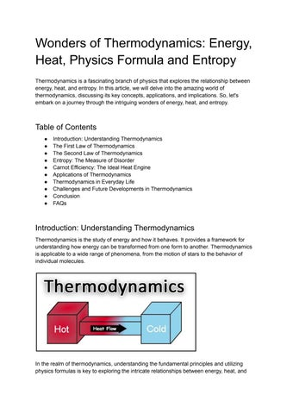
6
Maximizing Energy Use
Entropy and Efficiency Insights
For heat engines, entropy changes show that processes can be reversible if entropy stays constant, allowing maximum work from given temperatures.
High temperatures limit engine efficiency, with real systems rarely exceeding 60 percent due to factors like friction, based on second law constraints.
At least 25 percent of heat energy must be released as waste to follow the second law, ensuring systems do not violate natural energy rules.
Understanding entropy helps design better systems, where ideal conditions allow up to 75 percent efficiency, inspiring advancements in technology.
Photo by Google

Slide 9
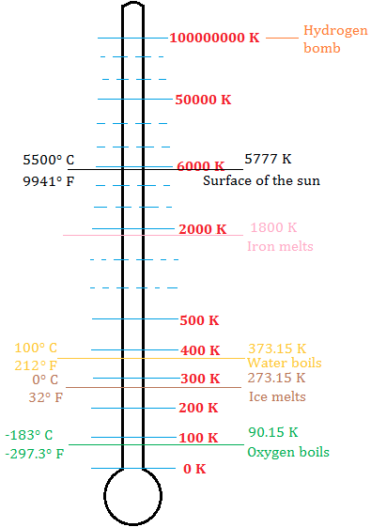
7
Zeroing in on Cold
The Third Law Revealed
For a perfect crystal in its stable form, entropy approaches zero as temperature nears absolute zero, setting a baseline for measuring disorder.
This law establishes an entropy scale that reflects system randomness, aiding in understanding behaviors at extremely low temperatures.
It defines entropy as a measure of randomness, where minimum entropy at absolute zero indicates the most ordered state in elements.
The third law connects to statistical views, helping explain how particles interact and systems behave in near-absolute zero conditions.
Photo by Google

Slide 10
8
Thermodynamics in Action
Real-World Energy Applications
Thermodynamics principles optimize steam engines by describing energy states and work capabilities, improving performance in industrial settings.
These laws fully outline changes in any system's energy and its work potential, applying to physical and biological systems alike.
While classical thermodynamics focuses on systems without atomic details, it sets the stage for statistical mechanics in modern studies.
By defining systems and their states, thermodynamics allows analysis of components like gases or atmospheres to understand larger interactions.
Photo by Google

Slide 11

9
Time's Unstoppable Flow
Entropy and the Universe
In isolated systems, entropy increases over time, leading to a heat death where all parts reach uniform temperature and no work is possible.
Systems naturally progress to maximum entropy states, representing a point of total disorder where energy conversions cease entirely.
Entropy's rise creates a clear direction for time, distinguishing forward events like heat flow from impossible reverses in natural processes.
Observing events like water cooling shows time's forward march, as entropy ensures heat flows in one direction, shaping our experiences.
Photo by Google

Slide 12
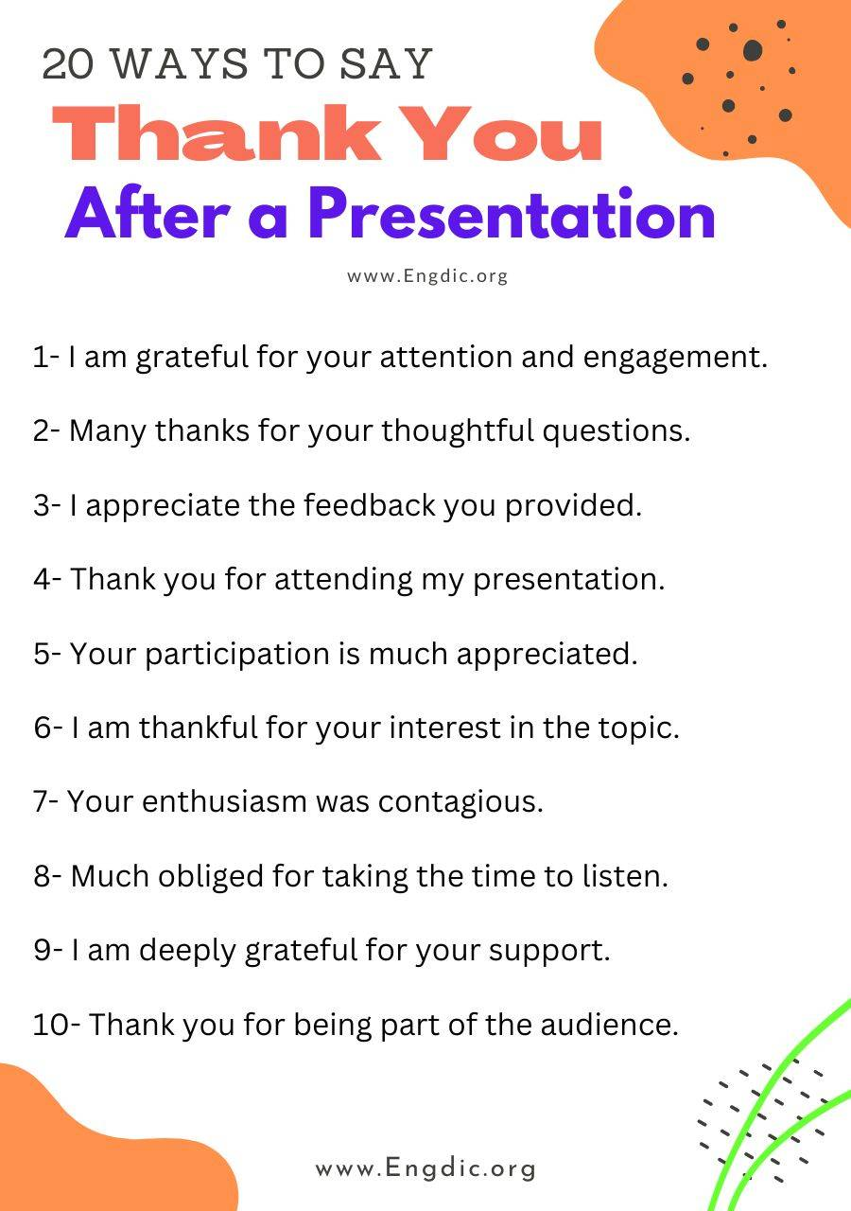
10
Thank You for Joining
Grateful for Your Engagement
Thank you for exploring thermodynamics with us, as these laws reveal the beauty of energy in our world and inspire further curiosity.
We appreciate your attention, knowing that understanding energy transfers can empower innovative ideas and real-world solutions.
Thank you for being part of this journey; may these concepts spark your own explorations into the wonders of science and nature.
We're thankful for your time and interest, hoping this presentation leaves you inspired to apply thermodynamics in everyday challenges.
Photo by Google

