Slide 1
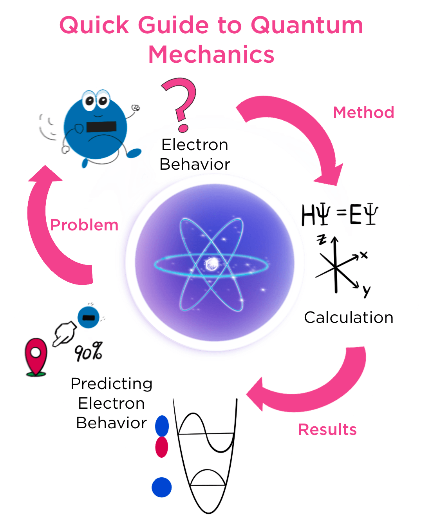
Unlocking the Mysteries of Physics
Discovering the Science of Matter, Motion, and Energy
Photo by Google

Slide 2
01
The Essence of Physics
Table of Contents
02
Ancient Astronomy Insights
03
Natural Philosophy Roots
04
Aristotle's Influence
05
Medieval and Islamic Developments
06
The Scientific Revolution
07
Classical vs. Modern Theories
08
Classical Theory in Depth
09
Modern Theory Explorations
10
Thank You for Joining

Slide 3
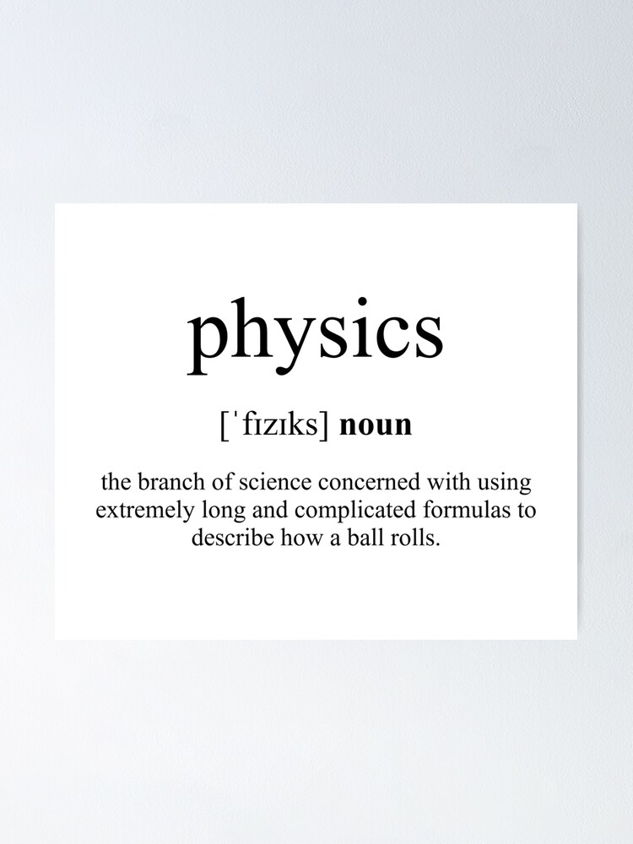
1
The Essence of Physics
Exploring its core definition and scope
Physics examines matter and its fundamental parts, revealing how these elements form the building blocks of the universe through scientific observation.
It investigates the movement and behavior of matter across space and time, showing patterns that govern everyday and cosmic events in a structured way.
Physics links energy and force as key entities that interact with matter, explaining how they drive changes and maintain balances in physical systems.
As a field, physics starts with studying these elements to understand the natural world, providing foundations for further inquiries into complex phenomena.
Photo by Google

Slide 4
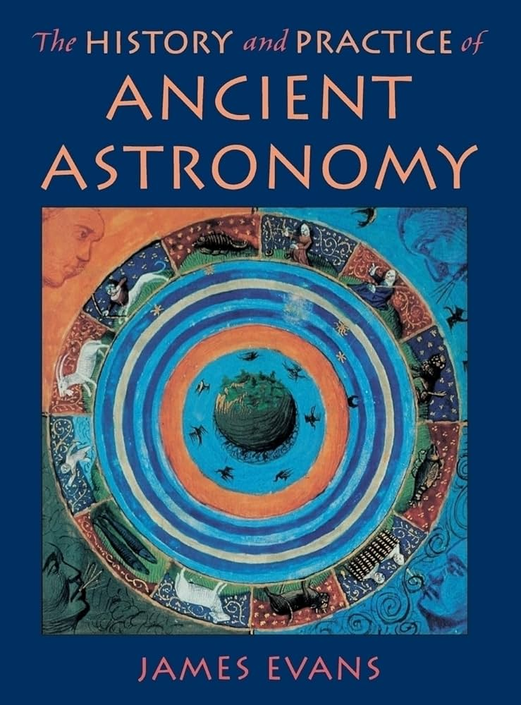
2
Ancient Astronomy Insights
Early observations shaping physics history
Ancient astronomy involved early peoples tracking celestial bodies, leading to basic understandings of motion and patterns that influenced later physics ideas.
These studies recorded star and planet movements, offering initial insights into time and space that set the stage for systematic scientific thought.
Through observations, ancient cultures developed tools and methods that connected earthly events to cosmic cycles, advancing early knowledge bases.
This era's work laid groundwork for physics by linking natural phenomena, encouraging future generations to explore the universe's mechanics more deeply.
Photo by Google

Slide 5
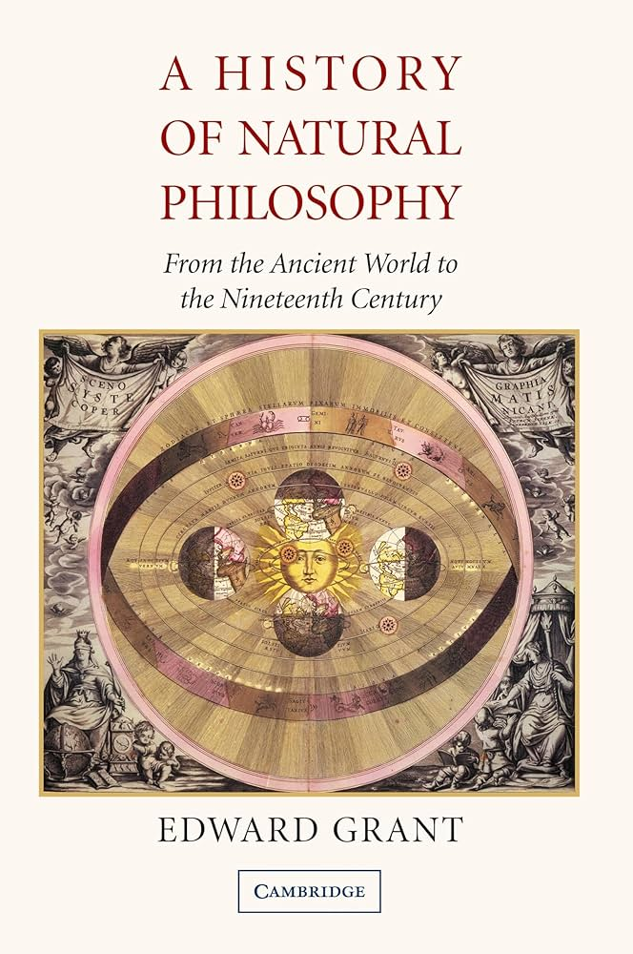
3
Natural Philosophy Roots
Philosophical foundations in physics
Natural philosophy integrated philosophical reasoning with observations of the natural world, forming early theories about matter and change in physics.
It explored fundamental questions on substances and forces, providing a framework that connected human inquiry to physical realities around them.
Philosophers created models explaining natural processes, which served as precursors to modern physics concepts and experimental approaches.
This philosophy evolved into structured science, emphasizing evidence-based ideas that shaped the direction of physics studies over centuries.
Photo by Google

Slide 6
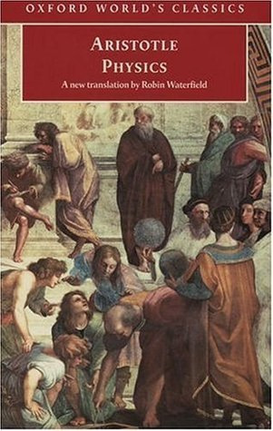
4
Aristotle's Influence
Hellenistic advancements in physics
Aristotle developed ideas on motion and matter, categorizing natural elements and their behaviors, which influenced physics for many generations.
In the Hellenistic period, thinkers built on these ideas with geometry and mechanics, exploring forces and objects in more detailed ways.
These contributions introduced logical methods to study physics, linking observations with reasoned explanations of the physical world.
Aristotle's work and Hellenistic physics provided core concepts that guided scientific thought, paving the way for later breakthroughs in understanding.
Photo by Google

Slide 7
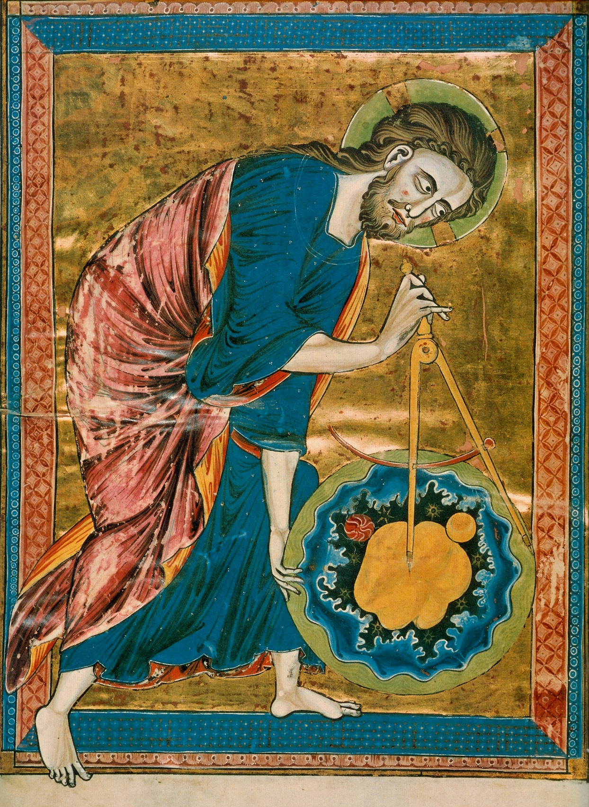
5
Medieval and Islamic Developments
Preserving and expanding physics knowledge
Medieval European and Islamic scholars maintained ancient texts, translating and commenting on physics ideas to keep them alive during transitions.
Islamic thinkers refined optics and mechanics, building on earlier works and introducing mathematical tools that enriched physics understanding.
In Europe, medieval studies revisited these concepts, blending them with emerging ideas that led to renewed interest in natural phenomena.
These efforts connected historical physics knowledge, setting foundations for the Scientific Revolution by fostering critical analysis.
Photo by Google

Slide 8
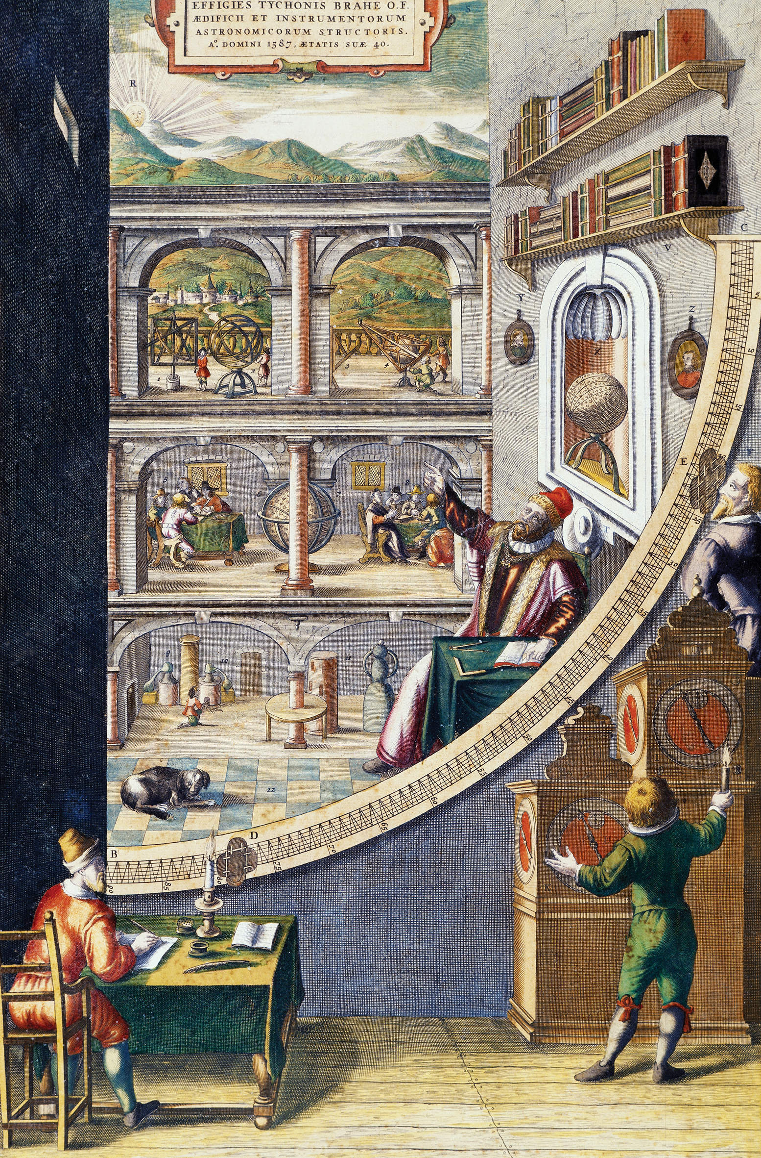
6
The Scientific Revolution
Transformative shifts in physics
The Scientific Revolution featured figures like Newton who formulated laws of motion and gravity, revolutionizing how physics explained the universe.
This period emphasized testing theories through experiments, shifting physics from philosophy to a data-driven science with precise measurements.
Innovations included mechanics and astronomy models that described planetary motions, providing accurate predictions of physical events.
These changes spread ideas worldwide, establishing physics as a cornerstone of modern science and encouraging ongoing exploration.
Photo by Google

Slide 9
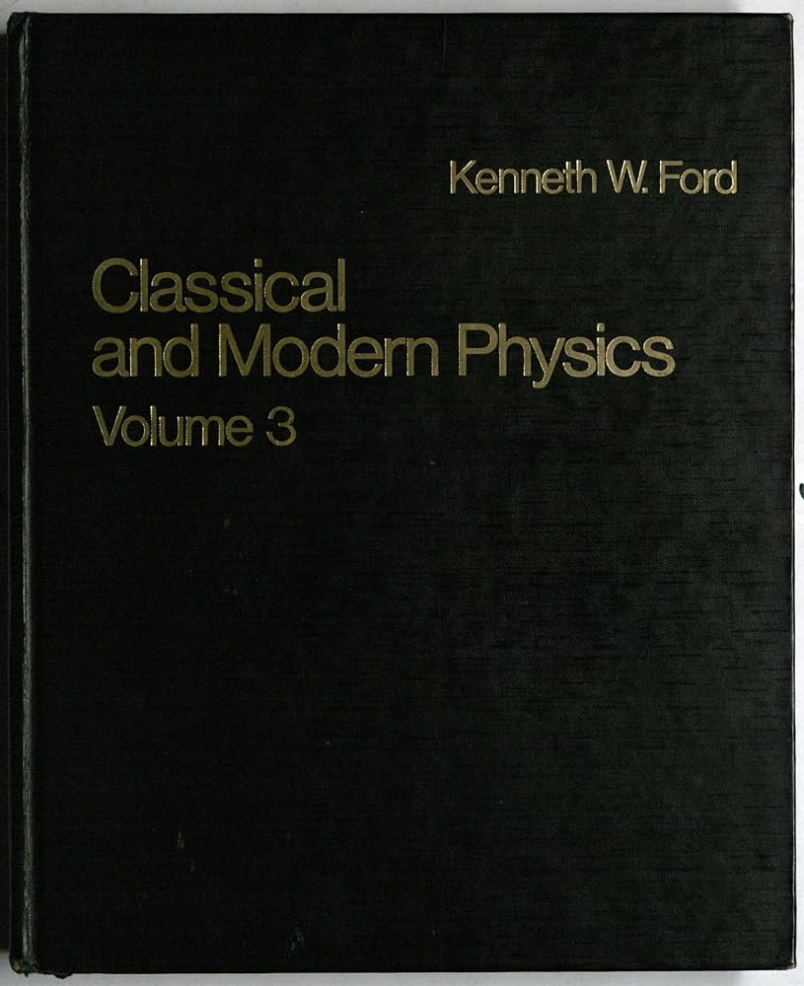
7
Classical vs. Modern Theories
Distinctions in physics approaches
Classical theory covers mechanics and electromagnetism, focusing on observable phenomena at everyday scales with straightforward laws.
Modern physics introduces relativity and quantum mechanics, addressing high speeds and atomic levels that classical theories could not explain.
The distinction lies in scale and complexity, where modern theories extend classical ones to cover extreme conditions in the universe.
Together, these theories provide a comprehensive view of physics, from macroscopic objects to microscopic particles in natural systems.
Photo by Google

Slide 10
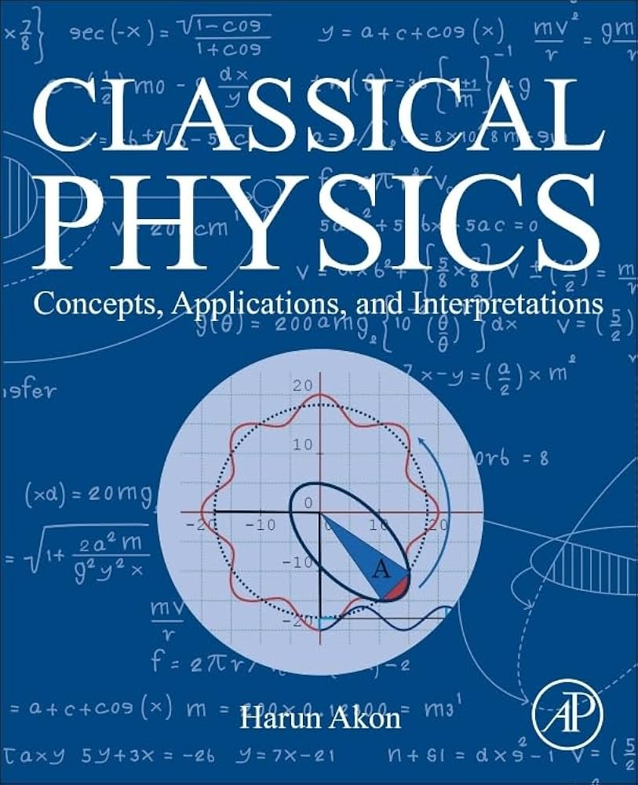
8
Classical Theory in Depth
Foundations of traditional physics
Classical theory details laws of motion and forces, explaining how objects interact and move in predictable ways based on Newton's principles.
It includes concepts of electric and magnetic fields, showing how they influence matter and energy in everyday physical environments.
This area explores heat and energy transfer, demonstrating how systems reach equilibrium through fundamental physical processes.
Classical physics examines light and waves, illustrating their behaviors and applications in various natural and technological contexts.
Photo by Google

Slide 11
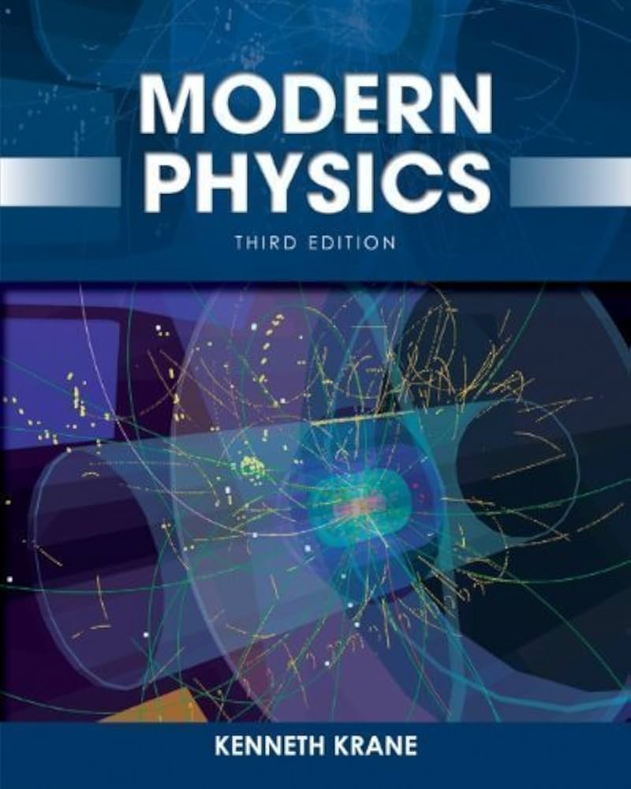
9
Modern Theory Explorations
Advancements in contemporary physics
Modern theory introduces Einstein's relativity, explaining how space, time, and gravity interconnect at high velocities in the universe.
It delves into particle behavior at atomic scales, showing probabilistic wave functions that govern subatomic interactions.
This includes studies of fundamental forces, revealing the structure of matter through advanced models in modern physics frameworks.
Modern theories build on these ideas, integrating them to address complex phenomena like black holes and cosmic expansion.
Photo by Google

Slide 12

10
Thank You for Joining
Reflecting on physics wonders
Thank you for exploring physics together, as it opens doors to understanding the world's core elements and inspires future discoveries.
This journey through physics highlights how its principles shape innovation, encouraging you to delve deeper into its applications.
We appreciate your interest, as physics continues to evolve and connect us to the universe in meaningful ways.
Thank you once more; may this overview spark curiosity and appreciation for the science that explains matter and energy around us.
Photo by Google

