Slide 1
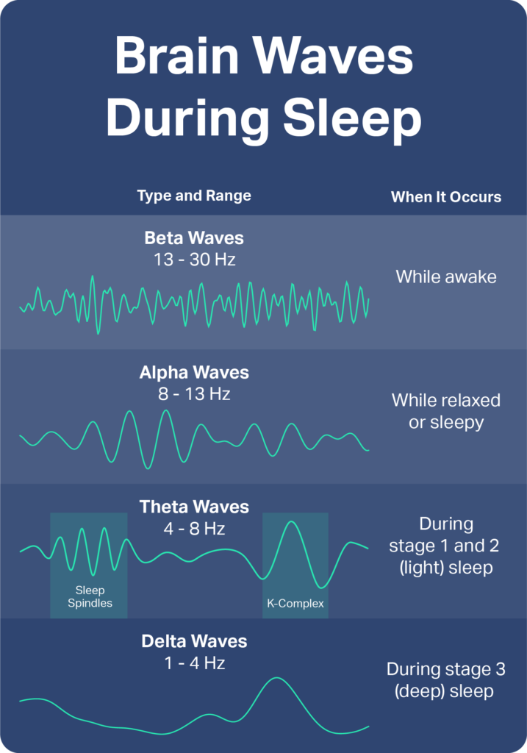
Unlocking the Mystery: The Science of Sleep
Explore how sleep effects the brain and body.
Photo by Google

Slide 2
01
The Sleep Enigma
Table of Contents
02
Brainwaves: The Language of Sleep
03
Sleep Stages: A Nightly Journey
04
The Circadian Rhythm: Your Internal Clock
05
The Impact of Sleep on Memory
06
Sleep and Physical Health
07
Sleep Disorders: When Sleep Goes Wrong
08
Improving Your Sleep Hygiene
09
The Future of Sleep Science
10
Thank You

Slide 3
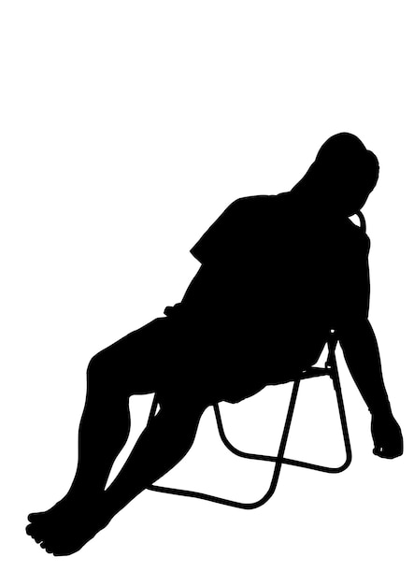
1
The Sleep Enigma
Why do we spend a third of our lives asleep?
Sleep offers an adaptive stillness to avoid danger. Allowing us to conserve energy and promote cellular repair, and cognitive restoration.
During sleep, the body repairs tissues, restores energy. The mind consolidates memories, and releases hormones for growth and development.
It's not just about resting our bodies. It's vital for cognitive function, emotional well-being, and overall health.
Explore how sleep effects the brain and body.
Photo by Google

Slide 4
2
Brainwaves: The Language of Sleep
Decoding the electrical activity during sleep stages.
Characterized by fast, irregular waves. Dominant during active thinking and alertness when we fully awake.
Slower, more rhythmic waves appear as we relax. Indicating a state of calmness and reduced mental activity.
Slowest, highest amplitude waves during deepest sleep. Crucial for physical restoration and hormone release.
Associated with REM sleep and dreaming. Similar to awake brainwaves but with muscle paralysis.
Photo by Google

Slide 5
3
Sleep Stages: A Nightly Journey
Understanding the different phases of sleep and their roles.
A transition phase where you drift in and out of sleep. Breathing slows, and muscles begin to relax, easily awakened.
Body temperature drops and heart rate slows. Brain produces sleep spindles that help with memory consolidation.
The most restorative stage where the body repairs itself. Difficult to awaken, groggy if woken, and strengthen immune.
Brain activity increases, rapid eye movements occur. Dreaming happens, muscles are paralyzed and memories consolidate.
Photo by Google

Slide 6
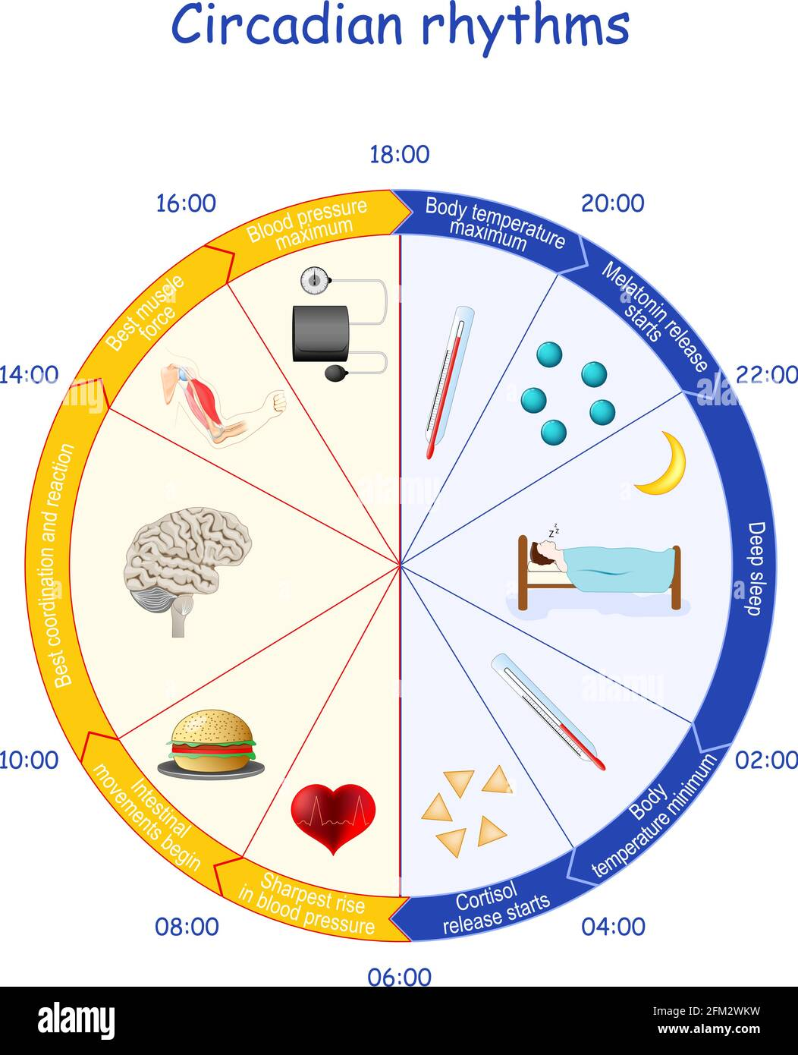
4
The Circadian Rhythm: Your Internal Clock
How light and darkness regulate our sleep-wake cycle.
The master clock in the brain. Located in the hypothalamus, receives light signals from the eyes.
Produced by the pineal gland in response to darkness. Promotes sleepiness and regulates sleep timing.
Exposure to light, especially blue light, suppresses melatonin. Helps to maintain wakefulness during the day.
Shift work, jet lag, and excessive screen time can disrupt the circadian rhythm. Resulting in sleep problems and health issues.
Photo by Google

Slide 7
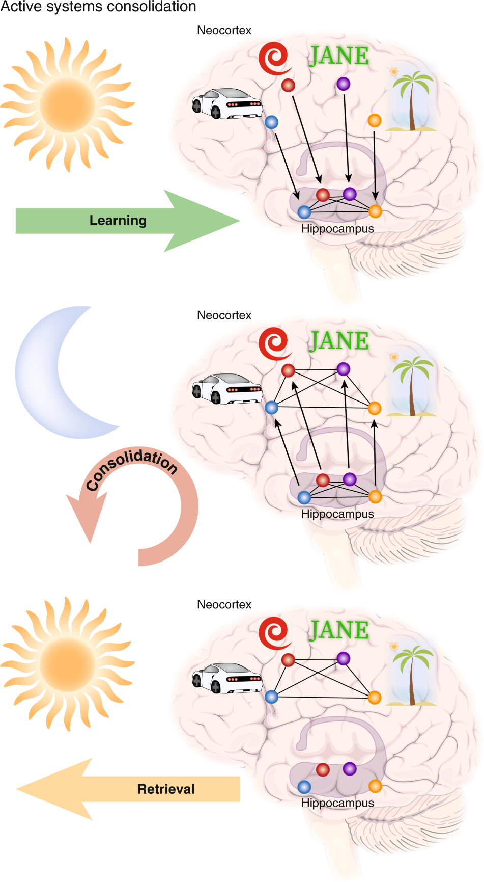
5
The Impact of Sleep on Memory
How sleep consolidates and strengthens memories.
During sleep, the brain replays and strengthens neural connections. Critical for forming long-term memories and learning.
Memories initially stored in the hippocampus are transferred to the cortex. Becoming more stable and integrated over time.
REM sleep plays a crucial role in consolidating procedural memories. Such as learning new skills or movements.
Lack of sleep impairs memory consolidation. Making it difficult to learn and retain new information, focus and attention.
Photo by Google

Slide 8
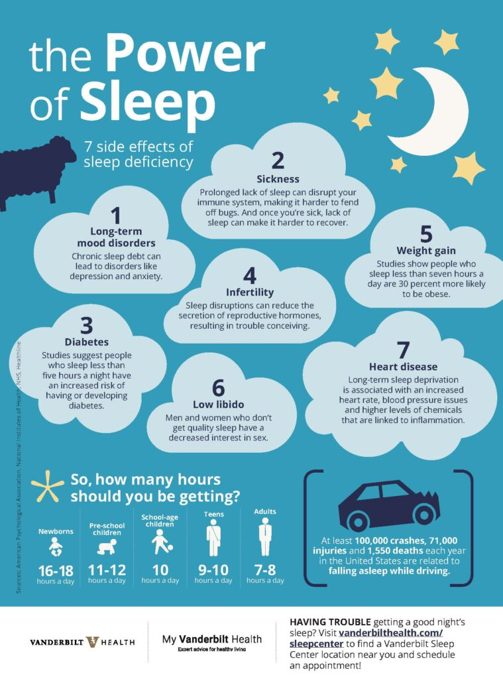
6
Sleep and Physical Health
The far-reaching effects of sleep on the body.
Adequate sleep strengthens the immune system. Improving the body's ability to fight off infections and illnesses.
Sleep regulates hormones involved in growth, appetite, and metabolism. Disruptions can lead to weight gain and other problems.
Chronic sleep deprivation increases the risk of heart disease and stroke. Adequate sleep promotes healthy blood pressure.
Improves reaction time, speed, and endurance. Sleep allows muscles to repair and recover.
Photo by Google

Slide 9
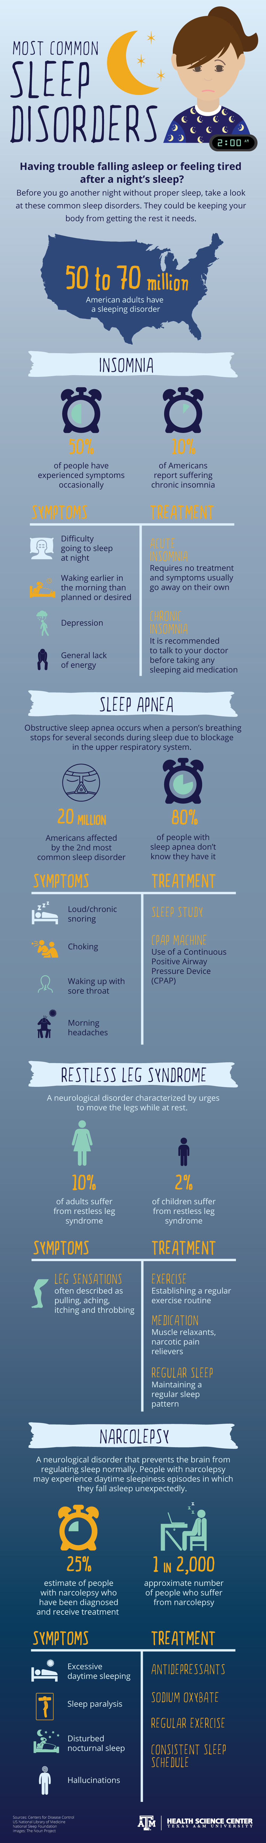
7
Sleep Disorders: When Sleep Goes Wrong
Exploring common sleep disorders and their treatments.
Difficulty falling or staying asleep is prevalent. Contributing factors include stress, anxiety, and poor sleep hygiene.
Breathing repeatedly stops and starts during sleep. Leading to disrupted sleep, can lead to serious health complications.
An irresistible urge to move the legs, especially at night. Disrupting sleep, resulting in fatigue and daytime sleepiness.
Excessive daytime sleepiness and sudden sleep attacks. Often accompanied by cataplexy, sleep paralysis, and hypnagogic hallucinations.
Photo by Google

Slide 10
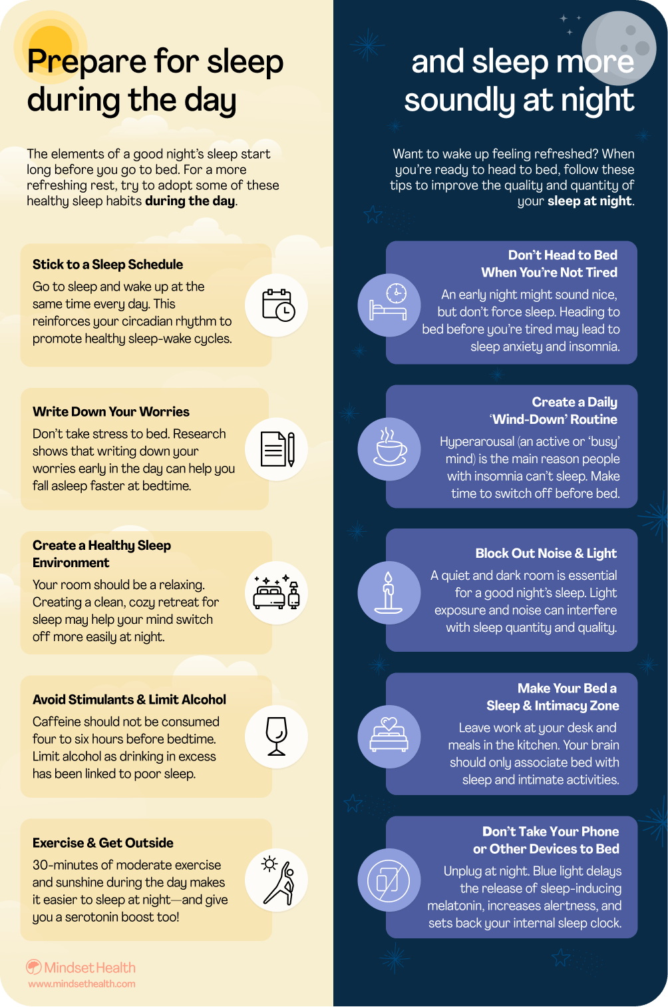
8
Improving Your Sleep Hygiene
Practical tips for a better night's sleep.
Go to bed and wake up at the same time every day. Even on weekends, to regulate your circadian rhythm.
Make sure your bedroom is dark, quiet, and cool. Use blackout curtains, earplugs, or a white noise machine.
Avoid using electronic devices for at least an hour before bed. Blue light can interfere with melatonin production.
Caffeine and alcohol can disrupt sleep. Avoid them close to bedtime, have a light snack instead.
Photo by Google

Slide 11
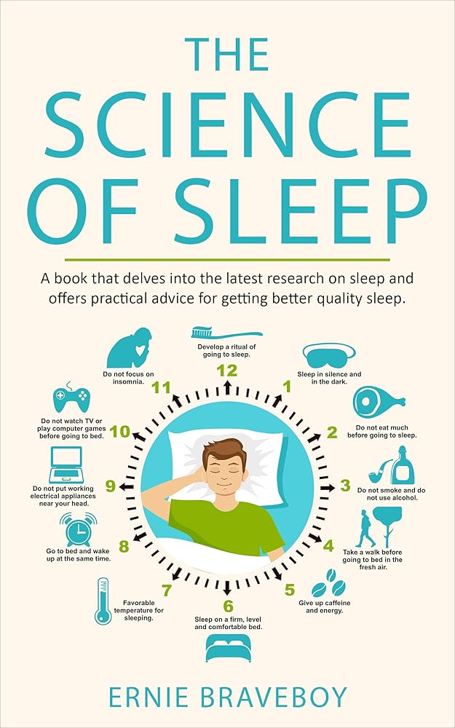
9
The Future of Sleep Science
Emerging research and technologies in sleep medicine.
Tailoring sleep interventions to individual needs. Through genetic testing, sleep monitoring, and data analysis.
Wearable devices that track sleep stages. Providing detailed data for researchers and individuals to improve sleep.
The growing understanding of how the gut microbiome affects sleep. Exploring interventions to promote a healthy sleep-wake cycle.
Transcranial magnetic stimulation to enhance sleep. Showing promise in treating sleep disorders and improving cognitive function.
Photo by Google

Slide 12

10
Thank You
For your attention!
Thank you for attending this presentation on the science of sleep. I hope you found it informative and engaging.
I am now happy to answer any questions you may have about sleep.
I encourage you to continue exploring the fascinating world of sleep and its impact on our lives.
Wishing you all a restful and rejuvenating night's sleep!
Photo by Google

