Slide 1
Unlocking the Secrets of Life: DNA and RNA
A Journey Through Landmark Experiments that Revealed the Nature of Genetic Material
Photo by Google

Slide 2
01
The Genetic Material Mystery
Table of Contents
02
Griffith's Transformation Triumph
03
Avery's Definitive Discovery
04
Hershey-Chase Blender Experiment
05
Frankel-Conrat's Viral Reassembly
06
DNA Structure
07
RNA's Versatile Roles
08
Implications and Impact
09
Key Takeaways
10
Thank You

Slide 3
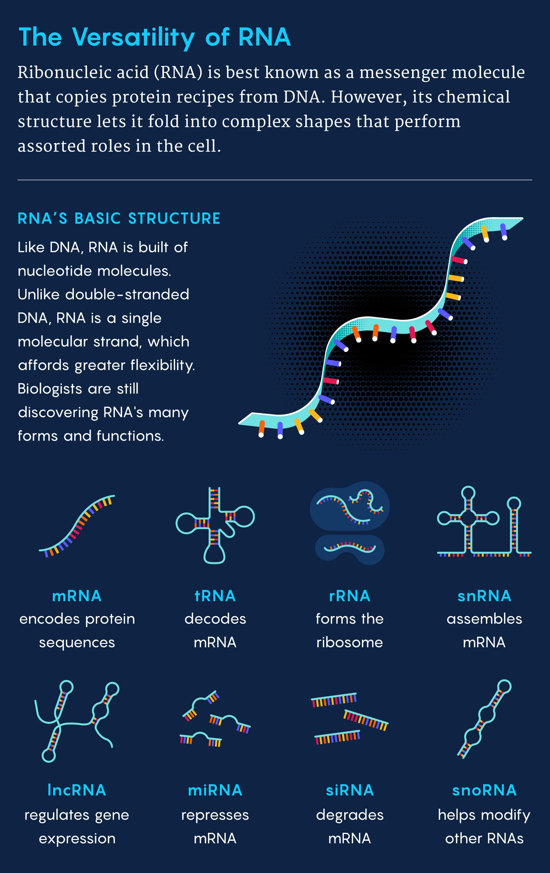
1
The Genetic Material Mystery
Embarking on the quest to identify the blueprint of life.
Early 20th century scientists knew genetic information existed, but its material nature was unknown. Was it protein or nucleic acid?
Scientists embarked on experiments designed to identify the molecule responsible for heredity. The journey was filled with meticulous research.
Researchers used bacteria, viruses, and biochemical techniques to follow the genetic material transfer from one organism to another during replication.
The results from multiple key experiments, taken together, pointed definitively to DNA, not protein, as the genetic material.
Photo by Google

Slide 4
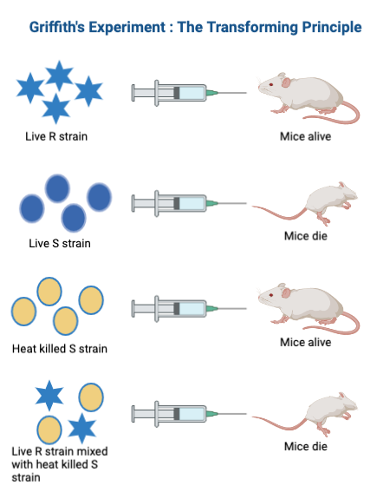
2
Griffith's Transformation Triumph
Unveiling the transformative power in bacteria.
Frederick Griffith's experiments with Streptococcus pneumoniae bacteria showed harmless bacteria could become deadly.
Griffith used two strains: a rough (R) strain and a smooth (S) strain. Only the S strain caused pneumonia in mice.
Heat-killed S strain was harmless. But, mixing it with live R strain resulted in deadly bacteria!
Griffith proposed a 'transforming principle' transferred from the dead S strain to the live R strain, making it virulent.
Photo by Google

Slide 5
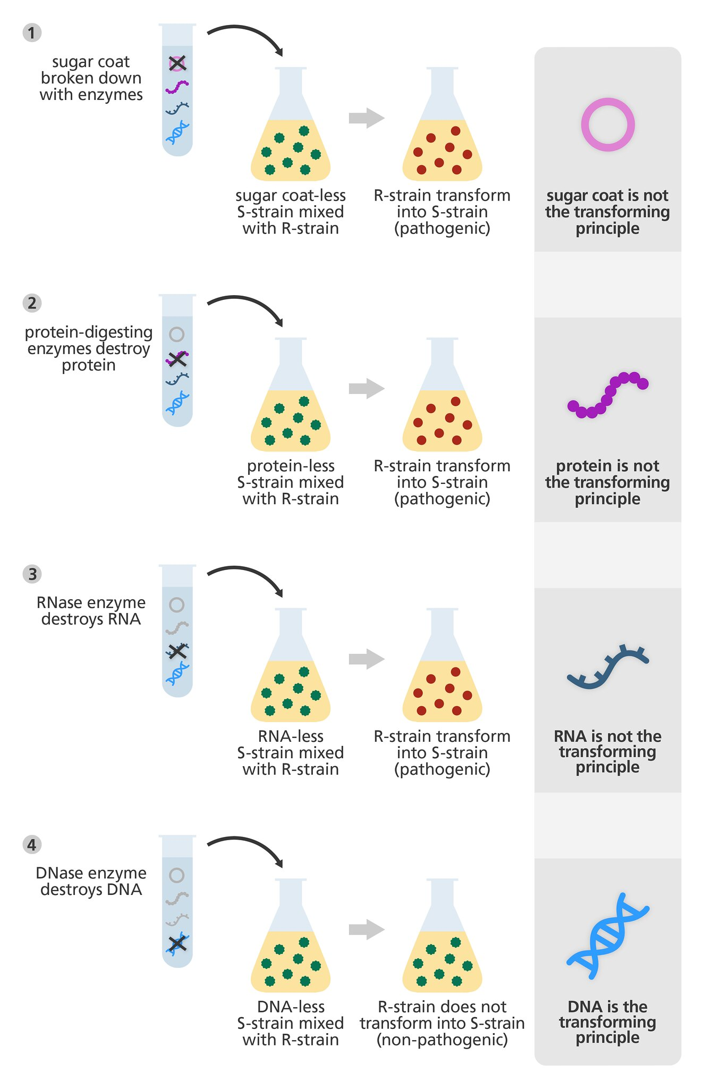
3
Avery's Definitive Discovery
Pinpointing DNA as the transforming principle.
Oswald Avery, Colin MacLeod, and Maclyn McCarty sought to identify Griffith's transforming principle.
They systematically purified various components from the heat-killed S strain, testing each for transforming ability.
DNA was degraded, transformation no longer occurred. RNA or protein degradation didn't inhibit the transformation.
Their results strongly indicated that DNA, not protein or RNA, was the molecule responsible for transformation.
Photo by Google

Slide 6
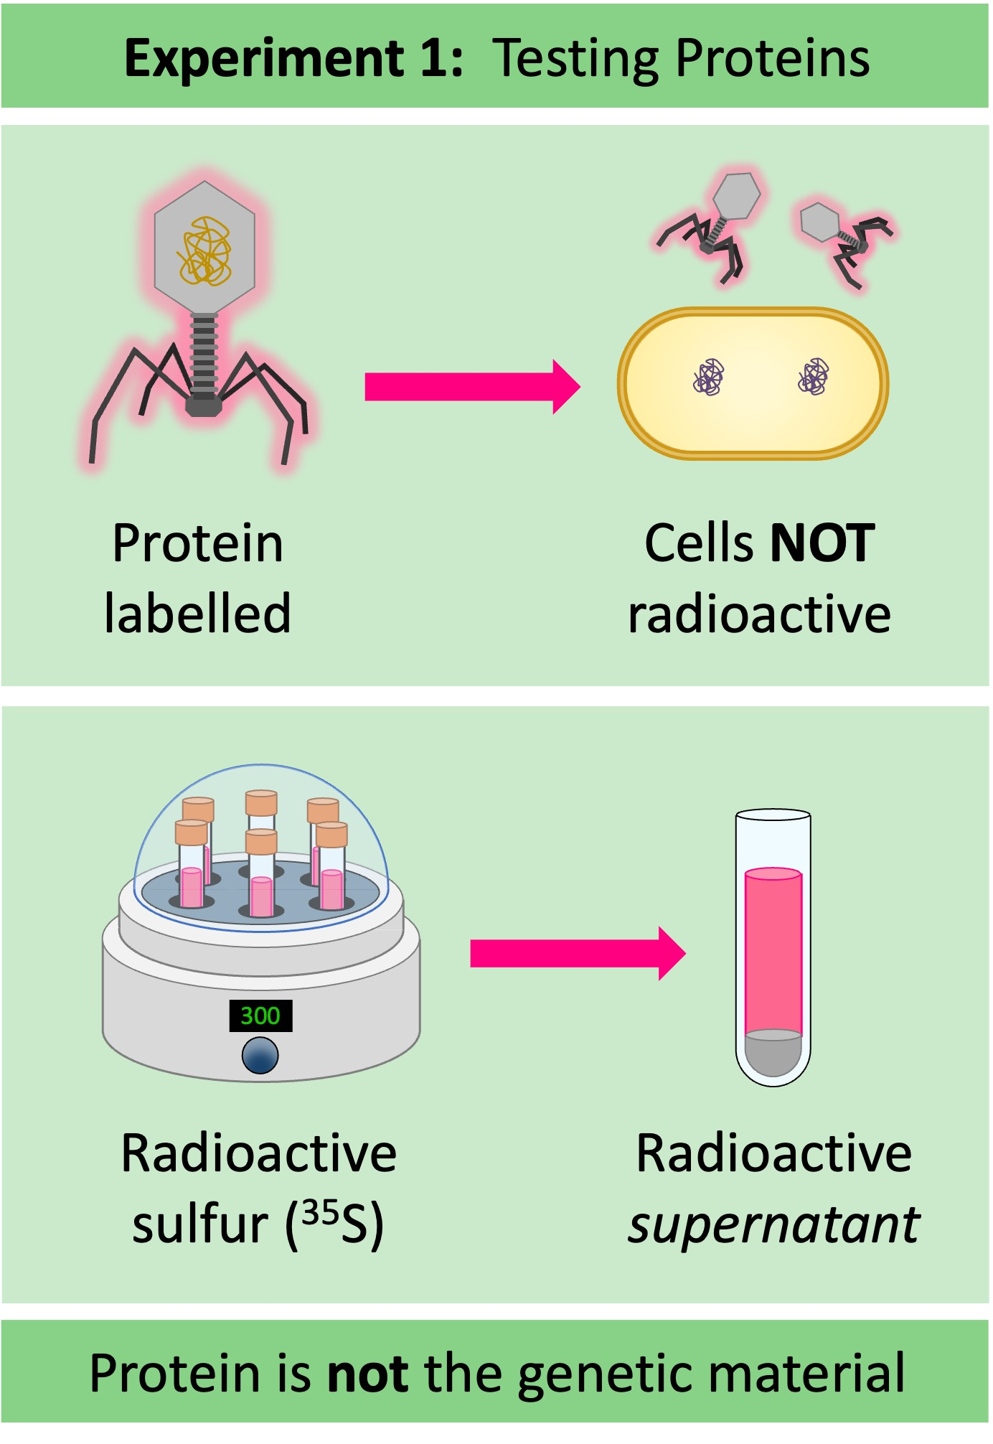
4
Hershey-Chase Blender Experiment
Using viruses to solidify DNA's role.
Alfred Hershey and Martha Chase used bacteriophages (viruses that infect bacteria) to investigate the genetic material.
They radioactively labeled phage DNA with phosphorus-32 and phage protein with sulfur-35.
Phages infected bacteria. A blender was used to detach phage particles from the bacterial cells.
Radioactive phosphorus-32 (DNA) was found inside the bacteria, while sulfur-35 (protein) remained outside, showing DNA carries genetic information.
Photo by Google

Slide 7
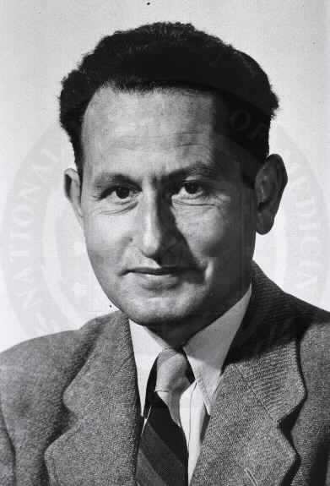
5
Frankel-Conrat's Viral Reassembly
Reconstructing viruses to prove RNA's genetic capabilities.
Heinz Fraenkel-Conrat and Robley Williams studied Tobacco Mosaic Virus (TMV), which contains RNA as its genetic material.
They separated TMV into its RNA and protein components.
The virus was reconstituted using RNA from one strain and protein from another. The resulting virus was infectious.
The new viruses characteristics always matched the RNA's original strain, showing RNA carries genetic information in TMV.
Photo by Google

Slide 8
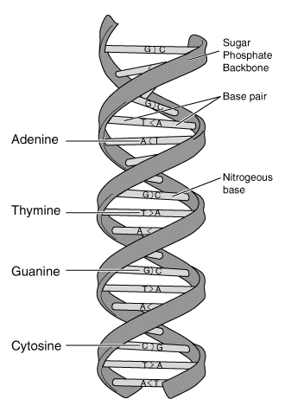
6
DNA Structure
Delving into the double helix.
James Watson and Francis Crick deduced the double helix structure of DNA in 1953 based on X-ray diffraction data.
DNA consists of two strands twisted around each other, forming a double helix.
Adenine (A) pairs with Thymine (T), and Guanine (G) pairs with Cytosine (C), held together by hydrogen bonds.
The sequence of these bases encodes genetic information, passed from one generation to the next.
Photo by Google

Slide 9
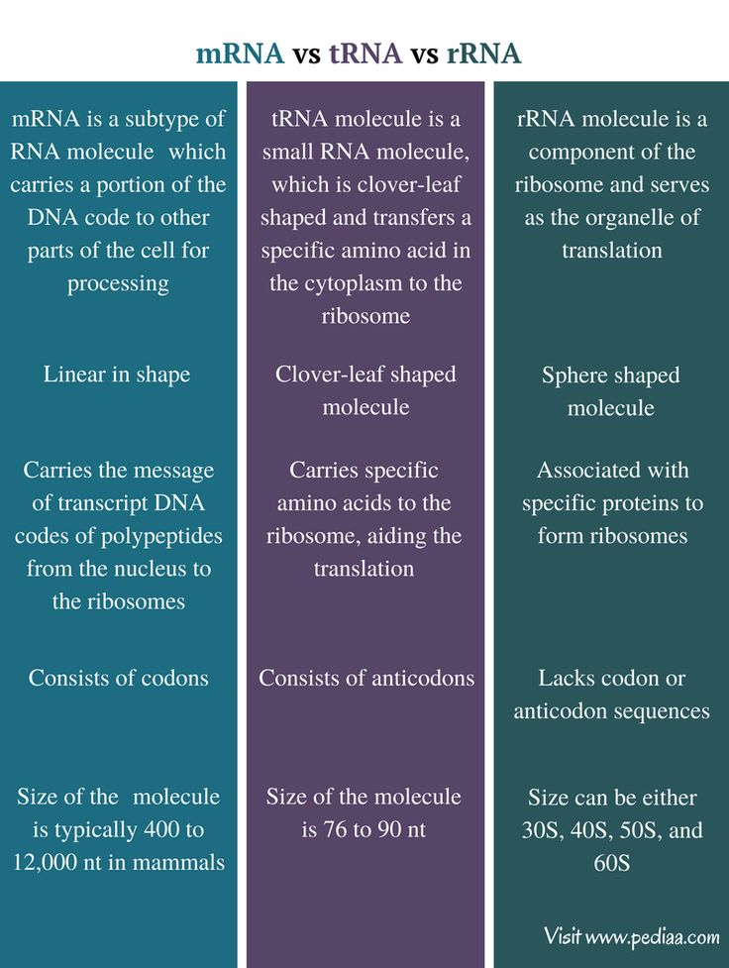
7
RNA's Versatile Roles
Exploring RNA's diverse functions beyond genetics.
RNA is typically single-stranded and contains ribose sugar instead of deoxyribose.
RNA uses uracil (U) instead of thymine (T) to pair with adenine.
mRNA carries genetic information from DNA to ribosomes for protein synthesis.
tRNA helps translate mRNA into amino acids, and rRNA forms part of the ribosome structure.
Photo by Google

Slide 10
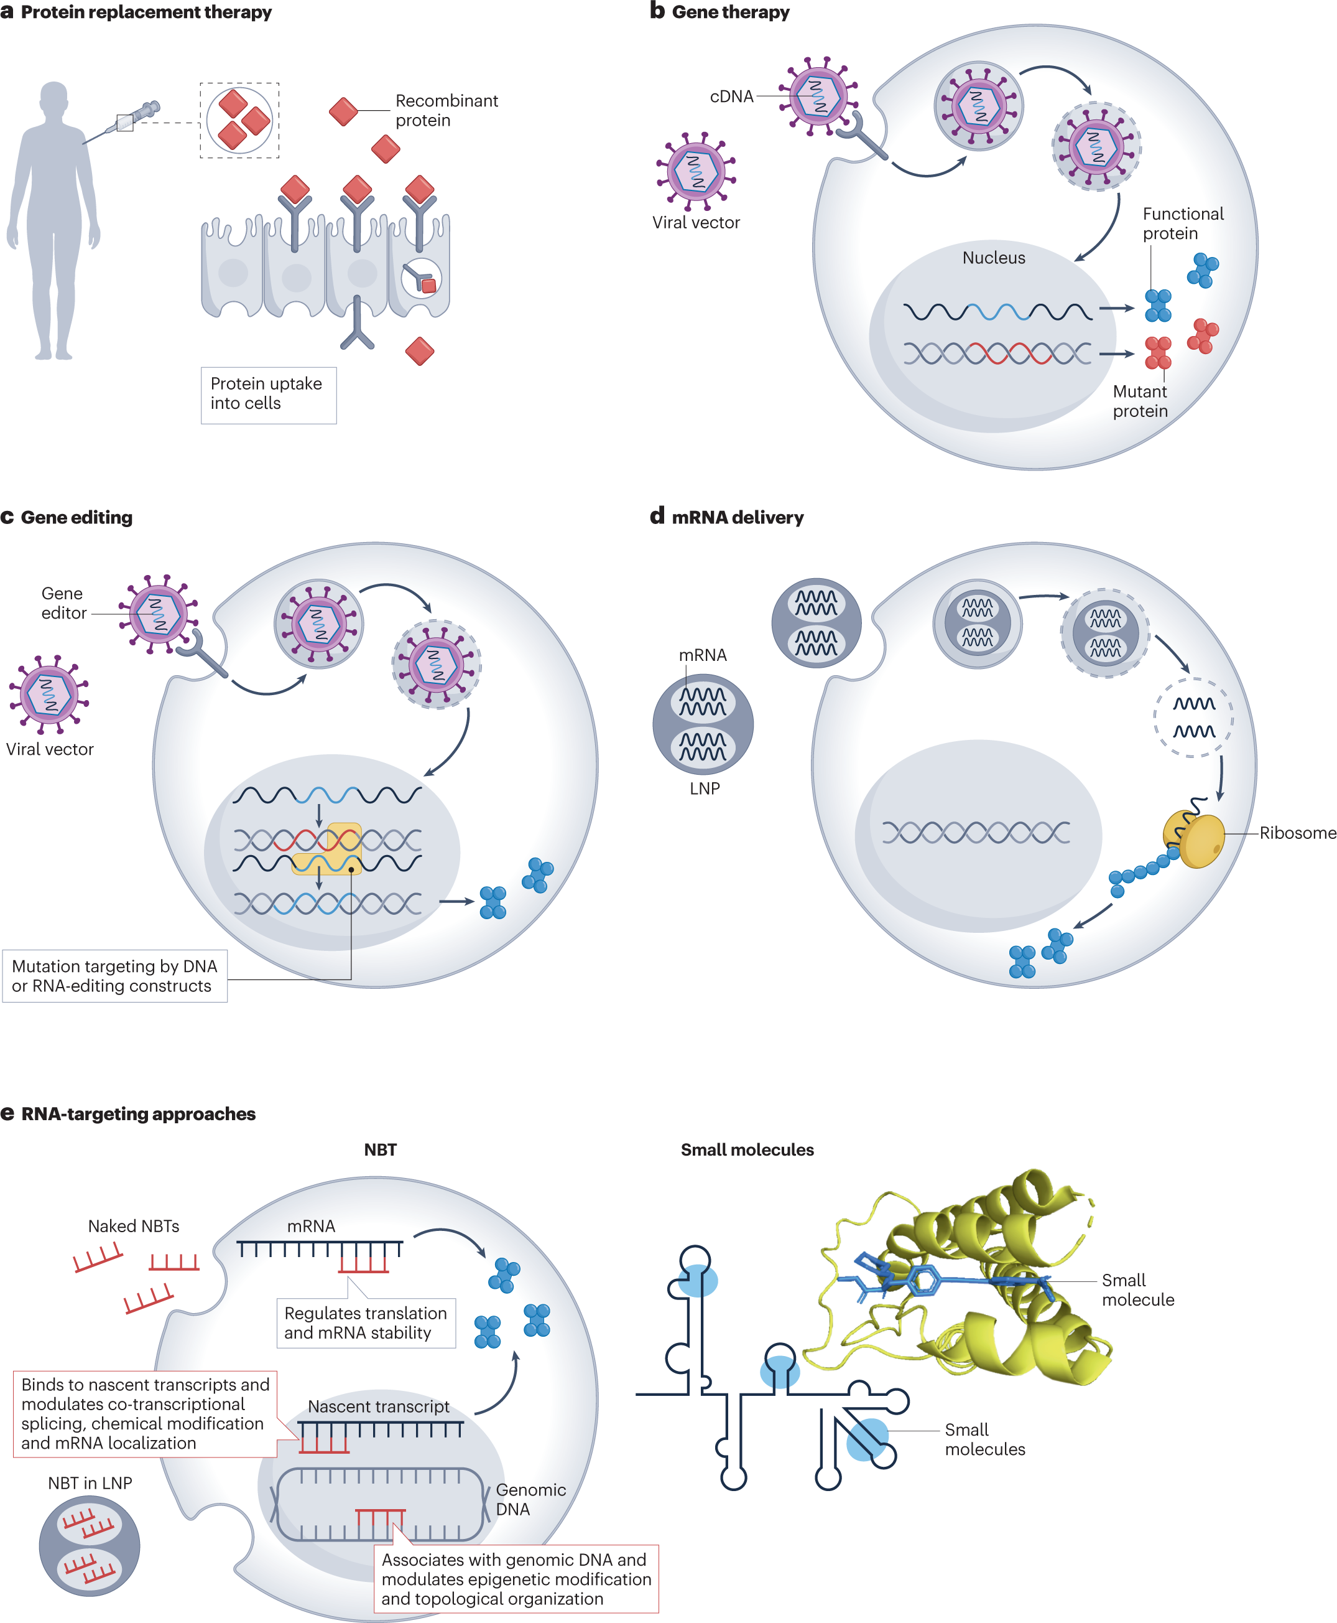
8
Implications and Impact
The far-reaching consequences of understanding genetic material.
The discovery of DNA and RNA as genetic material revolutionized biology and medicine.
Opened doors to genetic engineering, allowing us to manipulate and modify genes.
Advances in personalized medicine, tailoring treatments based on an individual's genetic makeup, became feasible.
Understanding genetic material has transformed our understanding of disease, evolution, and life itself.
Photo by Google

Slide 11
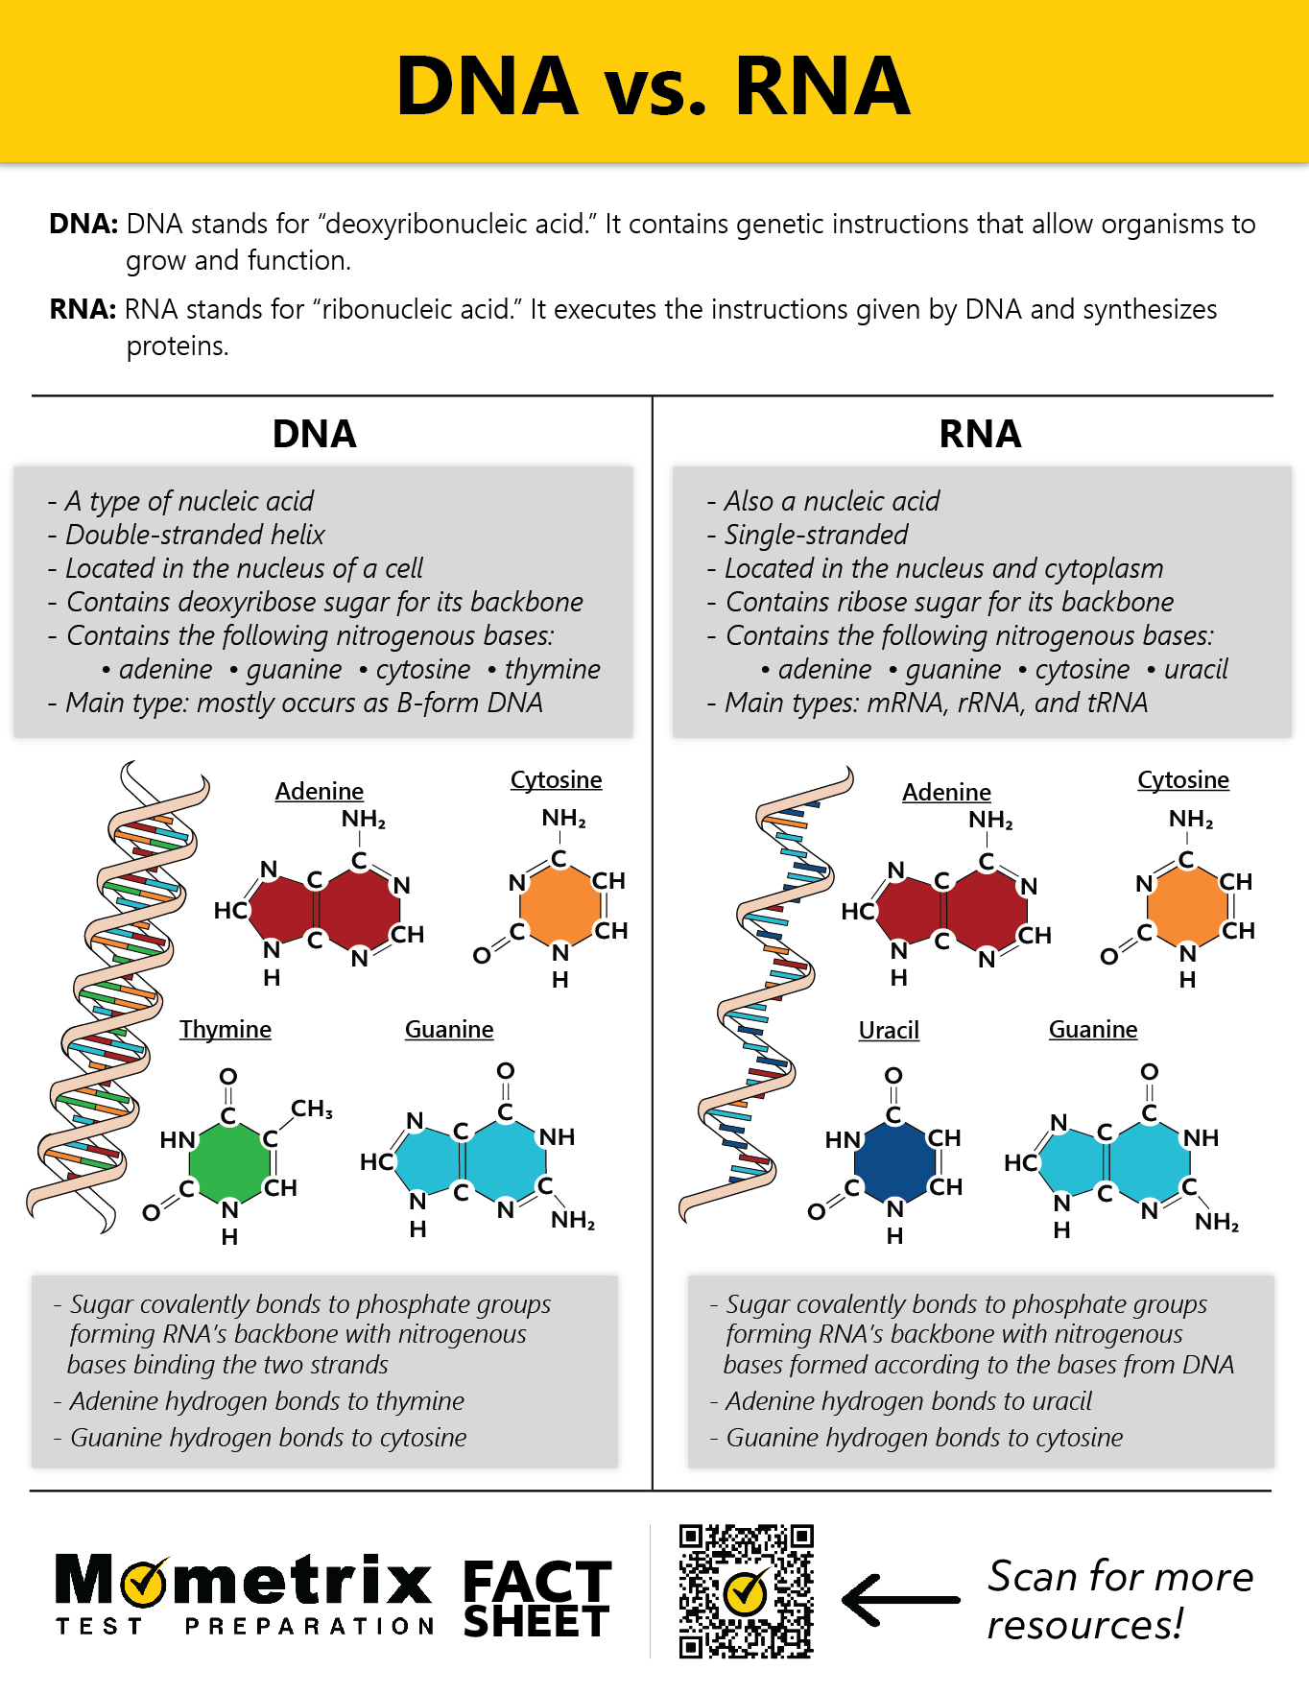
9
Key Takeaways
Summarizing the pivotal discoveries.
Showed that a 'transforming principle' could change the genetic makeup of bacteria.
Identified DNA as the transforming principle, proving that DNA is the genetic material.
Provided further evidence that DNA, not protein, carries genetic information in bacteriophages.
Concluded that, in some cases, RNA can also function as the genetic material.
Photo by Google

Slide 12

10
Thank You
Acknowledgment and Appreciation
Thank you for your time and attention!
Hope this presentation inspired you to explore the amazing world of molecular biology and genetics.
Continue your learning journey and explore more topics.
Feel free to reach out if you have any questions.
Photo by Google

