Slide 1
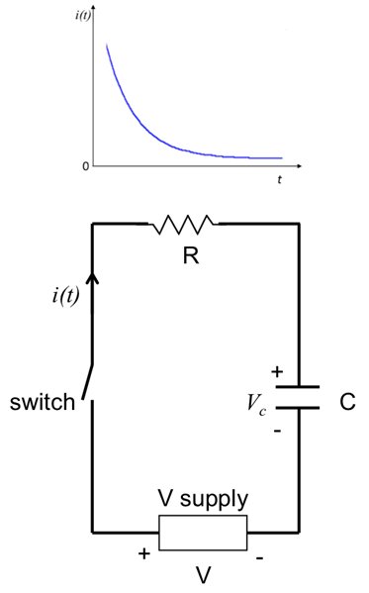
Unlocking the Secrets of RC Circuits
Mastering Charging, Discharging, and the Time Constant
Photo by Google

Slide 2
01
Charging Up: Battery Connection
Table of Contents
02
Power Down: Battery Disconnection
03
Decoding the Time Constant (τ)
04
Experiment Time: See It in Action
05
Wrapping Up: RC Circuit Mastery

Slide 3
1
Charging Up: Battery Connection
The Capacitor's Energy Boost
When the battery connects, the RC circuit springs to life, ready to start the charging process. Energy begins its journey.
The capacitor gradually stores charge, like filling a tiny energy reservoir. It builds up a storage over time.
Current courses through the resistor and into the capacitor, fueling its charging process. It happens slowly and gradually.
Once the capacitor reaches its capacity, charging halts, and current flow ceases. It is now fully charged up and energy is stored.
Photo by Google

Slide 4
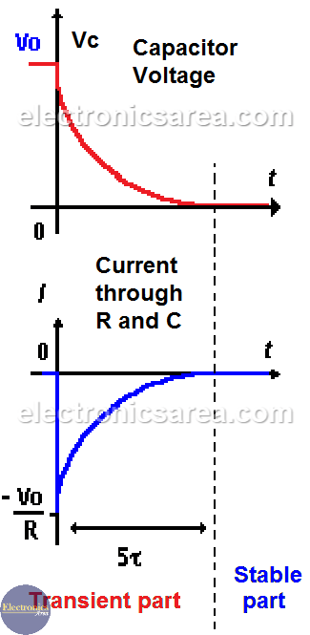
2
Power Down: Battery Disconnection
Releasing Stored Energy
The circuit transitions to discharging mode. The stored energy is unleashed, ready to power the way.
The capacitor releases its stored energy, reversing the current flow. It happens not instantly but slowly, and gradually.
Energy flows back through the resistor as the capacitor discharges, creating a controlled release. It is a gradual discharge.
Eventually, the capacitor completely discharges, returning to a state of zero stored energy. It becomes completely empty.
Photo by Google

Slide 5
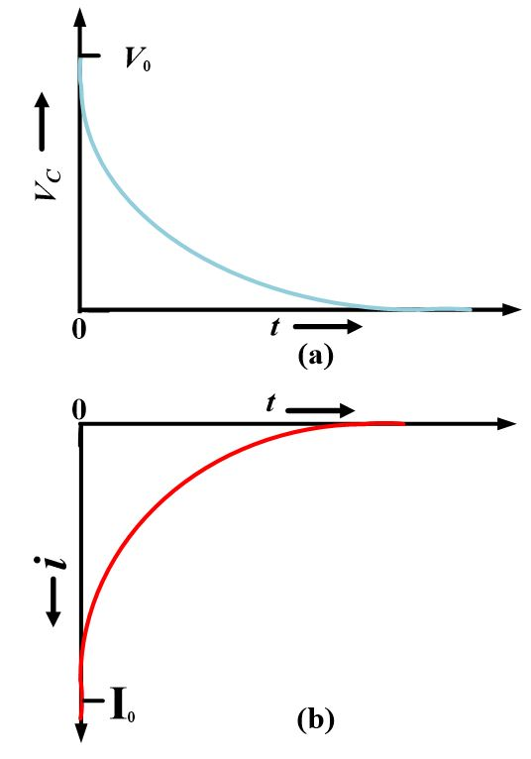
3
Decoding the Time Constant (τ)
The Rhythm of Charge and Discharge
The time constant dictates the charging or discharging speed, defining the circuit's temporal behavior. It is like the pace of charging.
The time constant is influenced by the resistor (R) and capacitor (C). Time constant() tells us how fast charging or discharging happens.
We acknowledge the formula but focus on understanding its impact without memorization. Focus more on understanding, not memorizing.
In one time constant, the capacitor charges to 63%. After five, it's almost fully charged. This provides clear visualization.
Photo by Google

Slide 6
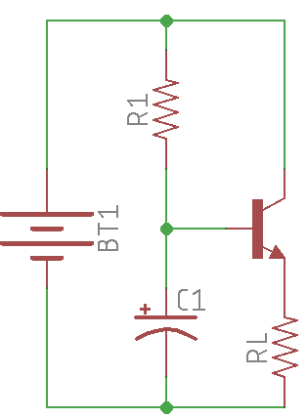
4
Experiment Time: See It in Action
LED Observations
We use a battery, resistor, capacitor, and an LED to visualize charging and discharging. It is an easy setup for understanding.
As the capacitor charges, the LED gradually brightens. Connect the battery and watch the LED light up slowly and gradually.
When the battery is removed, the LED slowly dims as the capacitor discharges. See the changes that happen slowly.
This demonstrates energy storage and release, highlighting the timing control in circuits. It shows how energy is stored and released.
Photo by Google

Slide 7
5
Wrapping Up: RC Circuit Mastery
Key Takeaways
RC circuits are fundamental for controlling timing. These are simple, yet these circuits can be very useful and powerful.
They're essential for controlling timing in various electronic applications. They help control timing in electronics.
Charging and discharging in RC circuits occur gradually, not instantaneously. And the discharge happens gradually, not instantly.
The time constant helps in understanding the speed of the charge/discharge process. It helps us understand the speed of this process.
Photo by Google

