Slide 1
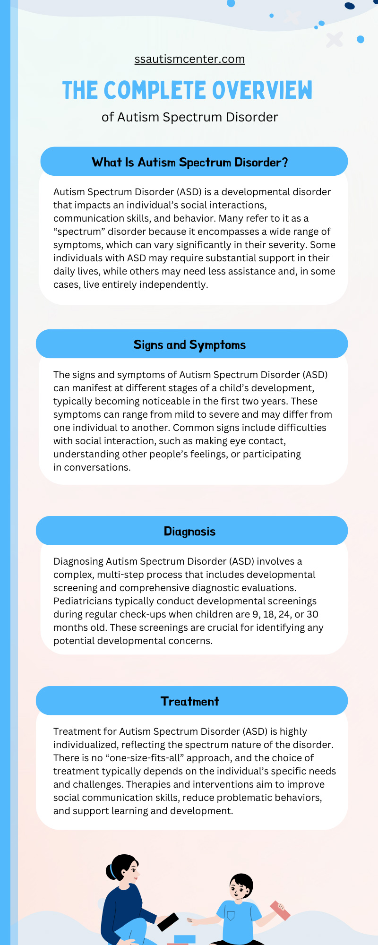
Unlocking the World of Autism Spectrum Disorder
Exploring Definitions, Causes, and Evaluations for a Deeper Understanding
Photo by Google

Slide 2
01
Discovering Autism Basics
Table of Contents
02
Evolution of Diagnosis
03
Global Prevalence Insights
04
Genetic Influences
05
Environmental Factors
06
Screening and Evaluation
07
Co-occurring Conditions
08
Interventions and Therapies
09
Future Research Directions
10
Thank You for Joining
11
Introduction to Autism Spectrum Disorder
12
Genetic Factors and ASD

Slide 3
13
Behavioral Patterns in ASD
Table of Contents
14
Therapeutic Approaches for ASD
15
Educational Support for Individuals with ASD
16
Family Impact and Support Systems
17
Neurodiversity and Inclusion
18
Research Innovations in ASD
19
Global Perspectives on ASD

Slide 4
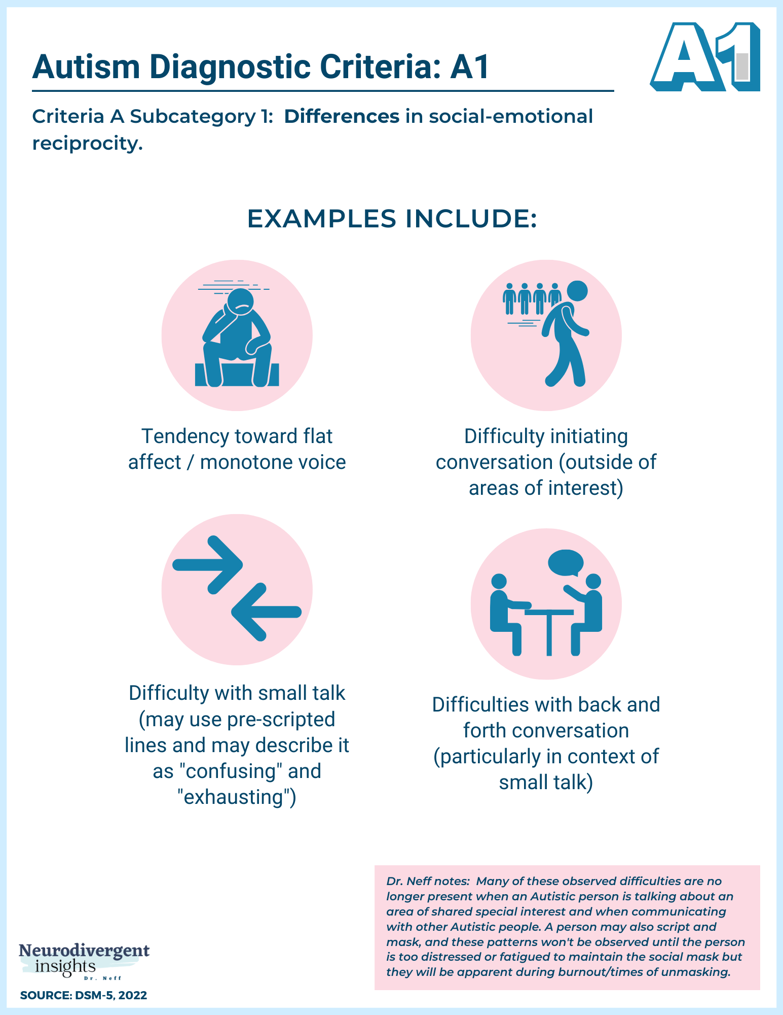
1
Discovering Autism Basics
An Introduction to the Spectrum
Autism spectrum disorder involves deficits in social communication and repetitive behaviors, affecting individuals differently based on support needs as described in clinical definitions.
Autism manifests uniquely in each person, from nonspeaking individuals to those with strong language skills, highlighting wide support requirements in daily life.
Psychiatry views autism as a mental disorder, but the autism rights movement sees it as part of neurodiversity, advocating for accommodations over cures in society.
There is no cure for autism, with interventions like applied behavior analysis helping skills, though some criticize it as unethical and unhelpful for certain individuals.
Photo by Google

Slide 5
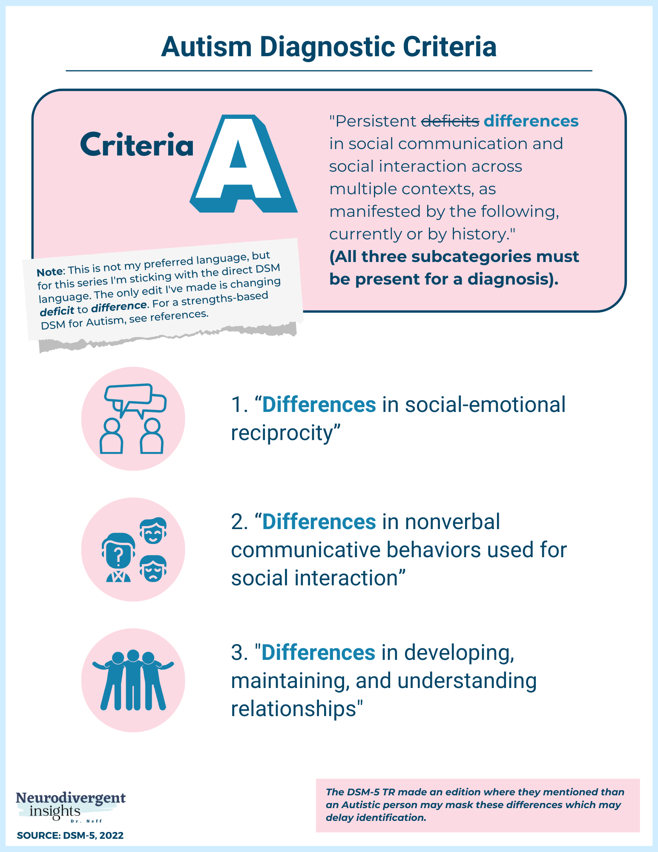
2
Evolution of Diagnosis
From DSM-IV to DSM-5 Changes
DSM-5 combines previous pervasive developmental disorders into one autism spectrum diagnosis, requiring deficits in social communication and repetitive behaviors for identification.
The new criteria focus on a dyad of symptoms, aiming for earlier diagnosis while potentially reducing prevalence estimates compared to DSM-IV standards.
Many with prior Asperger's or PDD-NOS diagnoses may not meet DSM-5 criteria, leading to concerns about missed cases, especially in older children and adults.
DSM-5 introduces social communication disorder for those with social deficits but without repetitive behaviors, addressing a subset of previous diagnoses.
Photo by Google

Slide 6
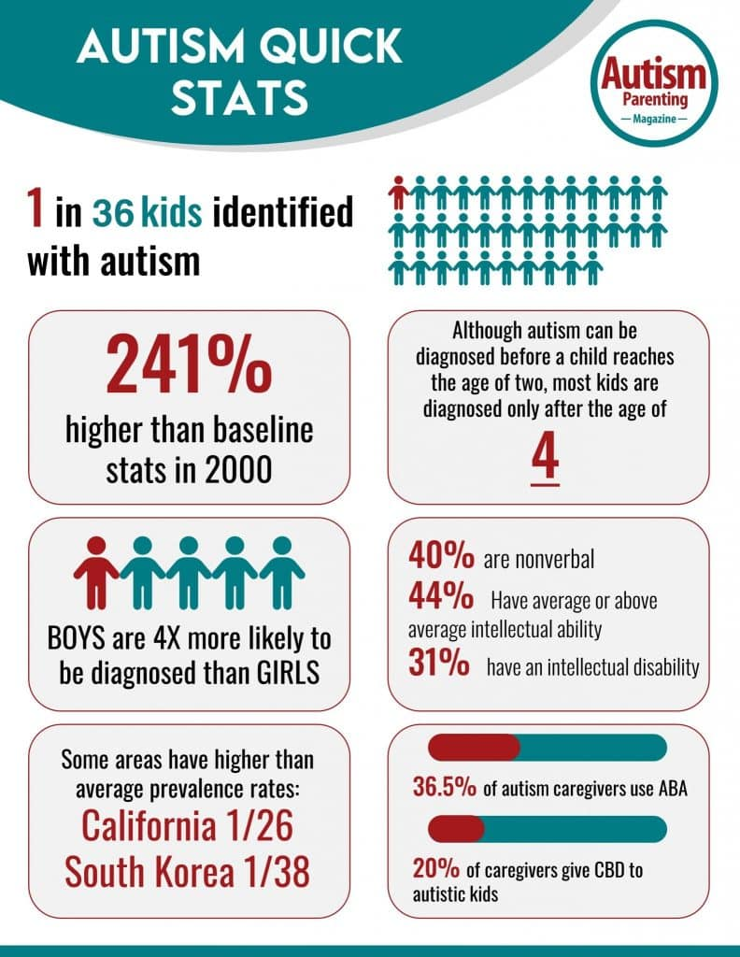
3
Global Prevalence Insights
Understanding ASD Rates Worldwide
The World Health Organization reports an international prevalence of about 0.76 percent, while the US Centers for Disease Control estimates around 1.68 percent in children aged eight.
US prevalence has more than doubled from 2000 to 2012 due to better awareness, insurance mandates, and diagnostic changes, though it appears to stabilize recently.
Autism occurs across all groups but is diagnosed more in Caucasian children than in black or Hispanic ones, with males affected more than females at a ratio near three to one.
Increased parental age, prematurity, and certain genetic conditions like fragile X correlate with higher ASD risk, influencing overall prevalence figures.
Photo by Google

Slide 7
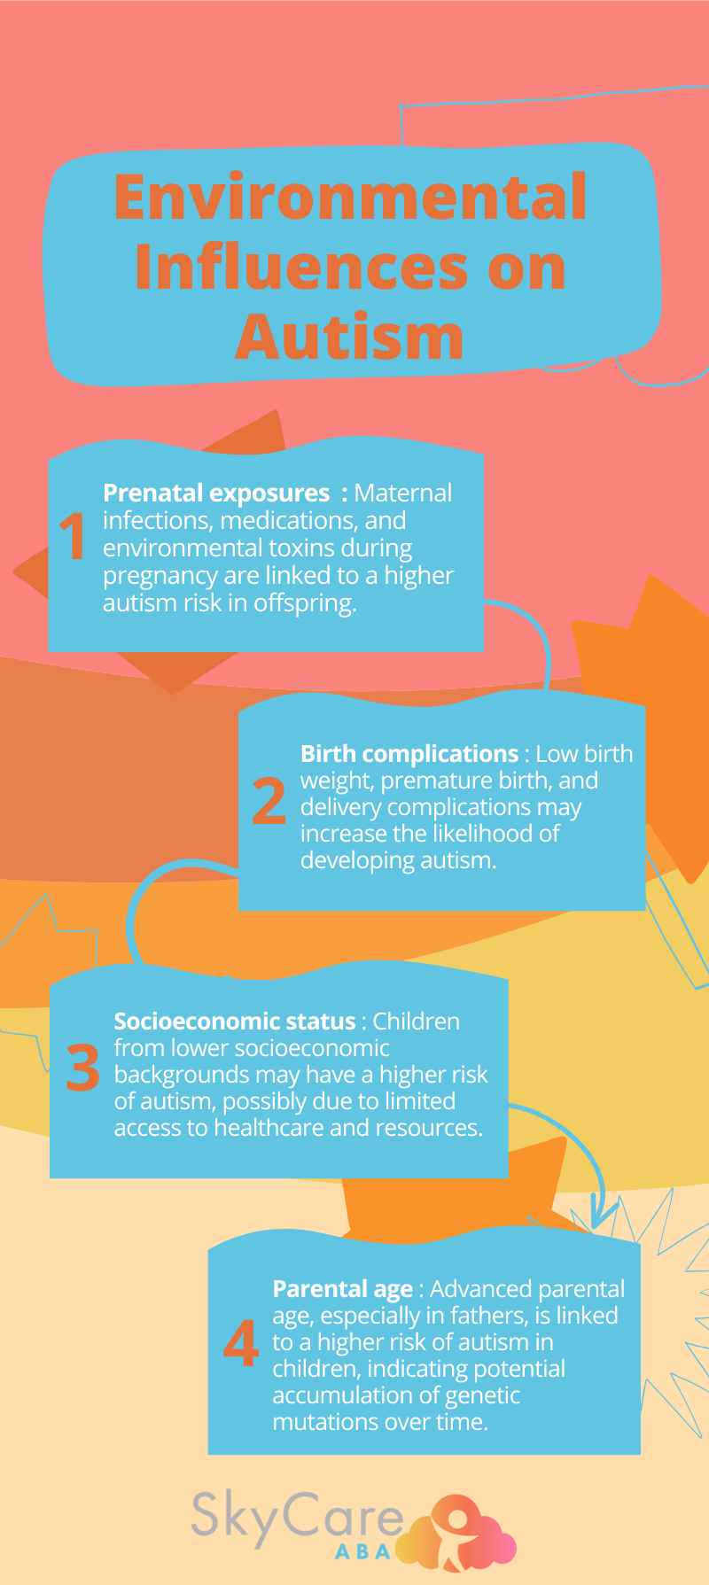
4
Genetic Influences
The Role of Heredity in ASD
Genetic factors significantly influence ASD, with siblings of affected individuals at higher risk and monozygotic twins showing greater concordance rates than population norms.
Over 700 genes are linked to ASD, involving brain development, neurotransmission, and neuronal excitability, revealing complex genetic heterogeneity in the disorder.
Disorders like fragile X and Down syndrome have higher ASD co-occurrence, with chromosomal sites such as X and 15 linked to increased risk through microarray studies.
Genetics alone do not determine ASD, as environmental factors modulate genetic risks, leading to diverse phenotypic outcomes in affected individuals.
Photo by Google

Slide 8
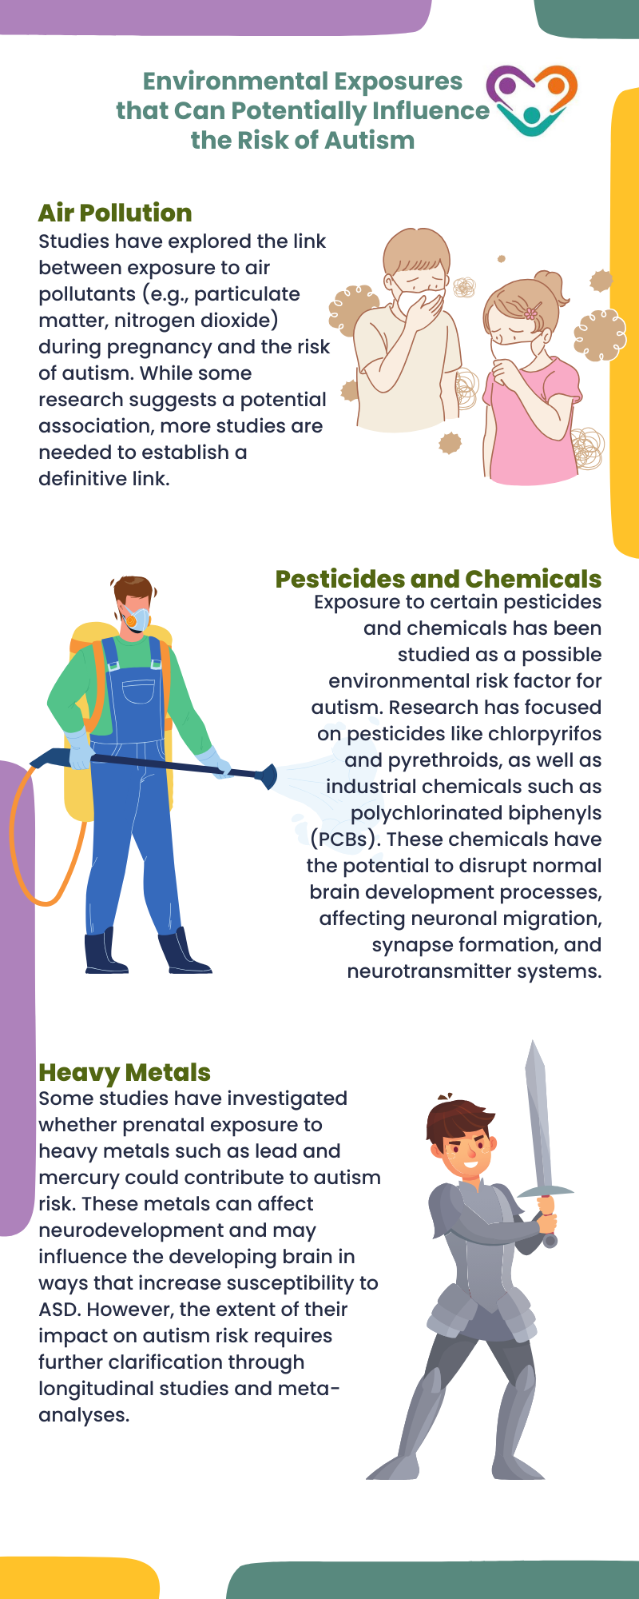
5
Environmental Factors
Beyond Genetics in ASD Development
Factors like advanced parental age, maternal infections, and certain medications increase ASD risk, while prenatal folic acid may reduce it in specific cases.
Prematurity, low birthweight, and complications like uterine bleeding correlate with higher ASD chances, highlighting the impact of perinatal conditions.
Maternal autoimmune diseases and inter-pregnancy intervals play roles, though research shows no link between vaccines and ASD despite past misconceptions.
Environmental factors affect the developing brain, leading to differences in cerebellar and cortical structures that contribute to ASD characteristics.
Photo by Google

Slide 9
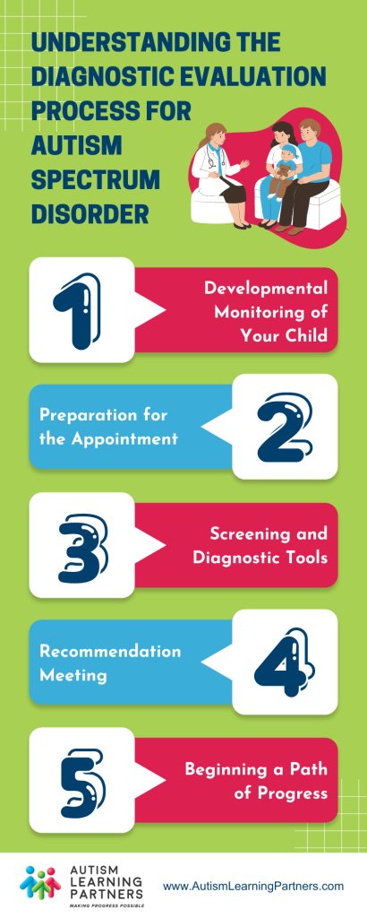
6
Screening and Evaluation
Early Detection Methods
Pediatric guidelines recommend surveillance at well-child visits and specific ASD screening at 18 and 24 months using tools like M-CHAT-R/F to spot early signs.
Signs include poor eye contact, lack of gesturing, and social skill delays; early intervention referrals follow if concerns arise in young children.
A full evaluation involves physical exams, parent interviews, and specialist observations to confirm ASD and assess cognitive and adaptive functioning.
ASD often accompanies conditions like intellectual disability, epilepsy, and gastrointestinal disorders, requiring additional screening during evaluations.
Photo by Google

Slide 10
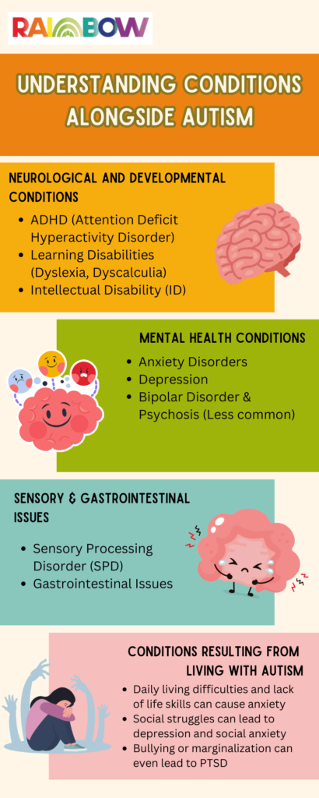
7
Co-occurring Conditions
Common ASD Companions
Many with ASD have additional diagnoses like intellectual disability, affecting up to 31 percent, alongside psychiatric issues such as anxiety and ADHD.
Gastrointestinal disorders, sleep problems, and seizures frequently occur, with obesity rates higher in ASD populations due to dietary and behavioral factors.
Anxiety, mood disorders, and disruptive behaviors are common, impacting daily functioning and requiring integrated management strategies.
Routine genetic tests like chromosomal microarray help identify underlying causes and guide family planning for those with ASD and related conditions.
Photo by Google

Slide 11
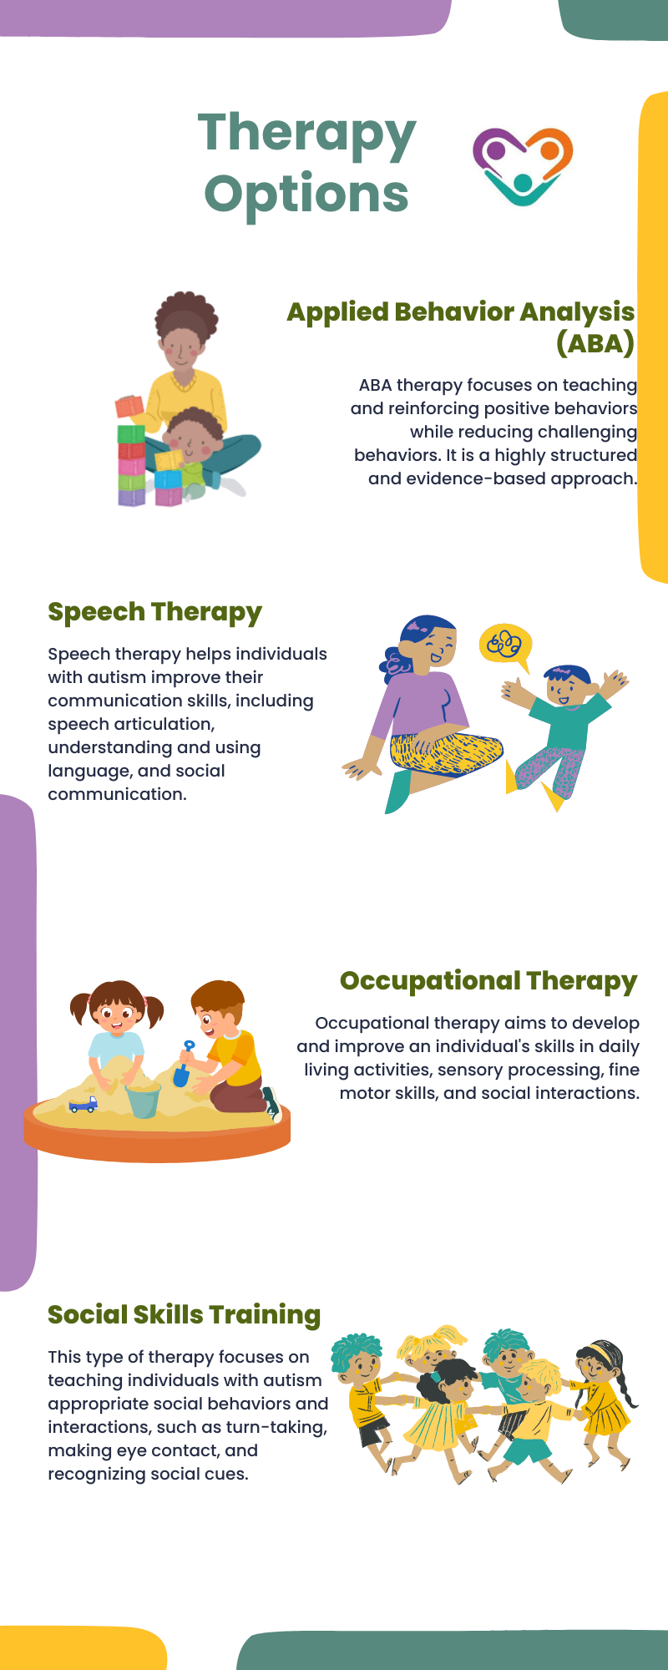
8
Interventions and Therapies
Support Strategies for ASD
Early interventions based on applied behavior analysis aid in developing self-care and social skills, though some view it as controversial and not always beneficial.
Speech and occupational therapies, along with alternative communication methods, serve as effective aids for individuals with varying support needs.
Medications like risperidone address co-occurring irritability but come with side effects such as sedation, offering targeted relief in severe cases.
Advocates emphasize societal accommodations over cures, promoting neurodiversity to enhance inclusion and quality of life for those on the spectrum.
Photo by Google

Slide 12
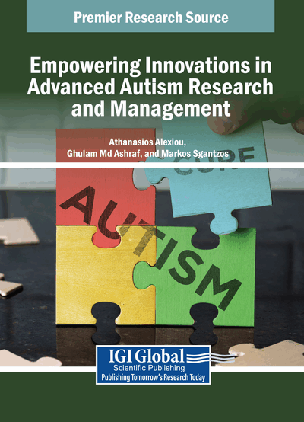
9
Future Research Directions
Advancing ASD Understanding
Research suggests deconstructing autism into behavioral traits and neuropathological factors, exploring prototypes and new causal models for better insights.
Developing transdiagnostic endophenotypes could help understand ASD beyond current spectrum models, focusing on cognitive compensation and environmental interactions.
New studies advocate for diverse research methods, including genetic and environmental correlations, to refine ASD definitions and support strategies.
Continued investigations reveal factors correlating with ASD risk, paving the way for improved diagnostics and personalized interventions in the future.
Photo by Google

Slide 13

10
Thank You for Joining
Grateful for Your Engagement
Thank you for exploring this presentation on autism spectrum disorder, hoping it inspires greater awareness and empathy in your studies and beyond.
Remember, understanding ASD promotes inclusion; carry forward this knowledge to support neurodiversity in communities and future discussions.
We appreciate your time and interest, encouraging further reading on the provided references to deepen your insights into autism.
Feel free to reach out for more resources or questions, as advancing autism awareness benefits everyone involved.
Photo by Google

Slide 14
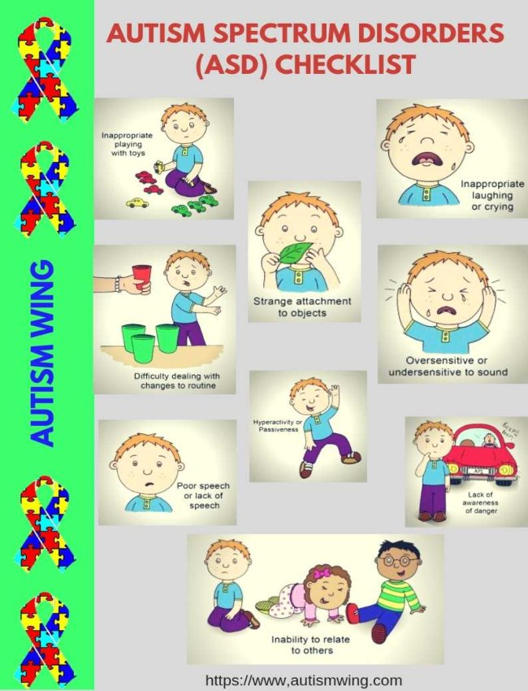
11
Introduction to Autism Spectrum Disorder
Defining ASD and its Impact
Autism Spectrum Disorder (ASD) is a developmental disorder that affects communication and behavior. It includes a wide range of conditions characterized by challenges with social skills, repetitive behaviors, and speech and nonverbal communication.
Research conducted by Xu, Strathearn, and Liu in 2018 revealed a 2.5% prevalence of ASD among US children and adolescents from 2014 to 2016.
Mandell et al. (2016) studied the effects of ASD insurance mandates on the treated prevalence of ASD, highlighting the importance of policy interventions in improving access to care.
Hansen et al. (2015) explored the increase in ASD prevalence attributed to changes in reporting practices, shedding light on the factors influencing the rise in diagnoses.
Photo by Google

Slide 15
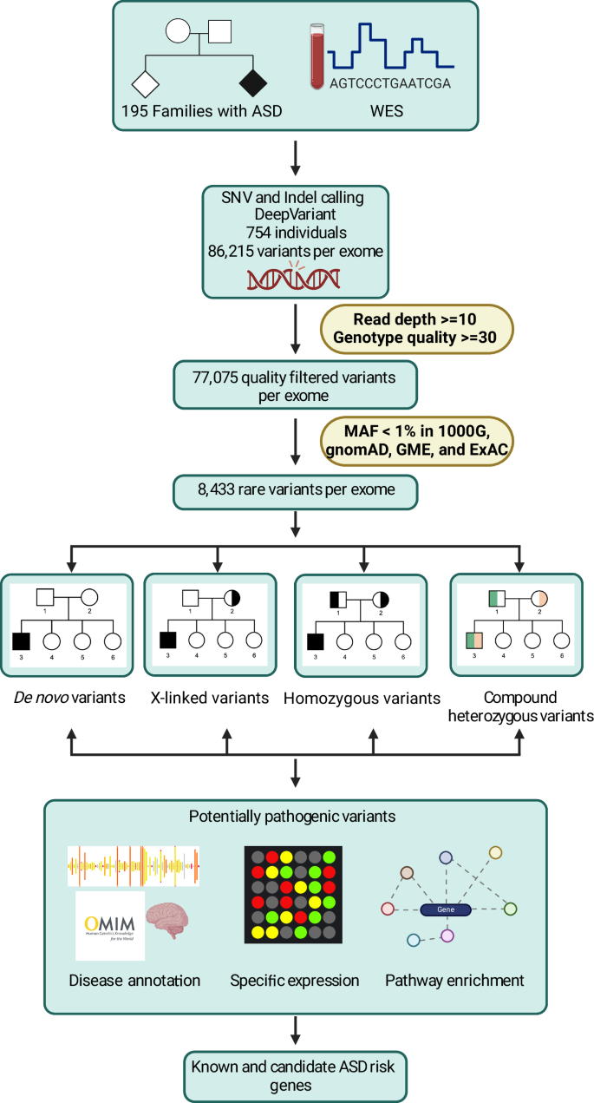
12
Genetic Factors and ASD
Understanding Genetic Links to ASD
Demily et al. (2017) presented a case report linking 49,XYYYY to ASD, emphasizing the importance of genetic investigations in understanding the complexities of ASD.
Tartaglia et al. (2017) investigated ASD in males with sex chromosome aneuploidy, including XXY/Klinefelter syndrome, XYY, and XXYY, highlighting the genetic variations associated with ASD.
Exploring the genetic underpinnings of ASD provides valuable insights into the neurodevelopmental pathways that contribute to the diverse manifestations of the disorder.
Understanding the genetic basis of ASD can inform personalized treatment approaches and enhance support strategies for individuals with ASD.
Photo by Google

Slide 16
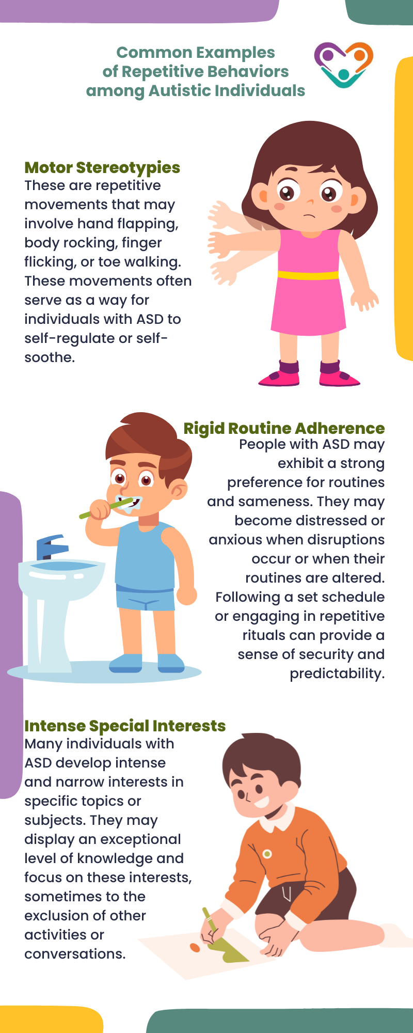
13
Behavioral Patterns in ASD
Analyzing Behavioral Characteristics
Individuals with ASD often experience difficulties in social interactions, such as understanding social cues and maintaining relationships.
Repetitive behaviors, including routines, rituals, and specific interests, are common among individuals with ASD and serve as coping mechanisms.
ASD can impact communication skills, leading to challenges in verbal and nonverbal expression, understanding gestures, and engaging in conversations.
Many individuals with ASD have sensory sensitivities, experiencing heightened or reduced sensitivity to sensory stimuli, which can impact their daily functioning.
Photo by Google

Slide 17
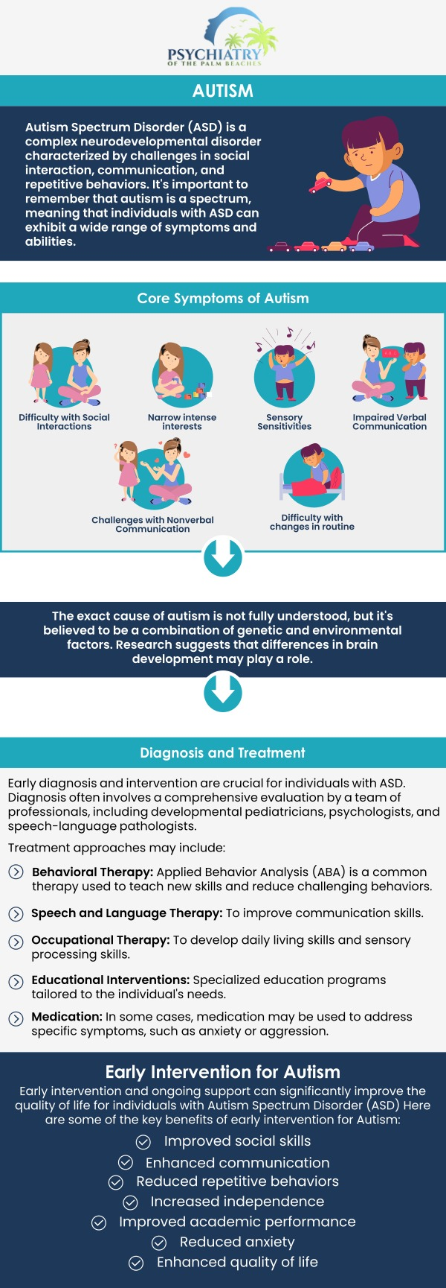
14
Therapeutic Approaches for ASD
Exploring Treatment Strategies
Early diagnosis and intervention play a crucial role in improving outcomes for individuals with ASD by addressing developmental needs and enhancing social and communication skills.
Behavioral therapies, such as Applied Behavior Analysis (ABA) and social skills training, are effective in targeting specific behaviors and promoting positive interactions.
Speech and language therapy helps individuals with ASD improve their communication skills, including speech articulation, language comprehension, and social pragmatics.
Occupational therapy focuses on developing daily living skills, sensory integration, and motor coordination to enhance independence and quality of life for individuals with ASD.
Photo by Google

Slide 18
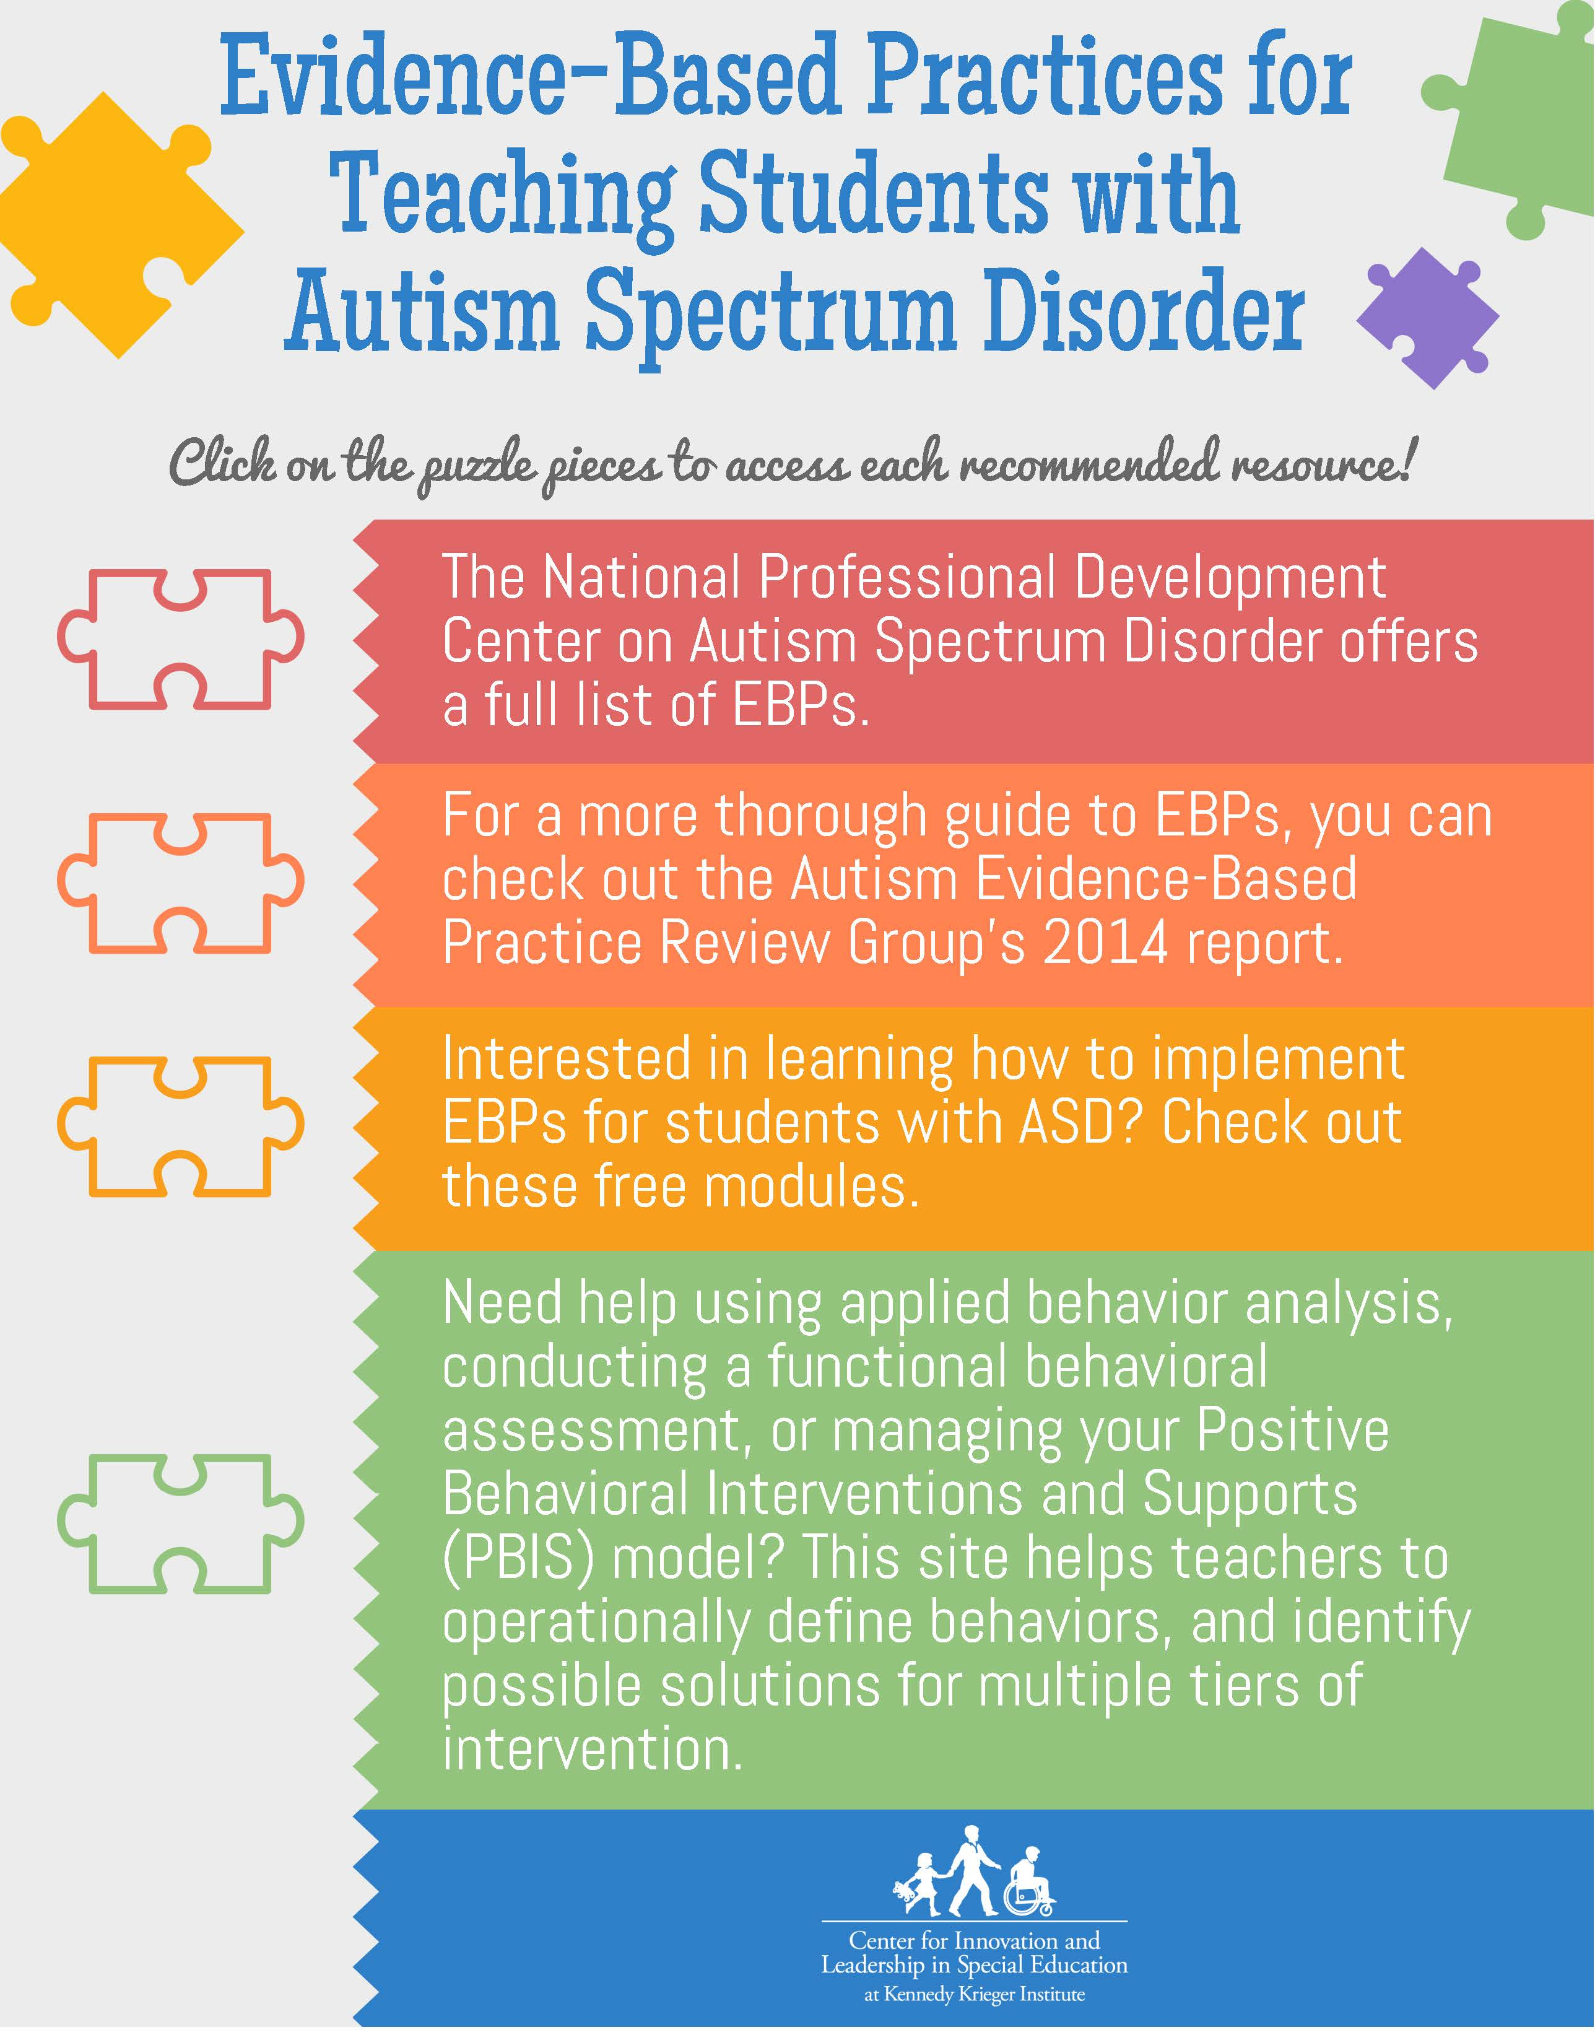
15
Educational Support for Individuals with ASD
Enhancing Learning Environments
Inclusive education promotes the integration of students with ASD into mainstream classrooms, fostering social inclusion and providing tailored support for diverse learning needs.
IEPs outline personalized goals, accommodations, and services for students with ASD to ensure they receive appropriate educational support and access to specialized resources.
Implementing positive behavior support strategies in educational settings helps manage challenging behaviors, create supportive environments, and promote social-emotional development.
Collaboration between educators, parents, therapists, and community resources is essential in creating a comprehensive support network for individuals with ASD to thrive academically and socially.
Photo by Google

Slide 19
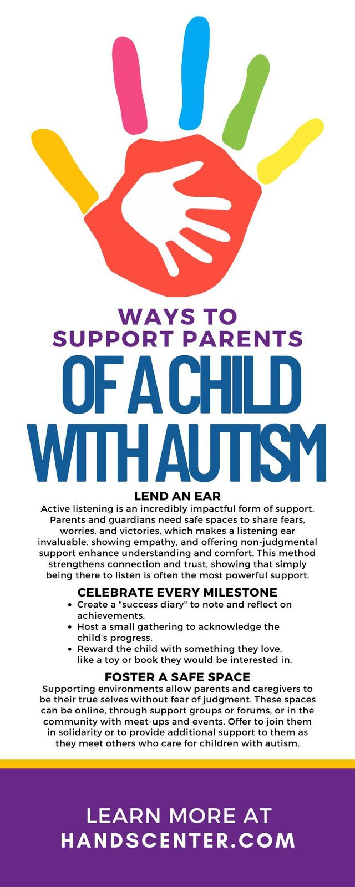
16
Family Impact and Support Systems
Addressing Family Needs
The impact of ASD extends beyond the individual, affecting family dynamics, relationships, and daily routines, highlighting the need for holistic support services.
Parents of children with ASD may experience heightened stress levels due to caregiving responsibilities, emotional challenges, and navigating complex healthcare and educational systems.
Understanding and supporting sibling relationships in families with a child with ASD is crucial for promoting positive interactions, fostering empathy, and building strong family bonds.
Access to community resources, such as support groups, respite care, and advocacy organizations, can provide valuable assistance and guidance to families navigating the challenges of raising a child with ASD.
Photo by Google

Slide 20
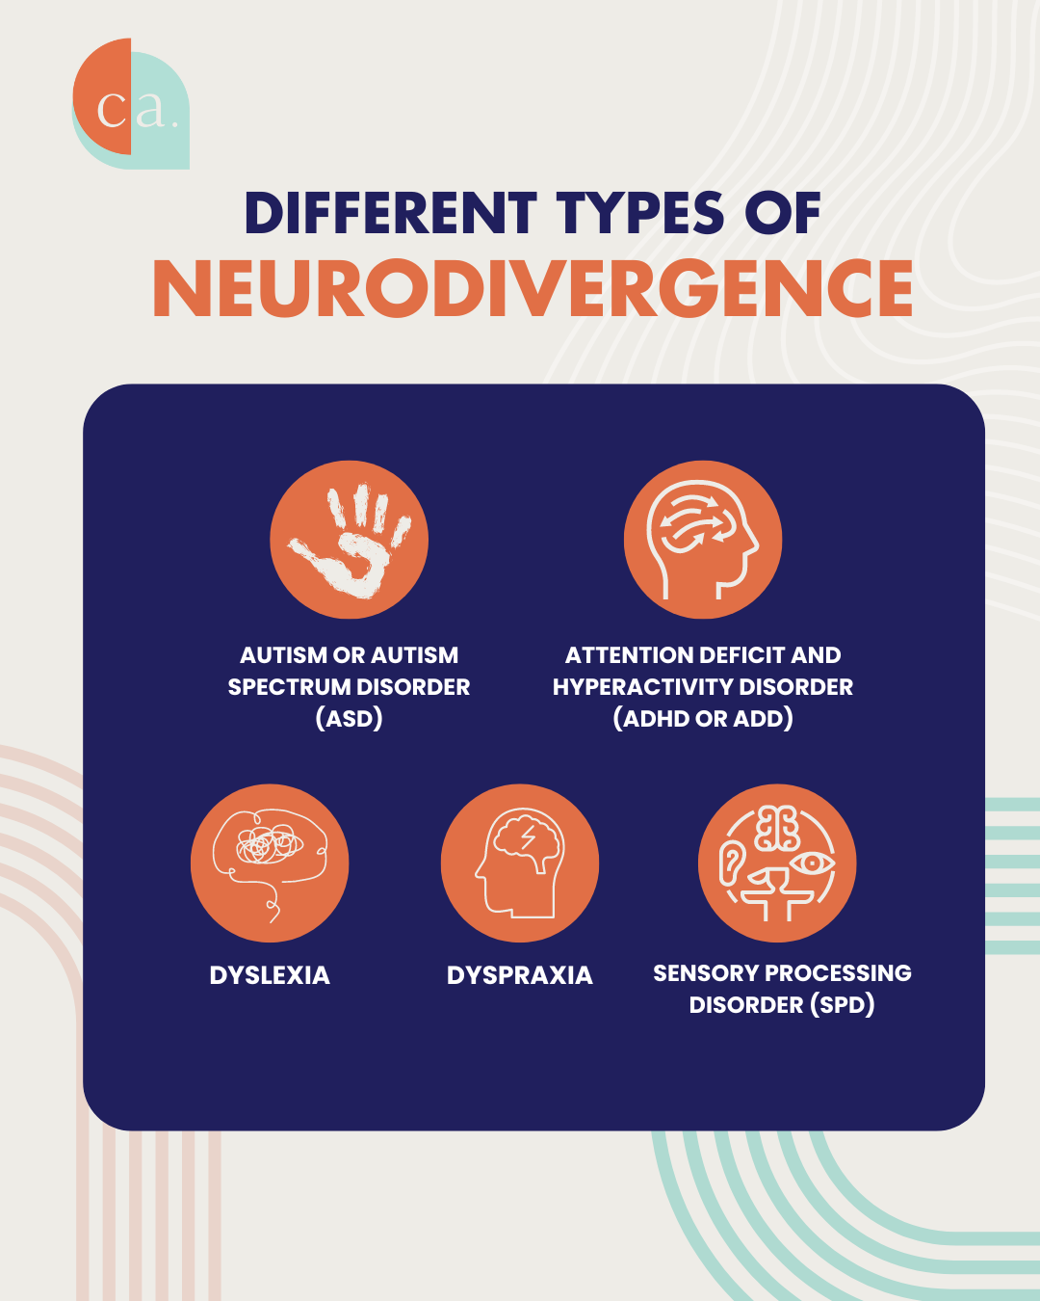
17
Neurodiversity and Inclusion
Embracing Neurodiversity
The neurodiversity paradigm emphasizes the value of diverse neurological differences, promoting acceptance, inclusion, and empowerment of individuals with ASD and other neurodevelopmental conditions.
Recognizing and nurturing the unique strengths and talents of individuals with ASD can enhance self-esteem, confidence, and opportunities for personal growth and success.
Advocacy efforts aim to raise awareness, promote acceptance, and advocate for the rights and inclusion of individuals with ASD in all aspects of society, including education, employment, and healthcare.
Building inclusive communities and workplaces that celebrate diversity, accommodate individual needs, and provide equal opportunities for individuals with ASD fosters a more inclusive and supportive society.
Photo by Google

Slide 21
18
Research Innovations in ASD
Advancements in ASD Research
Continued genetic studies and genomic research are advancing our understanding of the genetic underpinnings of ASD, paving the way for personalized medicine and targeted interventions.
Innovative neuroimaging techniques, such as functional MRI and diffusion tensor imaging, are providing insights into brain connectivity, neural pathways, and neurobiological markers associated with ASD.
Research on novel behavioral interventions, social skills training programs, and cognitive-behavioral therapies is enhancing treatment options and improving outcomes for individuals with ASD.
Translational research bridges the gap between basic science discoveries and clinical applications, accelerating the translation of research findings into practical solutions for individuals with ASD.
Photo by Google

Slide 22
19
Global Perspectives on ASD
Addressing Global Challenges
Disparities in access to diagnosis, intervention services, and support systems contribute to the global challenges faced by individuals with ASD and their families, highlighting the need for equitable healthcare policies.
Cultural beliefs, practices, and stigmas surrounding ASD vary across regions, influencing perceptions, diagnosis rates, and treatment approaches, underscoring the importance of culturally sensitive care.
International collaborations in research, advocacy, and policy development are essential for sharing best practices, promoting knowledge exchange, and addressing the multifaceted challenges of ASD on a global scale.
Engaging communities, policymakers, healthcare providers, and educators in dialogue and action can foster greater awareness, acceptance, and support for individuals with ASD, promoting inclusivity and empowerment.
Photo by Google

