Slide 1
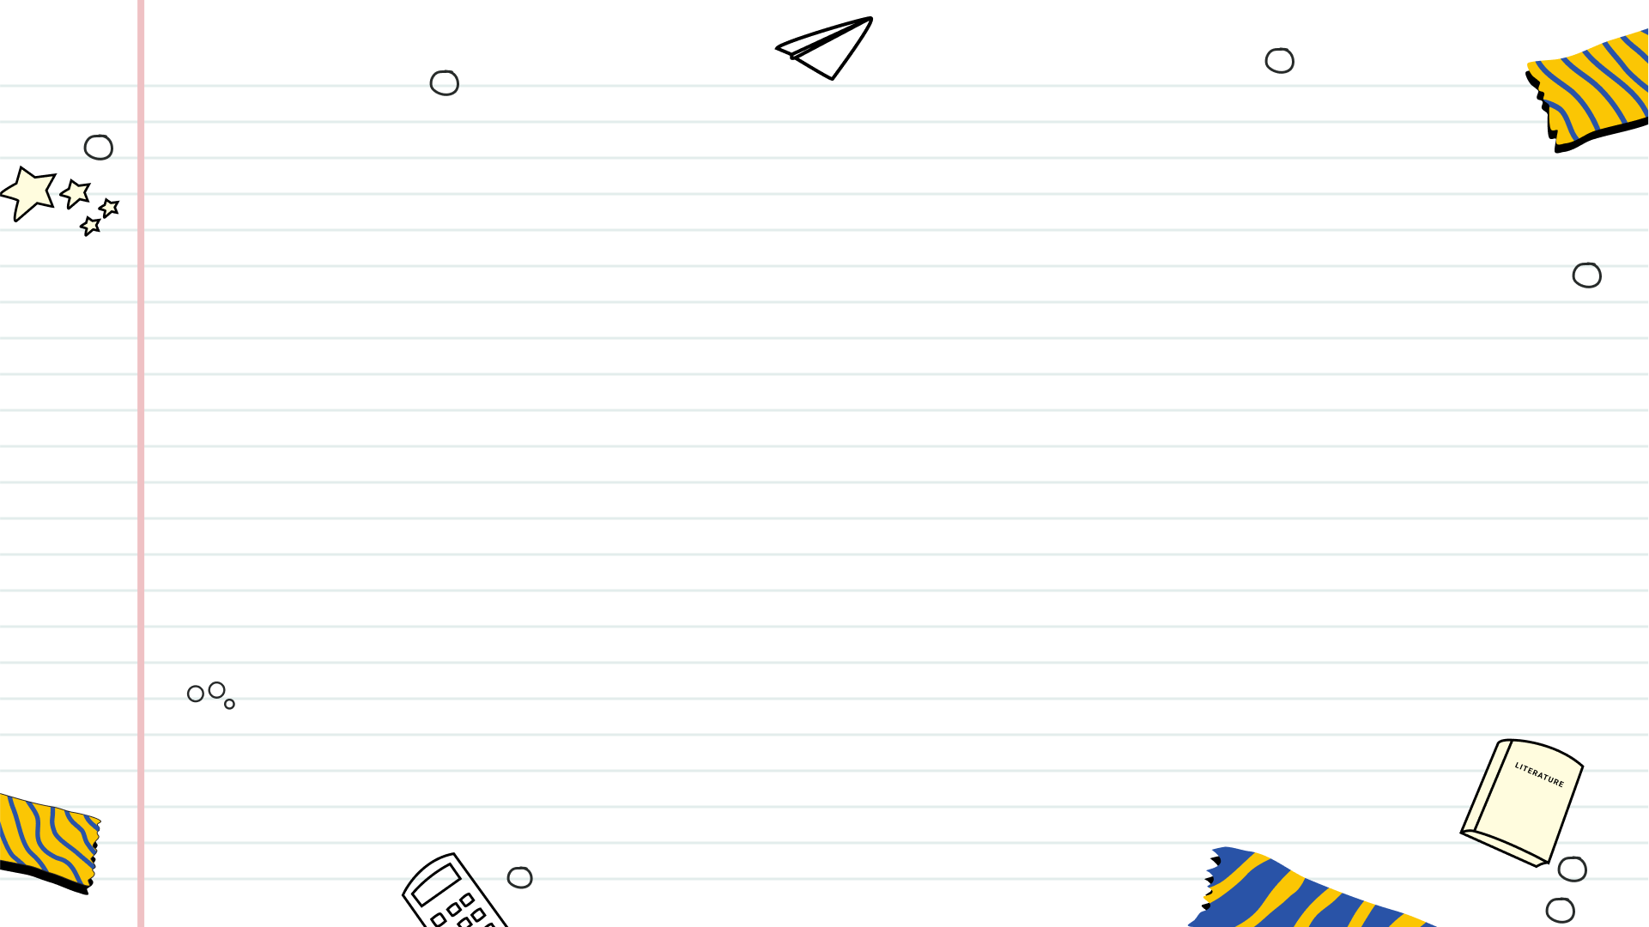
Unveiling Authenticity: Rolex in Pakistan
A Guide to Identifying Genuine Rolex Watches and Understanding Pricing

Slide 2
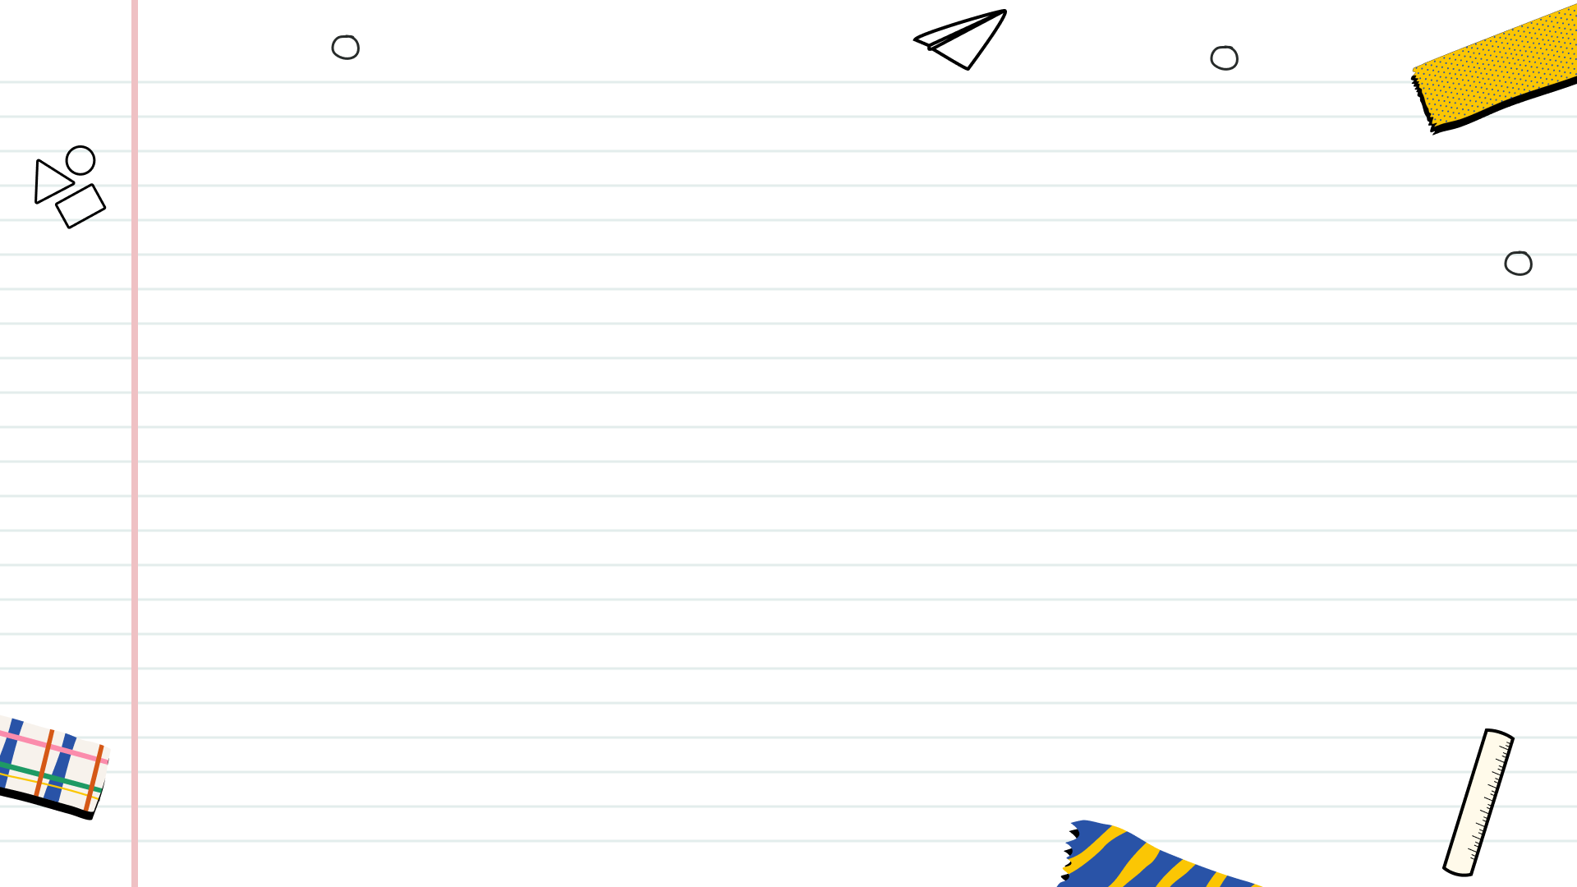
Table of Contents
1
The Allure of Rolex
2
Rolex Pricing in Pakistan
3
Authorized Purchase Channels
4
Weight and Feel
5
Movement and Sweep
6
The Cyclops Lens

Slide 3
7
Serial & Model Numbers
8
Trust Your Instincts
9
Recap: Authenticity Checklist
10
Thank You

Slide 4
The Allure of Rolex
Rolex represents prestige, exceptional craftsmanship, and timeless elegance in the world of luxury timepieces, coveted by many.
The presence of replicas, particularly in markets like Pakistan, emphasizes the importance of discerning genuine Rolex watches.
This presentation guides you through pricing, identification of genuine Rolex, and avoiding scams in the market.
Gain insights into navigating the Rolex market in Pakistan, ensuring you make informed and confident purchase decisions.
Equipping buyers with knowledge to confidently distinguish genuine Rolex watches from counterfeits, fostering trust.

Slide 5
Rolex Pricing in Pakistan
Original Rolex watches in Pakistan typically range from PKR 2,000,000 to PKR 15,000,000 or more, contingent upon specifications.
Popular models like Submariner and Oyster Perpetual command higher prices due to their demand and iconic status.
The use of gold, platinum, or diamond embellishments substantially increases the price of a Rolex timepiece.
Limited edition or vintage Rolex watches often carry a premium price tag because of their rarity and historical significance.
International demand and availability fluctuations can influence the pricing of Rolex watches in the Pakistani market.

Slide 6
Authorized Purchase Channels
Opt for authorized dealers in major cities like Karachi, Lahore, and Islamabad for a guaranteed authentic purchase experience.
Purchasing Rolex watches through unverified online platforms carries a significant risk of acquiring counterfeit products.
Prioritize reputable online platforms that provide authentication services to ensure the legitimacy of the Rolex watch.
Many buyers explore online luxury stores for insights into watch trends, however Rolex is typically sold through certified dealers only.
Always conduct thorough research and verification before committing to a purchase, especially from online sources.

Slide 7
Weight and Feel
Genuine Rolex watches are crafted from high-grade materials, imparting a substantial and premium feel to the timepiece.
Replicas often feel noticeably lighter due to the use of inferior materials, a telltale sign of inauthenticity.
The weight and build quality of a Rolex contribute to the overall perception of luxury and durability inherent in the brand.
The initial feel of a Rolex in your hand can be a strong indicator of its authenticity and quality craftsmanship.
Whenever possible, compare the weight of a suspected Rolex with the documented weight specifications for the model.

Slide 8
Movement and Sweep
Genuine Rolex watches feature a smooth sweeping second hand movement, a hallmark of their mechanical precision.
Counterfeit Rolex watches often exhibit a ticking second-hand movement, immediately signaling their inauthenticity.
The movement of a genuine Rolex is remarkably quiet and smooth, reflecting the high level of engineering involved.
Rolex movements are known for their precision and reliability, ensuring accurate timekeeping for years to come.
Listening closely to the watch movement can help identify irregularities indicative of a counterfeit timepiece.

Slide 9
The Cyclops Lens
Rolex watches with a date function feature a Cyclops lens that magnifies the date display by 2.5 times for enhanced readability.
Fakes often have a weak or flat magnification, often do not magnify at all, or use lenses of poor quality.
The Cyclops lens on a genuine Rolex is crystal clear, providing distortion-free magnification of the date window.
The Cyclops lens should be precisely centered over the date window, ensuring optimal viewing and symmetry.
Examine the Cyclops lens closely for any imperfections or inconsistencies that may indicate a counterfeit watch.

Slide 10
Serial & Model Numbers
Serial and model numbers are deeply and precisely engraved between the lugs of a genuine Rolex watch.
These numbers can be verified with Rolex to confirm the authenticity and specifications of the timepiece.
Counterfeit watches often feature poorly engraved or inconsistently formatted serial and model numbers.
Verify the correct placement of the serial and model numbers on the watch case, as specified by Rolex standards.
Consult with a Rolex expert or authorized service center to authenticate the serial and model numbers if needed.

Slide 11
Trust Your Instincts
Be wary of deals that seem too good to be true, as they often indicate counterfeit or stolen merchandise.
Research the seller's reputation and credibility before making a purchase, especially when buying online.
Carefully inspect the watch for any signs of tampering, inconsistencies, or subpar craftsmanship before finalizing the transaction.
Consult with a Rolex expert or authorized dealer if you have any doubts about the authenticity of a watch.
Always request original paperwork, warranty cards, and receipts to verify the watch's provenance and authenticity.

Slide 12
Recap: Authenticity Checklist
High-grade materials provide a substantial feel.
Look for the sweeping motion of the second hand.
Inspect the magnification and clarity of the date window.
Verify serial and model numbers with Rolex.
If it feels off, it probably is. Seek professional advice.

Slide 13
Thank You
Thank you for taking the time to explore the essential guide to identifying genuine Rolex watches.
We hope this presentation has provided you with the knowledge and tools necessary to confidently navigate the Rolex market.
Remember, vigilance and attention to detail are crucial in ensuring the authenticity of your Rolex timepiece.
Stay informed about the latest trends and techniques for identifying counterfeit watches to safeguard your investment.
We wish you success in your pursuit of owning an authentic Rolex, a timeless symbol of luxury and craftsmanship.

