Slide 1
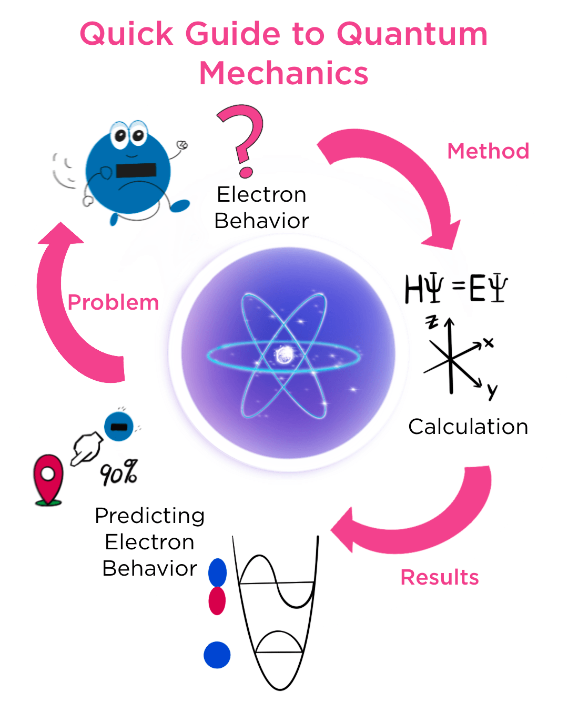
Unveiling the Wonders of Physics Exploring the Science of Matter, Motion, and Energy
Photo by Google

Slide 2
01
The Essence of Physics
Table of Contents
02
Ancient Sky Watchers
03
Roots in Philosophy
04
Greek Innovations
05
Medieval Advances
06
Revolutionary Breakthroughs
07
Industrial Era Physics
08
Modern Physics Era
09
Core Ideas in Physics
10
Thank You

Slide 3
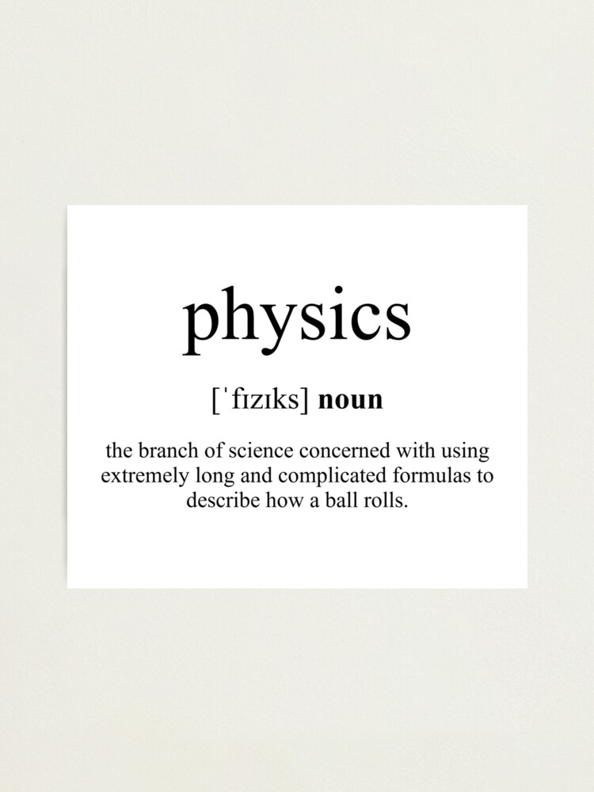
1
The Essence of Physics
Understanding the Core Definition
Physics delves into matter and its basic building blocks, examining how they form the foundation of everything around us. It explores the movement and behavior of matter through space and time, revealing patterns that govern daily experiences. Physics links matter with energy entities, showing how they interact to drive changes in the universe we observe. As a scientific study, physics investigates fundamental constituents, providing insights into the world's workings based on evidence.
Photo by Google

Slide 4
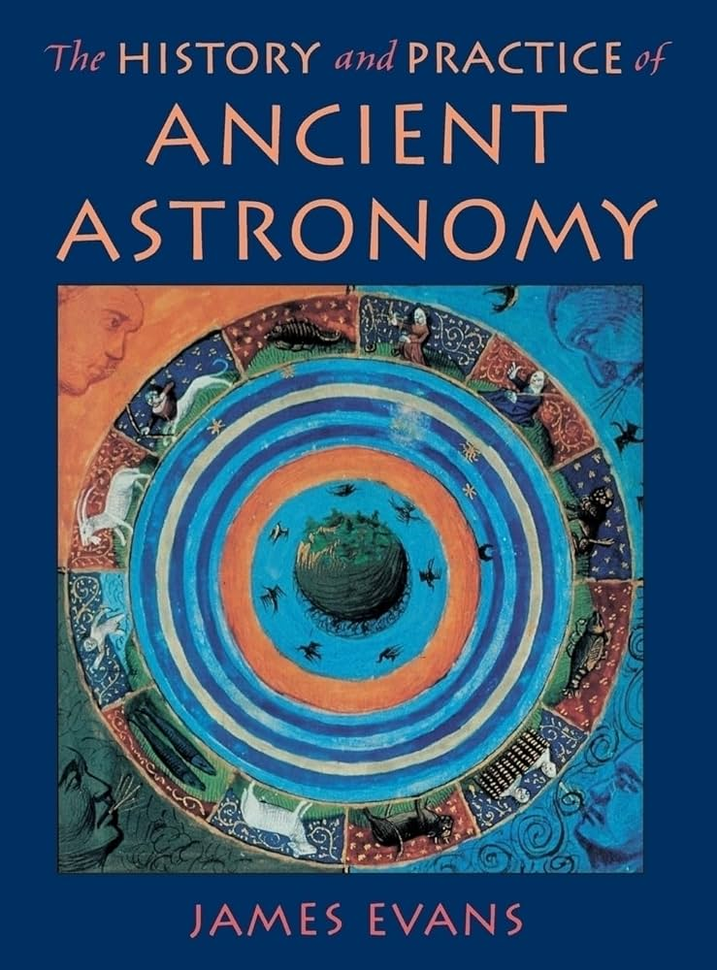
2
Ancient Sky Watchers
Early Human Observations
Ancient astronomy involved tracking stars and planets, laying early groundwork for understanding cosmic patterns and movements. These observations shaped ancient societies, influencing calendars and navigation through simple yet profound sky studies. Early astronomers developed ideas about the heavens, connecting human curiosity to the beginnings of physical knowledge. Their work set the stage for later physics, preserving knowledge that built upon initial celestial explorations.
Photo by Google

Slide 5
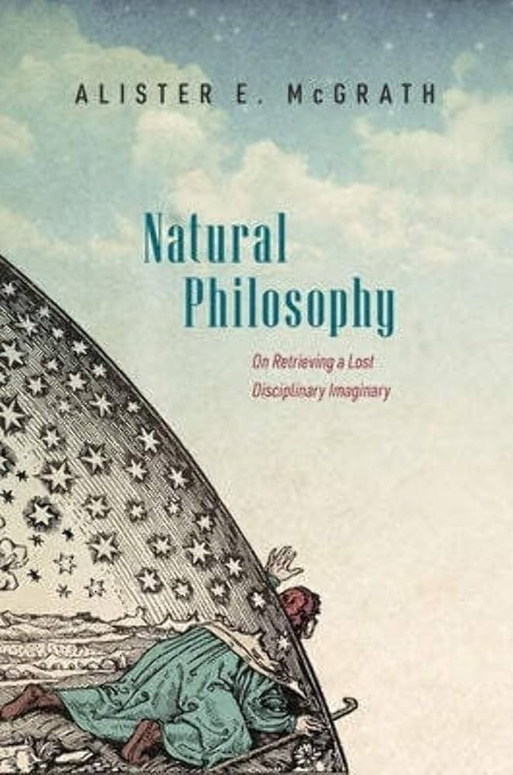
3
Roots in Philosophy
Nature's Early Explorations
Natural philosophy integrated questions of nature with logical reasoning, forming the early bridge to modern scientific thought. It involved examining everyday phenomena through reasoned inquiry, blending observation with theoretical ideas. This approach evolved concepts of the physical world, influencing how people understood matter and forces. Natural philosophy paved the way for structured physics by encouraging systematic study of natural events.
Photo by Google

Slide 6
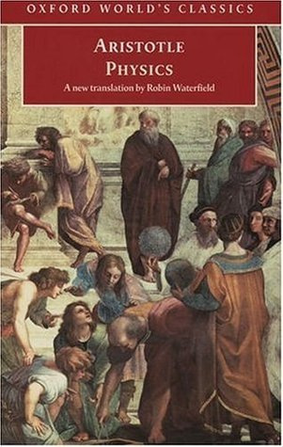
4
Greek Innovations
Aristotle's Contributions
Aristotle and Hellenistic thinkers developed theories on motion and elements, establishing key ideas in ancient physics. They explored concepts like forces and change, providing frameworks that influenced later scientific developments. This era combined philosophy with observations, creating enduring models of the physical universe. Their work formed the basis for mechanics and other areas, shaping how physics progressed through history.
Photo by Google

Slide 7
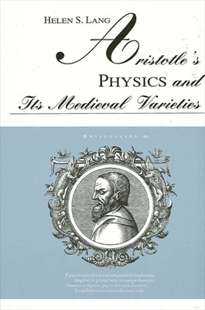
5
Medieval Advances
European and Islamic Insights
Medieval Islamic scholars preserved and expanded Greek ideas, advancing optics and mechanics with new experiments. In Europe, thinkers built on these foundations, integrating philosophy with emerging scientific methods during the Middle Ages. This period maintained ancient texts while adding practical applications, bridging gaps in physical understanding. Exchanges between regions enriched physics, leading to innovations that carried into the modern era.
Photo by Google

Slide 8
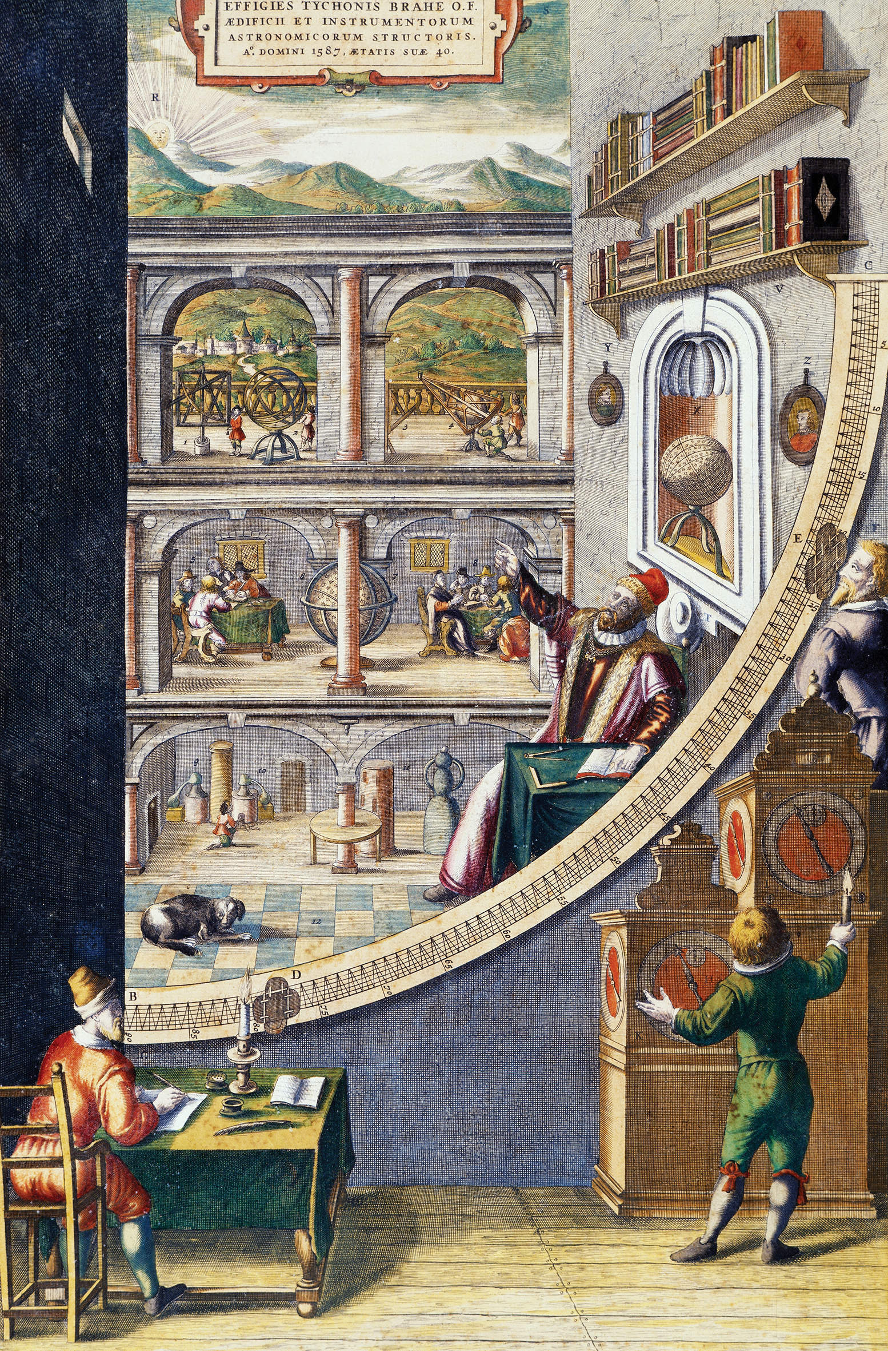
6
Revolutionary Breakthroughs
The Dawn of Modern Science
The Scientific Revolution introduced figures like Newton, who transformed physics with laws of motion and gravity. It emphasized testing ideas through experiments, shifting physics towards empirical evidence and precise measurements. This era established principles that explained planetary motion and forces, reshaping our view of the cosmos. Revolutionary ideas laid groundwork for technology, influencing how physics applied to real-world problems.
Photo by Google

Slide 9
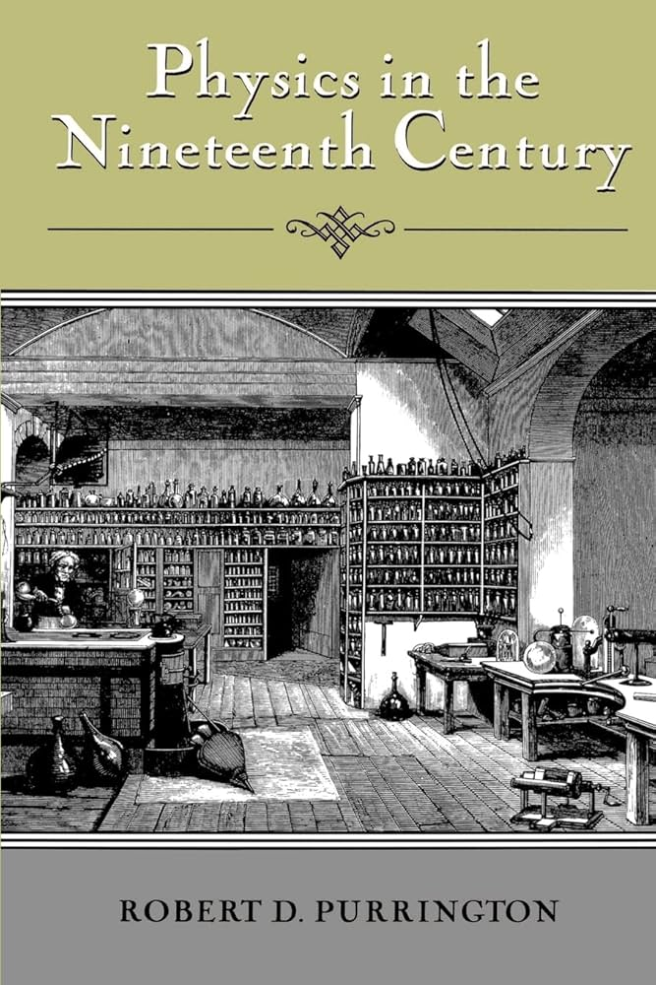
7
Industrial Era Physics
19th Century Developments
The 19th century saw advancements in electromagnetism, with discoveries that powered new technologies and machines. Physics expanded into thermodynamics, explaining heat and energy transfer in engines and industrial processes. This period developed theories of light and waves, enhancing understanding of energy and matter interactions. Innovations in physics during this time fueled the Industrial Revolution, linking science to practical advancements.
Photo by Google

Slide 10
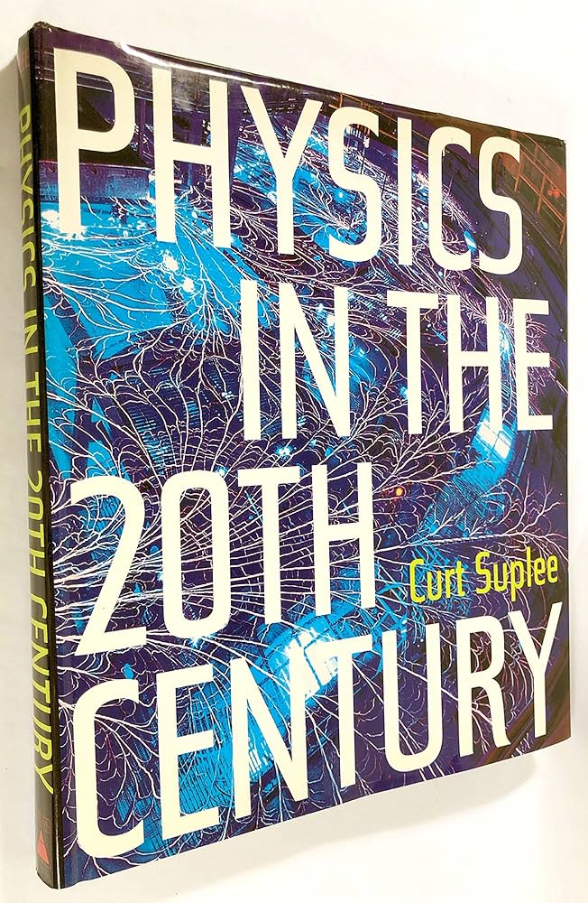
8
Modern Physics Era
20th Century Transformations
The 20th century introduced quantum mechanics, revealing the behavior of particles at atomic levels and changing physics fundamentally. Einstein's theories of relativity reshaped ideas of space, time, and gravity, offering new perspectives on the universe. Physics advanced with nuclear studies, leading to energy applications and deeper insights into matter's structure. This era built complex models that explained cosmic phenomena, pushing the boundaries of human knowledge.
Photo by Google

Slide 11
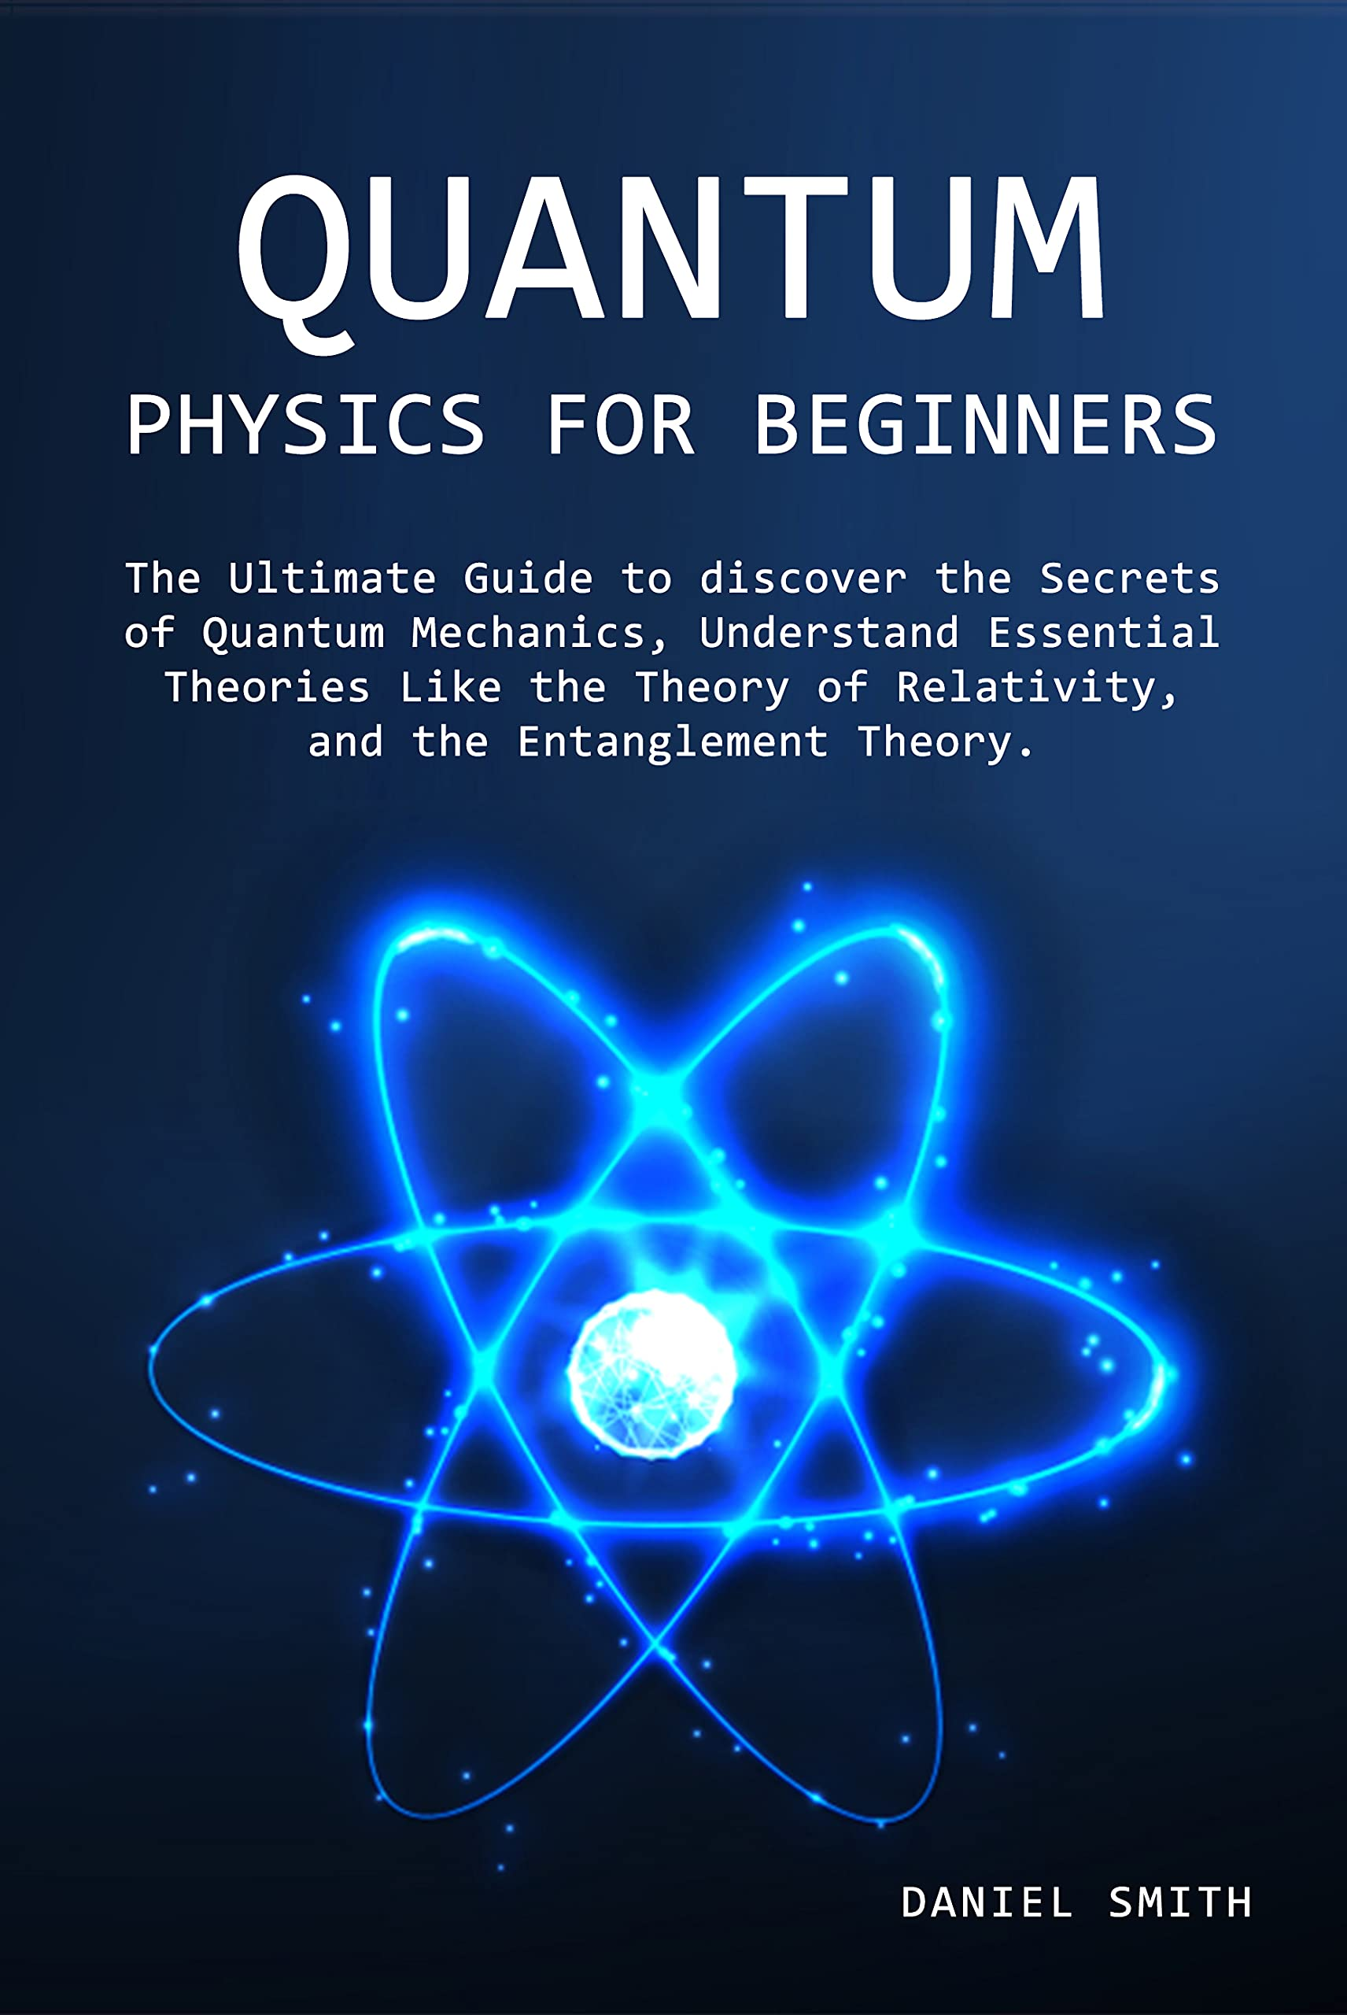
9
Core Ideas in Physics
Fundamental Theories and Fields
Classical physics covers mechanics and electromagnetism, providing essential tools for understanding everyday motion and forces. It includes quantum and relativity theories, explaining subatomic particles and the vast universe's structure. Physics uses scientific methods to test theories through experiments, aiming to uncover natural laws and patterns. Fields like astrophysics and condensed matter explore specific areas, applying core principles to specialized studies.
Photo by Google

Slide 12

10
Thank You
Gratitude for Your Engagement
Thank you for joining this journey through physics, where we've explored its rich history and ideas together. We hope these highlights inspire your own discoveries in the world of science and beyond. Remember, physics opens doors to endless curiosity; keep questioning and exploring for more knowledge. A heartfelt thank you for your attention—may this presentation spark your interest in the wonders of physics.
Photo by Google

