Slide 1
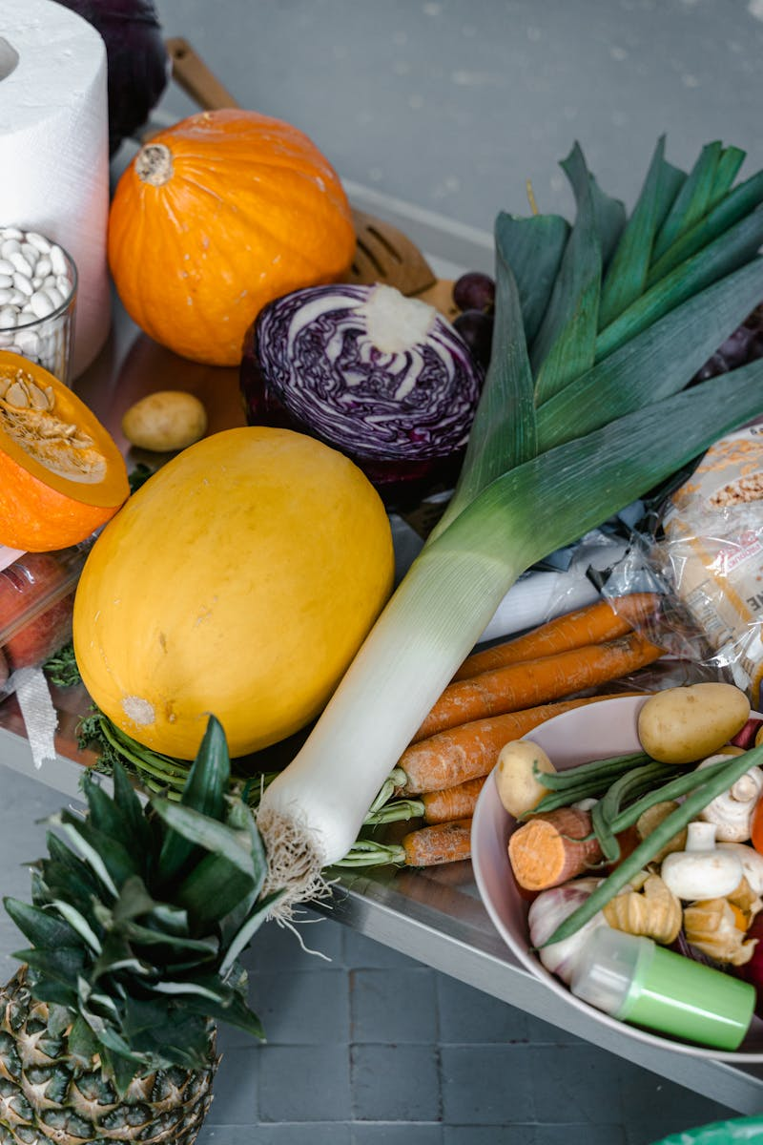
Vegetable Forms: A Culinary Journey Exploring the Diverse World of Vegetables: Fresh, Frozen, Canned, and Dried
Photo by Pexels

Slide 2
01
Spot the Difference!
Table of Contents
02
Learning Roadmap
03
Classify and Conquer
04
Defend the Importance
05
Thank You

Slide 3
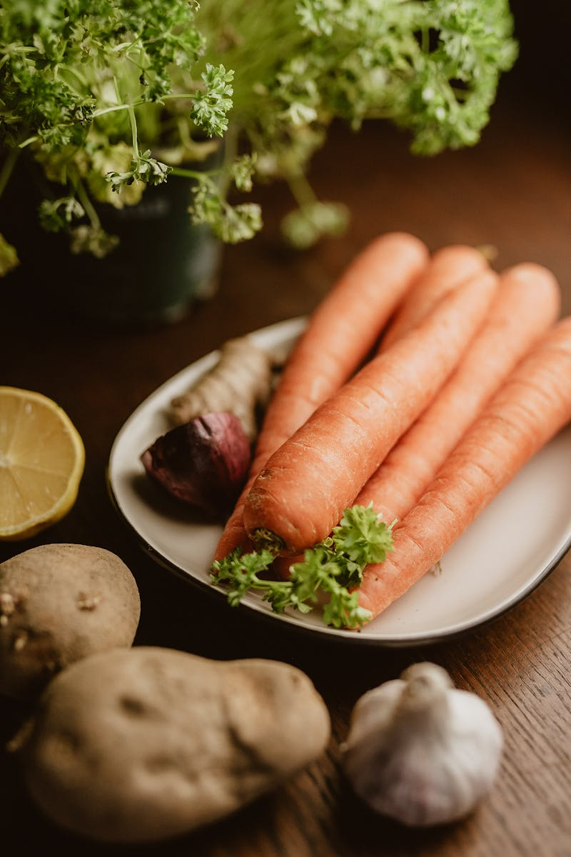
1
Spot the Difference!
Unveiling the Variety in Vegetables
Four images showcase vegetables: fresh carrots, frozen peas, canned mushrooms, and dried garlic. These items can be found in different places and state. The audience is prompted to observe differences among the market forms of vegetables in the images. They try to identify the vegetables from the images. The audience is encouraged to reflect on their familiarity with these vegetables. They recall instances of seeing each form at home and in the market. The activity serves as a gateway to understanding market forms of vegetables. This marks the beginning of the day's lesson.

Slide 4
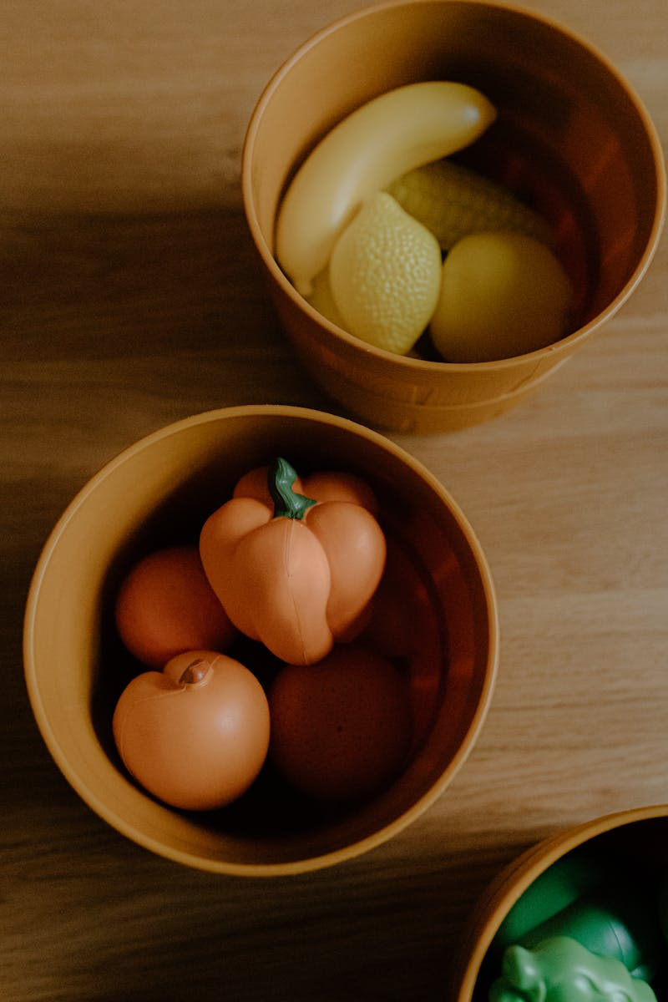
2
Learning Roadmap
Objectives of Vegetable Market Forms
Students will accurately identify the four distinct market forms of vegetables. These forms include fresh, frozen, canned, and dried vegetables. Students will develop a strong appreciation for the importance of vegetables. They will realize the role of the market forms of vegetables in family meals. Students will actively participate in a group activity. In that activity, they will classify vegetable pictures into correct market forms through it. The lesson aims for a comprehensive understanding. It covers knowledge, feelings, and practical application to enhance skills of the students.

Slide 5

3
Classify and Conquer
Interactive Exploration of Vegetable Forms
The class divides into two collaborative groups. This encourages peer interaction and teamwork throughout the activity. Each group gets picture cards of vegetables. They classify them into fresh, frozen, canned, or dried categories. The group effort brings best result. Each group will present their classified results in front of the class. They will write the results on manila paper. The presentation helps to communicate the ideas. Teacher facilitates a discussion to clarify misconceptions. They give the right information to the students to increase the understanding.

Slide 6
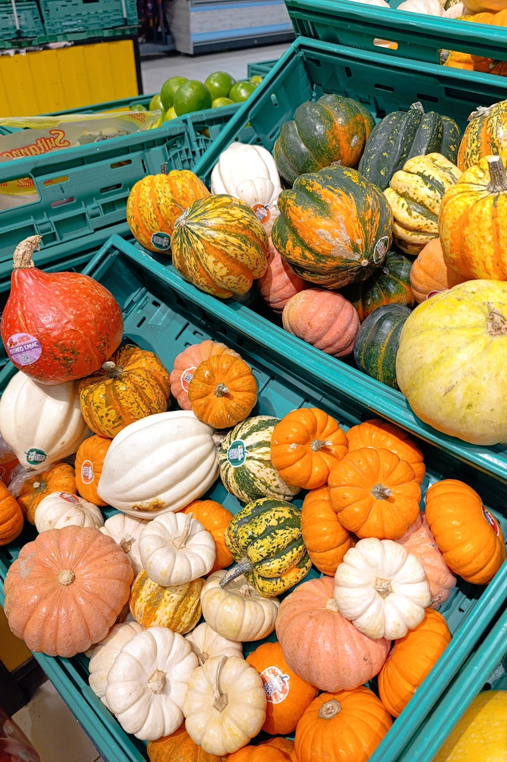
4
Defend the Importance
Justifying the Significance of Vegetable Forms
Each group will defend the importance of market forms of vegetables. They use the information gathered in the past activity. Guiding Questions are: 'Why do we need to know the market forms of vegetables?' and 'How do they help in cooking, nutrition, and budgeting?' Each group provides a concise 1–2 minute presentation. They explain why market forms are important. This increases communication ability. Teacher highlights values like wise buying, food safety, and appreciating vegetables. This helps to make responsible students.

Slide 7

5
Thank You
Gratitude for Your Participation
I extend my sincere appreciation to each of you. Your active involvement and keen attention made this presentation truly enjoyable and successful. I am grateful for your insightful questions, thoughtful comments, and enthusiastic participation. Your contributions enriched the learning experience for everyone. I hope that this presentation has sparked your curiosity. I encourage you to continue exploring the fascinating world of vegetables and their diverse forms. Thank you once again for your time, attention, and dedication. I wish you all the best in your future endeavors, and I look forward to our next learning opportunity together.

