Slide 1

Water Sustainability: Our Future Depends on It!
Understanding and Protecting Our Precious Resource

Slide 2

Table of Contents
01
Why Water Sustainability Matters
02
Interesting Water Facts
03
Simple Steps for Water Conservation
04
Quiz Time!
05
Learn More: Useful Videos

Slide 3

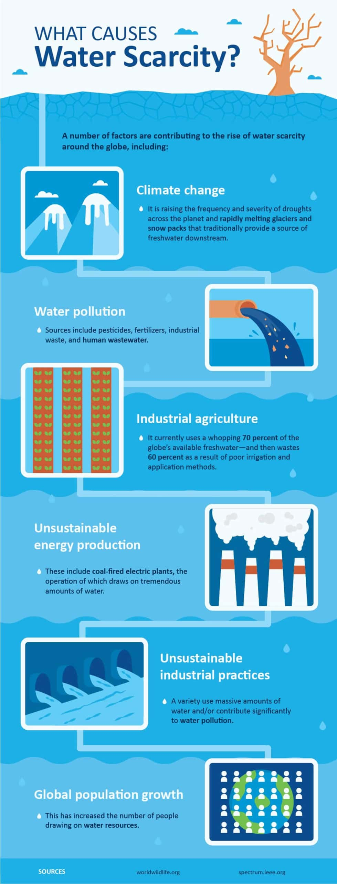



Why Water Sustainability Matters
1.
Water is Life
All living things need water to survive. Without it, we can't grow food, stay healthy, or maintain our ecosystems.
2.
Water is Limited
Only a small percentage of Earth's water is fresh and readily available for use. We need to manage it wisely.
3.
Growing Demand
As the population increases and industries expand, the demand for water rises, putting a strain on our resources.
Photo by Google

Slide 4
Why Water Sustainability Matters
4.
Protecting Our Future
By practicing water sustainability, we can ensure that future generations have access to this vital resource.
Photo by Google

Slide 5
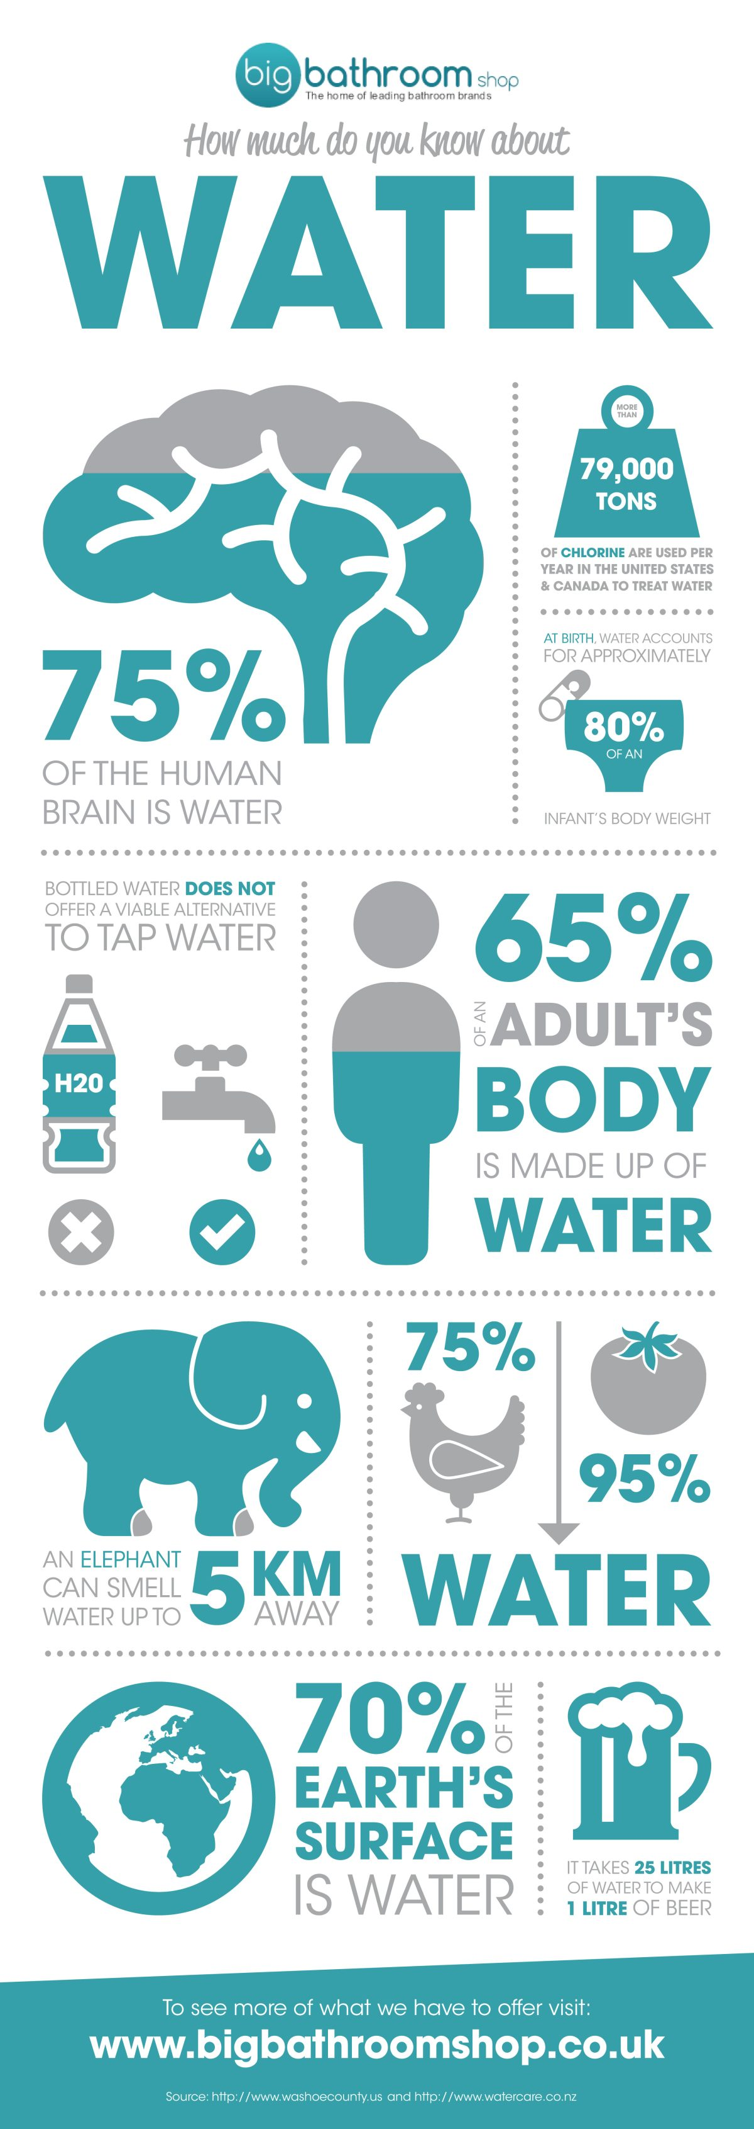
Interesting Water Facts
1.
Water on Earth
Only 3% of the water on Earth is fresh water. The rest is saltwater in oceans.
2.
Water Usage
Agriculture uses about 70% of the world’s freshwater resources.
3.
The Human Body
The human body is made up of 50-65% water. We need water to function properly.
Photo by Google

Slide 6
Interesting Water Facts
4.
Water Footprint
It takes about 1,800 gallons of water to produce just one pound of beef!
Photo by Google

Slide 7
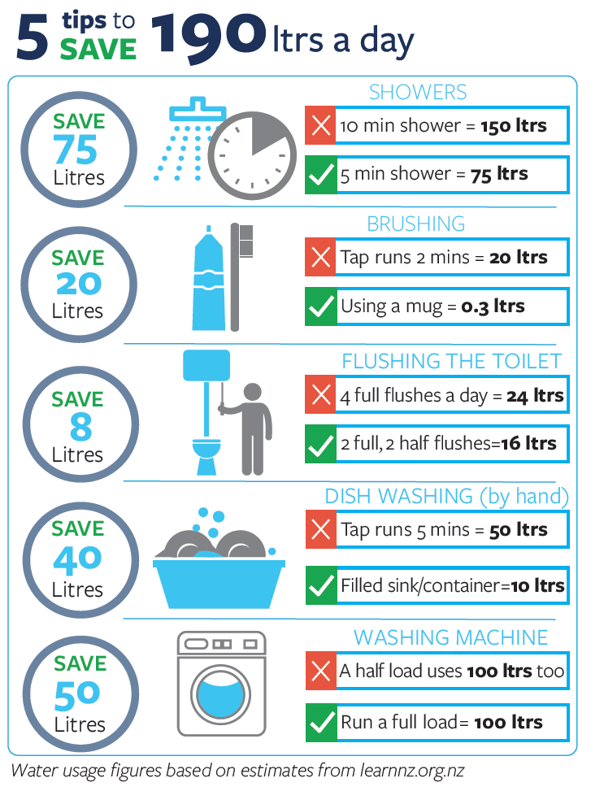
Simple Steps for Water Conservation
1.
Fix Leaks
A leaky faucet can waste gallons of water every day. Repair them promptly.
2.
Shorter Showers
Reduce your shower time by a few minutes to save water.
3.
Water-Wise Gardening
Use native plants that require less water and water your garden during cooler hours.
Photo by Google

Slide 8
Simple Steps for Water Conservation
4.
Full Loads Only
Only run your washing machine and dishwasher when they are fully loaded.
Photo by Google

Slide 9
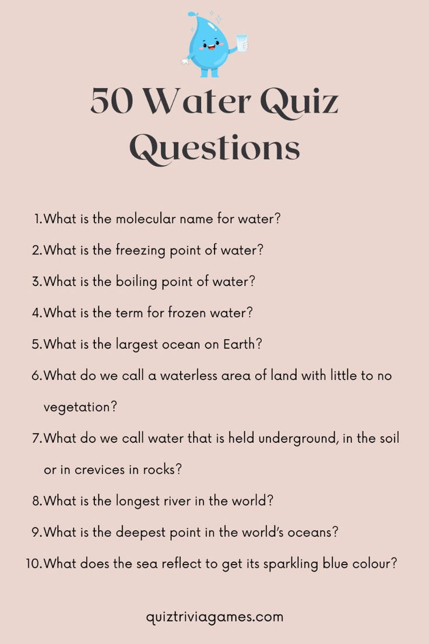
Quiz Time!
1.
Question 1
What percentage of Earth's water is freshwater? a) 97% b) 50% c) 3% d) 10%
2.
Question 2
Which sector uses the most freshwater globally? a) Industry b) Agriculture c) Domestic Use d) Energy Production
3.
Question 3
What is one simple way to conserve water at home? a) Take longer showers b) Leave the tap running while brushing teeth c) Fix leaky faucets d) Water the garden...
Photo by Google

Slide 10
Quiz Time!
4.
Answers
1. c) 3% 2. b) Agriculture 3. c) Fix leaky faucets
Photo by Google

Slide 11

Learn More: Useful Videos
1.
Video 1
Water is Life - Find video on YouTube about water crisis. [example: https://www.youtube.com/watch?v=qO48N0M0k0c]
2.
Video 2
Save Water - Find video on YouTube about saving water. [example: https://www.youtube.com/watch?v=w70h9POoIfc ]
3.
Video 3
Water Conservation at Home - Find a YouTube video on home water conservation techniques.[example: https://www.youtube.com/watch?v=8SgEu2_H2Uc]
Photo by Google

Slide 12
Learn More: Useful Videos
4.
Footer
Made by-Aiman & Aqil, Idea & quiz by - Azib & Kimi, Videos & image by : Iqbal Faisal
Photo by Google

