Slide 1

Wiring & Sensors: The Nervous System of Mechatronics
Understanding essential wiring diagrams and sensor integration in modern mechatronic systems

Slide 2

Table of Contents
01
Mechatronics Unveiled
02
Wiring Diagram Essentials
03
Schematic Diagrams Decoded
04
Wiring Layouts in Action
05
Sensor Fundamentals
06
Position & Motion Sensors
07
Force & Pressure Sensors
08
Temperature & Vision Sensors

Slide 3





Mechatronics Unveiled
1.
Interdisciplinary Fusion
Mechatronics blends mechanical, electrical, and computer engineering to create intelligent systems that sense and respond to their environment.
2.
Wiring as Neural Pathways
Electrical connections function like nervous systems, transmitting power and signals between components in precise configurations.
3.
Sensors: System Senses
Sensors act as electronic senses, detecting physical changes and converting them into actionable data for control systems.

Slide 4
Mechatronics Unveiled
4.
Integration Imperative
Proper wiring and sensor selection are critical for seamless communication between mechanical and electronic subsystems.

Slide 5

Wiring Diagram Essentials
1.
Circuit Roadmaps
Wiring diagrams visually map electrical pathways, showing component connections and current flow directions in systems.
2.
Standardized Symbolism
Universal symbols represent components like power sources, switches, and controllers for consistent interpretation.
3.
Connection Clarity
Diagrams specify wire types, connection points, and routing to prevent errors during assembly or troubleshooting.

Slide 6
Wiring Diagram Essentials
4.
Voltage Specifications
Clear labeling of voltage requirements ensures compatible power distribution across all electronic components.

Slide 7

Schematic Diagrams Decoded
1.
Functional Focus
Schematic diagrams emphasize component relationships and signal flow rather than physical layout or wire lengths.
2.
Circuit Behavior
They illustrate how electrical currents interact with components to perform specific control functions in systems.
3.
Troubleshooting Guide
Schematics enable technicians to trace signal paths and identify malfunctioning components efficiently.

Slide 8
Schematic Diagrams Decoded
4.
Design Foundation
Engineers use schematics to prototype and validate circuit logic before physical implementation.

Slide 9

Wiring Layouts in Action
1.
Spatial Configuration
Layout diagrams show exact component placement, wire routing paths, and connection points within enclosures.
2.
Real-World Constraints
They account for physical space limitations, heat management, and maintenance access requirements.
3.
Wire Management
Diagrams specify cable trays, conduits, and tie-points to prevent interference and ensure safety.

Slide 10
Wiring Layouts in Action
4.
Manufacturing Blueprint
Layouts guide technicians during assembly, reducing errors and ensuring consistent build quality.

Slide 11
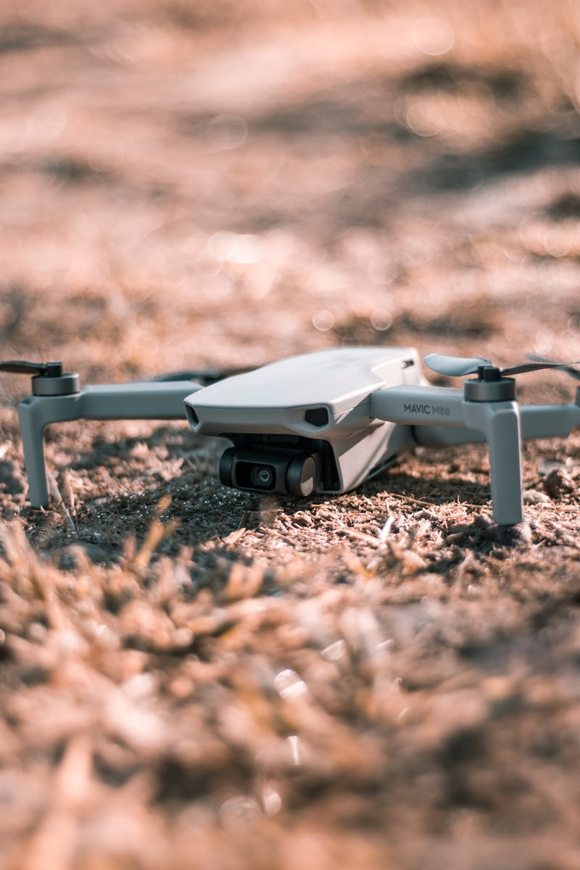
Sensor Fundamentals
1.
Input Converters
Sensors transform physical phenomena like pressure or motion into measurable electrical signals.
2.
Precision Requirements
Selection depends on measurement range, accuracy needs, and environmental operating conditions.
3.
Signal Types
Sensors output analog voltages, digital pulses, or serial data for processor interpretation.

Slide 12
Sensor Fundamentals
4.
Calibration Criticality
Regular calibration ensures sensors maintain accuracy throughout their operational lifespan.

Slide 13

Position & Motion Sensors
1.
Encoder Applications
Rotary encoders measure shaft position and speed in motors with high angular resolution.
2.
Linear Variants
Linear sensors track straight-line movement in actuators and conveyor systems using various principles.
3.
Proximity Detection
Inductive or capacitive sensors detect nearby objects without physical contact in automated systems.

Slide 14
Position & Motion Sensors
4.
Vibration Monitoring
Accelerometers identify abnormal machine vibrations for predictive maintenance protocols.

Slide 15

Force & Pressure Sensors
1.
Load Cell Operation
Strain gauge-based sensors convert mechanical force into proportional electrical resistance changes.
2.
Tactile Feedback
Pressure sensors enable responsive grip control in robotic arms handling delicate objects.
3.
Hydraulic Monitoring
Pressure transducers track fluid pressures in hydraulic and pneumatic control circuits.

Slide 16
Force & Pressure Sensors
4.
Safety Applications
Force sensors trigger emergency stops when machinery encounters unexpected resistance.

Slide 17

Temperature & Vision Sensors
1.
Thermal Management
Thermocouples and RTDs monitor component temperatures to prevent overheating damage.
2.
Infrared Sensing
Non-contact IR sensors detect heat distribution in motors and power electronics remotely.
3.
Machine Vision
Camera systems inspect parts, guide assembly robots, and verify quality control standards.

Slide 18
Temperature & Vision Sensors
4.
Optical Sensors
Photoelectric detectors register object presence, color, or position using light beams.

Slide 19

Integration Principles
1.
Signal Conditioning
Amplifiers and filters process raw sensor outputs into clean controller-ready signals.
2.
Shielding Essentials
Proper cable shielding prevents electromagnetic interference from corrupting sensor data.
3.
Power Considerations
Wiring diagrams must accommodate both sensor excitation voltages and signal return paths.

Slide 20
Integration Principles
4.
Diagnostic Features
Built-in test circuits in wiring enable quick sensor validation during maintenance checks.

Slide 21

Thank You
1.
Acknowledgments
We appreciate your engagement in exploring the foundations of mechatronic system design.
2.
Continuous Learning
Mastering wiring and sensor integration remains fundamental to advanced mechatronic applications.
3.
Future Horizons
These principles will underpin innovations in robotics, automation, and intelligent machinery.

Slide 22
Thank You
4.
Q&A Invitation
Let's discuss how these concepts apply to your own engineering projects and research interests.

