Slide 1
The Process of Sperm
Understanding Sperm Production and Maturation

Slide 2
Introduction
• Overview of the process of sperm production
• Importance of understanding the male reproductive system
• Link to video on the male reproductive system
• Key focus: production and maturation of sperm
Photo by Pexels

Slide 3
Anatomy of the Testes
• Testes contain numerous pipeline structures known as seminiferous tubules
• Seminiferous tubules have a central lumen and outer wall
• The wall of the seminiferous tubules is the main site for sperm production
Photo by Pexels

Slide 4
Cross Section of Seminiferous Tubule
• The wall of the seminiferous tubule contains various types of cells
• Primary germ cells are one of the cell types
• Primary germ cells transform into immature sperm known as sperm
Photo by Pexels

Slide 5
Process of Spermatogenesis - Phase 1
• Spermatogenesis is divided into two phases: maturation and spermiogenesis
• Maturation phase involves division of germ cells into precursor cells called primary spermatocytes
• Primary spermatocytes undergo meiosis to form four secondary spermatocytes
• Secondary spermatocytes go through the second phase of meiosis to form four immature sperm
Photo by Pexels

Slide 6
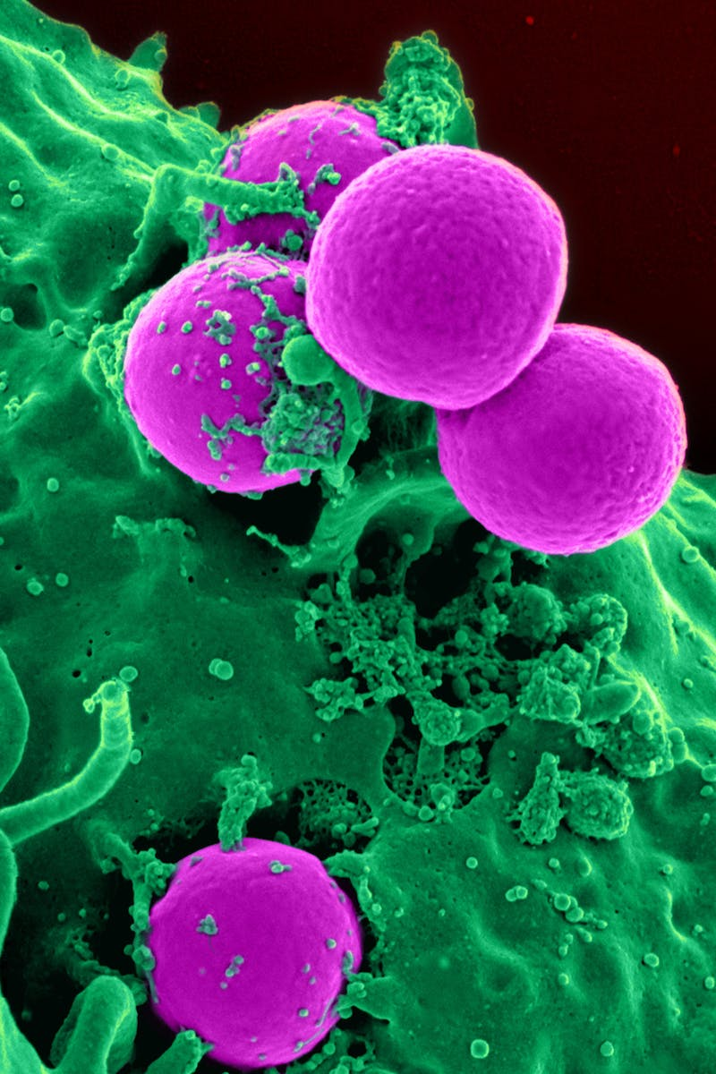
Cell Division in Phase 1 of Spermatogenesis
• Primary spermatocytes divide into type B primary spermatocytes
• Type B spermatocytes reproduce to maintain the number of type A spermatogonia
• First division in maturation phase leads to the formation of primary spermatids
• Second division forms secondary spermatids, which are haploid cells
• Secondary spermatids undergo meiosis II to maintain chromosome number
Photo by Pexels

Slide 7
Structure of Seminiferous Tubule Wall
• Primary spermatogonia are located in the basal layer of the seminiferous tubule wall
• Various divisions from primary spermatocytes to secondary spermatids can be seen
• Sertoli cells provide support and nutrition to developing germ cells
Photo by Pexels

Slide 8
Process of Spermiogenesis - Phase 2
• Spermiogenesis is the second phase of sperm maturation
• It involves four distinct phases: Golgi, acrosomal, tail, and maturation
• Golgi phase forms enzymes of the acrosome
• Acrosomal phase sees the formation of the acrosomal cap around the nucleus
• Tail phase develops the tail of the sperm
• Maturation phase eliminates excess cytoplasm and completes sperm maturation

Slide 9
Release of Mature Sperm
• Mature sperm are released into the lumen of the seminiferous tubule
• Process known as spermiation or sperm release
• Mature sperm spend time in the epididymis to gain motility
• Sperm become capable of fertilization
Photo by Pexels

Slide 10
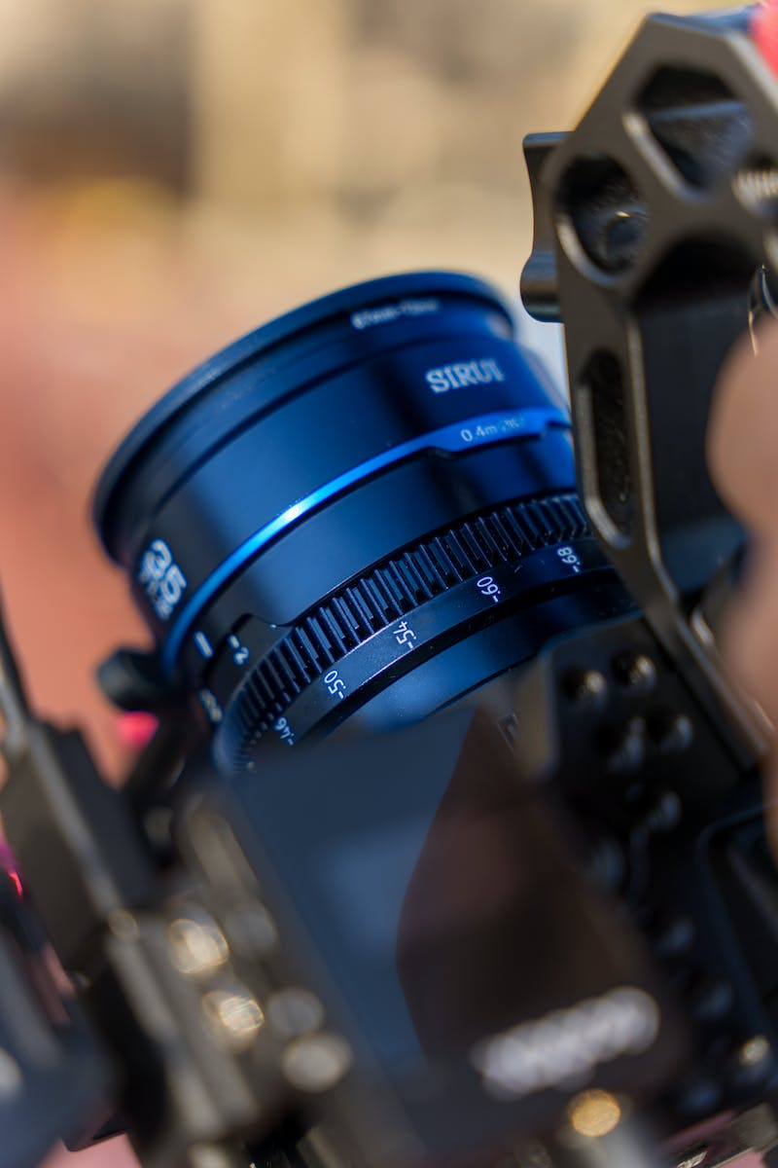
Conclusion
• Recap the process of sperm production and maturation
• Highlight the importance of understanding this topic
• Invite viewers to like the channel on YouTube and Facebook for more content
Photo by Pexels

