Slide 1
Understanding Story Elements: The Setting
Unveiling the Importance of Time and Place in Fiction

Slide 2
Introduction
• Story elements are different parts of a fiction story
• The setting is an important story element
• Setting is the time and place of a story
• It answers the question of when and where a story takes place
Photo by Pexels

Slide 3
Defining Setting
• Setting can vary in time and place
• It can be in the past, present, or future
• Different settings evoke different atmospheres
• Examples: school, park, city, desert
Photo by Pexels

Slide 4
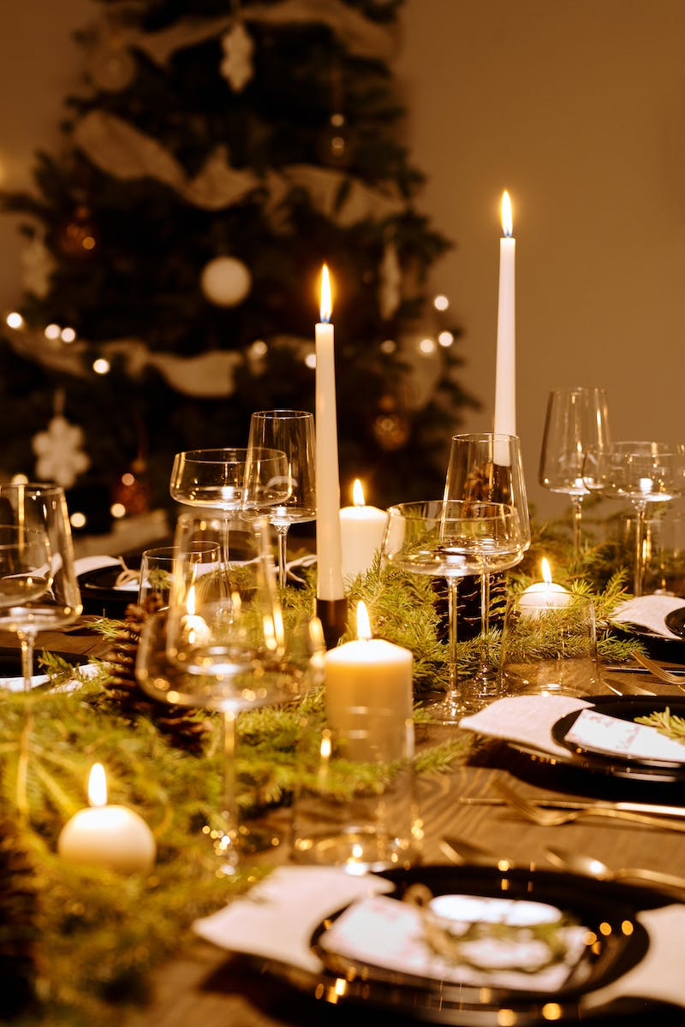
Describing the Setting
• Adjectives or describing words enhance the setting's portrayal
• Sunny, bright, dark, cold, rainy, spooky, busy, gigantic, amazing, quiet
• Adding adjectives creates a vivid image for the reader
• Illustrations and text provide clues about the setting
Photo by Pexels

Slide 5
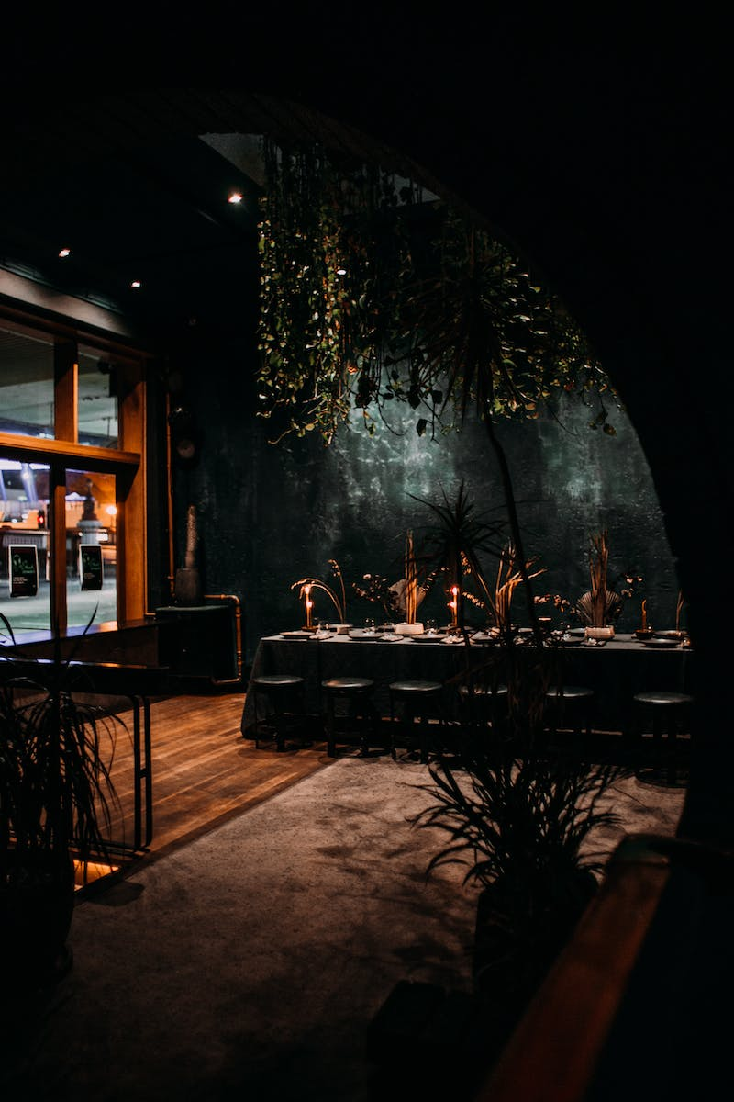
Determining the Setting
• Examining illustrations and text helps determine the setting
• Example: Children camping by the river
• Setting: Warm summer day by the river in the woods
• Example: Children playing at the park
• Setting: Warm sunny day at the park
Photo by Pexels

Slide 6
Recap: Setting as a Story Element
• Setting is the time and place a story takes place
• It provides context and atmosphere
• Variety of settings adds richness to storytelling
• Remember to use adjectives for descriptive depth
Photo by Pexels

