Slide 1
The Future of Drone Deliveries
Exploring the challenges and possibilities of drone delivery services

Slide 2
Introduction
• The future of commerce: drone deliveries
• Cities experiencing commercial drone deliveries
• Success of Wing's pilot program in Logan, Australia
• Temporary shutdown in Ka due to territorial ravens
Photo by Pexels

Slide 3
Package Limitations
• Commercial drones can carry up to six pounds
• Limitations on volume and type of packages
• Mostly used for food and medicine deliveries
• Future potential for delivering larger items
Photo by Pexels

Slide 4
Range and Area Limitations
• Drones can typically fly up to ten miles
• Long range drones operate up to 7.5 miles
• Limited delivery range for businesses
• Urban areas and obstacles pose challenges
Photo by Pexels

Slide 5
Last Mile Delivery
• Drone delivery's potential in the last mile
• Combining traditional shipping with drones
• Significant reduction in shipping costs
• Future possibilities with AI-powered drones
Photo by Pexels

Slide 6
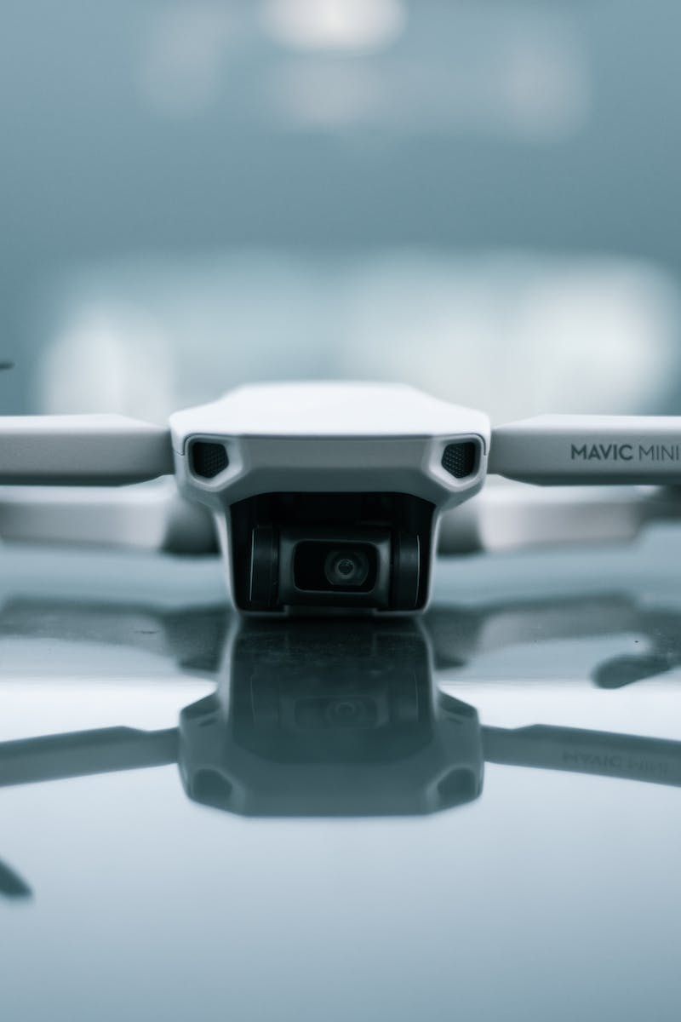
Safety and Security Concerns
• Survey results on concerns about drone delivery
• Security, package damage, and theft
• Comparison with Amazon's drone delivery progress
• Challenges faced in training and automation
Photo by Pexels

Slide 7
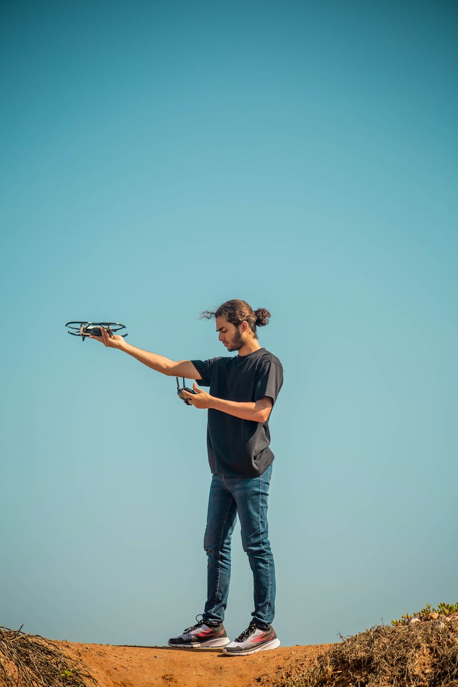
Real-World Applications
• Ups delivering COVID-19 vaccines via drones
• China's use of drones for emergency medical supplies
• Contact-free solutions and transportation efficiency
• Positive impact on addressing novel problems
Photo by Pexels

Slide 8
Environmental Implications
• Potential increase in carbon emissions
• Drone delivery's impact on cities
• Balancing environmental concerns with convenience
• Considerations for sustainable implementation
Photo by Pexels

Slide 9
Conclusion
• The future of drone deliveries in society
• Progress and challenges in implementing drone delivery services
• Exploring new possibilities and solutions
Photo by Pexels

