Slide 1
DJI Enterprise Department: Energy Sector Presentation
Using DJI Drones for Power Line Inspection and Maintenance

Slide 2
Introduction to DJI Enterprise Department
• DJI is the world leader in drone technology
• The DJI Enterprise Department focuses on industrial clients
• Industrial drones are specifically designed for industry needs
Photo by Pexels

Slide 3
Importance of Drones in the Energy Sector
• Drones are used in the energy sector to improve efficiency
• They allow inspectors to reach difficult areas and reduce inspection costs
• Drones also enhance worker safety in hazardous environments
Photo by Pexels

Slide 4
Introducing the Matrice 300 RTK
• The Matrice 300 RTK is the latest industrial drone platform
• Features include live mission recording and AI spot check
• The drone is designed for maximum safety with dual battery configuration and emergency landing capabilities
Photo by Pexels

Slide 5
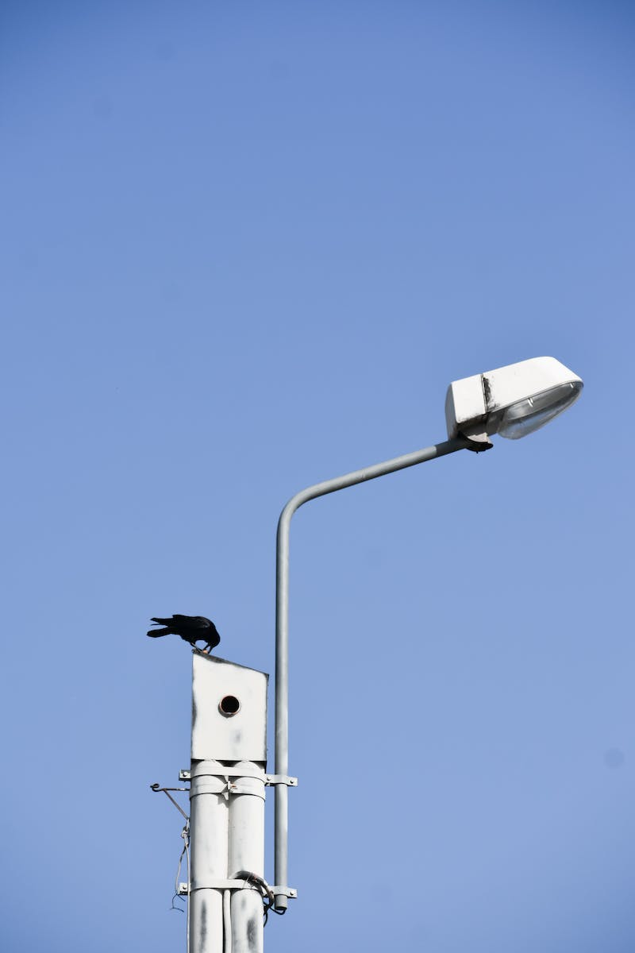
The H20 Camera System
• The H20 camera offers unique features for energy inspections
• Includes laser point rangefinder for precise distance measurement
• High-resolution grid photo allows for detailed inspection of elements
Photo by Pexels

Slide 6
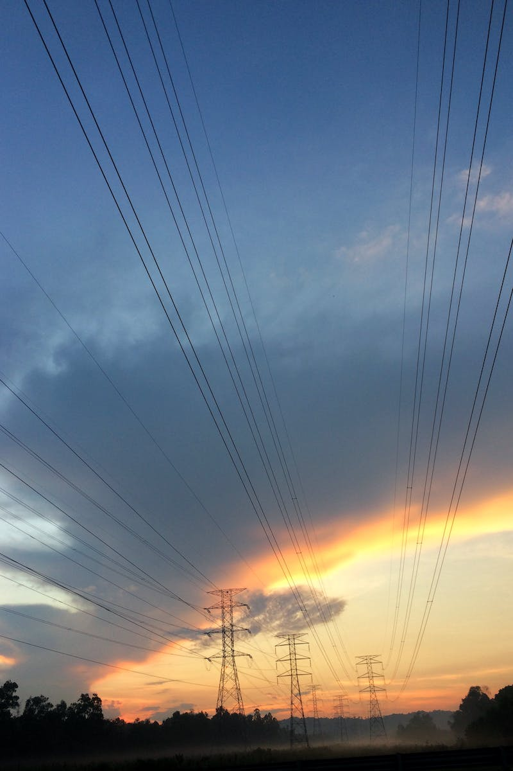
Planning and Executing Power Line Inspections
• Manual flight allows for precise control of the drone during inspections
• Waypoint missions enable repeatable flight routes for regular inspections
• Live mission recording ensures consistency in inspections over time
Photo by Pexels

Slide 7
Safety and Regulatory Considerations
• Ensure compliance with local regulations and airspace restrictions
• Inspectors should be trained in drone operations and safety procedures
• Adhere to maintenance and inspection schedules for equipment
Photo by Pexels

Slide 8
Cost and Time Savings with Drone Inspections
• Drone inspections can significantly reduce costs compared to traditional methods
• Less labor-intensive and time-consuming than manual inspections
• Improved efficiency leads to faster and more accurate inspections
Photo by Pexels

