Slide 1
Innovating with Siemens: A Journey Through Technology
Exploring the Impact of Siemens' Advancements in Engineering and Communication

Slide 2
Introduction
• Acquiring Serious German for Success
• Combining German Expertise with a Year of Innovation
• Highlighting the Importance of Technology
• The Journey Begins: Exploring Siemens' Impact
Photo by Pexels

Slide 3
Boosting Progress with Engineering Support
• Providing Engineer Support for Advancements
• Integration of YouTube, Netflix, Amazon, and Telegram
• Creating a Powerful Platform for Growth
• Exploring the Role of Engineer Ernest Werner
Photo by Pexels

Slide 4
Expanding Siemens' Business Electronically
• Creating New Opportunities through Electronic Business
• Exploring the Impact of Video and Fat Four Kilogram
• Introducing the Concept of Emotional Bright Subway
• Uncovering the Why behind Business Factory Email
Photo by Pexels

Slide 5
Siemens' Influence on the Internet and Design
• Siemens' Impact on Internet AG Forum
• Exploring the Six Design After Appear of Y
• Managing Ideal Design with Siemens
• Introducing Eric Management and Marco Siemens
Photo by Pexels

Slide 6
Siemens' Expansion into Communication and Gaming
• Siemens' Role in Home and Office Communication
• Exploring Siemens' Smartphone and Communication Device
• The Intersection of Gaming and Company K Dream
• Unlocking the Potential of Siemens' Communication Solutions
Photo by Pexels

Slide 7
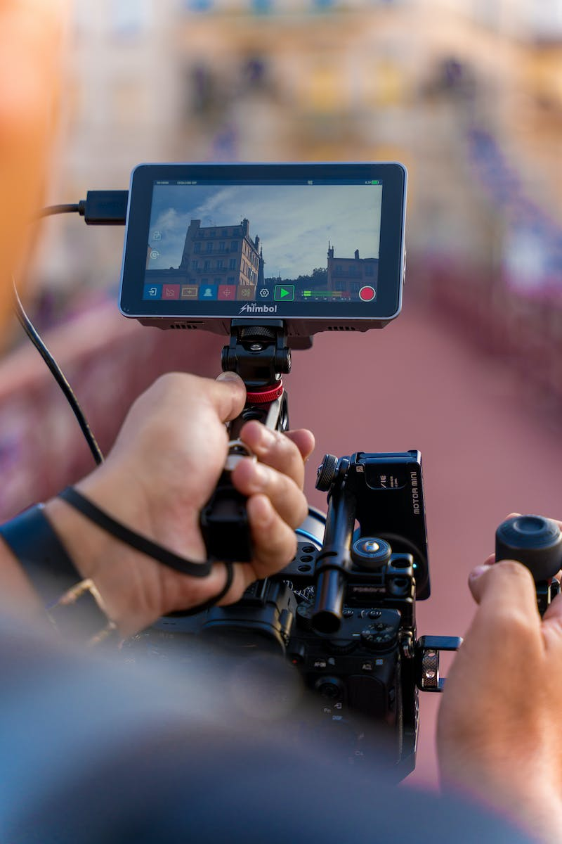
Conclusion: The Impact of Siemens' Technology
• Siemens' Technology: A Game-Changer
• Examining the Significance of Texts and Red Snow
• Reflecting on Siemens' Journey and Achievements
Photo by Pexels

