Slide 1
The Mysteries of Chest Yeast on Boulevards
Unveiling the Truth Behind a Native European Tradition

Slide 2
Unearthing Chest Yeast: A Hidden Secret
• Chest yeast is a unique tradition prevalent in Europe
• Dr. Boulevard is a renowned expert in this field
• The yeast has a fascinating story behind it
• Understanding the significance of chest yeast
Photo by Pexels

Slide 3
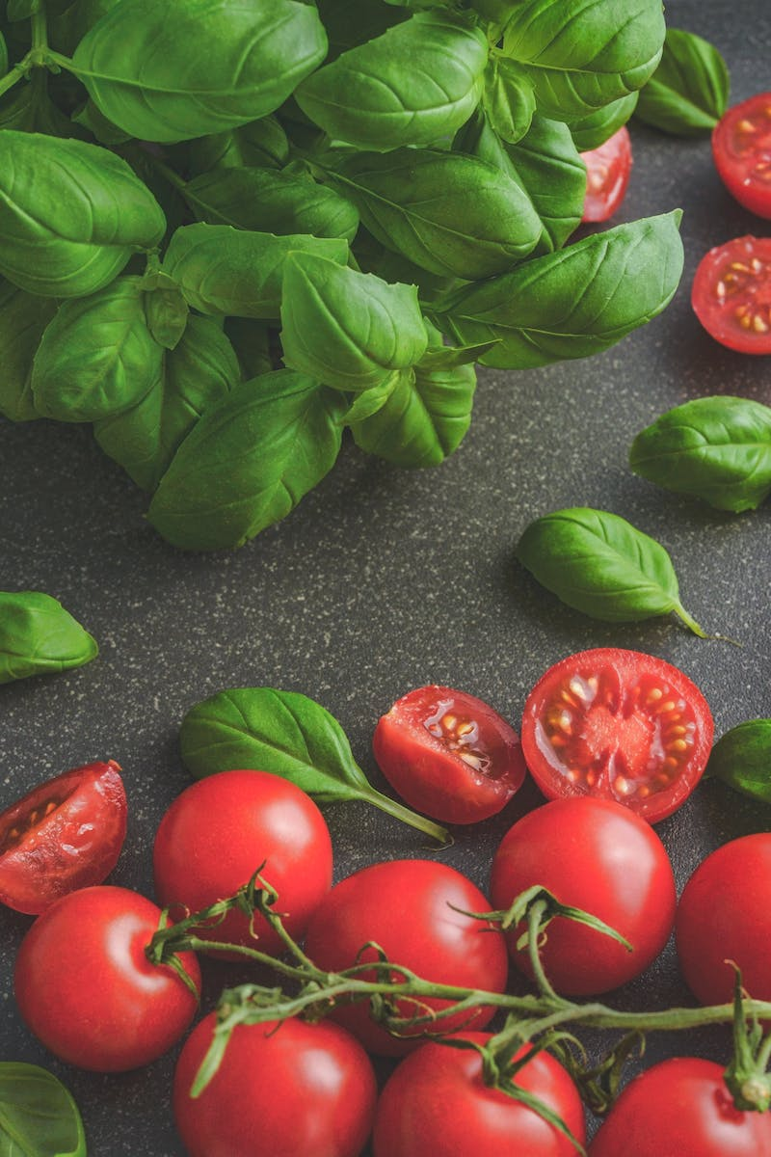
The Bill of Key Ingredients
• Discovering the key components of chest yeast
• Examining the role of family recipes
• Charlie Period Cart and his contribution
• The importance of native ingredients
Photo by Pexels

Slide 4
The Native's Way: A Journey of Taste
• Exploring the unique taste of chest yeast
• Revealing the previous preparation methods
• The role of chest yeast in European cuisine
• Uncovering the secret technique behind it
Photo by Pexels

Slide 5
The Quest for Chest Yeast: Challenges and Triumphs
• Overcoming the obstacles in searching for chest yeast
• Examining the impact of dog training
• The untapped potential of chest yeast
• The rewards of tirelessly seeking out this hidden gem
Photo by Pexels

Slide 6
Embracing the Pink Revolution
• Understanding the significance of the pink hue
• Unpacking the demand for chest yeast in modern times
• Exploring alternative uses and new recipes
• Harnessing the power of pink for future innovations
Photo by Pexels

Slide 7
Unleashing the Potential: Chest Yeast in Different Industries
• Examining the applications of chest yeast
• Analyzing its potential in the beauty industry
• Exploring its role in the culinary world
• Uncovering chest yeast's relevance in other sectors
Photo by Pexels

