Slide 1
The Impact of Telegram Ecosystem on Messages and Coins
Exploring the Growth and Potential of the Telegram Platform

Slide 2
Introduction to Telegram Ecosystem
• Telegram is a popular messaging app with a growing ecosystem
• Telegram allows users to send messages and exchange coins
• It has seen a significant increase in usage and engagement
• The ecosystem offers various features and opportunities
Photo by Pexels

Slide 3
The Role of Telegram Messages
• Telegram messages play a crucial role in connecting people
• Messages are secure, fast, and can be exchanged in large groups
• Telegram provides various features like stickers, GIFs, and voice messages
• The messaging platform has gained popularity among different user demographics
Photo by Pexels

Slide 4
The Rise of Telegram Coins
• Telegram coins have gained traction as a digital currency
• Coins can be used for various purposes within the Telegram ecosystem
• The adoption of Telegram coins has increased significantly
• They offer a decentralized and secure method of financial transactions
Photo by Pexels

Slide 5
Seventy Percent of Mag City and Its Significance
• Mag City has seen a growth of seventy percent in its Telegram ecosystem
• This growth indicates the potential and demand for Telegram services
• Mag City is a prime example of successful Telegram ecosystem implementation
• The city serves as a source of inspiration for other communities
Photo by Pexels

Slide 6
Serving the Welcome: Enhancing User Experience
• Improving user experience is a priority in the Telegram ecosystem
• Efforts are focused on providing a seamless and welcoming environment
• Features like welcome messages and onboarding tutorials are implemented
• Telegram aims to create an inclusive and user-friendly platform
Photo by Pexels

Slide 7
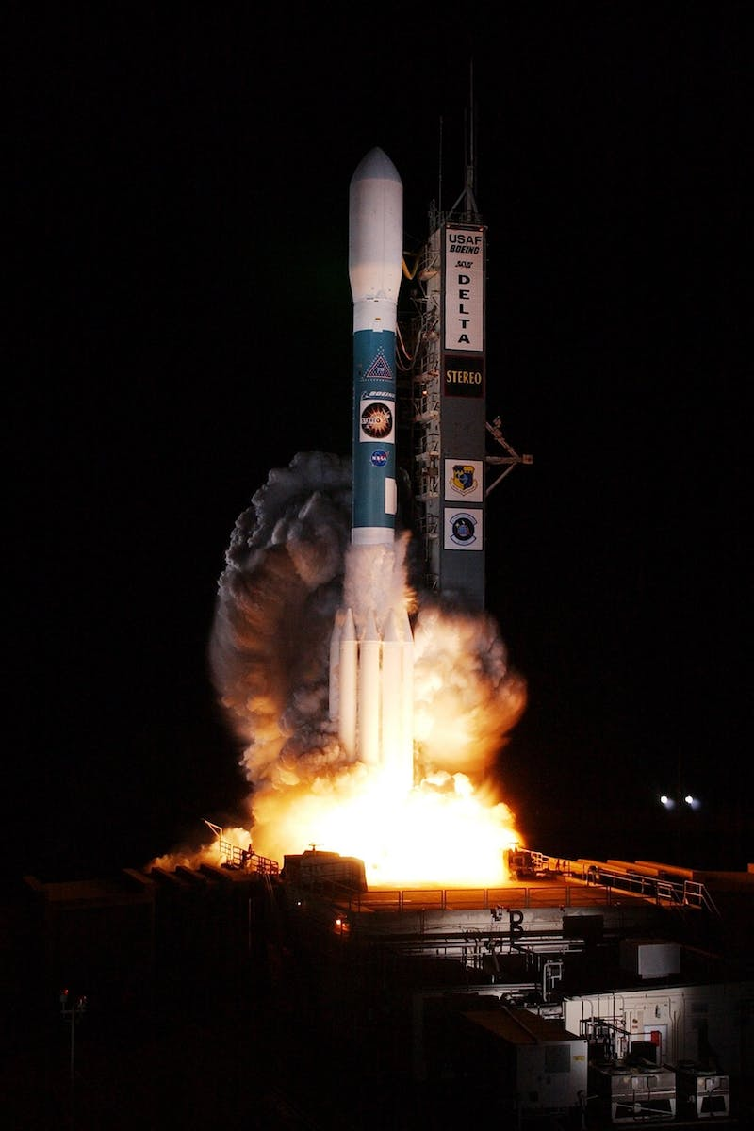
The Bonus of Rocket Percent and Its Benefits
• Rocket percent offers bonuses for users within the Telegram ecosystem
• These bonuses incentivize engagement and participation
• Users can earn rewards based on their activities and contributions
• The bonus system fosters a vibrant and active community
Photo by Pexels

Slide 8
Token Will Touch: The Executive Creation
• Token Will Touch is an executive creation within the Telegram ecosystem
• It offers a platform for token creation and management
• Users can create their own tokens for various purposes
• The executive creation of tokens adds value to the Telegram ecosystem
Photo by Pexels

Slide 9
Conclusion: Bright Future Ahead
• The Telegram ecosystem has a bright future with immense potential
• Continuous innovation and improvement drive its growth
• Telegram's focus on security and user experience sets it apart
• As more users join the ecosystem, its impact will only increase
Photo by Pexels

