Slide 1
The Power of Artificial Intelligence
Harnessing the Potential of AI for the Future

Slide 2
Introduction to AI
• AI is the simulation of human intelligence in machines
• It involves the ability to learn, reason, and problem-solve
• AI has the potential to revolutionize industries and enhance human lives
• Current AI applications include natural language processing and image recognition
Photo by Pexels

Slide 3
Machine Learning
• Machine learning is a subset of AI
• It involves training algorithms to learn from data and make predictions
• Supervised learning, unsupervised learning, and reinforcement learning are common machine learning techniques
• Applications of machine learning include personalized recommendations and fraud detection
Photo by Pexels

Slide 4
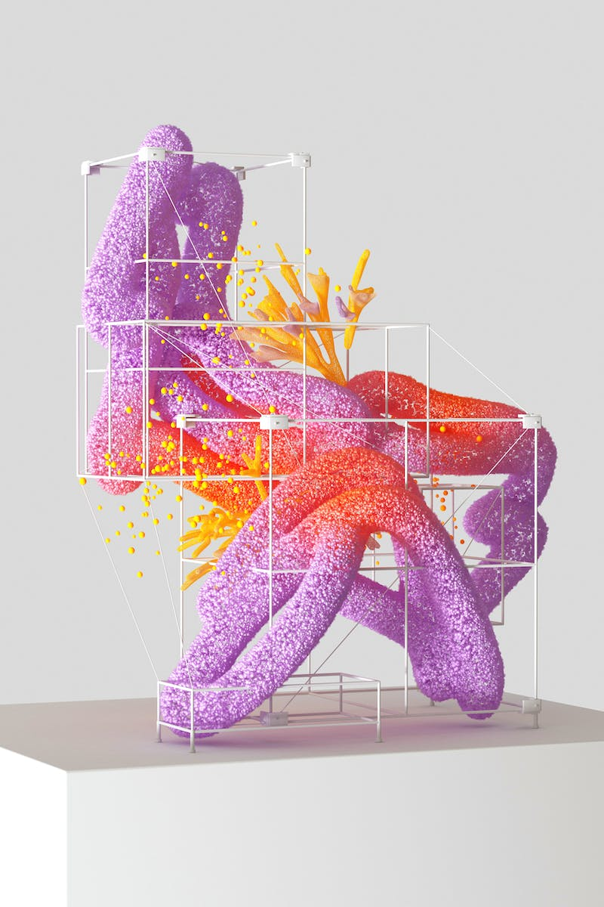
Deep Learning
• Deep learning is a subset of machine learning
• It focuses on training artificial neural networks with multiple layers
• Deep learning enables the processing of large, complex datasets for pattern recognition
• Applications of deep learning include speech recognition and autonomous vehicles
Photo by Pexels

Slide 5
Natural Language Processing
• Natural Language Processing (NLP) allows computers to understand and interact with human language
• NLP techniques include sentiment analysis, language translation, and chatbots
• NLP facilitates improved customer service, language processing automation, and content analysis
• NLP is used in virtual assistants like Siri and Alexa
Photo by Pexels

Slide 6
AI Ethics and Limitations
• AI raises ethical concerns around privacy, bias, and job displacement
• Developing regulations and standards is crucial for responsible AI implementation
• AI's limitations include lack of common sense reasoning and overdependence on data quality
• Understanding AI's limitations is essential for setting realistic expectations
Photo by Pexels

