Slide 1
Network Interface Configuration
Optimizing settings for improved performance

Slide 2
Introduction
• Overview of network interface configuration
• Importance of optimizing settings
• Summary of the current network setup
• Goals for improving performance
Photo by Pexels

Slide 3
Current Interface Configuration
• Problems with the current configuration
• Interface not operating normally
• Troubleshooting steps taken
• Interfaces and port channels affected
Photo by Pexels

Slide 4
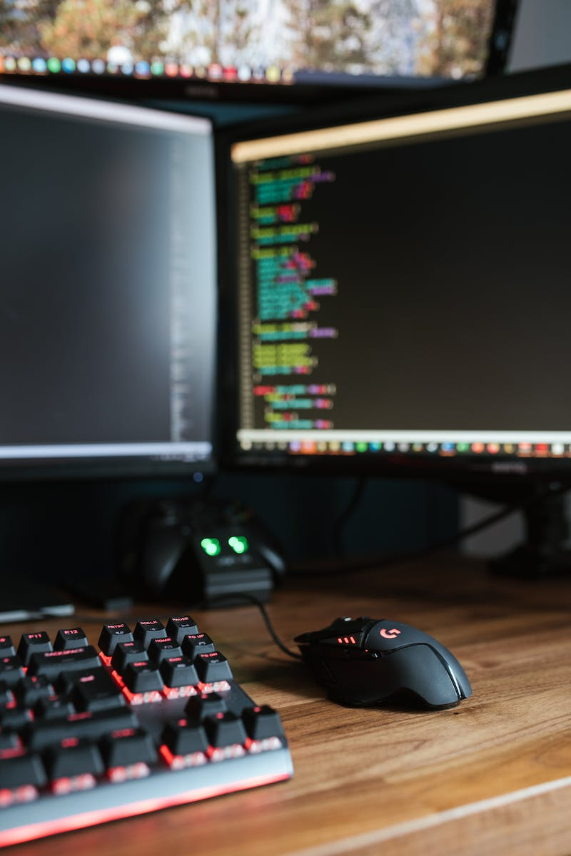
Optimizing Interface Configuration
• Configuring interface for renewable problem
• Trunk and caps dot settings
• Parameters for interface port channels
• Configuring Ethernet interface
Photo by Pexels

Slide 5
Troubleshooting Laser Channel
• Issue with laser channel
• Protocol-related command
• Link aggregation and use
• Formats for laser channel
Photo by Pexels

Slide 6
Port Channel Configuration
• Configuring port channel
• Link aggregation timing
• Counter and neighbor settings
• IP interface channel
Photo by Pexels

Slide 7
Network Status
• Monitoring network status
• Interface and port channel status
• Checking interface status
• Network inconsistency issues
Photo by Pexels

Slide 8
Conclusion
• Summary of key points covered
• Importance of optimizing interface configuration
• Next steps for improving network performance
• Closing remarks
Photo by Pexels

