Slide 1
The Power of Tofacitinib in Dermatology
Exploring the Clinical Applications and Efficacy of a Novel Drug

Slide 2
Introduction
• Tofacitinib is a novel drug used in dermatology
• It is gaining popularity in Pakistan and has numerous clinical applications
• Approved by FDA in 2012
• Mechanism of action: Inhibitor of enzyme genus kinase
• Blocks inflammatory effects of diseases

Slide 3

Medical Indications
• FDA approved for rheumatoid arthritis in 2012
• Also approved for ulcerative colitis and ankylosing spondylitis
• Significant improvement observed in phase 3 trials for ulcerative colitis
• Surprising approval for severe and critical COVID-19 patients
Photo by Pexels

Slide 4
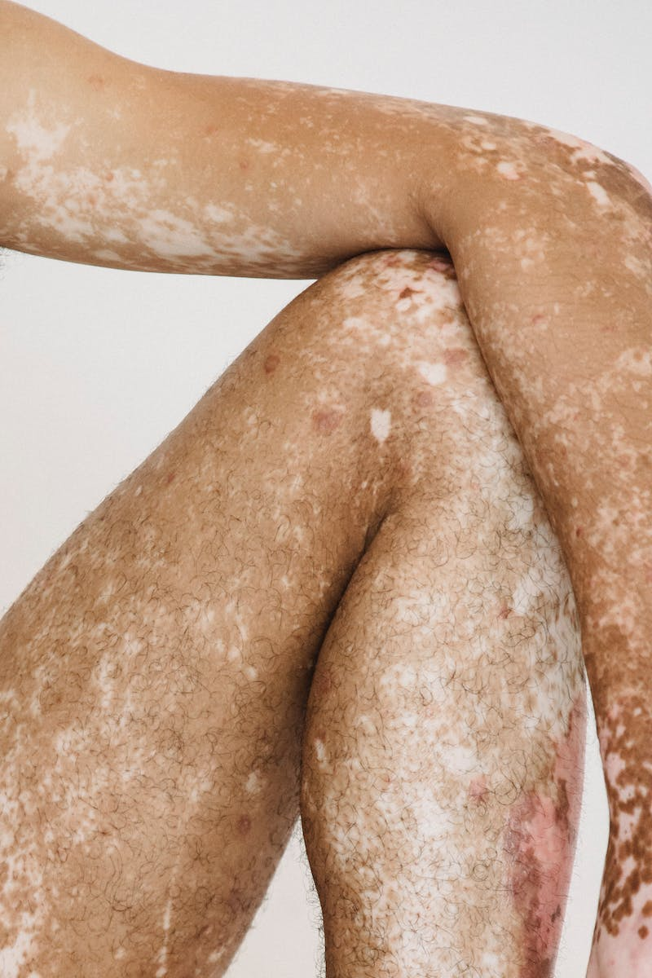
Tofacitinib in Dermatological Conditions
• Promising treatment for psoriasis and psoriatic arthritis
• Clinical trials show reasonable efficacy in both conditions
• Effective topical treatment option for psoriasis
• Potential application in alopecia areata and vitiligo
• Improvement shown in atopic eczema
Photo by Pexels

Slide 5

Safety Profile and Precautions
• Relatively safe with low incidence of serious side effects
• Common side effects include headache and diarrhea
• Caution in specific populations like older adults and pregnant women
• Thorough investigations required before prescribing tofacitinib
• Potential risk of serious infections and other complications
Photo by Pexels

Slide 6

Conclusion
• Tofacitinib is a valuable addition to dermatology treatment in Pakistan
• Well-tolerated with fewer side effects compared to other drugs
• Effective in various dermatological conditions
• Requires careful monitoring and investigations before prescription
Photo by Pexels

