Slide 1
The Importance of Dung in Ecosystems
Exploring the Surprising Benefits of Animal Waste

Slide 2
Slide 1: Introduction
• Dung plays a vital role in ecosystem health
• Often overlooked, it serves as a rich source of nutrients
• Dung provides habitat and food for various organisms
• Let's delve into the fascinating world of animal waste
Photo by Pexels

Slide 3
Slide 2: Nutrient Cycling
• Dung is a natural fertilizer for plants
• It provides essential elements like nitrogen, phosphorus, and potassium
• Nutrient cycling facilitated by dung helps maintain soil fertility
• Without dung, ecosystems can suffer from nutrient depletion
Photo by Pexels

Slide 4
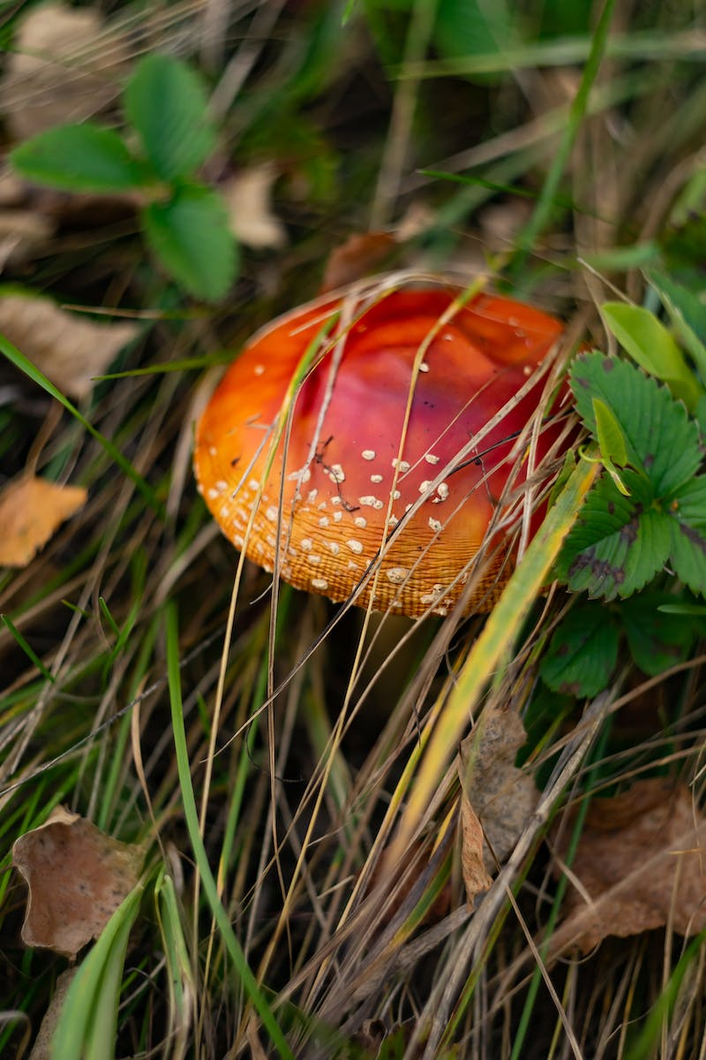
Slide 3: Biodiversity and Habitat
• Dung attracts a diverse array of organisms
• Insects, microbes, and scavengers rely on dung for food and habitat
• Biodiversity is enhanced by the presence of dung in ecosystems
• These organisms play critical roles in ecosystem functioning
Photo by Pexels

Slide 5
Slide 4: Dung as Medicine
• Traditional medicine uses dung in various remedies
• Dung contains compounds with medicinal properties
• Historically used to treat ailments and enhance healing
• Some modern research supports the efficacy of dung-based treatments
Photo by Pexels

Slide 6
Slide 5: Conclusion
• Dung is an underappreciated player in ecosystem dynamics
• Its diverse benefits contribute to overall ecosystem health
• Understanding the importance of dung can aid conservation efforts
• Let's appreciate the value of animal waste in creating balanced ecosystems
Photo by Pexels

