Slide 1
The Mystery of Language Acquisition
Exploring the Origins and Mechanisms of Human Language

Slide 2
Introduction
• Language sets humans apart from other animals
• Young children learn new languages effortlessly
• Debate between innate ideas and blank slate
• American Linguist Noam Chomsky's perspective
Photo by Pexels

Slide 3
The Poverty of Stimulus
• Children lack sufficient information for complex grammar
• Despite this, they generate unlimited new sentences
• Implication: Something beyond stimulus is at play
• Highlight the need for innate structures in the brain
Photo by Pexels

Slide 4
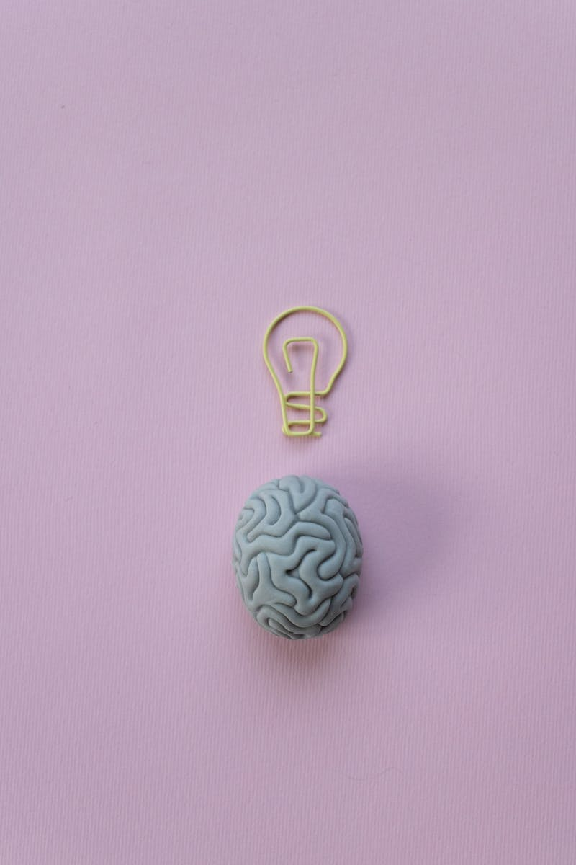
Language Acquisition Device (LAD)
• Chomsky's hypothesis: Innate structures in our brain
• LAD provides a natural propensity to organize language
• Allows interpretation of spoken language into grammar
• Essential for language learners to begin their journey
Photo by Pexels

Slide 5
Universal Grammar
• Chomsky's proposition: Language structure is hardwired
• Universal Grammar as a set of linguistic principles
• Explains the universality and diversity of languages
• Suggests a shared linguistic foundation across humans
Photo by Pexels

Slide 6
Conclusion
• Language acquisition: A product of nature and nurture
• Innate structures combined with environmental inputs
• Deeper understanding of human language acquisition
• Implications for education, language acquisition disorders
Photo by Pexels

