Slide 1
What If the Universe is Small?
Exploring Exocontinents, Stellar Explosions, and the Size of the Observable Universe

Slide 2
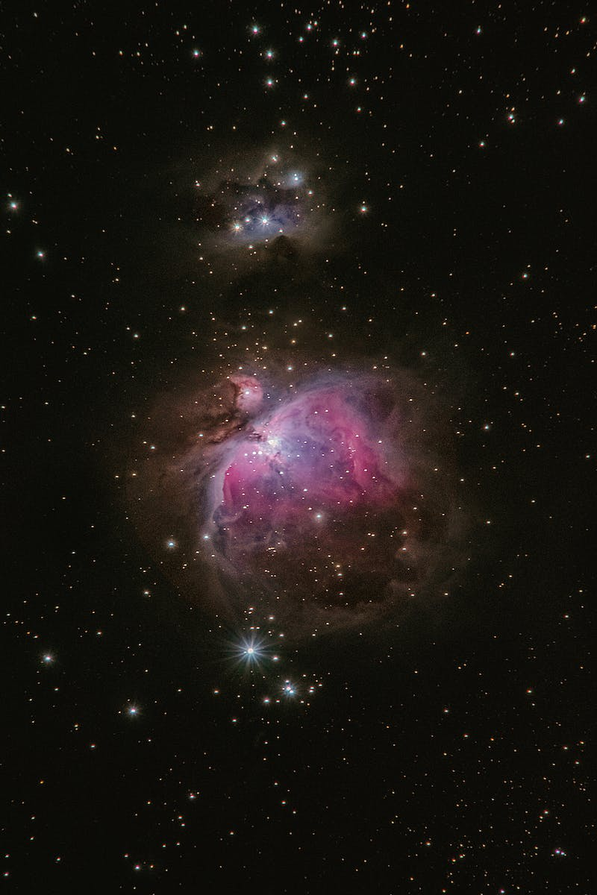
Introduction
• The universe may be smaller than we think
• Exocontinents and their connection to life
• Exploring and predicting stellar explosions
• The limitations of our observable universe
Photo by Pexels

Slide 3
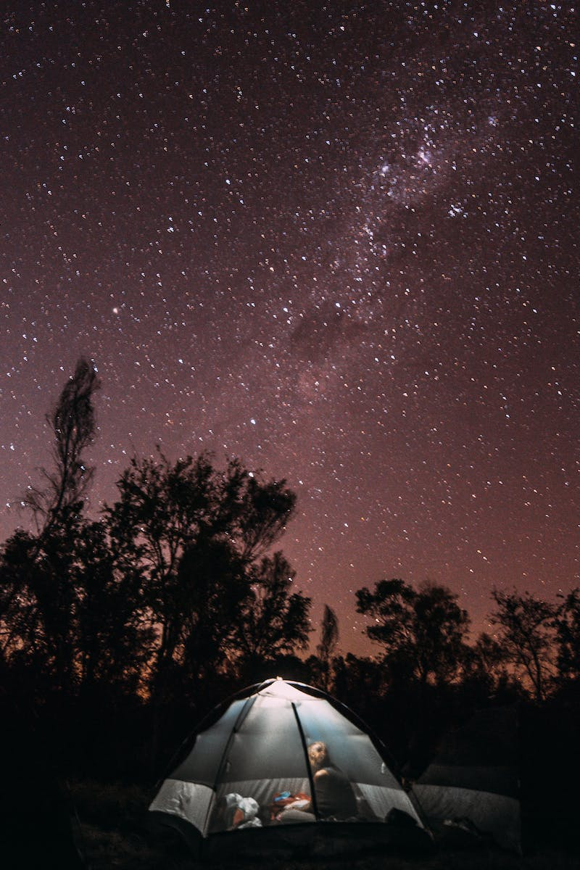
The Horizon of Observation
• The observable universe is limited by the speed of light
• We are confined to a bubble of observation
• Each observer has their own observable universe
• The boundaries of our observable universes differ even if we are close
Photo by Pexels

Slide 4
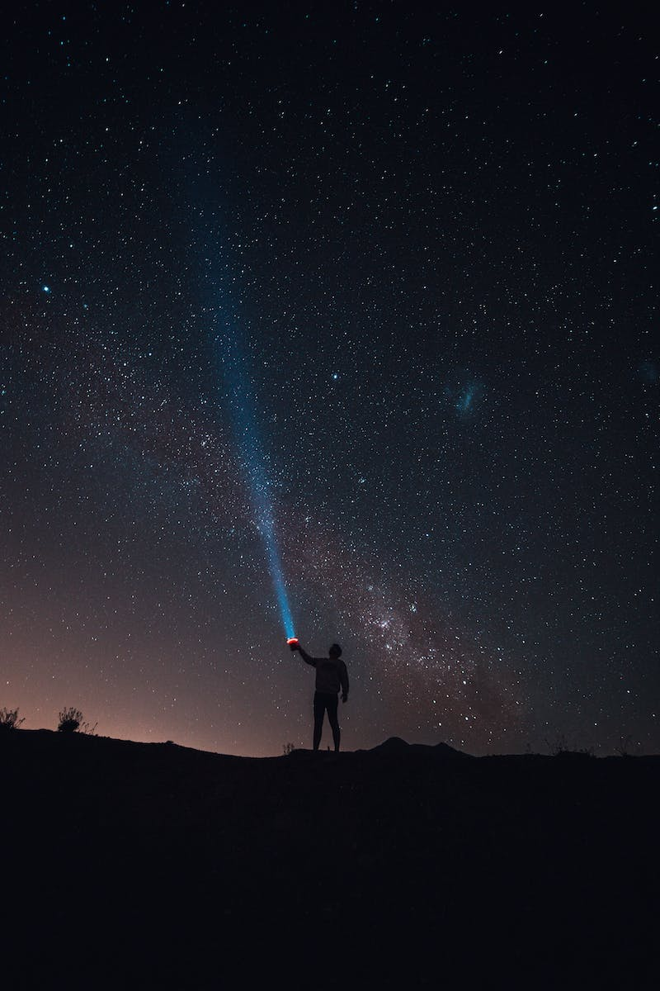
The Unknown Beyond the Horizon
• Direct knowledge of what lies beyond the horizon is limited
• Speculative assumptions about the nature of the universe
• Possible existence of similar universes beyond the observable
• The challenge of definitively understanding the universe's extent
Photo by Pexels

Slide 5
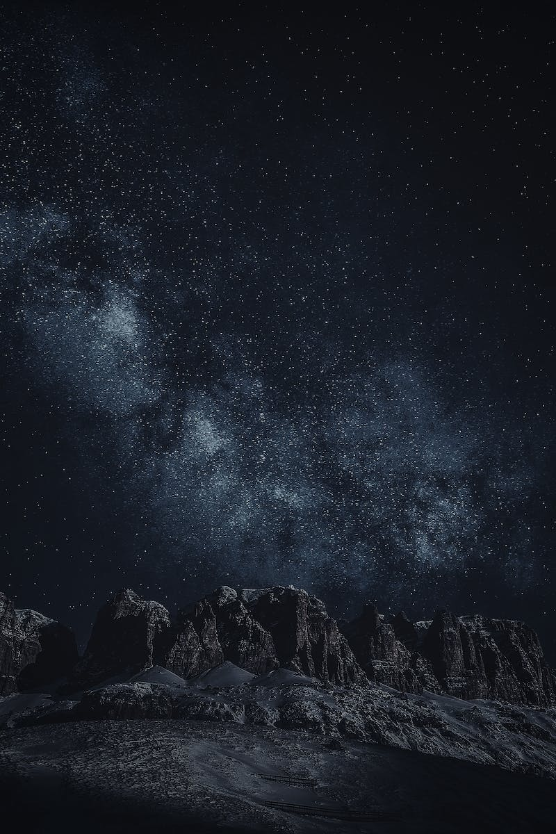
The Size of the Observable Universe
• The observed universe is vast by our standards
• Comparing the size of galaxies to familiar objects
• The scale of the Milky Way galaxy
• Estimates of the size of the observable universe
Photo by Pexels

Slide 6
Speculation: The Small Universe Hypothesis
• The possibility of the universe being smaller than observed
• Inflation models suggest a much larger universe
• Proposing a model where the universe is comparatively small
• Implications for the search for extraterrestrial life
Photo by Pexels

Slide 7
Continents and the Possibility of Life
• The role of tectonic plates and continents in creating habitable conditions
• Potential for life on planets without active tectonics
• The importance of continents for long-term biosphere development
• Searching for exoplanets with continent-like features
Photo by Pexels

Slide 8
Finding Planets with Continents
• The challenge of detecting continents on distant exoplanets
• Using spectroscopic analysis and composition estimates
• Estimating the prevalence of radioactive isotopes in a planetary system
• The potential for identifying planets with suitable conditions for life
Photo by Pexels

Slide 9
The Fate of Earth and Life
• The eventual end of Earth due to the aging Sun
• The potential extinction of complex life within 250 million years
• Supercontinents, increasing volcanism, and growing solar luminosity
• The importance of understanding the evolution and future of our planet
Photo by Pexels

Slide 10
Conclusion
• The universe is full of mysteries and possibilities
• Continued exploration and observation will provide more insights
• The search for life and the understanding of planetary evolution
• The importance of curiosity and scientific inquiry
Photo by Pexels

