Slide 1
Understanding India's Climate
Exploring the Factors and Variations

Slide 2
Introduction to Climate and Weather
• Climate is the average weather condition of a particular region over a long period of time.
• Weather refers to the state of the atmosphere at any point in time.
• Understanding the difference between climate and weather is key.
• Climate is more stable and predictable, while weather can change rapidly.
Photo by Pexels

Slide 3
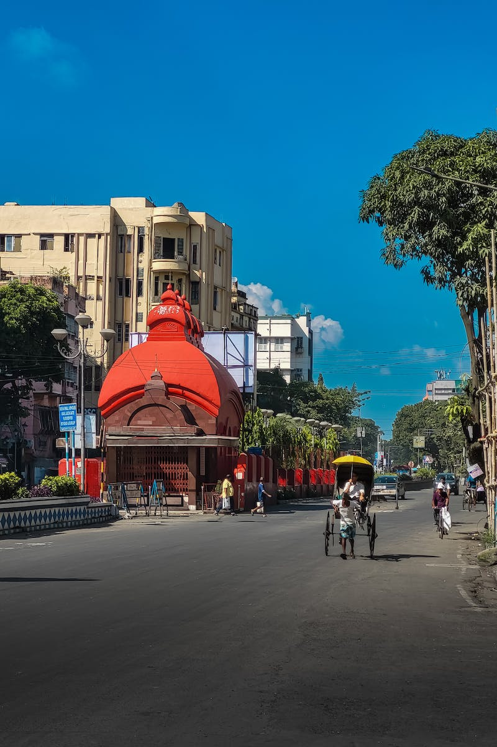
Climate of India
• India has diverse climate conditions due to its varied geography.
• Temperature, precipitation, and other climate factors vary significantly across different regions of the country.
• Discussing the climate of India provides insights into its unique environmental characteristics.
Photo by Pexels

Slide 4
Factors Affecting India's Climate
• India's climate is influenced by several key factors.
• Latitude, altitude, pressure and wind systems, distance from the sea, ocean currents, and relief features all play a role in shaping the climate of India.
• Explore each factor and its impact on India's climate.
Photo by Pexels

Slide 5
Impact of Latitude on India's Climate
• Latitude plays a significant role in determining India's climate.
• The Tropic of Cancer and the Tropic of Capricorn mark the boundaries of the tropical climate zone.
• Regions near these latitudes experience distinct climatic patterns.
• Discuss how latitude affects India's climate and its implications.
Photo by Pexels

Slide 6
Altitude and Climate in India
• Altitude plays a significant role in shaping India's climate.
• Mountainous regions experience different climate conditions compared to low-lying areas.
• Discuss the impact of altitude on India's climate and its implications for the country's diverse ecosystems.
Photo by Pexels

Slide 7
Pressure and Wind Systems in India
• Pressure and wind systems have a significant impact on India's climate.
• Discuss the high and low-pressure systems and how they influence weather patterns.
• Explore the role of jet streams and their seasonal variations in India's climate.
• Explain the Indian monsoon and its importance in understanding India's weather and climate.
Photo by Pexels

Slide 8
Ocean Currents and India's Climate
• Ocean currents play a significant role in shaping India's climate.
• Describe the constant flow of ocean water in definite patterns.
• Discuss how ocean currents influence India's climate and local weather conditions.
• Explain the connection between ocean currents and monsoons in India.
Photo by Pexels

Slide 9
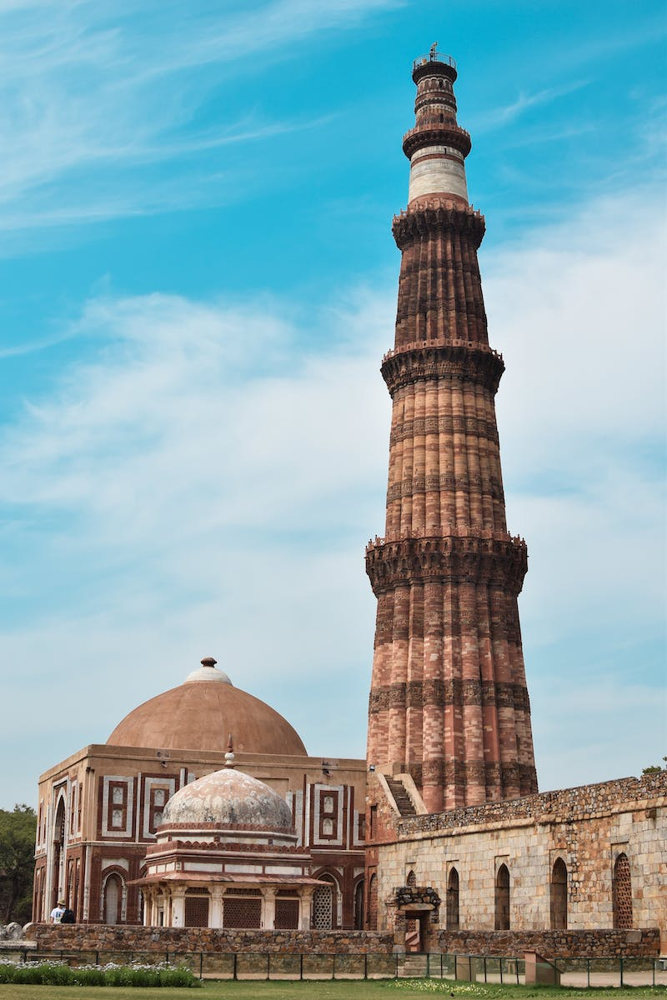
Relief Features and Climate in India
• Relief features have a significant impact on India's climate.
• Mountains and other topographical variations create distinct climate conditions.
• Discuss how relief features affect India's climate and contribute to regional variations.
• Explore the ecological diversity resulting from relief features in India.
Photo by Pexels

Slide 10
Conclusion: Understanding India's Climate
• India's climate is influenced by several factors, including latitude, altitude, pressure and wind systems, ocean currents, and relief features.
• These factors contribute to the country's diverse climate conditions and ecological variations.
• Understanding India's climate is crucial for various sectors, from agriculture to tourism.
• Appreciating the complexities of India's climate enhances our understanding of the country's unique environmental characteristics.
Photo by Pexels

