Slide 1
The Significance of Props in Photography
Enhance your Photos with the Right Props

Slide 2
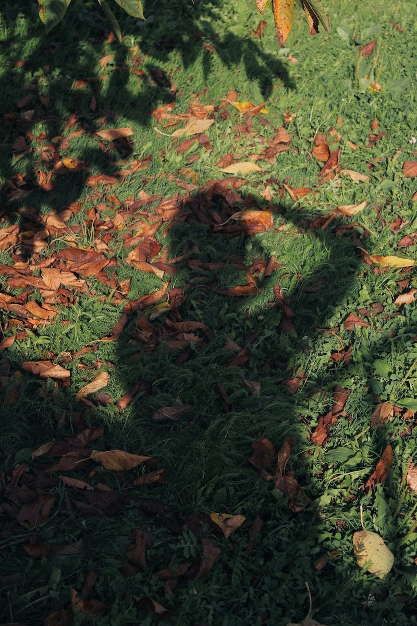
Introduction
• Requisites are an integral part of photography
• They add complexity and interest to the composition
• Start with a photo background to create a compelling composition
• Use lighter shades like gray or beige for a pleasing effect
Photo by Pexels

Slide 3
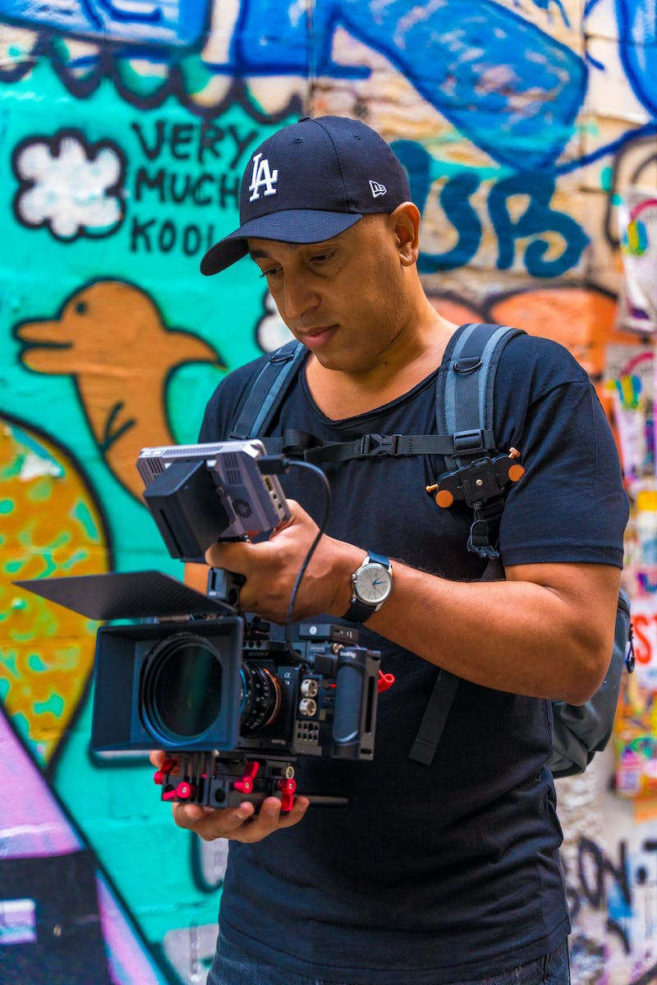
Photography Backdrops
• Photofons are convenient for creating complex compositions
• Avoid black and dark shades as they may lead to overexposure
• Gray, cool-toned, or beige backdrops are recommended
• Yellow backdrops can distort skin tones
Photo by Pexels

Slide 4
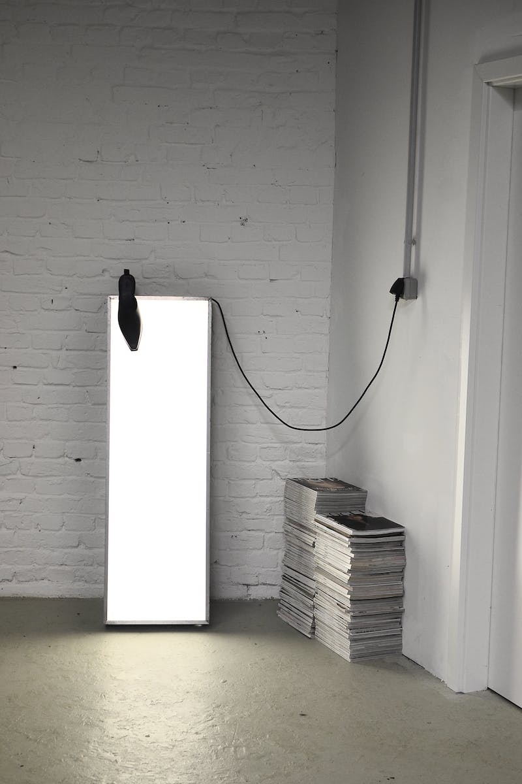
Magazines and Covers
• Magazines and covers can add aesthetics to your photos
• Use them for creative compositions or as backgrounds
• Vintage or hard-to-find magazines can be sourced online
• Explore options like Vox or old magazine issues
Photo by Pexels

Slide 5
Posters and Newspaper Clippings
• Imitate newspapers, book covers, or magazine covers with posters
• Add visual interest to your photos with these props
• Search for posters with appealing designs
• You can also use old newspaper clippings
Photo by Pexels

Slide 6
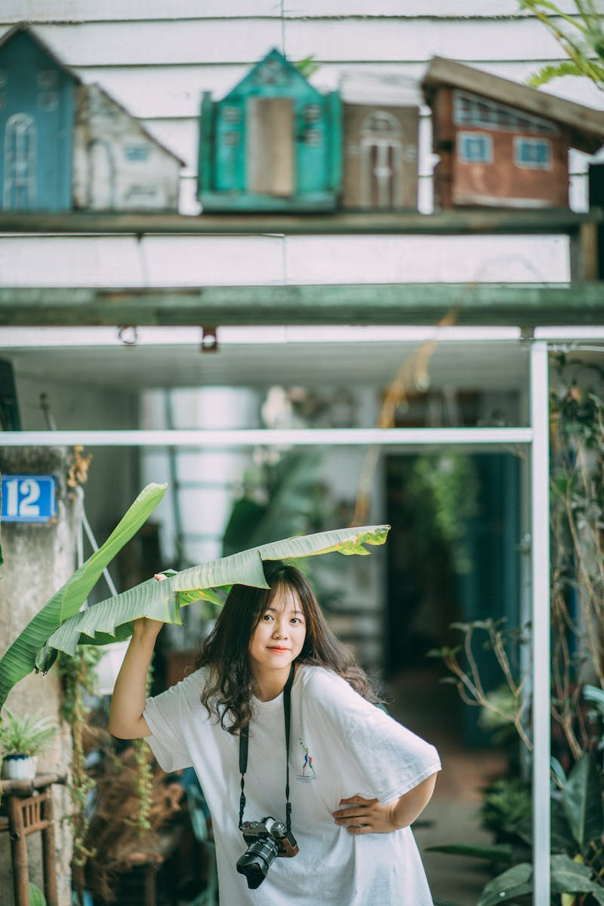
Plants and Foliage
• Choose high-quality plants for a visually pleasing effect
• Avoid plastic or cheap-looking foliage
• Use dried eucalyptus branches for a unique touch
• Don't overcrowd the frame with excessive foliage
Photo by Pexels

Slide 7
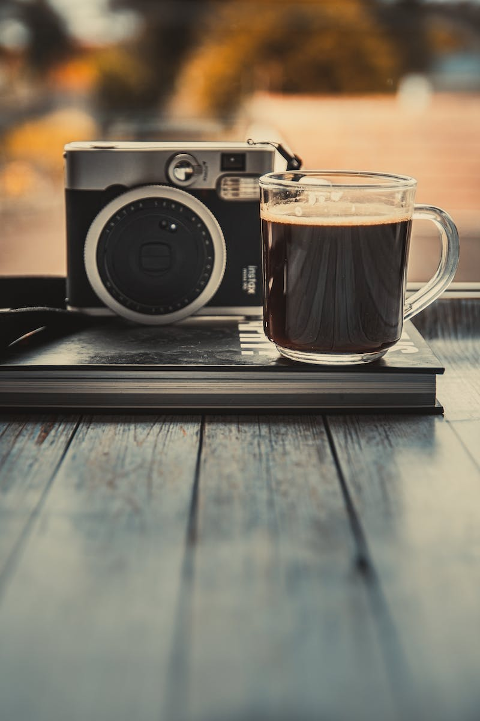
Minimalistic Accessories
• Choose minimalist accessories that don't overpower the composition
• Avoid flashy or distracting elements
• Subtle accessories can enhance the overall aesthetic
• Examples include simple rings, delicate bracelets, or elegant handbags
Photo by Pexels

Slide 8
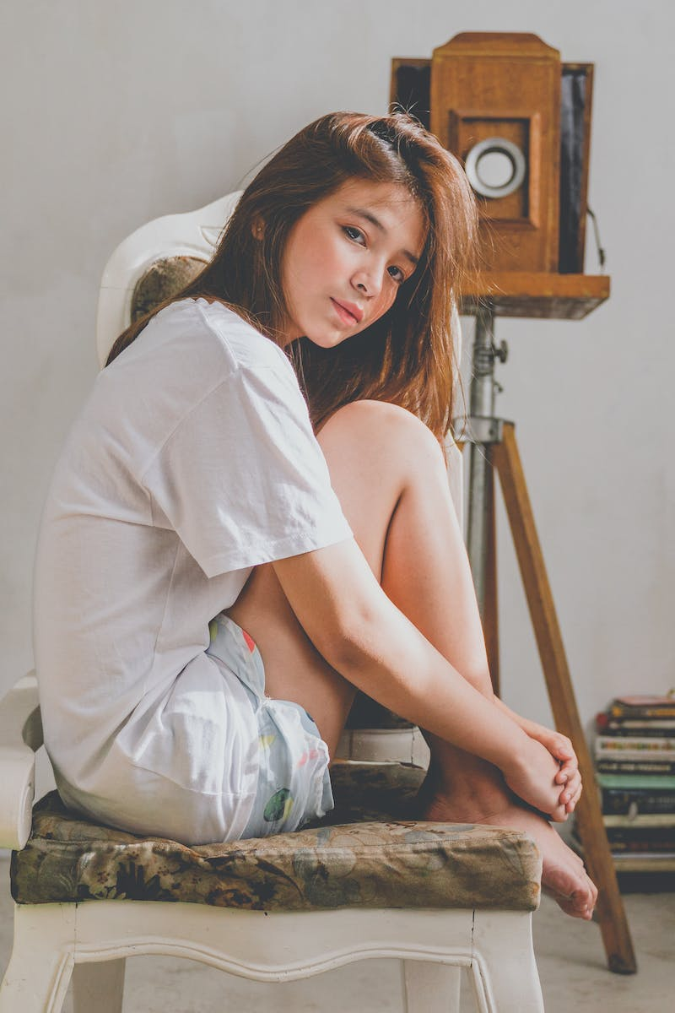
Clothing and Apparel
• Use clothing items to enhance the overall composition
• Consider lending or purchasing basic shirts or jackets
• Layering clothes can create interesting visuals
• Experiment with different styles and colors
Photo by Pexels

Slide 9
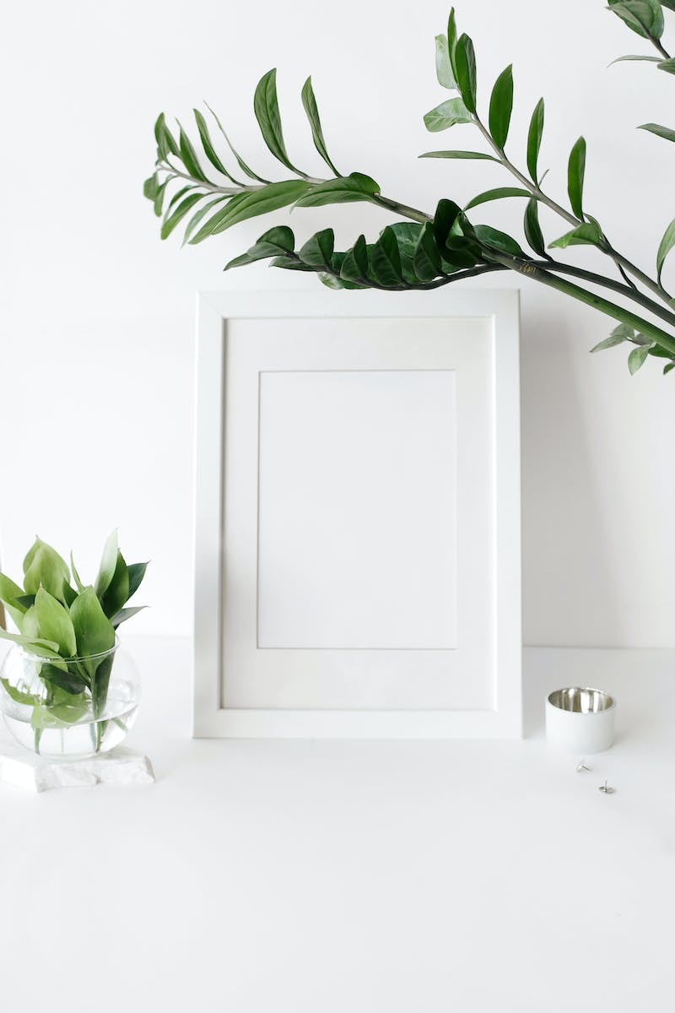
Conclusion
• Utilize props to enhance your photography compositions
• Choose props of good quality and visual appeal
• Avoid using cheap or artificial-looking props
• Create visually appealing and captivating images
Photo by Pexels

