Slide 1
Introducing AudioRead: Revolutionize your listening experience
Enhance productivity, learn on the go, and multitask like never before

Slide 2
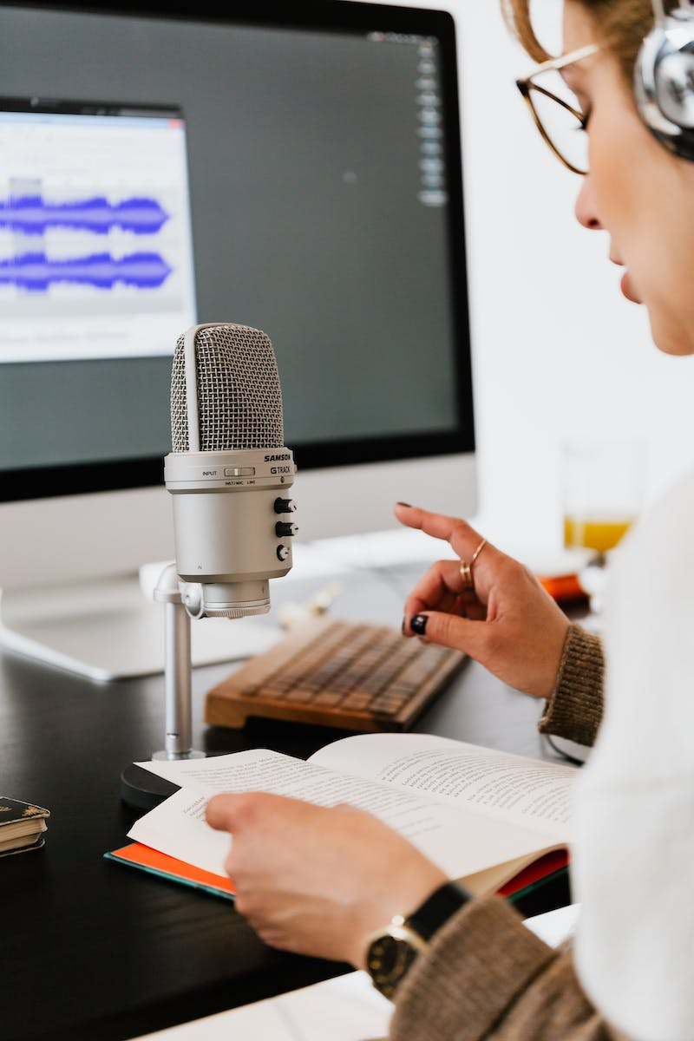
Welcome to AudioRead
• The new audio reading program
• Use AI to listen to articles, PDFs, emails, and more in your podcast player
• Read while walking, driving, cleaning, and more
• Experience scar good audio quality
Photo by Pexels

Slide 3
Ultra Realistic Text-to-Speech Engine
• Our advanced text-to-speech engine delivers ultra-realistic narration
• Convert any text into professional audio
• Designed for long-form listening
• Indistinguishable from real audio recordings
Photo by Pexels

Slide 4
Simple Conversion on Any Device
• Convert text into audio in just two clicks
• Available on web app, browser extension, iOS shortcut, and Android app
• Various options to convert text, including emails, PDFs, and more
• Listen on any podcast app or in-browser playback
Photo by Pexels

Slide 5
Private Podcast Subscription
• Create and subscribe to your own private podcast
• Generate a private RSS feed
• Listen to articles, PDFs, emails, and more on popular podcast platforms
• Ideal for podcast enthusiasts and busy professionals
Photo by Pexels

Slide 6
Flexible Options for Various Browsing Habits
• Use the web app for instant text-to-audio conversion
• No need to install a podcast app
• Browser extension for seamless conversion and saving web articles
• Safari and Chrome compatibility for Mac and Android users
Photo by Pexels

Slide 7
Maximize Productivity and Convenience
• Increase productivity and multitask effectively
• Listen to articles, PDFs, emails, and other texts
• No installation required on computer or phone
• Perfect for professionals and learners on the go
Photo by Pexels

Slide 8
Thank You for Watching!
• Likes and subscriptions are greatly appreciated
• Stay tuned for the next video from...
•
Photo by Pexels

