Slide 1
The Top Backyard Layer Chickens
Choosing the Best Breed for Your Chicken Farm

Slide 2
Introduction to Backyard Layer Chickens
• Understanding the importance of breed selection
• Factors to consider before starting a chicken farm
• Overview of the top backyard layer chickens
• Benefits of raising backyard layer chickens
Photo by Pexels

Slide 3
Top Backyard Layer Chicken Breeds
• Rhode Island Red
• Plymouth Rock
• Sussex
• Leghorn
• Wyandotte
• Ameraucana
• Orpington
Photo by Pexels

Slide 4
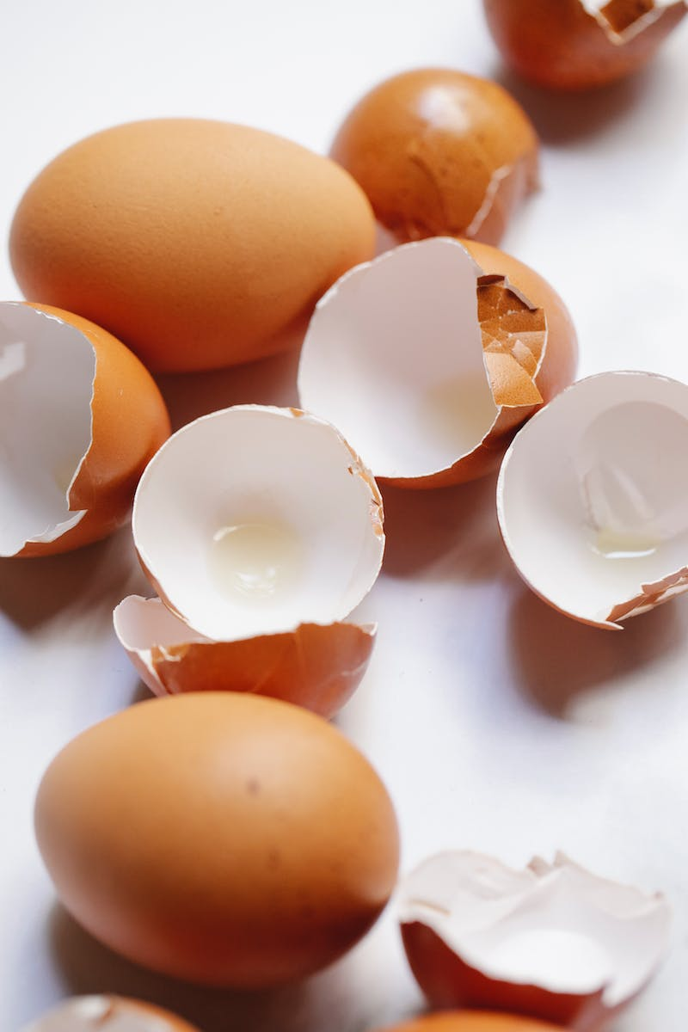
Egg Production and Starting Lay
• Number of eggs laid by each breed
• Age at which the breeds start to lay
• Considerations for optimal egg production
• Factors affecting egg production
Photo by Pexels

Slide 5
Egg Size, Color, and Origin
• Variations in egg size across breeds
• Diversity of egg colors and patterns
• Origins of different breeds
• Factors influencing egg size and color
Photo by Pexels

Slide 6
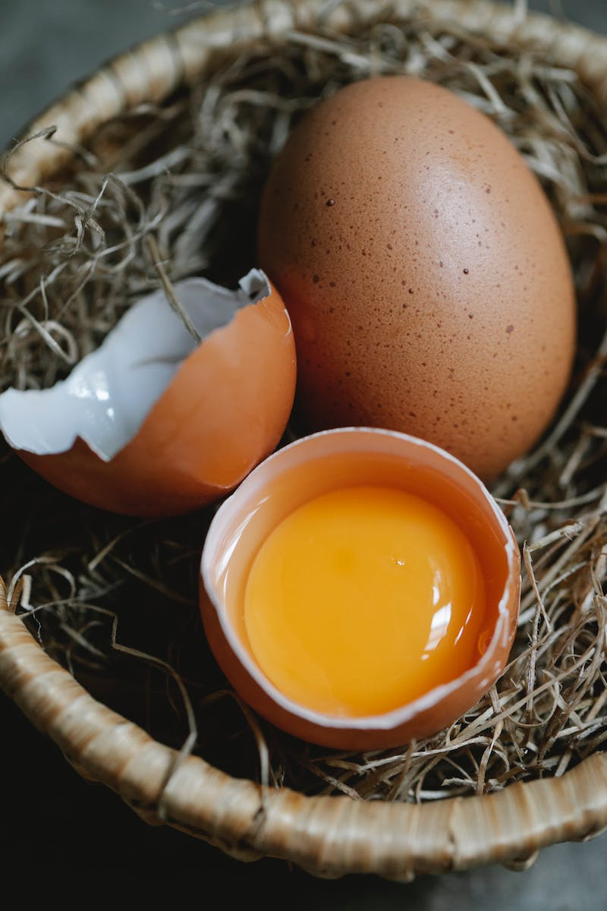
Best Practices for Keeping each Breed
• Environment requirements for each breed
• Feed and nutrition considerations
• Health and care guidelines for optimal well-being
• Suitability for free-range or confined environments
• Compatibility with other chicken breeds
Photo by Pexels

Slide 7
Conclusion
• Recap of the top backyard layer chicken breeds
• Key considerations before choosing a breed
• Summarize the benefits of keeping backyard layer chickens
Photo by Pexels

