Slide 1
The Impact of Artificial Intelligence in Healthcare
Revolutionizing patient care through AI advancements

Slide 2
Introduction to Artificial Intelligence
• AI refers to the simulation of human intelligence in machines
• It allows machines to learn, reason, and problem-solve
• AI has made significant advancements in various industries
• Healthcare stands to benefit greatly from AI integration
Photo by Pexels

Slide 3
AI Applications in Diagnostics
• AI can analyze medical images with greater accuracy than humans
• It enables early detection of diseases, improving treatment outcomes
• AI algorithms can assist in diagnosing rare or complex conditions
• Automated diagnosis reduces reliance on overburdened radiologists
Photo by Pexels

Slide 4
Enhancing Patient Care with AI
• AI-powered chatbots can provide 24/7 patient support and triage
• Virtual assistants streamline administrative tasks, improving efficiency
• Predictive analytics help identify patients at risk of deteriorating health
• Precision medicine leverages AI to tailor treatments based on individual genetic profiles
Photo by Pexels

Slide 5
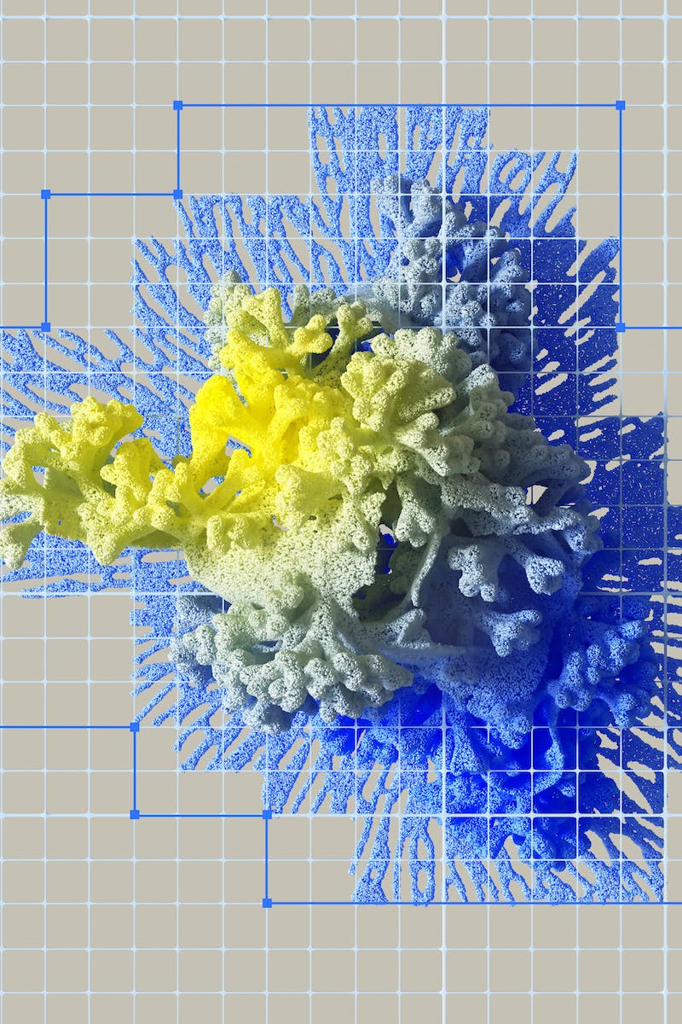
Ethical Considerations of AI in Healthcare
• AI raises concerns about patient privacy and data security
• Bias in algorithms can lead to unequal access to healthcare services
• Ensuring transparency and accountability in AI decision-making
• Striking a balance between human oversight and autonomous AI systems
Photo by Pexels

Slide 6
Future Directions in AI Healthcare Research
• AI-driven drug discovery for more efficient and targeted therapies
• Smart sensors and wearables for continuous health monitoring
• Precision public health interventions using AI predictive models
• Collaboration between AI experts and healthcare professionals
Photo by Pexels

