Slide 1
Journey to the Center of the Earth
An Exciting Adventure to Rescue Missus Father Gill

Slide 2
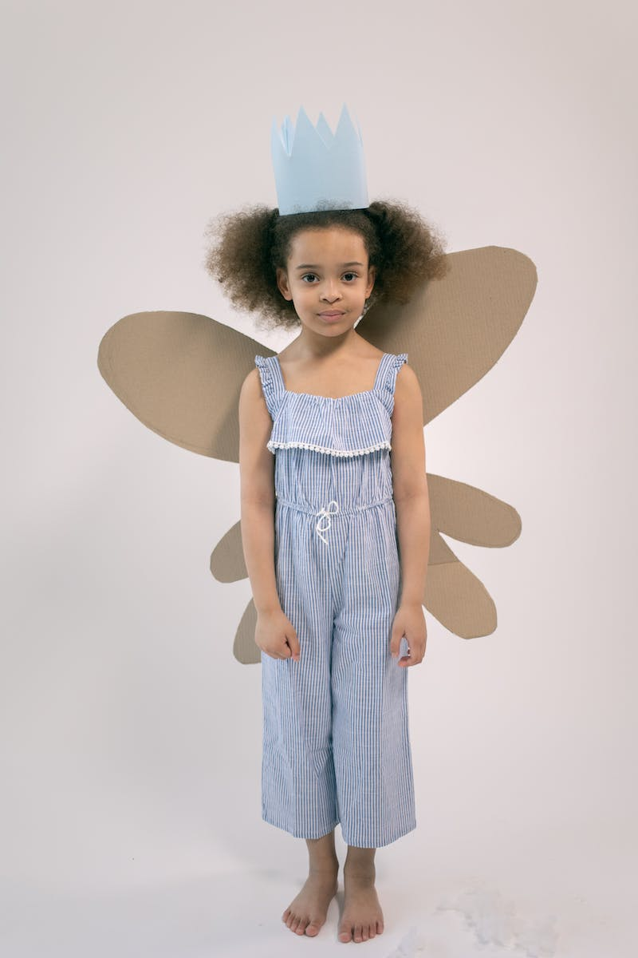
Introduction
• Somewhere, hidden amongst thorn bra bulls is a little kingdom of elves and fairies.
• Everyone who lives here is very, very small.
• Meet Princess Holly and Ben Elk.
• Today's adventure starts at the little castle.
Photo by Pexels

Slide 3
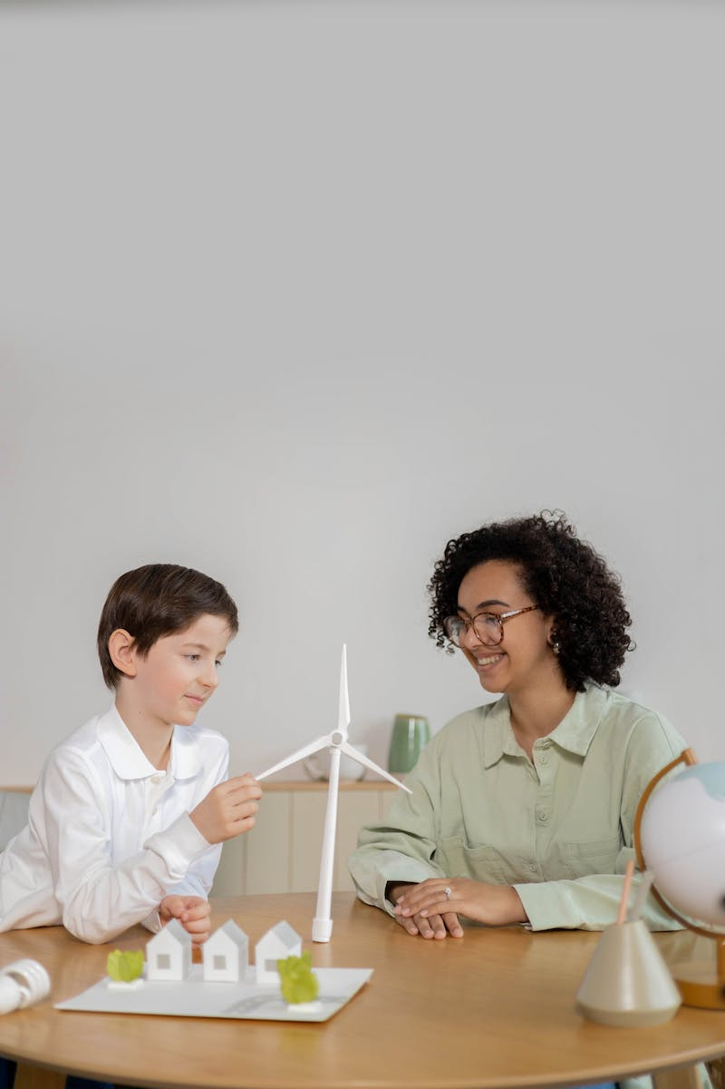
Missus Father Gill's Lesson
• Missus Father Gill is here to give the twins, Daisy and Poppy, their lesson.
• She is determined not to let them get the better of her this time.
• The twins are mischievous and caused trouble in the past.
• They have a tendency to make things disappear.
Photo by Pexels

Slide 4
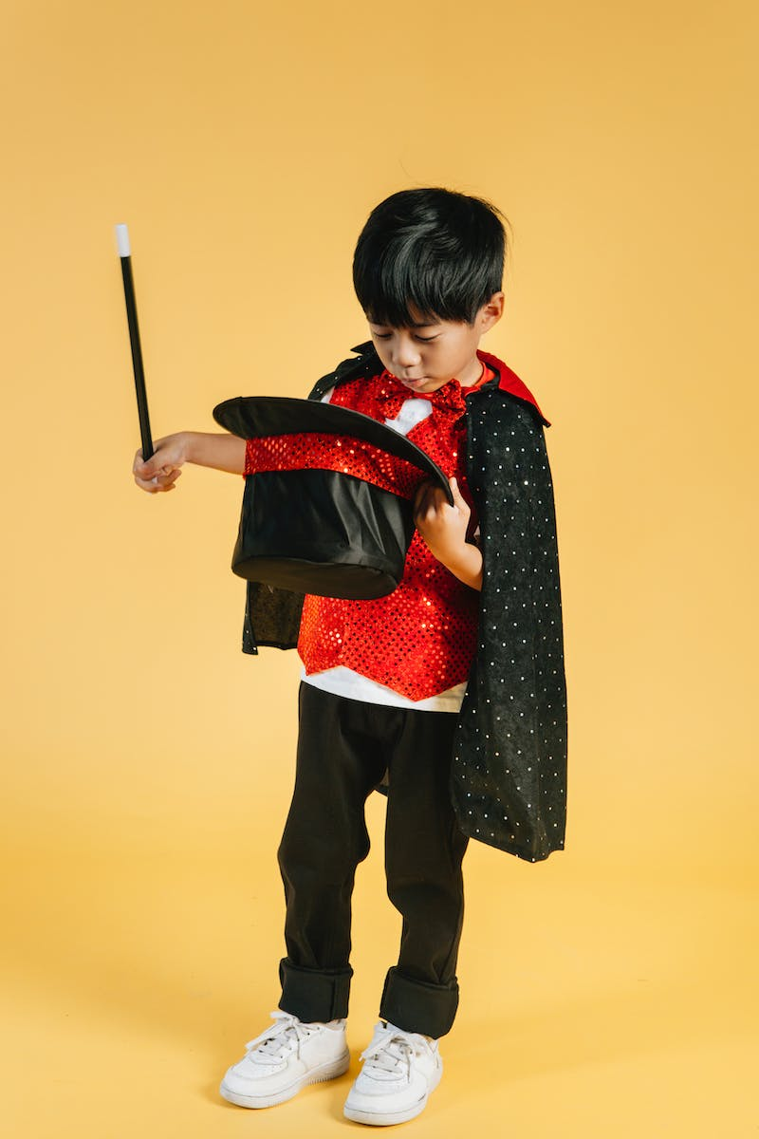
The Twins' Mischief
• Missus Father Gill starts the lesson with a picture book, but the twins make her disappear.
• They have sent her to the center of the earth.
• The other characters are worried about Missus Father Gill's safety.
• They decide to rescue her from the center of the earth.
Photo by Pexels

Slide 5
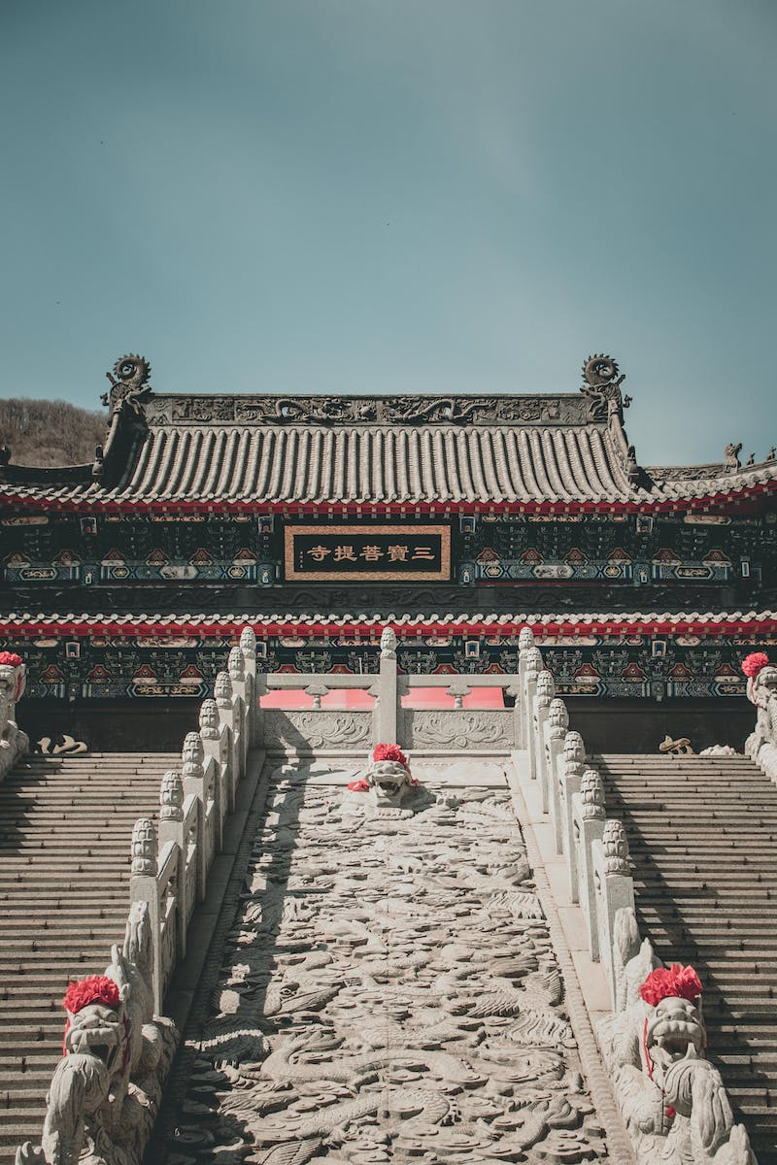
The Journey Begins
• The characters discover secret stairs in the little castle that lead to the center of the earth.
• They find a message written by dwarves, guiding them towards dinosaurs.
• They realize they need to go through various challenges and obstacles to reach Missus Father Gill.
• The journey to the center of the earth begins.
Photo by Pexels

Slide 6
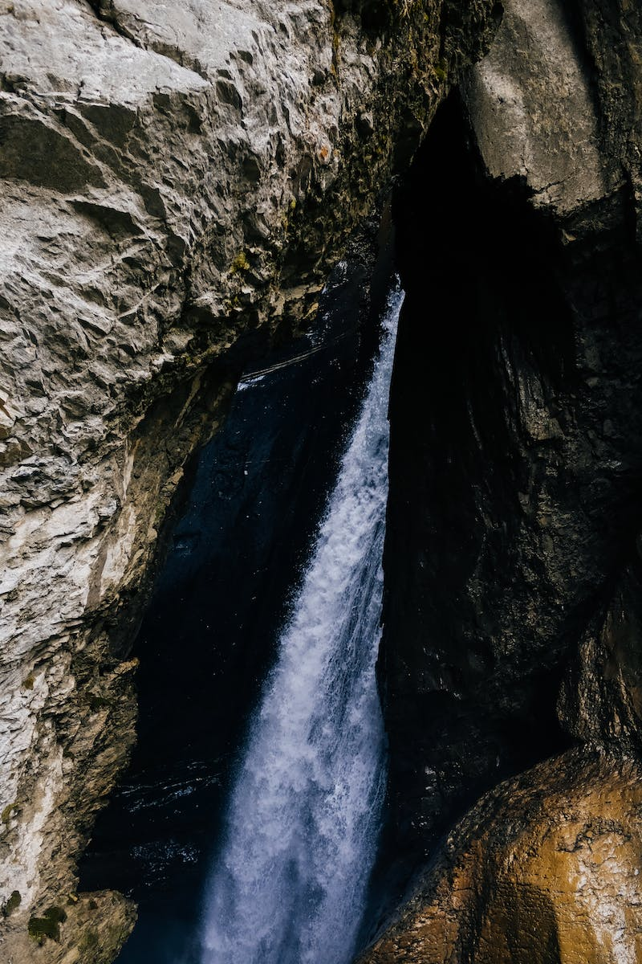
Meeting a Lost Tribe
• During their journey, the characters encounter a lost tribe of surface dwellers in the center of the earth.
• The tribe welcomes them and believes they are traveling through their land.
• The characters introduce themselves and explain their mission to rescue Missus Father Gill.
• The tribe agrees to help them.
Photo by Pexels

Slide 7
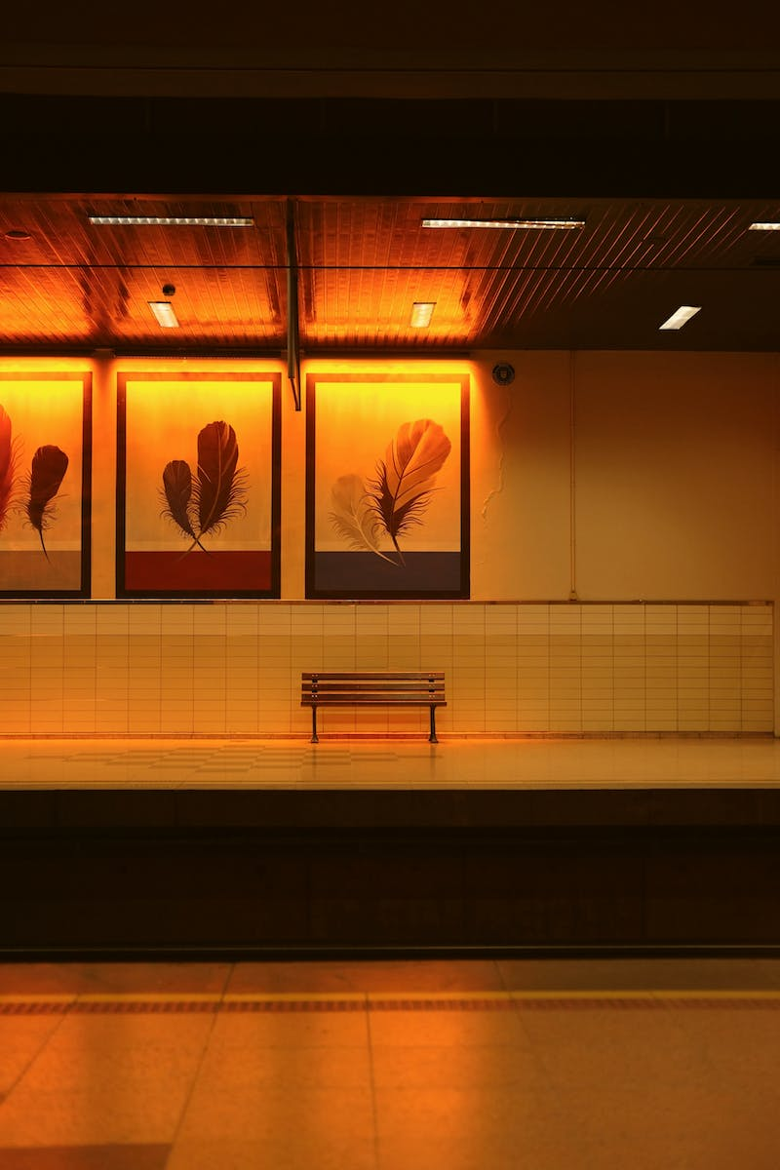
Rescuing Missus Father Gill
• The characters finally find Missus Father Gill in the center of the earth.
• She expresses her gratitude for the rescue but mentions enjoying the peacefulness of the underground.
• The characters insist on bringing her back to the little castle.
• They say their goodbyes to the underground dwellers and begin their journey back.
Photo by Pexels

Slide 8
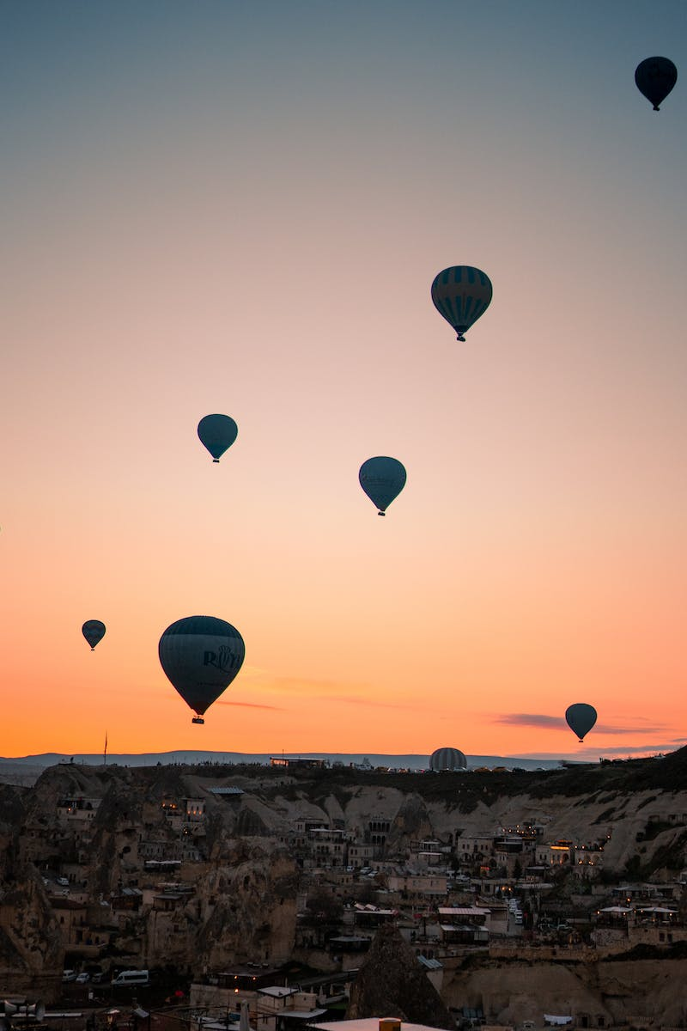
Return Journey
• The characters decide to use a balloon for the return journey to the surface.
• They bid farewell to the underground dwellers and board the balloon.
• As they ascend, the volcano starts to erupt, adding to the excitement of the journey.
• Finally, they reach the little castle and head back home.
Photo by Pexels

Slide 9
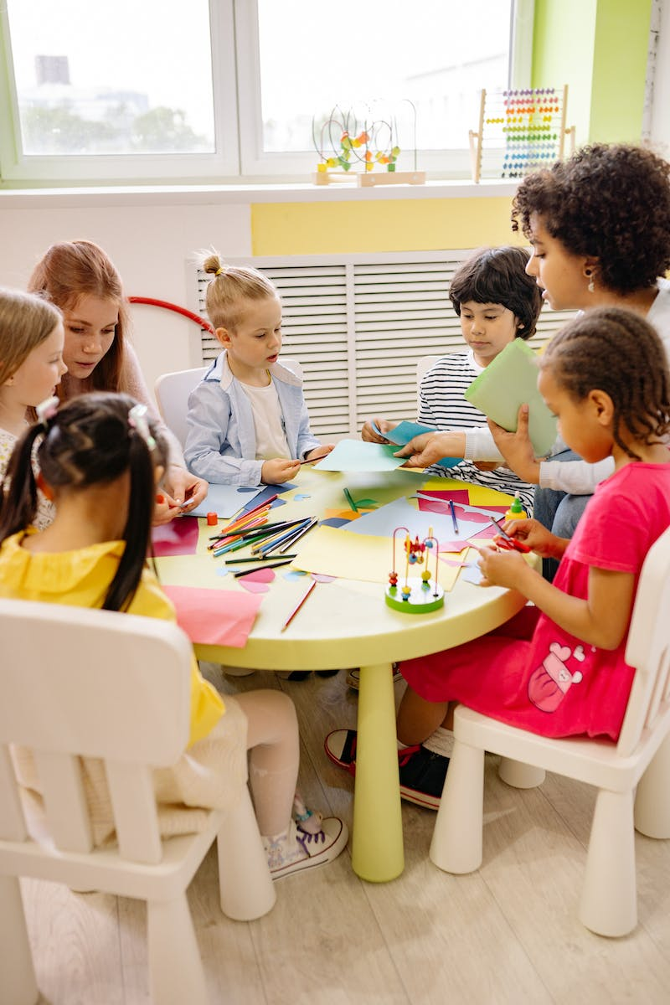
Conclusion
• Missus Father Gill is reunited with the twins, Daisy and Poppy.
• They apologize for causing trouble and promise to behave.
• The characters reflect on the adventure and the mischievous nature of the twins.
• They express gratitude for their safe return and look forward to peaceful days ahead.
Photo by Pexels

