Slide 1
The Power of Visual Storytelling
Exploring the impact of visual media in communication

Slide 2
Unlocking the Potential of Video
• Videos have become the preferred medium of communication in the digital age
• They capture attention and engage audiences more effectively than any other format
• Video has the power to convey emotions, tell stories, and evoke empathy
• By harnessing the power of video, we can create impactful and memorable presentations
Photo by Pexels

Slide 3
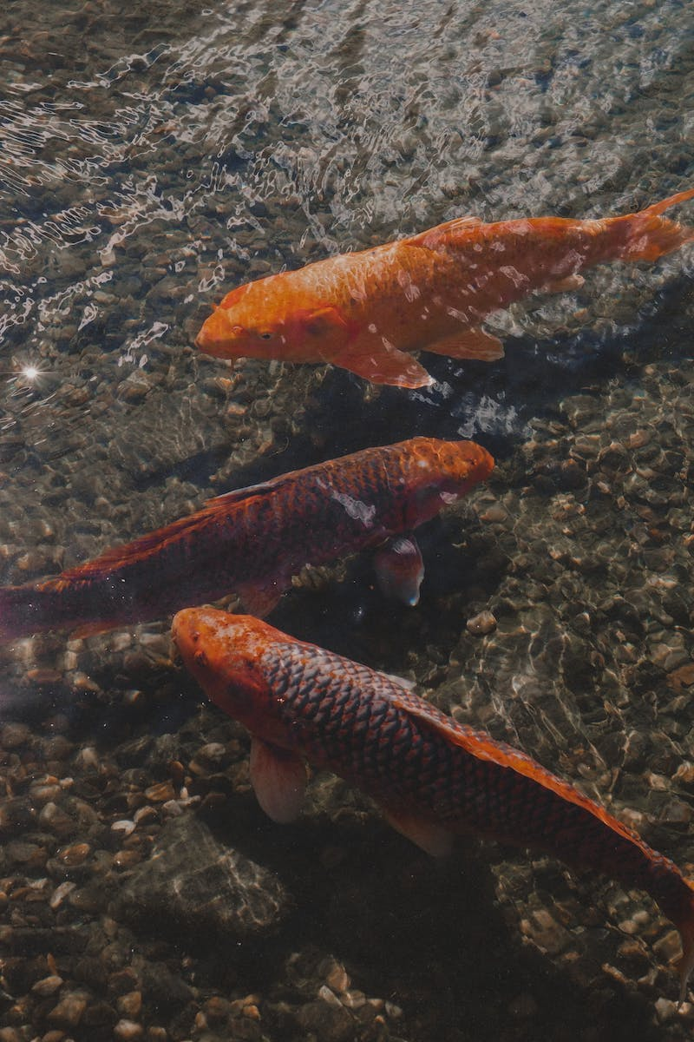
The Importance of Water
• Water is essential for all forms of life
• It sustains ecosystems and supports biodiversity
• Water plays a crucial role in human health and hygiene
• The conservation and responsible use of water are critical for the future
Photo by Pexels

Slide 4
Dal: A Nutritional Powerhouse
• Dal, also known as lentils, is a staple food in many cultures
• It is an excellent source of plant-based protein and dietary fiber
• Dal contains essential vitamins and minerals for overall health
• Incorporating dal into a balanced diet promotes well-being and sustainability
Photo by Pexels

Slide 5
The Impact of Data in Education
• Data-driven education empowers teachers and students
• It enables personalized learning experiences and targeted interventions
• Data analysis helps identify educational trends and improve outcomes
• Using data effectively can drive innovation and improve educational systems
Photo by Pexels

Slide 6
The Majesty of Pine Forests
• Pine forests are a significant part of global ecosystems
• They provide habitat for diverse plant and animal species
• Pine trees contribute to carbon sequestration and climate regulation
• Preserving and restoring pine forests is crucial for biodiversity and environmental sustainability
Photo by Pexels

