Slide 1
Democratizing Data and AI
Unlocking the Potential for All

Slide 2
Introduction
• The future is here, beyond our imagination
• Generation AI is at the center of it
• Unify everyone and everything
• Break barriers between artificial and human intelligence
• Open up data and AI to everyone
• Unlock a wave of innovation
Photo by Pexels

Slide 3
Generation AI
• Becoming data and AI companies
• Liberated from the past
• Open to a wildly expansive future
• Driving innovations through mass participation
Photo by Pexels

Slide 4
Data and AI Summit
• Global event with 12,000 attendees
• Representing over 150 countries
• 320+ sessions and 100 exhibitors
• Showcasing data teams and projects
• Focus on data democratization and AI applications
Photo by Pexels

Slide 5
The Power of Data
• 500 petabytes of data at JPMorgan Chase
• Data-driven decision making
• 300 use cases in production
• Significant value creation
• Applications in fraud detection and personalization
Photo by Pexels

Slide 6
Democratizing Data
• Providing access to everyone in the organization
• Language-based querying and exploration
• Simplified data discovery and entitlement
• Unification of structured and unstructured data
• Enhanced data governance and lineage
Photo by Pexels

Slide 7
Generative AI
• Advancements in generative AI
• Capabilities in summarization, QA, and code generation
• Enhanced productivity and personalization
• Training on proprietary data for custom solutions
• Responsible AI considerations and risk mitigation
Photo by Pexels

Slide 8
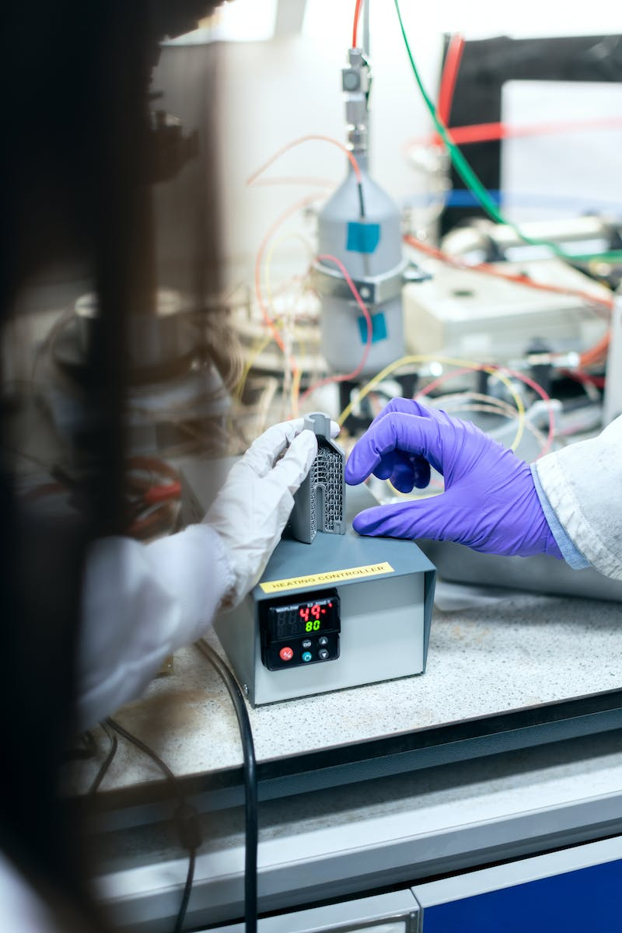
Enabling Innovation
• Platform approach for scalable deployment
• Interoperability and integration with AI security
• Innovation driven by collaboration and talent
• Embedding data scientists within the business
• Recognition and celebration of innovation
Photo by Pexels

