Slide 1
Fry Based Polynomial Commitments
Lecture Eight of ZK Learning MOOC

Slide 2
Introduction
• Lecture Eight
• Covering Fry based polynomial commitments and the Fiat Shamir transformation
• Polynomial IOP and polynomial commitment scheme combine to form an interactive argument (SNARK)
• Different protocols have unique performance profiles and trade-offs
Photo by Pexels

Slide 3
Polynomial IOP and Commitment Scheme
• Polynomial IOP: Prover's first message specifies a large polynomial H
• Verifier evaluates H at a single point of their choosing
• Subsequent messages are short and fully read by the verifier
• Verifier decides whether to accept or reject the claim as valid
• Polynomial Commitment Scheme: Allows the prover to simulate the polynomial IOP
• Verifiable evaluation proofs for the polynomial commitment scheme

Slide 4
Performance Profiles of Polynomial IOP and Commitment Schemes
• Different polynomial IOPs and polynomial commitment schemes have unique performance profiles
• Consider trade-offs such as prover time, verification costs, and security
• Transparent and plausibly post-quantum secure options
• Polynomial commitment schemes categorized based on pairing friendly, discrete logarithm, and hashing
Photo by Pexels

Slide 5
Transparent SNARKs
• Examples: Halo 2, Starks, Fractal, Aurora, Virgo
• Halo 2: Shortest proofs, slow verifier
• Starks, Fractal, Aurora, Virgo: Combining polynomial IOP with fry-based commitments
• Pros: Shortest proofs among plausibly post-quantum snarks
• Cons: Proofs still large, limited flexibility in field used
Photo by Pexels

Slide 6
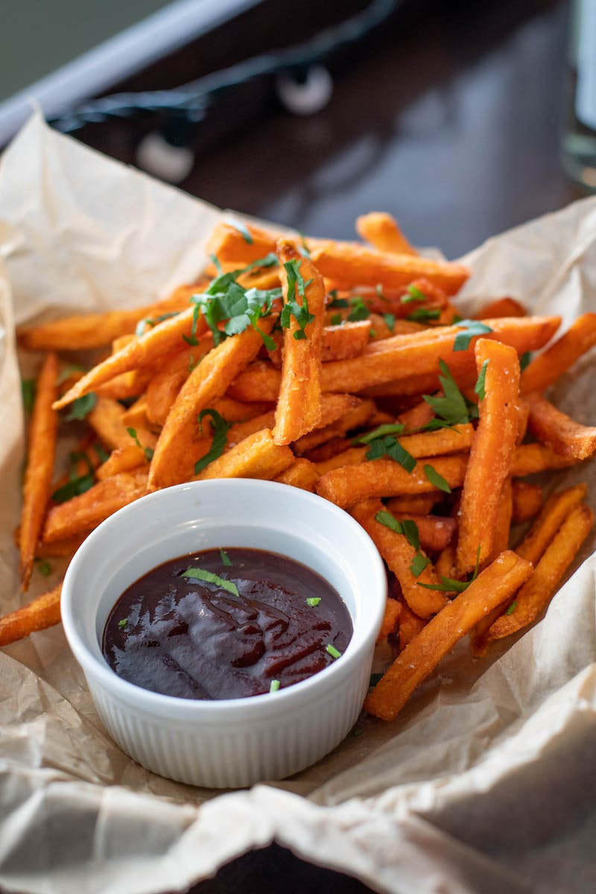
Non-Transparent SNARKs
• Examples: Groth16, Marlin, Planck
• Groth16: Best verification costs, circuit-specific trusted setup
• Marlin, Planck: Trusted setup independent, larger proofs, slower prover
• Pros: Trusted setup independence, applicable to various circuit types
• Cons: Larger proofs, slower prover compared to Groth16
• Final choice depends on circuit type and specific requirements
Photo by Pexels

Slide 7
Fry Based Polynomial Commitments
• Prover only commits to evaluations of Q for points in a carefully chosen subset
• Subset Omega consists of nth roots of unity
• Size of Omega depends on the blow-up factor
• Prover time grows with the blow-up factor
• Verification costs decrease logarithmically with the blow-up factor
• Optimal blow-up factor balances prover and verifier costs
Photo by Pexels

Slide 8
The Subset Omega
• Omega consists of nth roots of unity
• Primitive nth root of unity, square yields an N/2 root of unity
• Each nth root has a corresponding negative nth root
• Largest power of two dividing N relates to the field size
• Subset Omega depends on the power of two dividing the field size minus one
Photo by Pexels

Slide 9
Example of Roots of Unity
• Example: Prime field of order 41
• Size of multiplicative subgroup: 40
• Divisible by 8 (largest power of two dividing 40)
• Eight 8th roots of unity: 1, -1, 9, -9, 3, -3, 14, -14
• Fry commits to evaluations on a through to Unity
Photo by Pexels

Slide 10
Low Degree Test in Fry
• Verifier inspects a few entries of the committed vector
• Authentication paths provided by prover for each query
• Traditional low degree tests impractical in the context of fry
• Fry's low degree test will be interactive
• Combines a folding phase and a random challenge phase
Photo by Pexels

