Slide 1
Exploring the Beauty of Paris
Unveiling the Charms of the City of Love

Slide 2
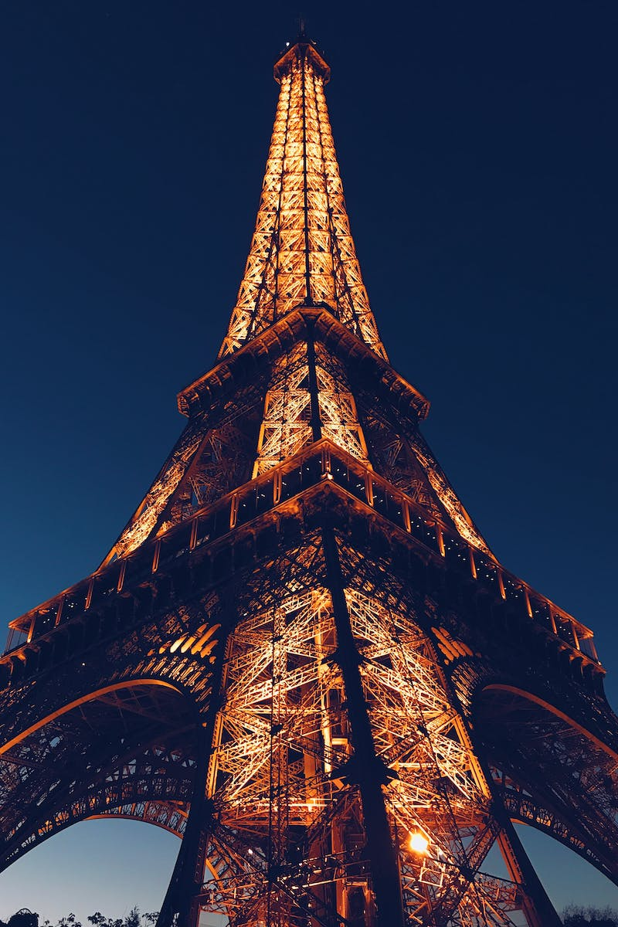
Introduction
• Paris - a city known for its romance and elegance.
• Home to iconic landmarks such as the Eiffel Tower and Louvre Museum.
• Rich in history, art, and culture.
• Let's embark on a journey to discover the hidden treasures of Paris.
Photo by Pexels

Slide 3
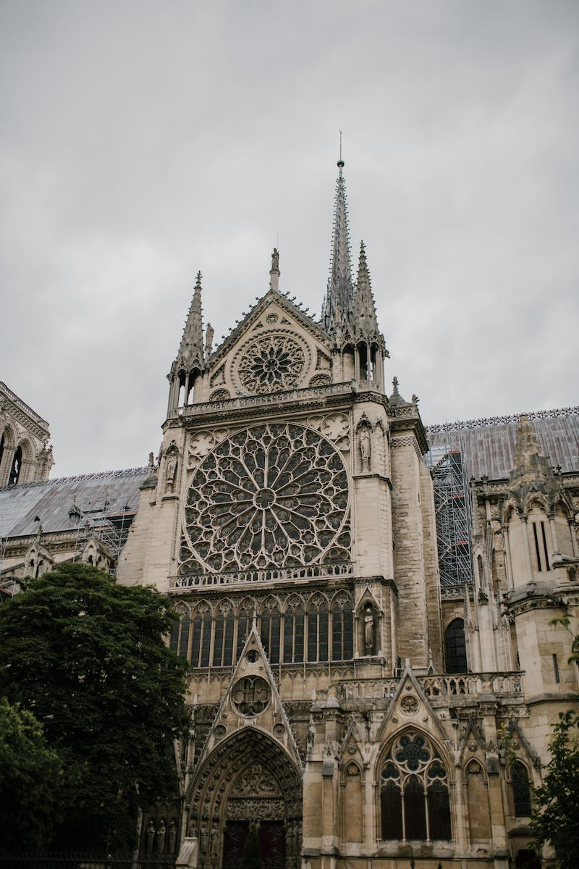
Historical Significance
• Paris has witnessed centuries of historical events.
• Birthplace of the French Revolution and Enlightenment ideals.
• Dive into the impact of these historical events on the city's architecture and society.
• Experience the essence of Parisian history through its streets and buildings.
Photo by Pexels

Slide 4
Artistic Haven
• Paris has been a haven for artists throughout history.
• Explore the world-renowned Louvre Museum and its vast collection of masterpieces.
• Discover the vibrant art scene of Montmartre and its inspiring atmosphere.
• Unravel the influence of Paris on famous artists like Picasso, Monet, and Van Gogh.
Photo by Pexels

Slide 5
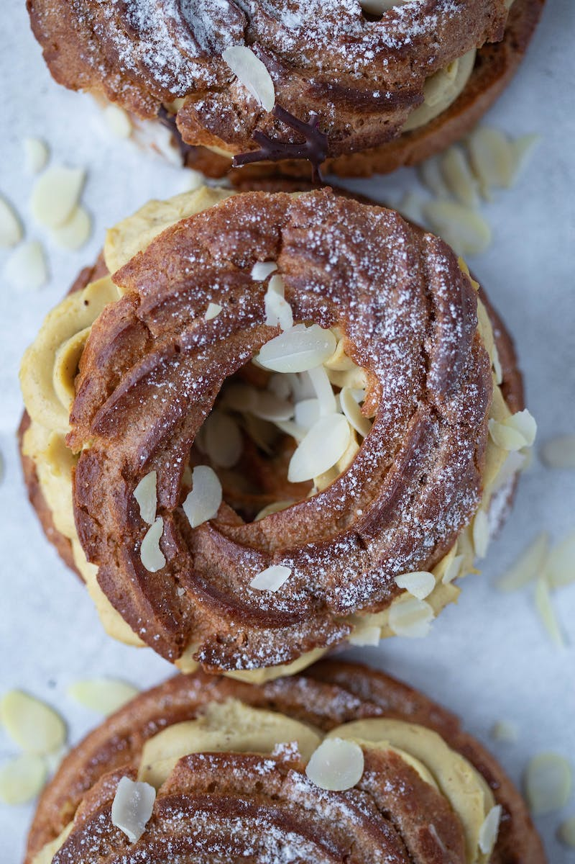
Culinary Delights
• Paris is a culinary paradise, offering an array of exquisite dishes.
• Indulge in the decadent flavors of French cuisine, from escargots to pastries.
• Experience the charming ambiance of Parisian cafes and bistros.
• Explore the world of French wine and cheese for an unforgettable gastronomic journey.
Photo by Pexels

Slide 6
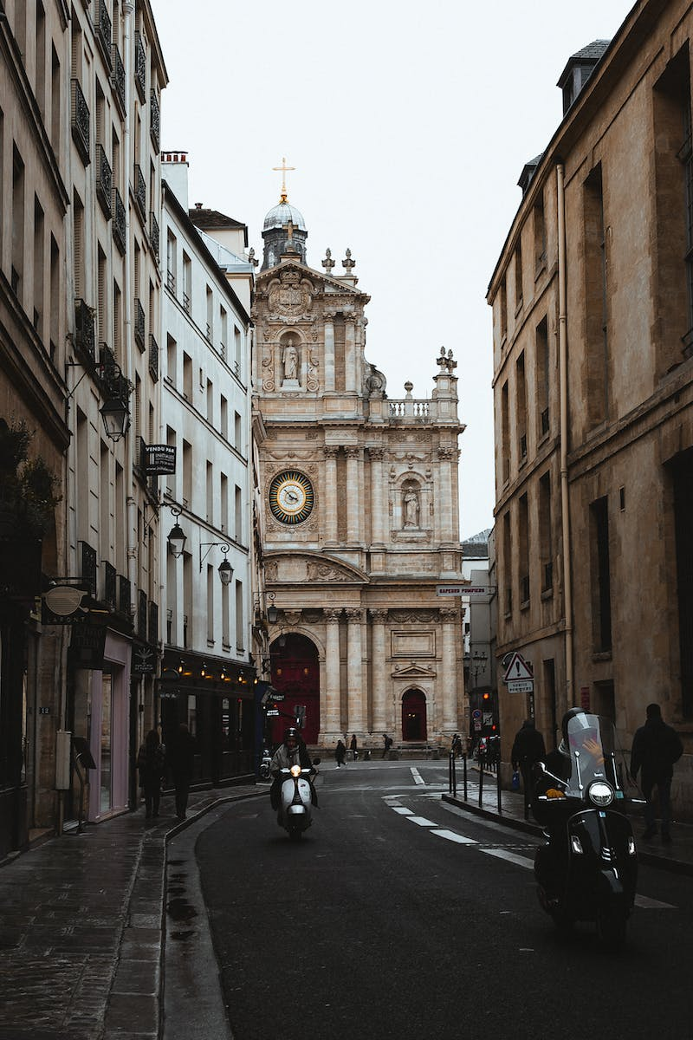
Charming Neighborhoods
• Paris is comprised of distinct neighborhoods, each with its own charm.
• Stroll along the scenic streets of Le Marais and discover its medieval architecture.
• Experience the bohemian atmosphere of Saint-Germain-des-Prés and its artistic cafes.
• Explore the lively Montmartre and its breathtaking views from the Sacré-Cœur Basilica.
Photo by Pexels

Slide 7
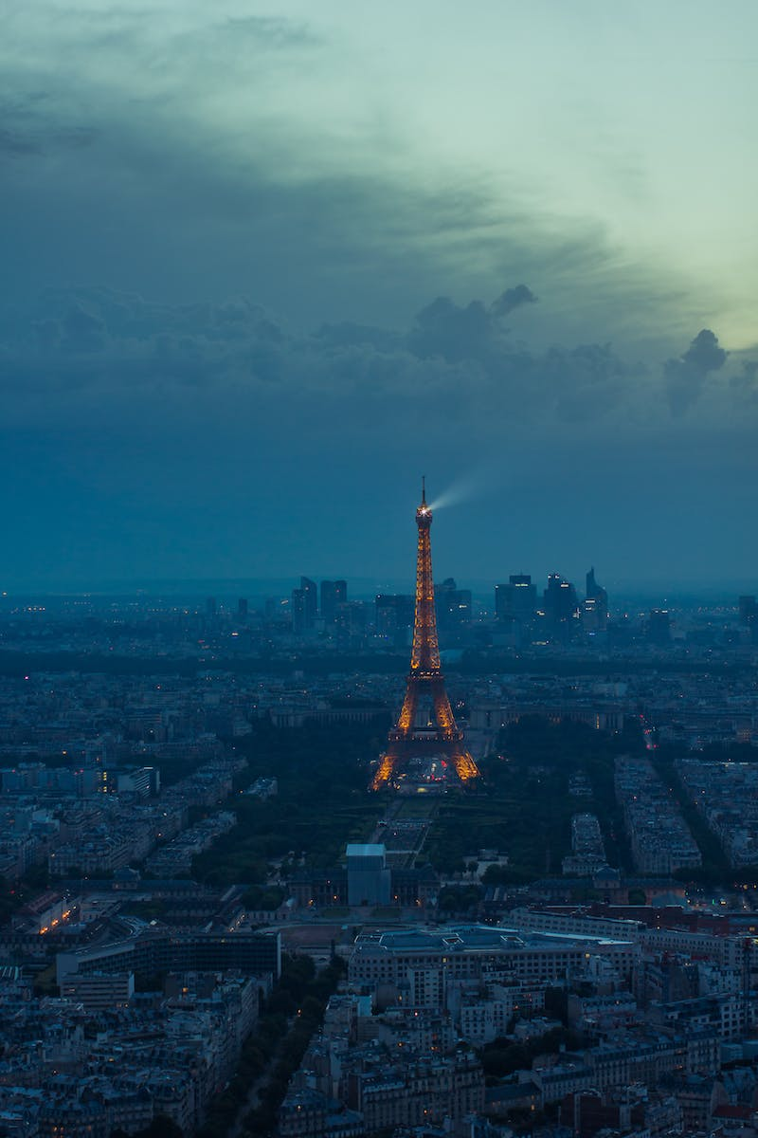
Conclusion
• Paris is a city that captivates the heart and soul.
• Its beauty, history, art, cuisine, and neighborhoods make it a must-visit destination.
• Embark on your own Parisian adventure and create unforgettable memories.
• Experience the magic of the City of Love.
Photo by Pexels

