Slide 1
The Fascinating World of Cows
Exploring the history, behavior, and impact of cows

Slide 2
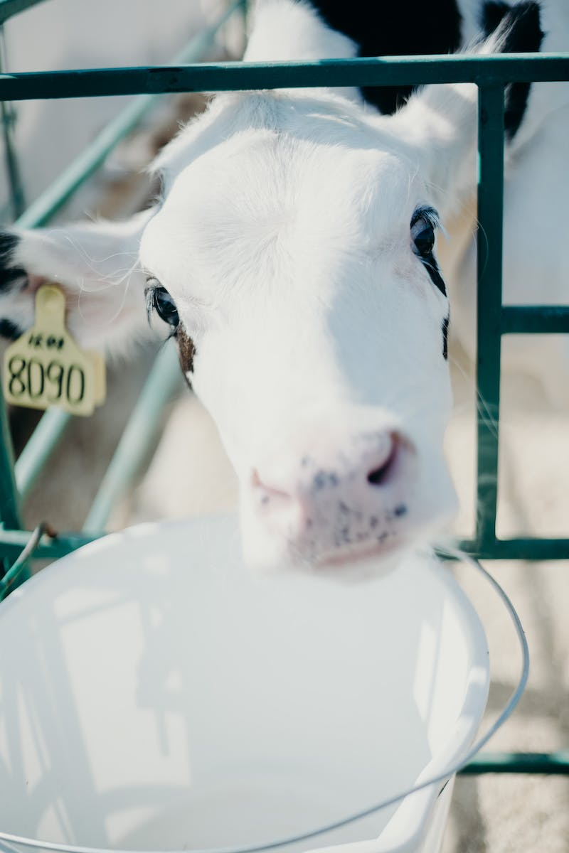
Introduction
• Cows are one of the oldest domesticated animals.
• They play a crucial role in agriculture and food production.
• There are about 1.6 billion cattle in the world today.
• Cows have a complex social structure and hierarchical behavior.
• They are known for their docile and gentle nature.
Photo by Pexels

Slide 3
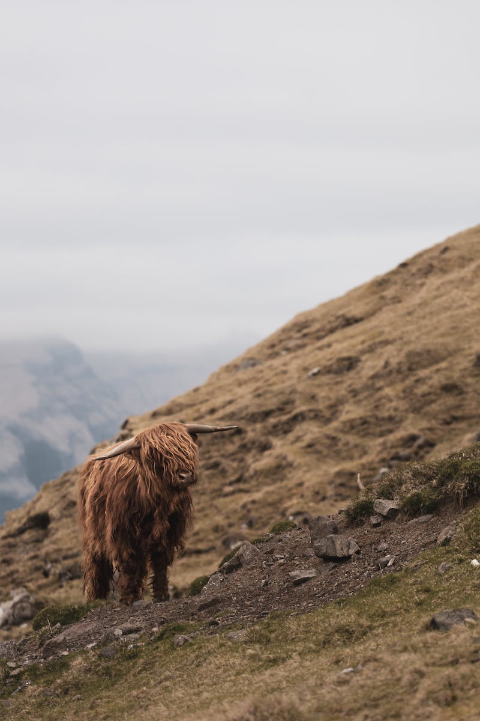
Evolutionary History
• Cows belong to the Bovidae family, which originated about 20 million years ago.
• The modern cow species, Bos taurus, emerged around 10,000 years ago.
• Selective breeding has led to various breeds with distinct characteristics.
• Cattle were first domesticated for their milk, meat, and hide.
• The partnership between humans and cows has shaped agricultural practices and civilizations throughout history.
Photo by Pexels

Slide 4
Cows and the Environment
• Cows are major contributors to greenhouse gas emissions.
• Livestock farming is responsible for a significant portion of global deforestation.
• Efficient and sustainable farming practices can mitigate environmental impacts.
• Methane from cow belching is a potent greenhouse gas.
• Balancing the need for food production with environmental conservation is a pressing challenge.
Photo by Pexels

Slide 5
Cow Behavior and Communication
• Cows are highly social animals and form strong bonds within their herd.
• They communicate through various vocalizations and body language.
• Dominance hierarchies exist within cow herds.
• Cows have a remarkable memory and can recognize familiar individuals.
• Understanding cow behavior is vital for their welfare and effective farming practices.
Photo by Pexels

Slide 6
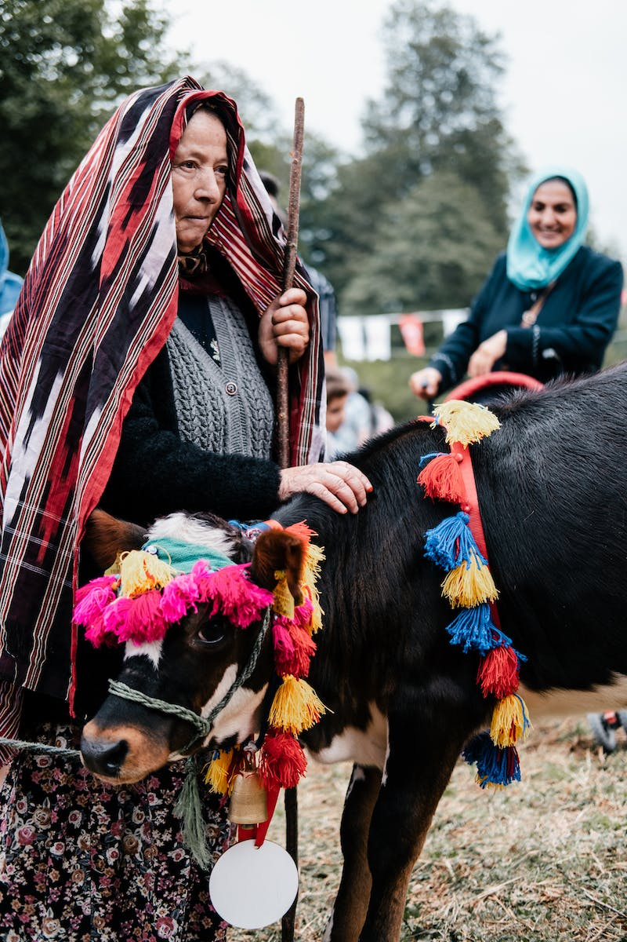
Cows and Cultural Significance
• Cows hold significant cultural and religious importance in many societies.
• In Hinduism, cows are considered sacred and symbolize motherhood.
• Cows have been revered and worshipped in various ancient civilizations.
• The cow has influenced art, literature, and folklore throughout history.
• Understanding the cultural significance of cows fosters respect and intercultural dialogue.
Photo by Pexels

Slide 7
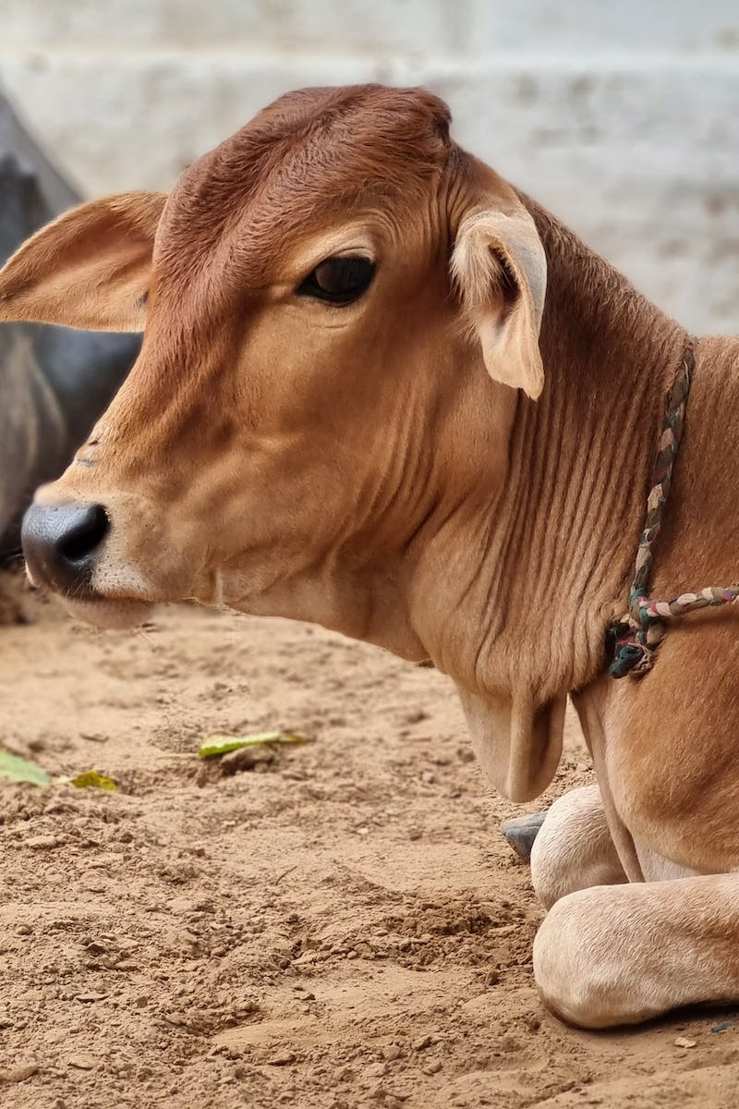
Conclusion
• Cows have played a crucial role in human civilization for thousands of years.
• Understanding their history, behavior, and impact allows us to make informed decisions about sustainable agriculture and environmental conservation.
• Balancing the ethical treatment of cows with the need for food production remains an ongoing challenge.
• Appreciating the cultural and historical significance of cows promotes intercultural understanding and respect.
• Let's continue to explore the fascinating world of cows and their impact on our lives.
Photo by Pexels

