Slide 1
The Art of Russian Par Bathing
A Journey into the Traditional Russian Bathing Ritual

Slide 2
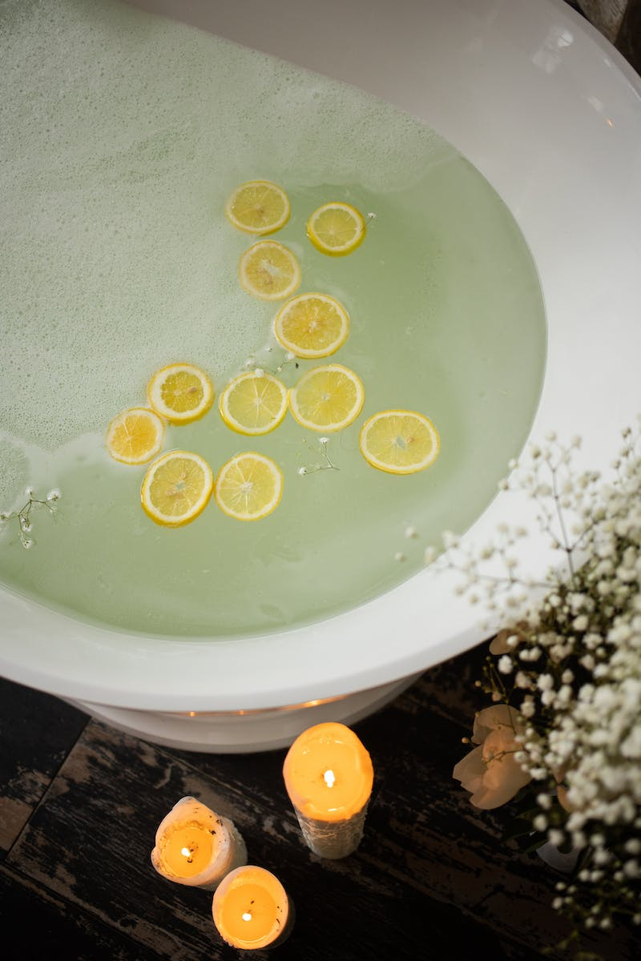
Introduction to the Traditional Russian Par Bath
• Welcome to the world of Russian Par Bathing
• Experience the ancient tradition of heating and steam bathing
• Discover the benefits of deep relaxation and rejuvenation
• Immerse in the unique cultural heritage of Russia
Photo by Pexels

Slide 3
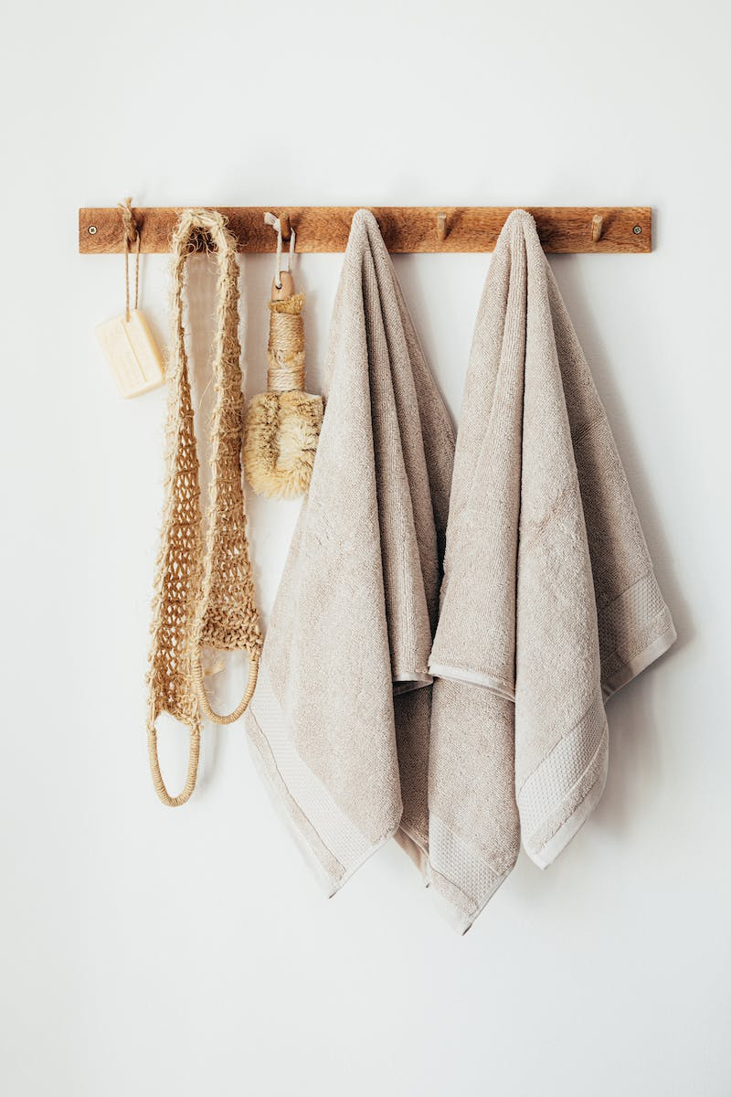
The Classic Par Studio
• Explore the features of a classic Par Studio
• Designed for intimate face-to-face steam sessions
• Equipped with essential tools for a blissful experience
• Create a serene and comfortable environment for your guests
Photo by Pexels

Slide 4
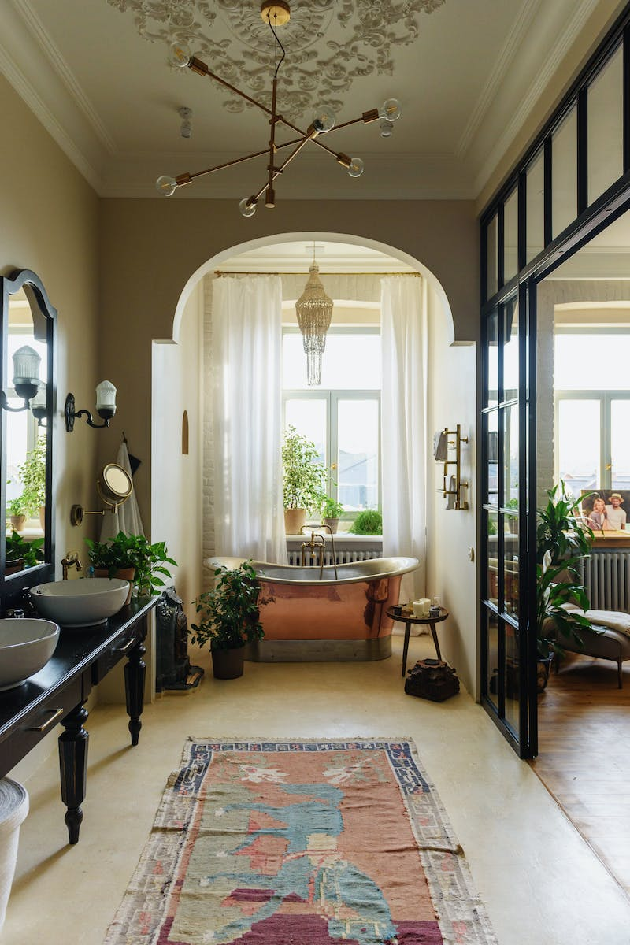
The Opahalo: The Essential Instrument
• Learn about the Opahalo and its significance
• Discover the traditional technique of using the Opahalo
• Promote blood circulation and enhance the steam bath
• Experience the gentle and invigorating effects of the Opahalo
Photo by Pexels

Slide 5
The Fan: The Art of Cooling Down
• Discover the importance of the Fan in the Par Bathing ritual
• Master the skill of gentle air circulation and cooling
• Enhance the overall steam bath experience
• Promote relaxation and balanced body temperature
Photo by Pexels

Slide 6
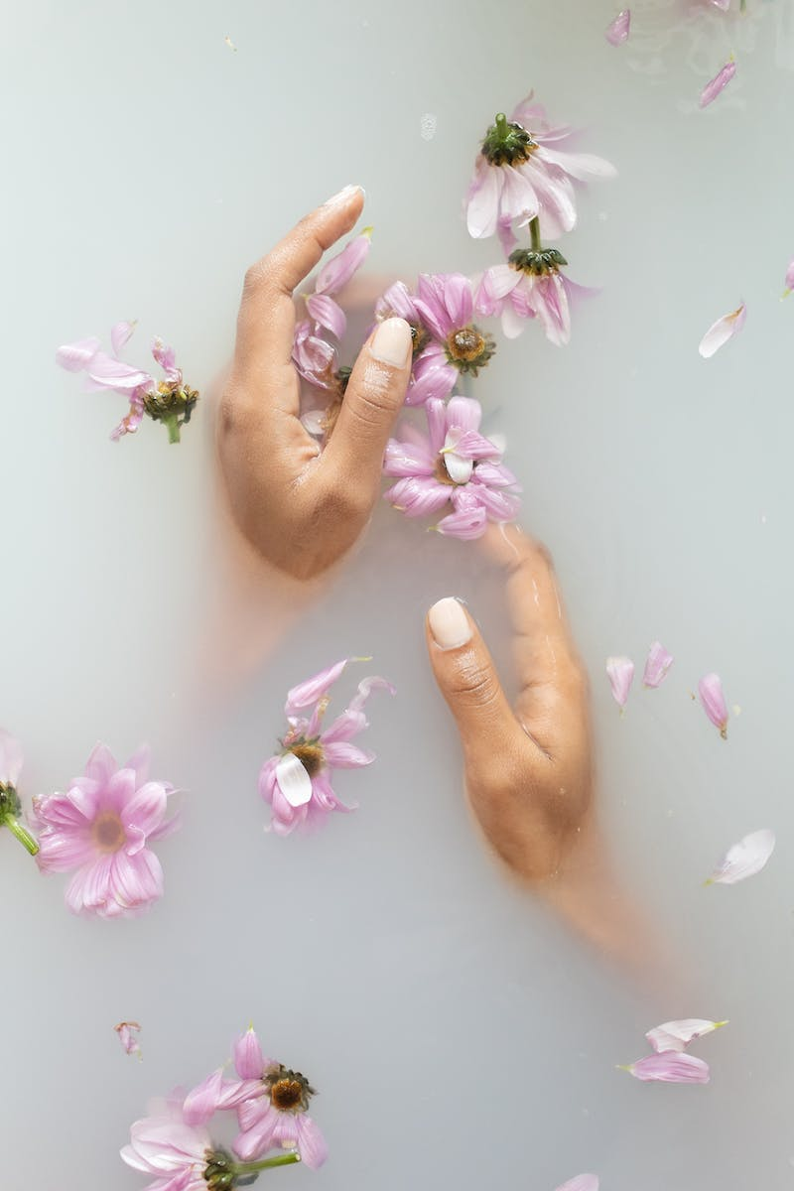
The Sunding Oven: A Masterpiece of Par Heating
• Witness the exceptional Sunding Oven
• Experience optimal heating for the Par Bathing procedure
• Enjoy the efficient and comfortable steam production
• Appreciate the craftsmanship behind the Sunding Oven
Photo by Pexels

