Slide 1
Scaling Culture and Team
Insights from Founders: Ben Silver and John and Patrick Call

Slide 2
Introduction
• Part two of culture and team
• Featuring Ben Silver, founder of Pinterest, and John and Patrick Call, founders of Stripe
• Discussion on the importance of culture and team-building
• Three areas to be covered: general thoughts on culture, building the early team, and adapting culture as the company scales
Photo by Pexels

Slide 3
Key Aspects of Culture
• Who we hire and their values
• Daily activities and the purpose behind them
• Effective communication and transparency
• Celebrating successes and promoting positive behavior
Photo by Pexels

Slide 4
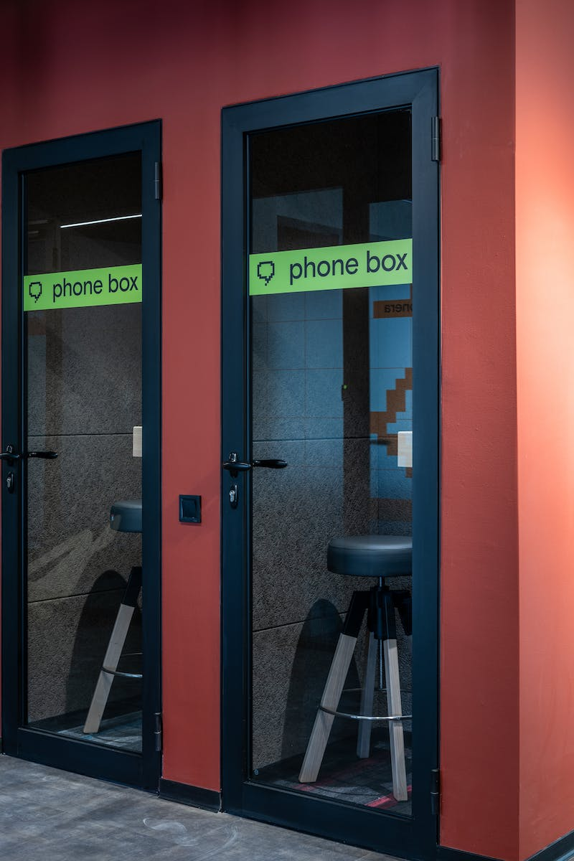
The Role of Transparency
• Transparency as a valuable asset for building teams
• Alignment, belief in the mission, and access to information
• Tools and processes to maintain transparency in growing organizations
• Importance of information flow and collaboration
Photo by Pexels

Slide 5
Culture as a Solution to Bandwidth Problem
• Adapting culture as the organization grows
• Maintaining core principles despite limited involvement in decision-making
• Importance of cultural traits and values in hiring decisions
• Value of hiring early employees who align with the company's vision
Photo by Pexels

Slide 6
Identifying Great Talent
• Inductive approach to hiring based on personal value alignment
• Importance of genuine, creative, and passionate individuals
• Qualities of genuine, high-integrity candidates
• Traits of individuals who care deeply about their work
Photo by Pexels

Slide 7
Referrals as Lifeblood of Hiring
• Growing reliance on referrals as the company scales
• Effective screening for talent and cultural fit
• Importance of calibrating references to evaluate talent
• Utilizing references as a source of new recruits
Photo by Pexels

Slide 8
Onboarding and Managing Growth
• Creating effective onboarding processes for new hires
• Balancing autonomy and nimbleness in growing teams
• Making teams feel like startups within a larger organization
• Challenges of managing growth and maintaining culture
Photo by Pexels

Slide 9
Scaling Transparency and Time Horizons
• Scaling transparency as the company grows
• Challenges and benefits of transparent communication
• Managing time horizons and adaptivity as the organization scales
• Systematic approaches to maintain culture with growth
Photo by Pexels

Slide 10
Conclusion and Insights
• Importance of culture and team in building successful organizations
• Lessons learned from experienced founders in hiring and managing growth
• Continuous adaptation and refinement of cultural practices
• Ongoing commitment to transparency and effective communication
Photo by Pexels

