Slide 1
The Power of Science: Unraveling the Mysteries of the Universe
Exploring the Essence and Impact of Scientific Endeavors

Slide 2
What is Science?
• A systematic and logical approach to understanding the natural world
• Based on observation, experimentation, and analysis
• Explores cause-and-effect relationships
• Seeks to develop theories and laws that explain phenomena
Photo by Pexels

Slide 3
How Science Works
• Hypotheses are formulated based on existing knowledge
• Experiments and observations are conducted to test hypotheses
• Data is collected and analyzed using statistical methods
• Conclusions are drawn and theories are refined or formed
Photo by Pexels

Slide 4
The Importance of Science
• Advances knowledge and understanding
• Drives technological innovations
• Solves complex problems
• Improves quality of life
Photo by Pexels

Slide 5
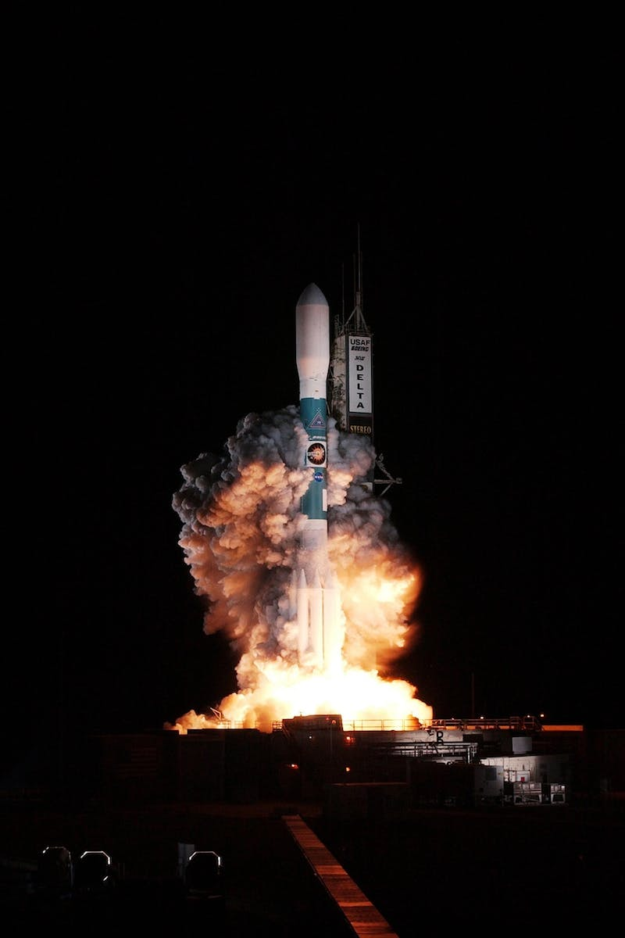
Unraveling the Size of Things
• Science enables exploration of both the macroscopic and microscopic realms
• From galaxies and planets to subatomic particles
• Unveils the vastness and intricacies of the universe
• Allows us to comprehend our place in the grand scheme of things
Photo by Pexels

