Slide 1
The Soviet Union: Rise and Fall
1914-1991

Slide 2
Introduction
• The Soviet Union, also known as the USSR, was a socialist state that existed from 1917 to 1991.
• It was the first country to establish a socialist government led by the Bolshevik Party.
• The Soviet Union was formed after the Russian Revolution and went on to become a major world power.
• This presentation will explore the history of the Soviet Union from 1914 to 1991.
Photo by Pexels

Slide 3
1914-1917: Prelude to Revolution
• In 1914, the Russian Empire entered World War I on the side of the Allies.
• The war put a strain on the Russian economy and led to widespread discontent among the population.
• In 1917, popular unrest and the failure of the war effort led to the February Revolution.
• Tsar Nicholas II abdicated, and a provisional government was established.
Photo by Pexels

Slide 4
1917-1922: Russian Civil War
• Following the revolution, a power struggle ensued between various factions.
• The Bolsheviks, led by Vladimir Lenin, emerged victorious and established the Soviet Union.
• The Russian Civil War followed, pitting the Red Army (Bolsheviks) against the White Army (anti-Bolsheviks).
• The Bolsheviks were ultimately successful and established a one-party communist state.
Photo by Pexels

Slide 5
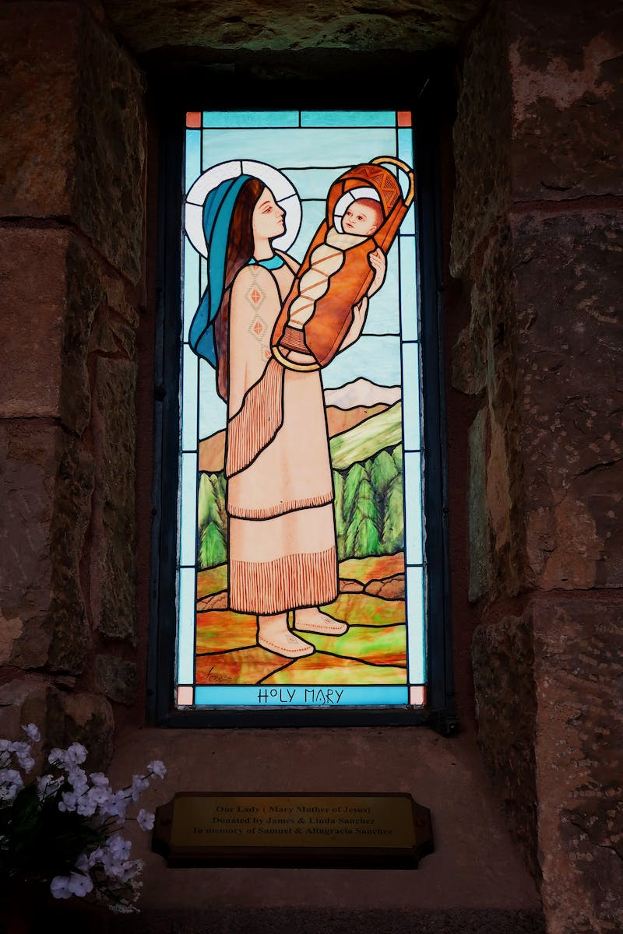
1922-1941: Stalin's Rule
• Joseph Stalin came to power after Lenin's death in 1924.
• Under Stalin's rule, the Soviet Union underwent rapid industrialization and collectivization of agriculture.
• Stalin's policies led to widespread famine and the deaths of millions of people.
• The Soviet Union became a major world power during this period.
Photo by Pexels

Slide 6
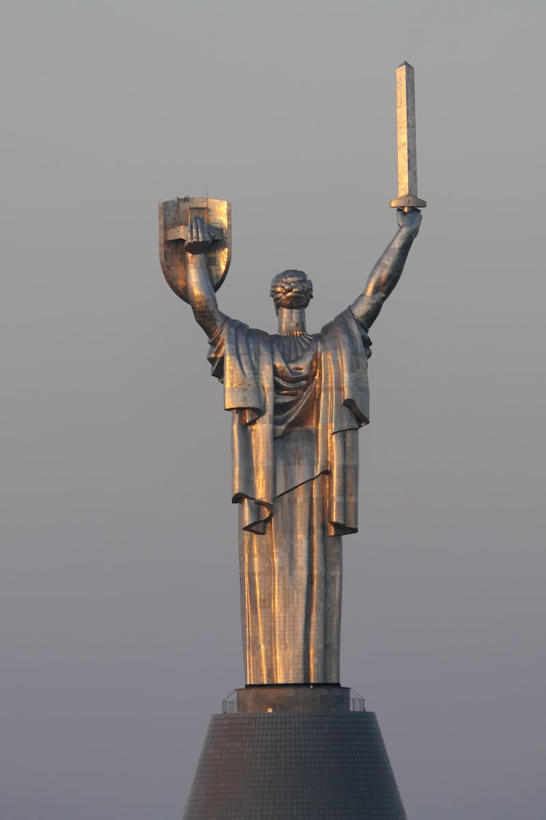
1941-1945: World War II
• The Soviet Union was invaded by Nazi Germany in 1941.
• The Eastern Front of World War II was the largest and bloodiest theater of the war.
• The Soviet Union played a crucial role in the defeat of Nazi Germany.
• The war resulted in immense devastation and loss of life in the Soviet Union.
Photo by Pexels

Slide 7
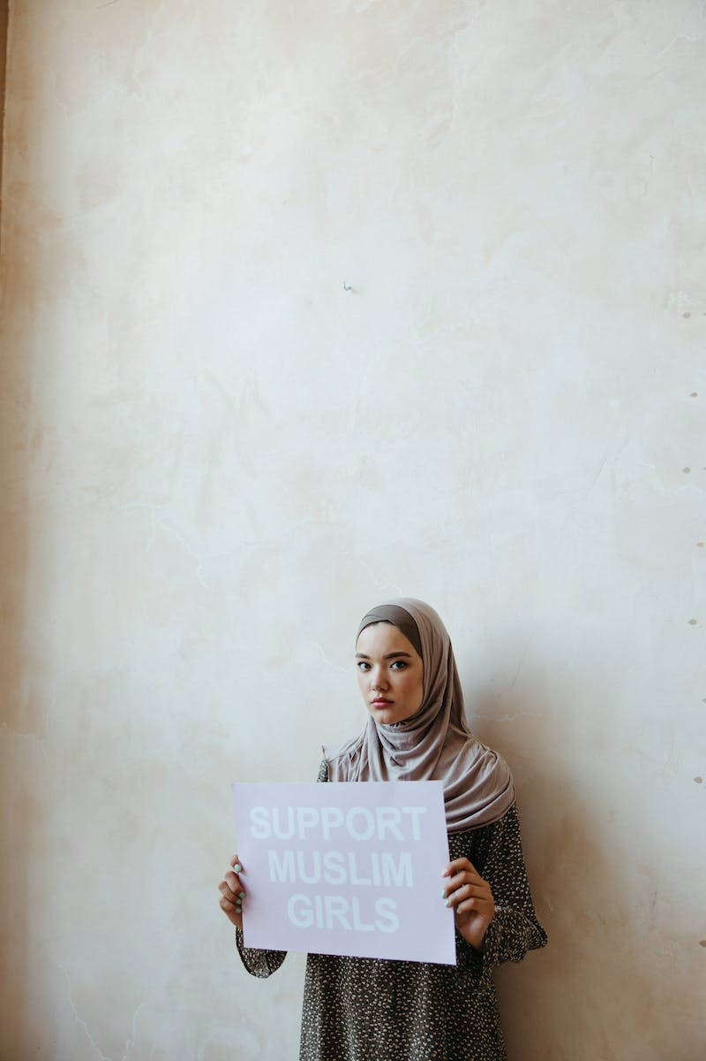
1945-1985: Cold War and Space Race
• After World War II, the Soviet Union emerged as a superpower and entered into a period of tension with the United States known as the Cold War.
• The two countries engaged in an arms race and competed for influence around the world.
• The Soviet Union became the first country to launch a satellite into space with the launch of Sputnik in 1957.
• This marked the beginning of the Space Race between the Soviet Union and the United States.
Photo by Pexels

Slide 8
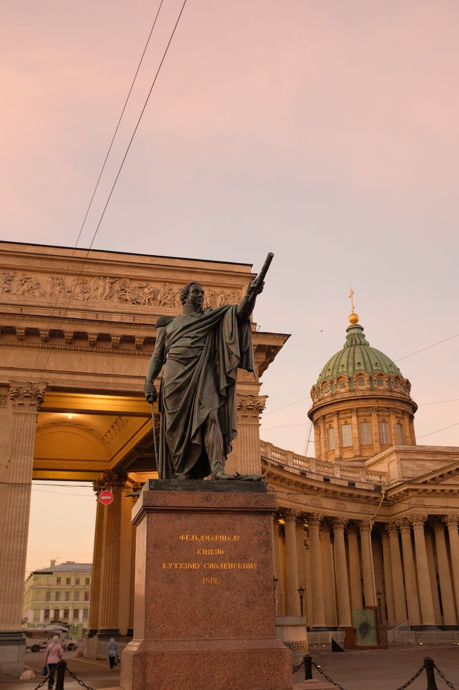
1985-1991: Perestroika and Collapse
• In 1985, Mikhail Gorbachev came to power and introduced reform policies known as perestroika and glasnost.
• These policies aimed to modernize the Soviet economy and increase transparency.
• However, they also led to political instability and demands for independence from the various republics.
• In 1991, the Soviet Union was officially dissolved, marking the end of the communist regime.
Photo by Pexels

Slide 9
Conclusion
• The Soviet Union had a significant impact on the world during its existence.
• It played a major role in World War II, the Cold War, and the Space Race.
• The collapse of the Soviet Union marked the end of the communist era and had far-reaching geopolitical consequences.
• Understanding the history of the Soviet Union helps us contextualize many of the global events of the 20th century.
Photo by Pexels

